Slide 1
PMPD August 24, 2021 Building Relationships, Partnering & Trust

Slide 2
100% Management
Think
Proactivity
Plan
Ownership
Organization
Communication
Care
Accountability
Be Positive
Finishing 100%
Perception

Slide 3
In the Unit
It starts with communication!
Gather information
Understand their need
Understand the priority
Be their voice
Know your facilities
Be responsive
Be a resource
Set expectations
Honesty
Be transparent

Slide 4
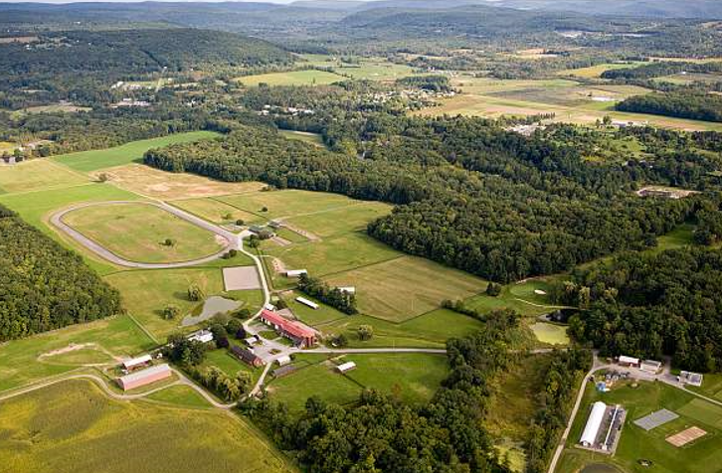
*
Within Facility Services
It starts with communication
Be prepared
Understand the process
If you don’t know ask
Work together
Be sure they understand why it’s a priority
Come with options
Prepare a plan
Be responsive
Honesty
Don’t blame

Slide 5
External Resources - Contractors, A&E
It starts with communication
Be prepared
Be responsive
Set clear expectation
Know the process
Know your facilities
Be a resource
Be fair
Honesty

Slide 6
Share your examples & questions

