Slide 1
Ithaca Energy Code Supplement Guidance Document
August 2021
Facilities Engineering

Slide 2
Summary - Ithaca Energy Code Supplement
Adopted by both Town and City of Ithaca
City – August 4, 2021
Town - September 13, 2021
Encourages electrification of building heating/cooling as a means to lower greenhouse gas emissions resulting from fossil fuel usage.
We have pathways to compliance, but project teams need to strategize early.
Difficulty ratchets over time (2021 – 2023 – 2026)

Slide 3
Ithaca Energy Code Supplement Applicability and Project Compliance Guidance Document v1.1
We have prepared a guidance document which has been linked within the PM Checklists (D3b Municipal Approvals, Cornell owned) – resources section.
Compiled information and interpretations from CU stakeholders involved in the crafting of the code language (FE, E&S, Counsel).
Prepared for PMs and Project Designers to provide a summary of the full code document, and our interpretation of the most achievable pathways to compliance.
This is a living document – please share your experiences in working through this new local code so we can revise!

Slide 4
IECS Applicability
The IECS applies to projects within City (or Town once adopted) of Ithaca that meet any one of the following conditions:
All new construction, excluding additions and renovations that are not specified below.
All additions 500 square feet or larger to single or two-family dwellings
All additions 1,000 square feet or larger to buildings other than single or two family dwellings
All MAJOR RENOVATIONS, defined as the following:
MAJOR RENOVATION – Any construction or renovation to an existing structure other than a repair or addition, where (1) the WORK AREA exceeds 75 percent of the FLOOR AREA and (2) two or more of the following occur:
Replacement or new installation of a heating plant or system (e.g. boiler, furnace, or other major system). Changes to ventilation and air conditioning systems are not considered renovations of the heating system.
Construction that involves disassembly of greater than 50% of the area of the above-grade portion(s) of the BUILDING THERMAL ENVELOPE in the building.
Changes to lighting, including but not limited to new installation, replacement, relocation, or removal, of lamps, lighting, or other illumination fixtures in greater than 50% of the building FLOOR AREA.
EXCEPTIONS:
The IECS does not apply to construction within unheated spaces
The IECS only applies to projects seeking a building permit within the City (and soon Town) of Ithaca (SUNY/Campus Let projects do not fall in this category).
IECS does not apply to modular construction certified by NYS

Slide 5
Submission and Verification
Cornell Collaboration
Review Guidance Document and provide to design team
Contact Matt Kozlowski (mdk39) for guidance as early as possible
Identify strategy and collaborate with the FE and E&S SMEs
Submission to AHJ
Compliance Plan due at time of building permit application
Compliance verification
Building division required review for final Certificate of Occupancy
Some paths require third party verification (Energy modeling, LEED or Passive House)
Recordkeeping
Renewable energy credits tracked for 15 years! (By E&S)

Slide 6
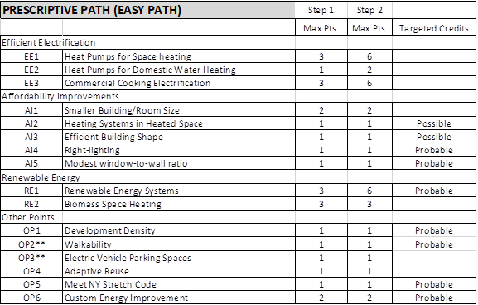
Easy Path Compliance 2021/2023
2021-2023 (Step 1) minimum 6 points
2023-2026 (Step 2) minimum 12 points

Slide 7
Whole Building Compliance Pathways
Three Whole Building Path Options
LEED or Energy Modeling Path
EITHER Achieve 17 LEED energy points between optimize energy performance and renewable energy credits (Possible)
OR Provide third-party reviewed ECB energy model showing >40% reduction (80% in 2023) (Possible – but an additional model)
Passive House Path
Meet all standards and achieve precertification or certification (Possible – but never pursued on campus)
Greenhouse Gas Accounting Path
Conduct GHG accounting calculation based on grid and CHP emissions rates. (Possible, but not probable in 2021 depending on energy mix.)

Slide 8
Key Take-Away Information
Use the Easy Path if possible!
Contact Matt Kozlowski (MDK39) early in the project to review scope and applicability
RECs are key to compliance – but not our easy button.

Slide 9
Questions?

