Slide 1
Today’s Agenda
Monthly Updates
Andrew Magré
Project Based Metrics Dashboard
Paul Stemkoski, Donna Sutliff, and Taylor Thompson
Budget Mechanics Presentation
Jessie Dimick, Paul Stemkoski, and Donna Sutliff
Ithaca Energy Code Supplement Presentation
Matt Kozlowski

Slide 2
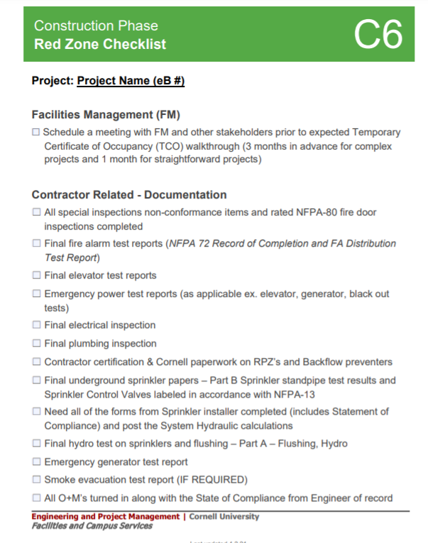
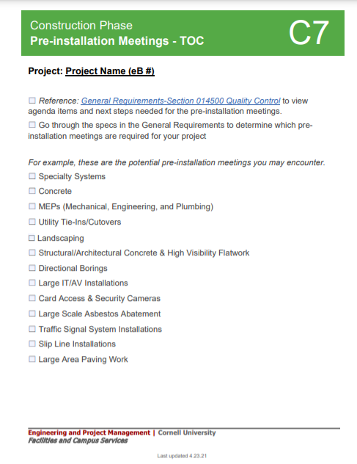
June Updates
Summer Work Update
COVID-19 update, contractors and consultants still required to wear face coverings
Checklist Reminder
Friendly reminder, as we go into summer please utilize the C6 Red Zone Checklist and C7 Pre-Installation Checklist
Want to search for a specific Checklist or resource? Try the command (ctrl+F) to search the page.
Notes:
Moment of silence

Slide 3
June Updates
Facilities Contracts Office’s Reminder
CRP’s, CO’s, CAA’s, TA’s, - show your work for State funded construction projects
In-Person Pre-Bid Meetings are now approved by AVP of E&PM and you will still need to submit your email request to the AVP. Please copy Jessie Dimick.
Financial Fiscal Year End Reminder
If you have pay applications or other financial processes that are open or lingering, make sure you approve or reject them
Finance would like to see expenses invoiced on the correct year
Notes:
CRP’s, CO’s, CAA’s, TA’s, - etc. need to have all of the backup attached to the process including how they requested the pricing, ASI’s, RFI’s the actual proposals, etc. The analogy I use is when you had math tests and you had to “show your work”, Contracts need to see the work without having to search for it.

Slide 4
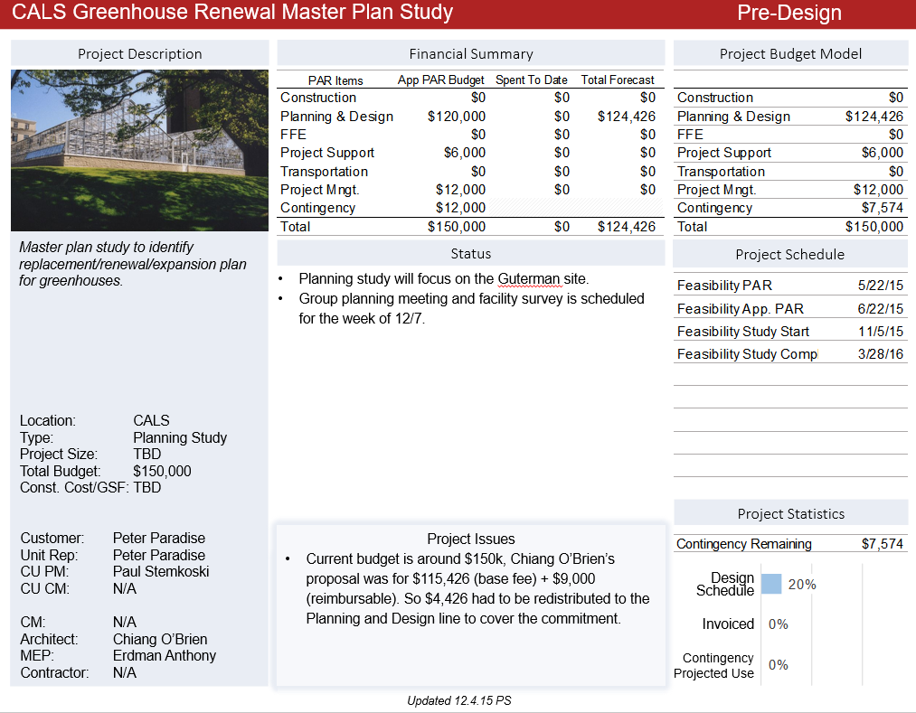
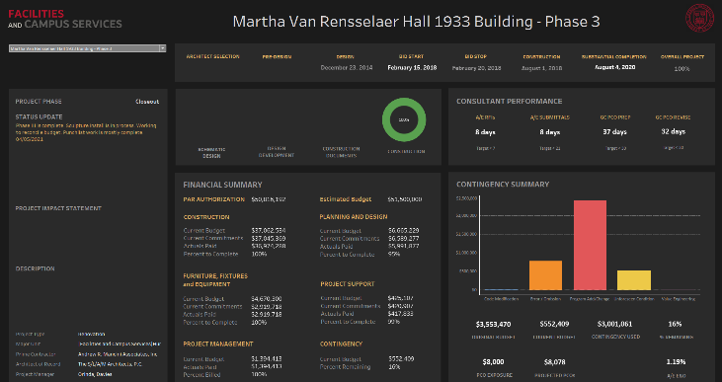
June Updates
Project Endorsement Review
Last review will be during June’s CF&PC but we will continue to do a modified version of the review
Project Based Dashboard
Details coming soon!
PP Dashboard
New Tableau Dashboard

