Slide 1
Ithaca Energy Code Supplement and the Impact to Cornell University Projects
June 2021

Slide 2
Summary - Ithaca Energy Code Supplement
Adopted by CITY of Ithaca May 5th, Applies to projects seeking building permit beginning August 4th.
TOWN of Ithaca has not yet adopted, but all indications are that it will be adopted soon.
Encourages electrification of building heating/cooling as a means to lower greenhouse gas emissions resulting from fossil fuel usage.
We have pathways to compliance, but project teams need to strategize early.
Difficulty ratchets over time (2021 – 2023 – 2026)

Slide 3
Applicability
The IECS applies to projects within City (or Town once adopted) of Ithaca that meet any one of the following conditions:
All new construction, excluding additions and renovations that are not specified below.
All additions 500 square feet or larger to single or two-family dwellings
All additions 1,000 square feet or larger to buildings other than single or two family dwellings
All MAJOR RENOVATIONS, defined as the following:
MAJOR RENOVATION – Any construction or renovation to an existing structure other than a repair or addition, where (1) the WORK AREA exceeds 75 percent of the FLOOR AREA and (2) two or more of the following occur:
Replacement or new installation of a heating plant or system (e.g. boiler, furnace, or other major system). Changes to ventilation and air conditioning systems are not considered renovations of the heating system.
Construction that involves disassembly of greater than 50% of the area of the above-grade portion(s) of the BUILDING THERMAL ENVELOPE in the building.
Changes to lighting, including but not limited to new installation, replacement, relocation, or removal, of lamps, lighting, or other illumination fixtures in greater than 50% of the building FLOOR AREA.
EXCEPTIONS:
The IECS does not apply to construction with unheated space
The IECS only applies to projects seeking a building permit within the City (and soon Town) of Ithaca (SUNY/Campus Let projects do not fall in this category).

Slide 4
Submission and Verification
Cornell Collaboration
Review upcoming IECS Cornell Compliance Document
Contact Matt Kozlowski (mdk39) for guidance as early as possible
Identify strategy and collaborate with the FE and E&S SMEs.
Submission to AHJ
Compliance Plan due at time of building permit application
Compliance verification
Building division required review for final Certificate of Occupancy
Some paths require third party verification (Energy modeling, LEED or Passive House)
Recordkeeping
Renewable energy credits tracked for 15 years! (By E&S)

Slide 5
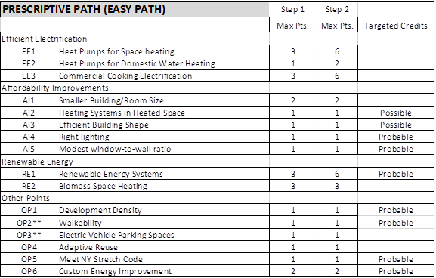
Easy Path Compliance 2021/2023
2021-2023 (Step 1) minimum 6 points
2023-2026 (Step 2) minimum 12 points

Slide 6
Whole Building Compliance Pathways
Three Whole Building Path Options
LEED or Energy Modeling Path
EITHER Achieve 17 LEED energy points between optimize energy performance and renewable energy credits (Possible)
OR Provide third-party reviewed ECB energy model showing >40% reduction (80% in 2023) (Possible – but an additional model)
Passive House Path
Meet all standards and achieve precertification or certification (Possible – but never pursued on campus)
Greenhouse Gas Accounting Path
Conduct GHG accounting calculation based on grid and CHP emissions rates. (Possible, but not probable in 2021 depending on energy mix.)

Slide 7
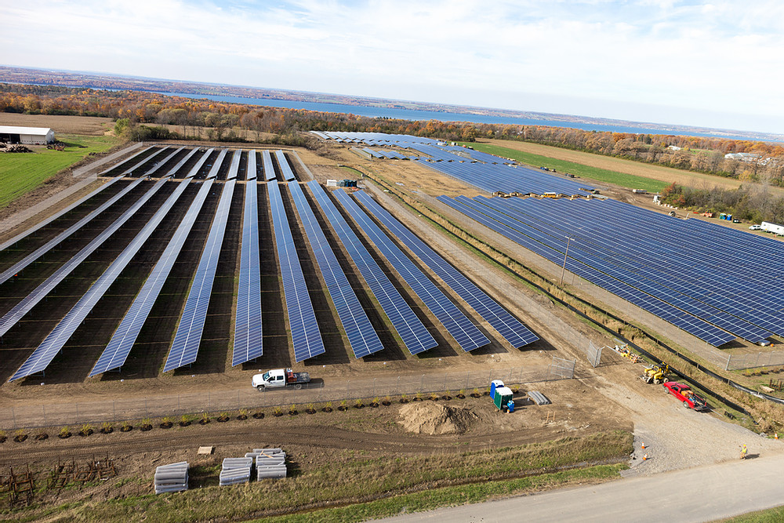
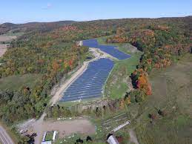
Renewable Energy Certificates (RECs) – Our Campus Pathway to Success
Includes both onsite and offsite renewable energy systems within the NYISO service territory.
Existing systems installed since 2015 or new systems.
Harford, Musgrave Farm, and Geneva solar plants
Limited supply from existing systems – but should have sufficient to serve projected new loads through 2026.
Projects must demonstrate compliance with CU Design and Construction Standards or document variance in order to receive RECs.
Musgrave Farm Solar Plant
Harford Daisy Hollow Road Solar Plant

Slide 8
Key Take-Away Information
Use the Easy Path if possible!
Contact Matt Kozlowski early in the project (SD)
Guidance document being drafted, but we are available to meet and assist projects now.
REC’s are key to compliance
Applies to projects in the City seeking building permit beginning August 4th

Slide 9
Public Service Announcements
The City/Town are exploring an existing building standard.
CU Design and Construction Standards
Planning an update in concert with the IECS. Now that the IECS has been adopted our Green Building and Energy Modeling Standards will be updated. Expect enhanced language around commissioning, LEED, and adoption of NYS Stretch Energy Code.
Projects in Dryden? – NYS Stretch Energy Code adopted

Slide 10
Questions?

