Slide 1
Goal: Replace existing turnover letter with an e-Builder Turn Over Process (following “Red Zone”)
Project Turn Over

Slide 2
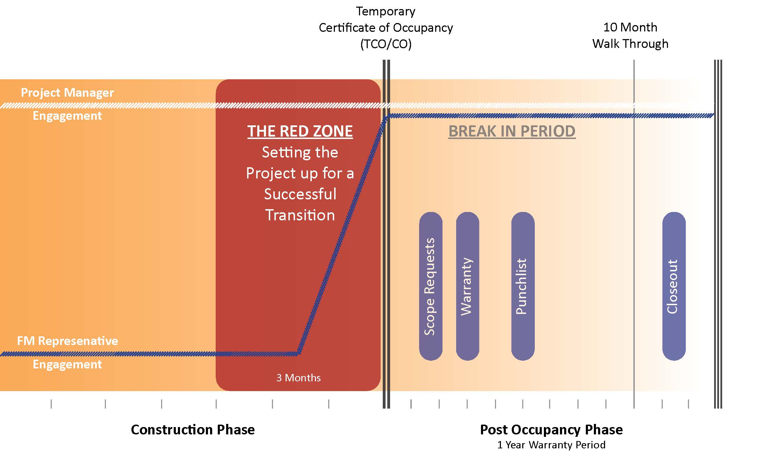
Project Turn Over
e-Builder Project Turnover Process
X

Slide 3
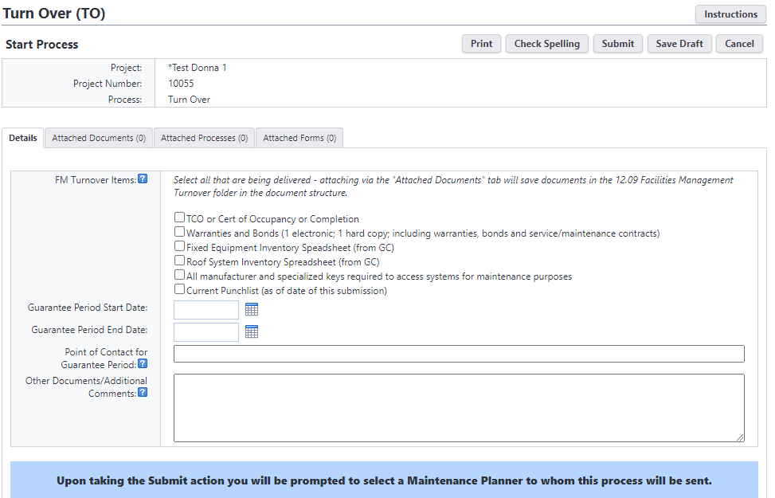
Turn Over Process
Notes:
Start – Project Manager or Project Coordinator
Guarantee Period End Date and the Point of Contact During GP will populate fields of the same name on the Project Details Page for future reference ge
Submit – prompts user to select a Maintenance Planner
RedZone Check list C6 and the CL1 Close Out Master checklist

Slide 4
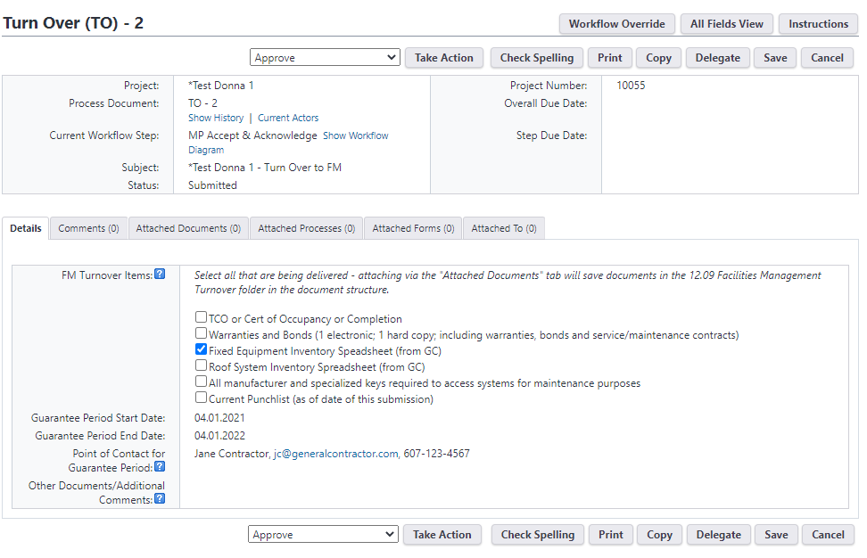
Turn Over Process
Notes:
Maintenance Planner (MP) review and acknowledge
Opportunity for back and forth via request comment or phone call if needed; users can attach new documents at any time
MP takes approve action to complete the process

Slide 5
Turn Over Process
When Maintenance Planner takes approve action to complete the process, the following roles on the project will be notified:
Zone Facility Director
AVP FM&CCF (Keith Barton)
AVP E&PM (Andrew Magré)
Project Director
Unit Representative

Slide 6
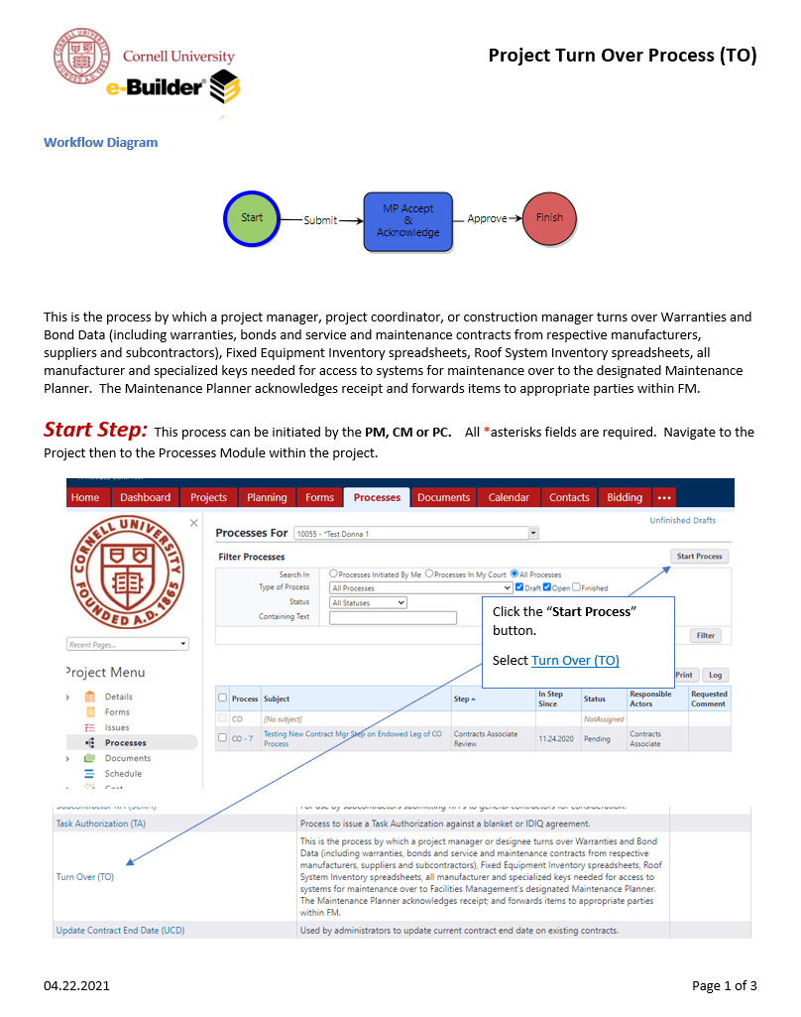
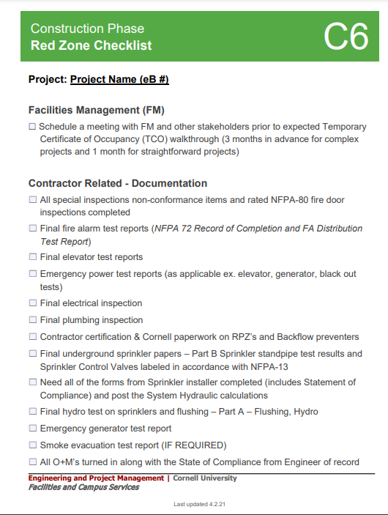
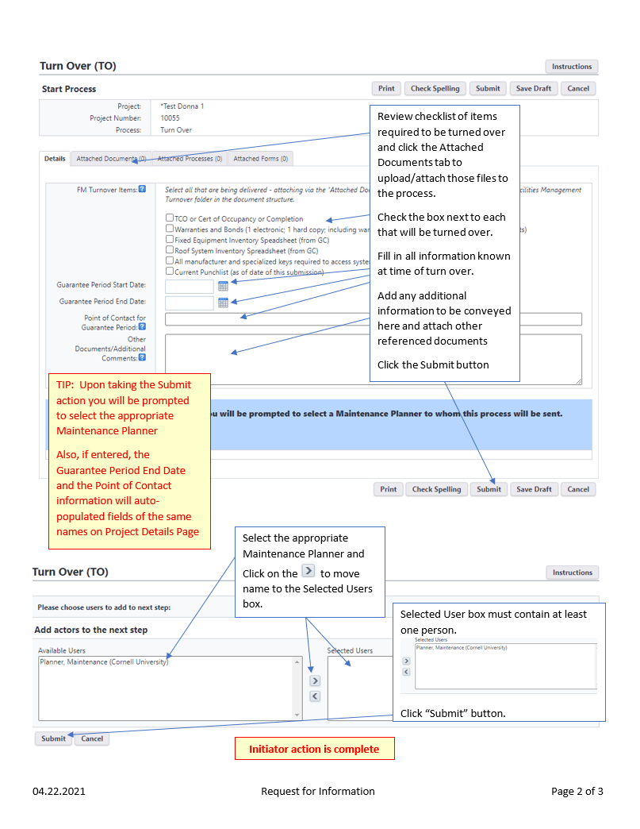
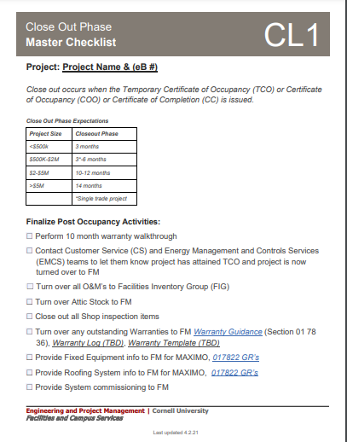
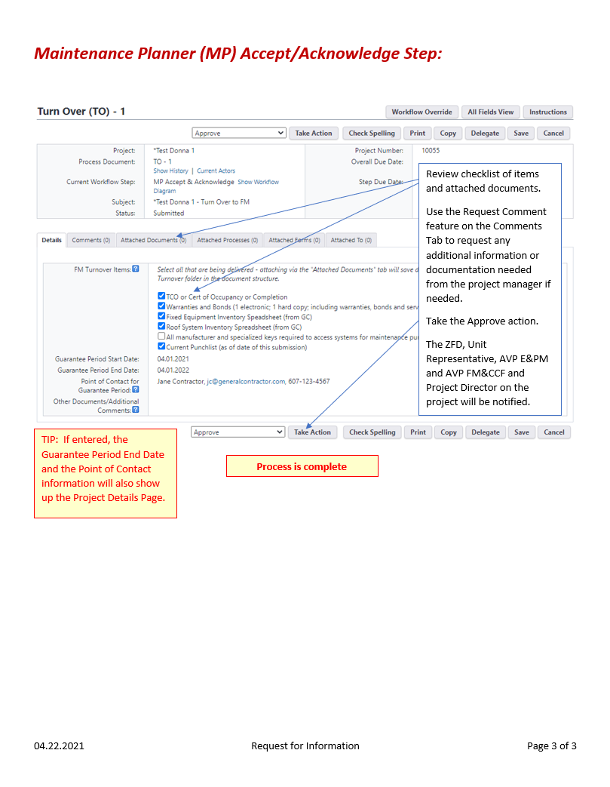
Turn Over Reference Materials
PM Checklists
https://fcs.cornell.edu/departments/engineering-project-management/project-management-checklists
00007 - *e-Builder Resources
Documents \ User Resources \ TO - Turn Over Process

