Slide 1
Project Management – Professional Development Series
Facilities and Campus Services Engineering and Project Management
May 19, 2021

Slide 2
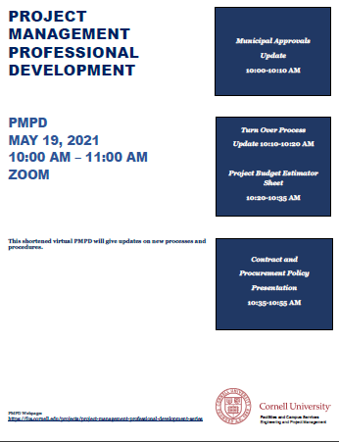
Today’s Agenda
OUA Minute: Municipal Approvals Update
Leslie Schill
eB Minute: Turn Over Process Update Presentation
Donna Sutliff
PM Minute: Project Budget Estimator Sheet Presentation
Paul Stemkoski
Contract and Procurement Policy Presentation
Kelley Cooper and Brenda Frank

Slide 3
OUA Minute

Slide 4
eB Minute

Slide 5
PM Minute

Slide 6
Contract and Procure Presentation

