Slide 1
PMPD: Municipal Approvals Overview, 5/19/21
Municipal Clearinghouse Monthly Meeting (NEW)
What are Municipal Approvals?
Which Projects Require Municipal Approvals?
When do Projects have to go for Municipal Approvals?
What Resources are Available to Help Identify Steps in the Municipal Approval Process?
How do I Successfully Navigate Municipal Approvals?

Slide 2
Municipal Clearinghouse Monthly Meeting
What: New monthly meeting to review upcoming projects headed to municipalities for approvals
Who: Campus Planning, PM Project Directors, Building Code Manager, any PM with a project slated for municipal approval meeting in coming 30 days
Why: Streamline and coordinate all Projects’ approvals, maintain CU-municipal working relationship, keep projects on time and on budget
BOTANIC GARDENS
“RICE BOWL”
HERITAGE OAKS
Notes:
First Meeting Held 5/7

Slide 3
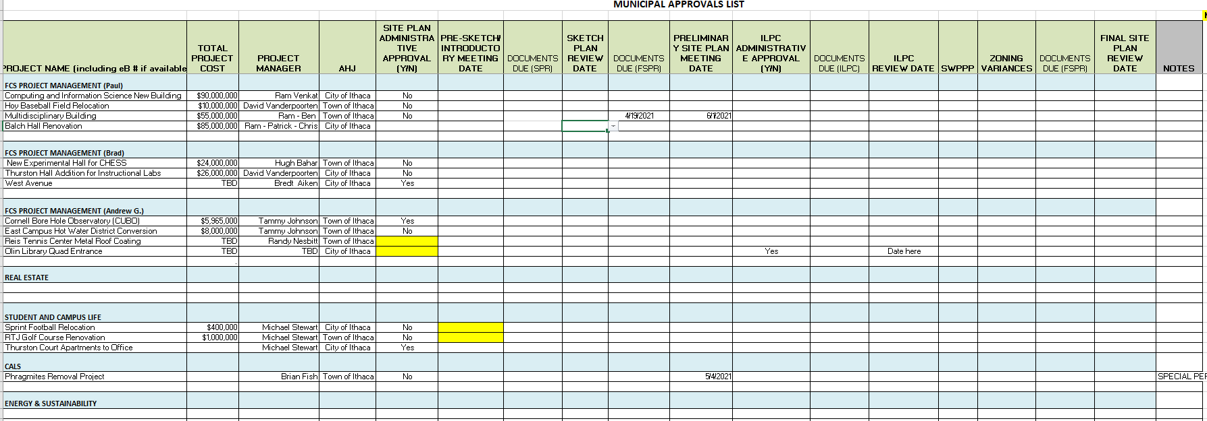
Municipal Clearinghouse Monthly Meeting
BOTANIC GARDENS
“RICE BOWL”
HERITAGE OAKS
Notes:
First Meeting Held 5/7, Modeled on PAR/PAC meeting.
Goal: Coordinate all projects going to munis, timelines, meetings, messaging

Slide 4
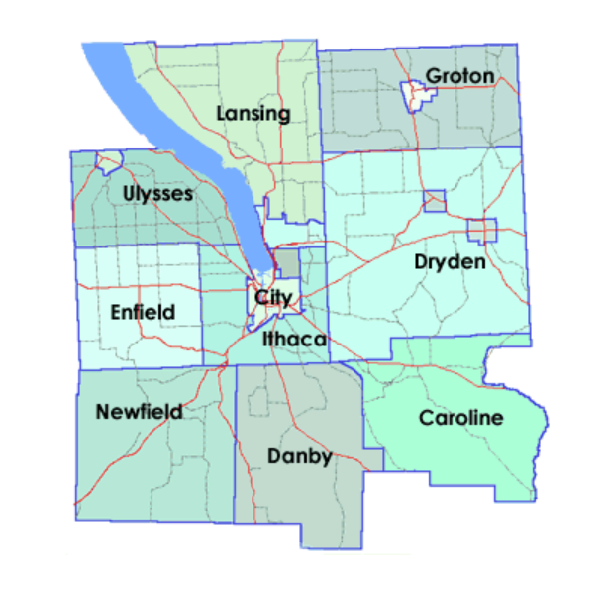
What are Municipal Approvals?
16 municipalities &
Local Home Rule
RICE HALL
PARKING LOT
NORTH PEDESTRIAN WALKWAY
TOWER ROAD
Notes:
Constitutional home rule power is now granted to all counties outside New York City, and all cities, towns and villages (Section 3(d)(1)). Prior to 1963 no towns and only some villages had constitutional home rule power. This includes: The right to local self-government including the powers to regulate for the protection of the public health, safety, morals, and welfare; to license; to tax; and to incur debt. Home rule involves the authority of a local government to prevent state government intervention with its operations.

Slide 5
What are Municipal Approvals?
TYPICAL MUNICIPAL APPROVALS:
SITE PLAN APPROVAL (and its attending steps): Sketch Plan approval, preliminary Site Plan Approval, Final Site Plan Approval : Planning Board
SEQR - Environmental Quality Review: Planning Board https://www.dec.ny.gov/permits/357.html
ZONING VARIANCE: Height, Use, Area, Stream Setback and Lot Cover variance: Zoning Board of Appeals
SPECIAL USE PERMIT: Almost any development in the Town of Ithaca: Planning Board
CERTIFICATE OF APPROPRIATENESS: Changes to an historic building, work in/adjacent to a Historic District: Ithaca Landmarks Preservation Committee
239 General Municipal L-M: Projects near municipal boundaries, County lands/roads, etc.: Tompkins County Planning https://tompkinscountyny.gov/files2/planning/community%20planning/documents/Fall%202018%20FINAL%20GML%20239%20Guide%20no%20apps%209-1-2018.pdf
Notes:
May also have to pull permits, other than a building permit: fill, floodplain development,

Slide 6
Which projects are subject to Municipal Approvals?
NEW CONSTRUCTION AND ADDITIONS
TRANPORTATION AND UTILITIES PROJECTS
MAJOR LANDSCAPE PROJECTS/PROJECTS THAT DISTRUB LARGE AREAS OF LAND
IMPROVEMENTS ON NON-CORNELL OWNED LAND
SMALL PROJECTS THAT TRIGGER SPECIFIC CODE REVIEW/EXCEED CODE THRESHOLDS
Notes:
Endowed and State provisions
List examples of projects

Slide 7
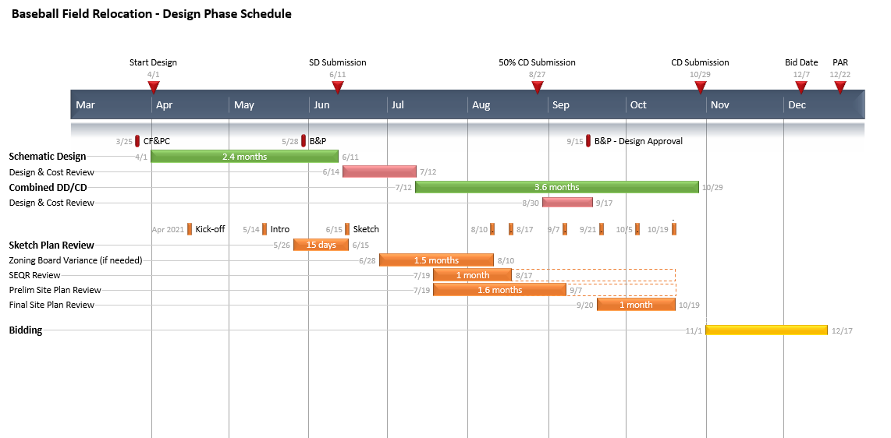
When do Projects have to go for Municipal Approvals?

Slide 8
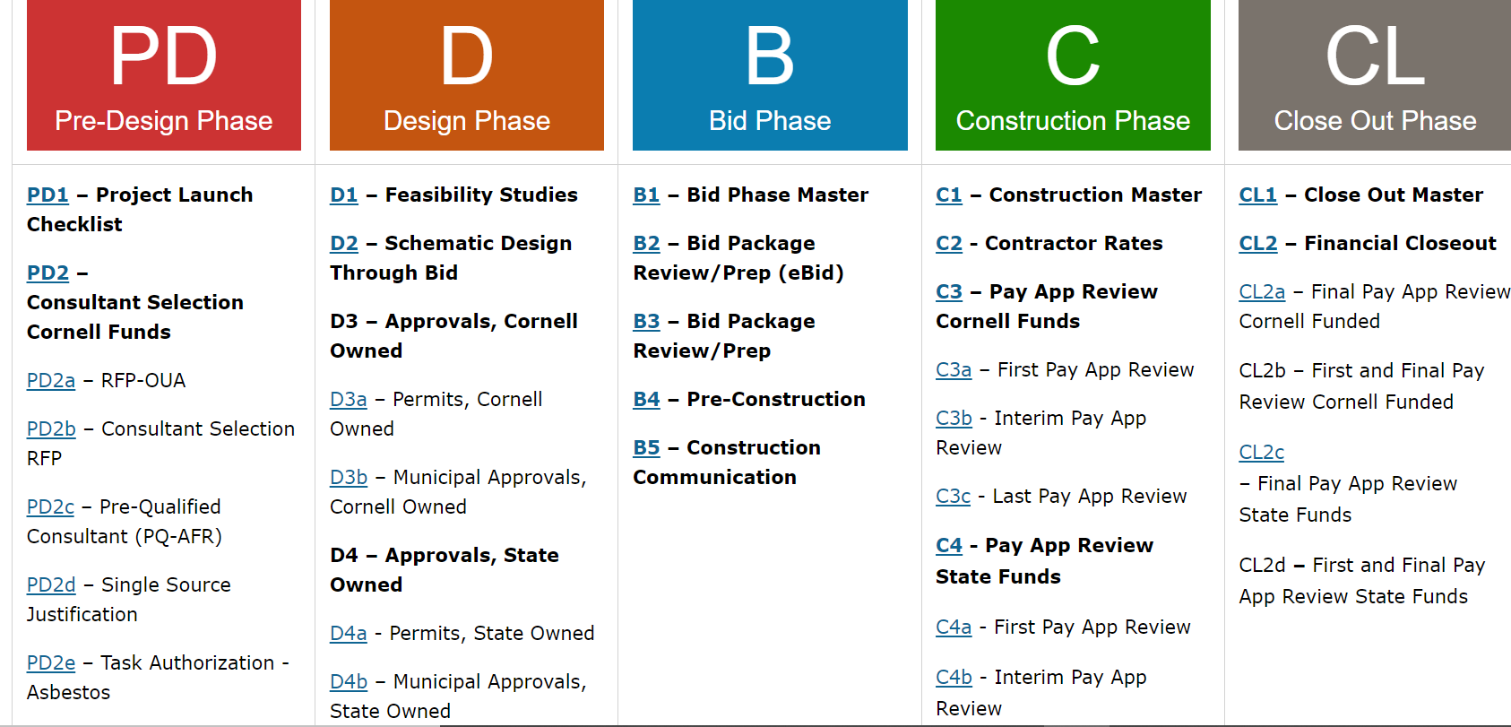
What Resources are Available to Help Identify Steps in the Municipal Approval Process?

Slide 9
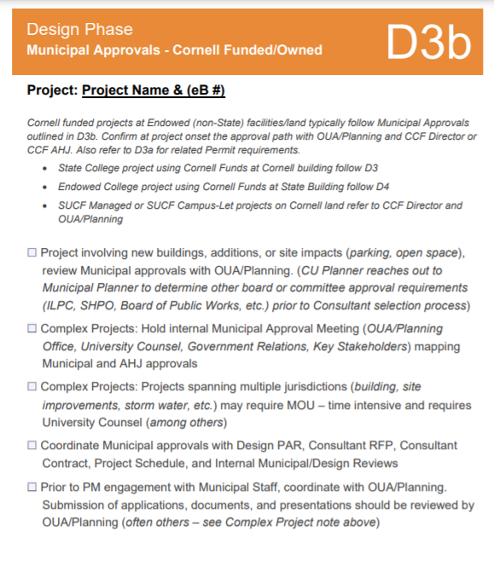
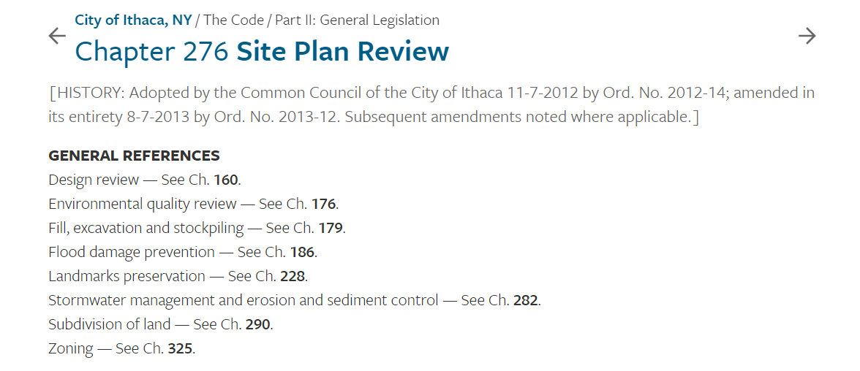
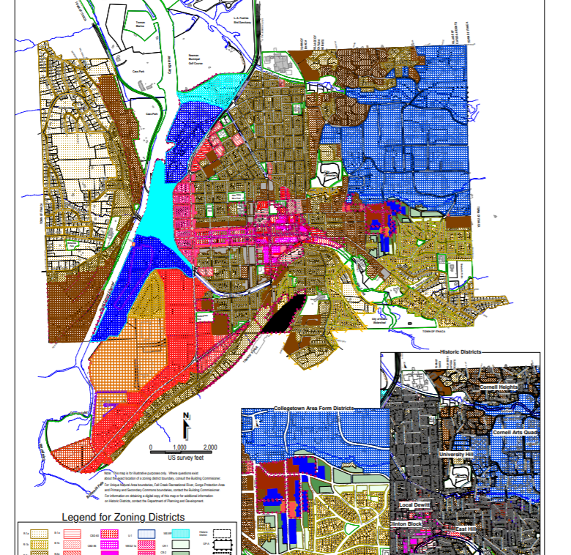
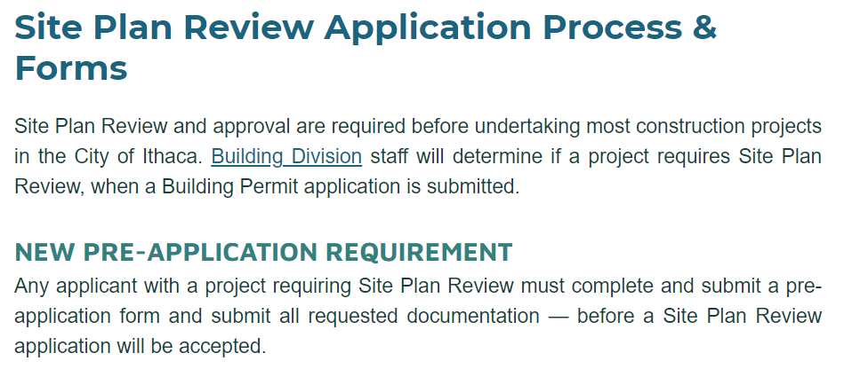
Resources, cont:
Local Municipal Code, Plans & Processes

Slide 10
How do I Successfully Navigate Municipal Approvals?
Engage Campus Planning at Project Initiation for a strategy session
2. Review Project Manager Checklist for Approvals (Endowed, State)
3. Check appropriate municipal website to confirm requirements for your specific project
4. In partnership with Campus Planning, build a project timeline that sequences: project steps, Cornell approval steps, and municipal approvals
For complex projects, convene a municipal approvals team throughout design process.
In partnership with Campus Planning, contact municipality to initiate municipal approvals first step/coordinate an introduction meeting
7. In partnership with Municipal Approvals review team in advance of municipal presentations
Notes:
to build a municipal approvals strategy during initial project thinking, RFP development--PM needs to review schedule that goes into the RFP to make sure there is appropriate time allotted right from the get go…and so the firms proposing understand how this can impact timeline and their scope of work
, and at the cusp of design
6. to confirm municipal approvals timeline and municipal deadlines and engagements

Slide 11
IS THERE AN EASY BUTTON FOR INFORMATION ABOUT MUNICIPAL APPROVALS?
YES! CALL OR EMAIL LESLIE SCHILL:
Leslie.Schill@cornell.edu
202-997-2344
Notes:
to build a municipal approvals strategy during initial project thinking, RFP development--PM needs to review schedule that goes into the RFP to make sure there is appropriate time allotted right from the get go…and so the firms proposing understand how this can impact timeline and their scope of work
, and at the cusp of design
6. to confirm municipal approvals timeline and municipal deadlines and engagements

