Slide 1
Design Standards Overview
Notes:
Introduction
Representing 30 members of Facilities Engineering

Slide 2
Outline
Why do we need standards?
Philosophy
What are design standards & details?
Definitions
Approach
Statistics
Variance Process
Notes:
I am going to provide an overview of the Cornell University Design Standards today. We are going to cover the topics in the outline.

Slide 3
Why do we need standards?
Notes:
I thought I would start out with a funny clip about designing the complex systems which the campus community relies on.

Slide 4
Why do we need standards?
100,000 Sprinklers
225 Sprinkler Systems
60 Miles of Sidewalks
100 Acres of Parking Lots
10 Miles of Roads
280 Elevators
26 LEED Certified Buildings
243,000 Ft of Steam Pipe
6,900 Under-ground Structures
145,000 Ft of Chilled Water Piping
22 Bridges
2,000,000 SF of Laboratory Facilities
Notes:
Cornell University is a high-tech city with a complex physical plant
To demonstrate the complexity and scale of our campus we have assembled a few statistics.
Facilities professionals hold institutional knowledge and best practices about these various systems which allows us to provide expert advice and successfully guide consultants who don’t fully understand our challenges and climate.

Slide 5
Philosophy
Design Standards influence the design phase and are incorporated into the construction documents by the design professional.
Window of Opportunity
Design Standards
SD
DD
CD
BID
BUILD
OCCUPY
Notes:
Standards are provided to aid the design professional in the development of contract documents and are not intended to be used verbatim as a contract specification nor replace the work and best judgement of the design professional.
It is also key to understand the window of influence for the design standards. It is important to incorporate standards into the earliest point of design to minimize the cost impact on a project.
Once the construction documents are complete, the contractor will bid on the documents they are provided.

Slide 6
Philosophy - Feedback Loop
Design
Construct
Occupy
Learn
Design Standards
Feedback Loop
Notes:
Our standards are created and updated based on a continuous feedback loop where all of you play a role.
As facilities professionals we are always learning and finding ways to improve over time. This feedback loop provides the lessons learned to update our design standards and document that information for future projects.

Slide 7
Philosophy
EXTEND LIFE
REDUCE O&M
HIGH ROI
SECURITY
QUALITY
CU STANDARDS
BUILDING CODE
DESIGN REQUIREMENTS
Notes:
It is important to note that the CU Design Standards do not replace building codes and industry standards but rather explain where Cornell is going above and beyond code minimums.
This graphic represents how Cornell goes above minimum code in several area. We chose to have higher standards than code minimum for several reasons:
To extend the service life (Cornell maintains buildings for centuries)
To reduce operation and maintenance costs and save Cornell money over the service life of the building
Due to a high return on investment in the case of energy conservation
Due to higher levels of security
Due to higher quality level expectations

Slide 8
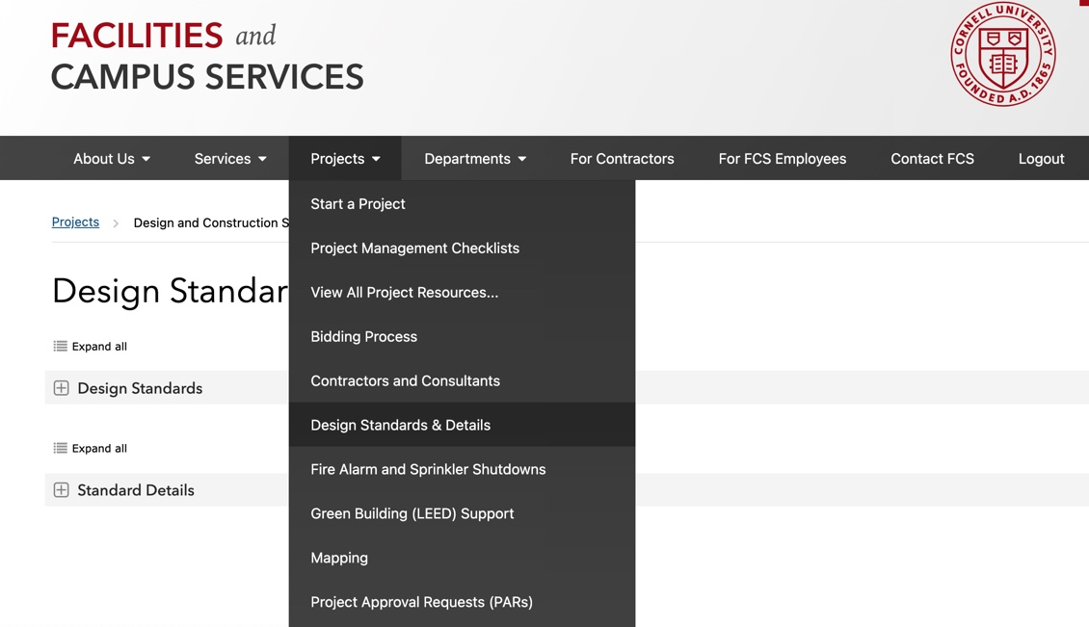
What are Design Standards & Details?
Written Standards & Guidelines
Standard Details
Notes:
Facilities Engineering is the Curator of the Design Standards & Details.
There is a subject matter expert (SME) who lead the development of each standard.
Some SME’s are from Facilities Engineering and others are from units at Cornell like EHS, E&S, OUA, CIT, CU Police, Etc.
The SME tracks industry standards, trends, coordinates updates and gathers input from campus stakeholders.
The SME will also weigh in on variance discussions which we will discuss later in the presentation.

Slide 9
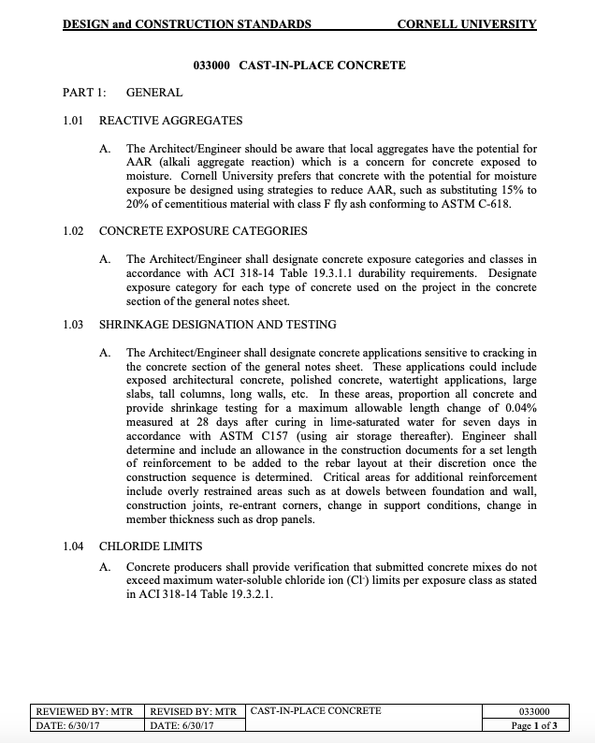
Example Standard
033000 Cast-In-Place Concrete
Notes:
Each Design standard is unique in content based on the material or system. Some standards are a single page and others are over 30 pages long. The expectation is that the design professional responsible for each discipline is familiar with the particular design standard as they are designing your project. If the designer has questions related to the design standard, we can put them in touch with the Subject Matter Expert responsible for the standard.

Slide 10
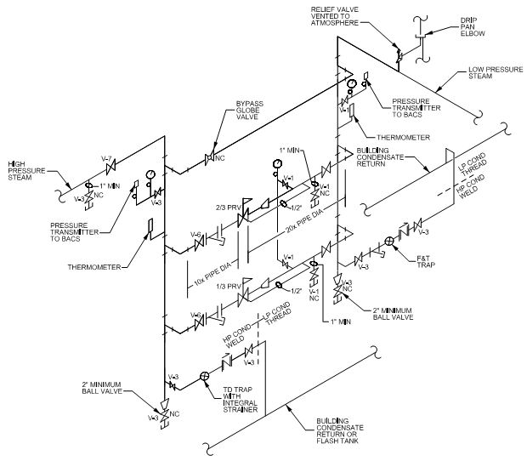
Example Details
Notes:
Design Standard details are prescriptive in many cases, for instance the hydrant detail on the left. In other cases, details may be schematic in nature. For instance, the high-pressure steam schematic on the right. This is a schematic for an engineer to develop their design which allows CU to properly operate and maintain the steam system as the project ties into our district system.

Slide 11
Definitions
Standards
High in authority and set specific minimum quality (Requirements, “Shall”)
No discretion (requires a variance)
Guidelines
Lower in authority, recommendation or best practice (Considerations, “Should”)
Allows for some discretion (discussion required)
“Shall”
“Should”
Standards and Guidelines are integrated into one document by topic based on CSI number.
Notes:
As mentioned, the CU standards are organized by topic or material. Within each document you will find both prescriptive standards and general guidelines.
(Read slide text)
Standards should be incorporated into the project and guidelines should considered as part of the design process.
Example of shall and should…

Slide 12
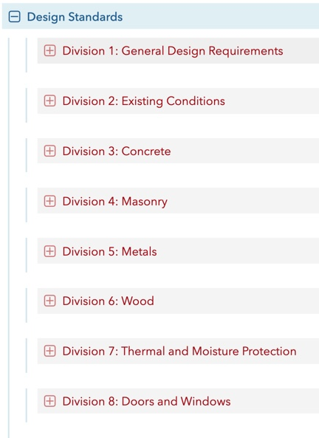
Approach
Organized by CSI Division
Division 1 – General Design
Spaces
Accessibility
Safety
Energy
Programming
Division 2-43 – Technical Divisions
Materials
Systems
Assemblies
Notes:
Standards are generally organized by CSI format for the benefit of the design professional as they create the construction documents.
Division 1 covers general design topics including space, accessibility, safety, energy and programming. Examples include: Custodial standards and Green building guidelines
Division 2 – 43 covers technical divisions including building materials, systems and assemblies. Examples include: Door hardware, Roofing, Elevators, Electronic safety and security systems.
Most standards follow typical CSI specification categories including:
General Requirements which covers Basis of Design Criteria, Guidelines, Submittal requirements.
Products which includes specific materials or manufacturers
Execution which describes work procedures related to the specific standard

Slide 13
Statistics
Design Standards – 103 Total
Informs design and construction documents
Standard Details – 199 Total
Starting point for construction documents
Review Period
Goal to review once every two years
Standards are reviewed, revised or removed
Standards are added as a need is identified
Notes:
As mentioned before, Cornell University is a high-tech city with a complex physical plant which has led over time to a robust set of Design Standards and Details.
Currently we have 103 unique written Design Standards which inform the construction documents and 199 Standard Details which act as a starting point for details within the construction documents.
Facilities Engineering and the designated SME are targeting to review the various standards once every two years.
The review may lead to no change, an update, the standard may no longer be needed.
If there are specific updates required due to a change in code or a lesson learned, a standard can be updated at any time working with the particular standard SME.
Also, as we learn as an organization, we can add new standards to address lessons learned or an industry change.

Slide 14
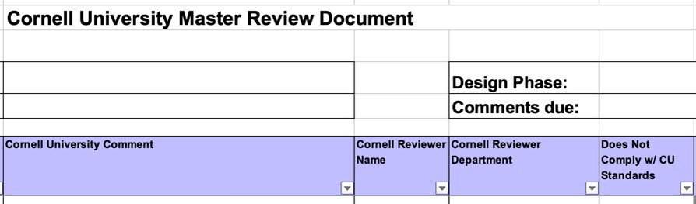
Standard Variance
Design review spreadsheet non-compliant checkbox
Variance request in writing to the University Engineer
Facilities Engineering will review the request & consult with the standard point-of-contact & SME
The UE will respond with a determination
Notes:
The particular design reviewer has the opportunity to identify a review comment as being non-compliant with CU Design Standards using the Master Review document found in eBuilder through the design review process. This will bring to the attention of the design team and PM where a non-compliant design issue occurs in the construction documents.
We understand that there may be unique situations where a variance may be required for a particular standard.
Please note that these considerations are rare when there is a true conflict with a required standard.
Standard variances should be made in writing to me as the University Engineer with supporting documentation for the request.
The standard variance request will be reviewed on a case-by-case basis and waivers may be granted after consultation with the standard SME and stakeholders.

Slide 15
Thank You

