Slide 1
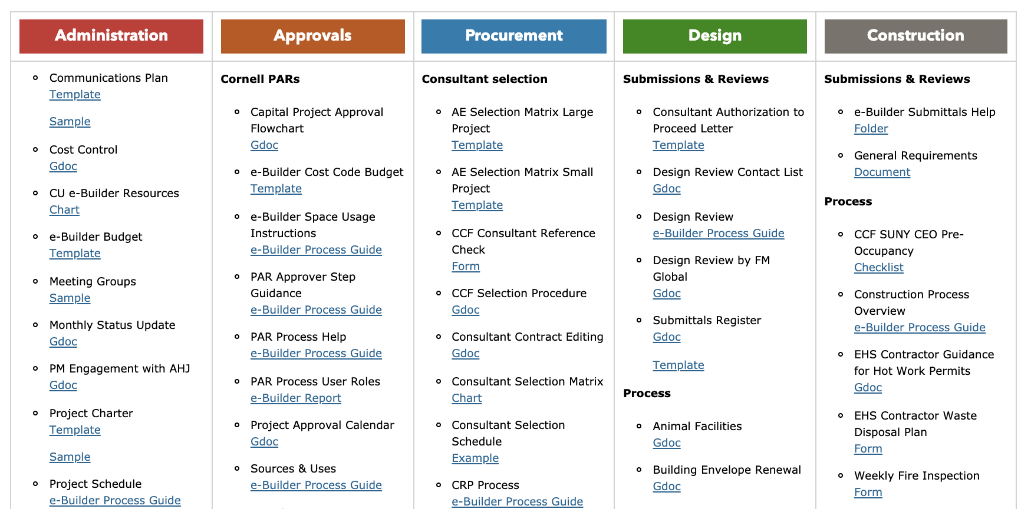
Revised Project Management Resources Page
New Guidance Documents & Templates
Animal Facilities (Gdoc)
Building Envelope Renewal (Gdoc)
Classrooms (Gdoc)
Electronic Safety & Security Systems (Gdoc)
Fire Extinguishers (Gdoc)
Historic Buildings - Municipal Approvals (Gdoc)
Ithaca Area Storm Water Compliance (Gdoc)
PM Engagement with AHJ (Gdoc)
Submittals (Gdoc)
Research Labs (Gdoc)
Pre-Bid Agenda (Template)
AE Selection (Templates)

Slide 2
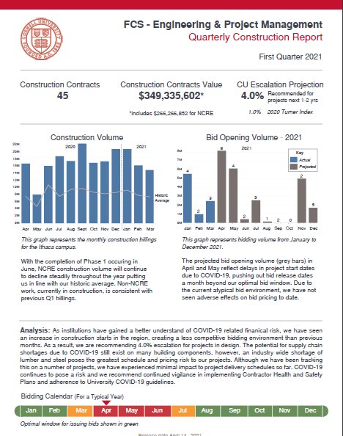
Quarterly Construction Report
The first quarter report is ready
Increase in regional construction starts
Tracking wood & steel price increases
Recommend holding 4% escalation
New Project Approvals Outlook Calendar
Subscribe to new shared CF&PC and B&P Calendar on Outlook
Includes PAR and presentation submission dates
Go to “Open Shared Calendar” click on CF&PC Calendar
Get in touch with Taylor if you need assistance gaining access

Slide 3
MWBE Participation % for Cornell Funded Projects
For Cornell funded projects: We are no longer required to obtain the MWBE Calculation Worksheet when preparing front-end documents for bidding
Be sure to use the updated General Conditions template and Bid Certification form located in eBuilder
Campus Let/Public Bid projects are still required to provide the MWBE participation percentage and calculation worksheet
Transportation Assessment in Project Budgets
No longer required after July 1, 2021
Funded by central appropriation

