Slide 1
Project Management – Professional Development Series
Facilities and Campus Services Engineering and Project Management
April 14, 2021

Slide 2
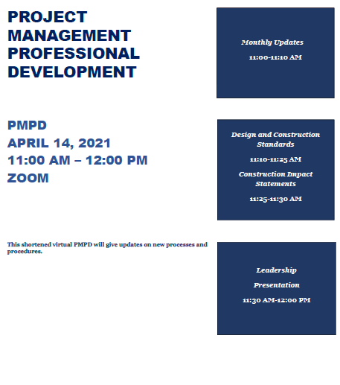
Today’s Agenda
Monthly Updates by Andrew Magré
Revised Project Management Resources Page
New Guidance Documents and Templates
Quarterly Construction Report
New Project Approvals Outlook Calendar
MWBE Participation Percentage for Endowed Projects
Transportation Assessment
FE Minute: Design Standards Overview
Erik Eshelman
PM Minute: Project Status Update and Construction Impacts on Operations Reminder
Andrew Germain
Leadership Presentation
Jess Cisco

