Slide 1
Project Management – Professional Development Series
Facilities and Campus Services
Engineering and Project Management
April 14, 2021

Slide 2
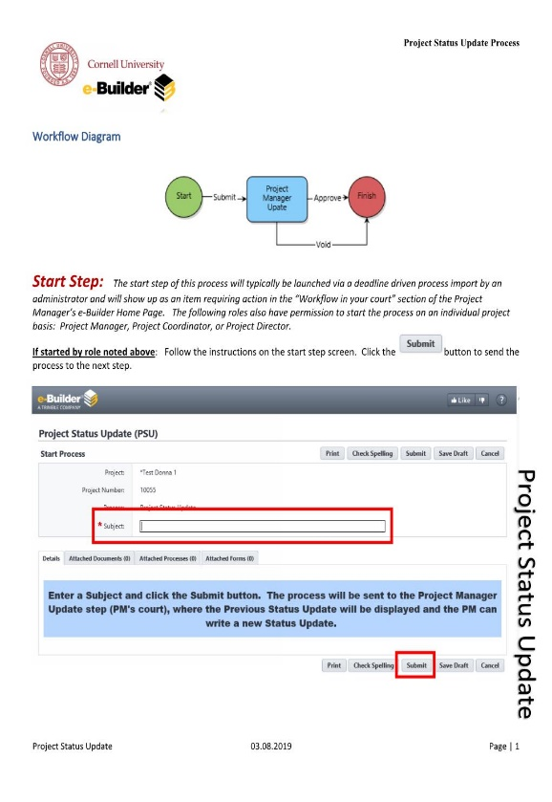
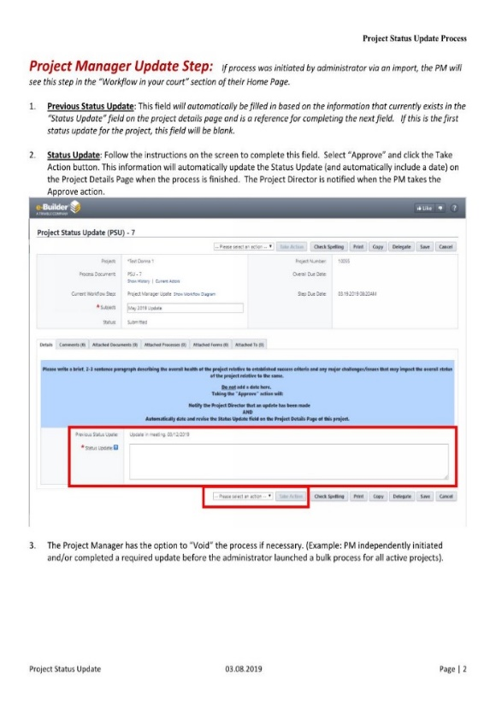
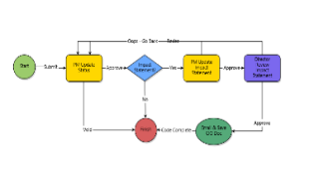
Project Status Update (PSU) & Construction Impact on Operations
Monthly Project Status Update – GDoc
Process & Expectations
Key Data Points – Construction Impact
Consistency & Reporting
Partnership & Communication
Leverage PSU Process:
Improve Campus Communication
Timeline:
Spring/Summer 2020: Roll out
Spring 2021: Guidance Doc: Further Guidance & Examples
Notes:
Audience:
Who is this for?
Stakeholders, Project Directors, and Administration
Goal of the Project Status Update is to fully inform the project directors / Executives and Stakeholders of your project's status and overall direction without having to get involved themselves.
Directors/Stakeholders should be able to read the project status without having to reach out to the PM directly to find out where things are. A project manager is to create clarity from confusion for the project team and for management. Essentially, the task of a project status update is one of analysis and communication.

Slide 3
Workflow: Project Status Update & Construction Impact Statement

Slide 4
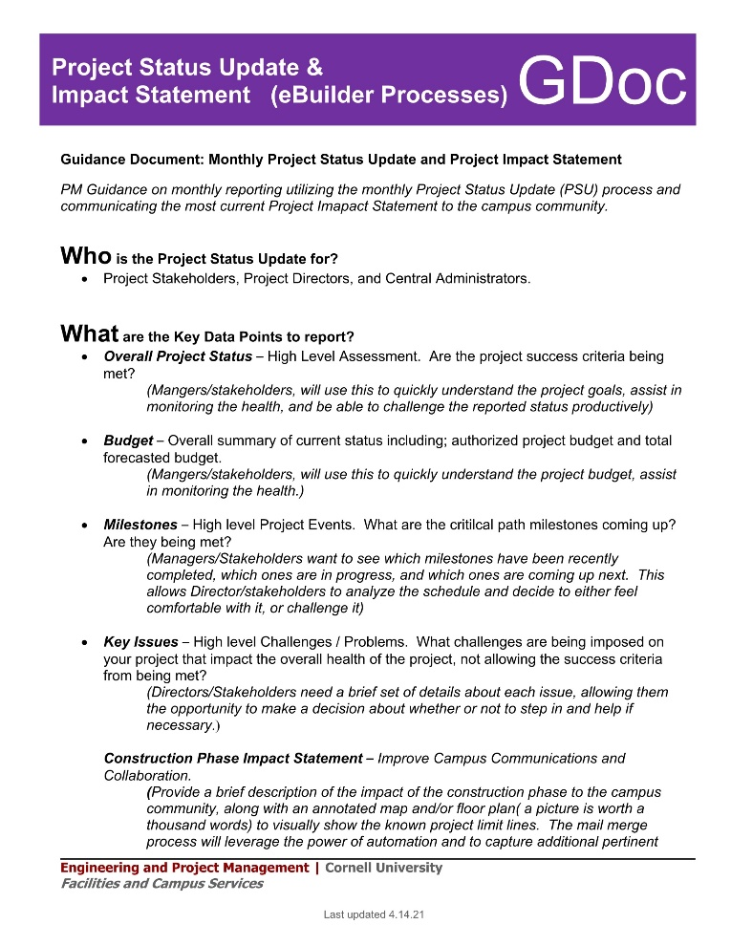
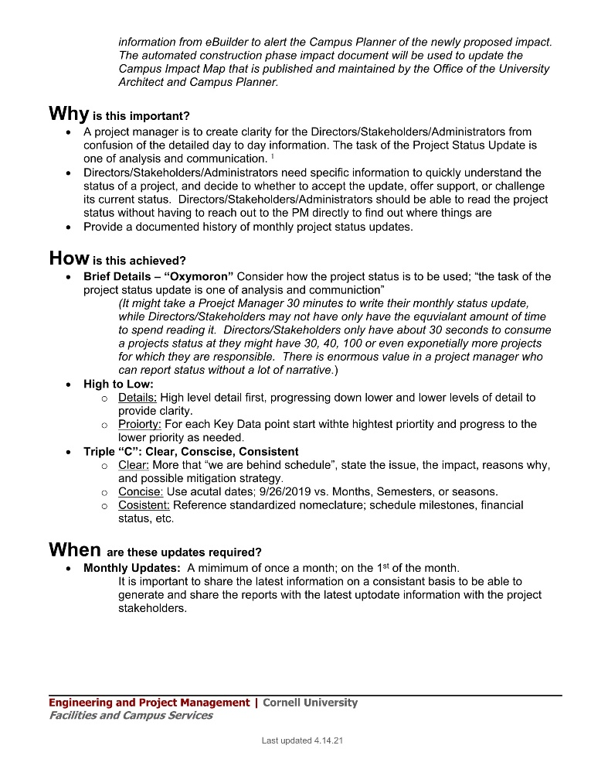
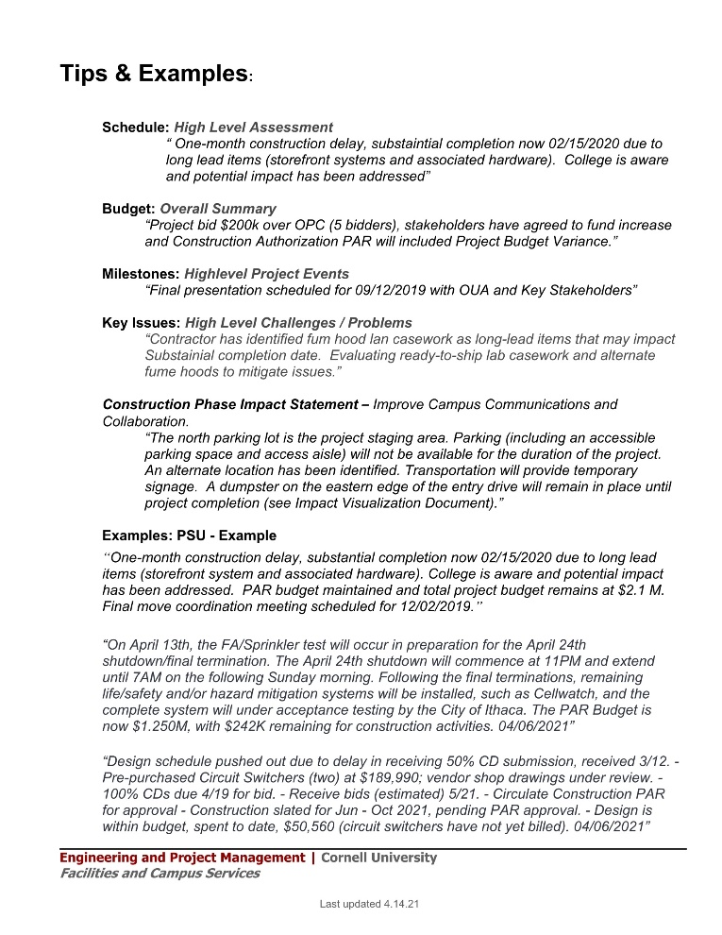
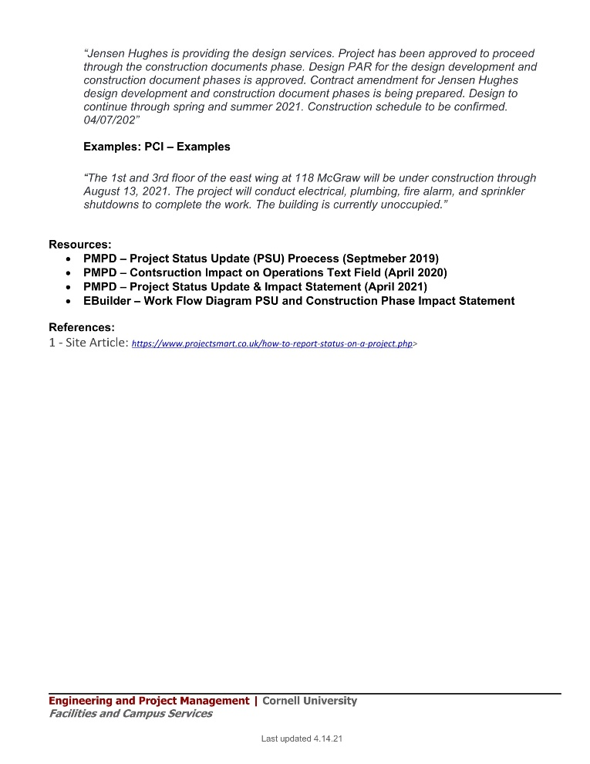
Project Status Update (PSU) & Construction Impact on Operations
PSU & Impact Statement
Who is the audience?
What key Data?
Why is it important?
How are expectations met?
When is it required?
Tips & Examples:

Slide 5
Construction Impact Statement – eBuilder
Expectations – Update with monthly PSU
Impact Statement (Optional – Update impact when known through the design process)
Add Sketch to eBuilder to the Process
Schedule (Construction Phase) Updated
Annotate Map with proposed contact limit lines

Slide 6
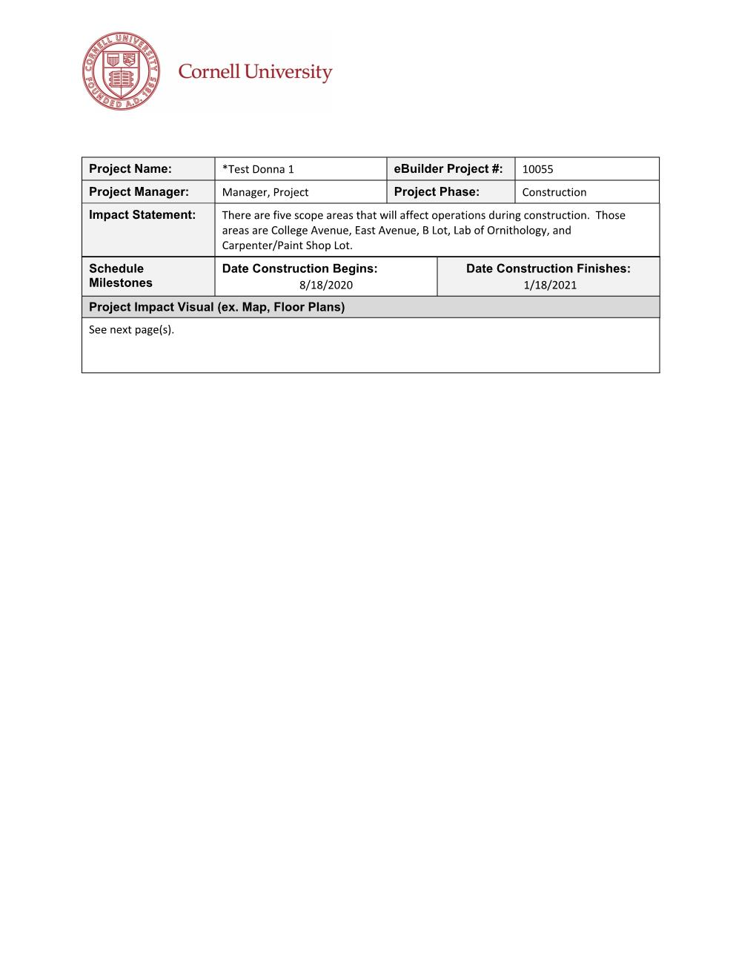
Construction Phase Impact Statement - GIS
Communication:
Project Specific Info.
Schedule Information
Project Limit Lines
Share with Campus Community
Consistent Deliverable (PDF):
Project Details Page
Project Status Update
Project Schedule Module
Annotated Image
Notes:
e-Builder Mail Merge
Project Details Page
Project Name
Project Manager
eBuilder number
Project Phase
Project Status Update
Impact Statement
Project Schedule Module
Construction Begins
Construction Finishes
Annotated Image
- Google Earth
eBuilder Mail Merge
Pull project data
Create deliverable
eBuilder Notification
Document Saved in eBuilder File Structure
Message sent to OUA
ARC GIS – MAPs
Link project data to Map

Slide 7
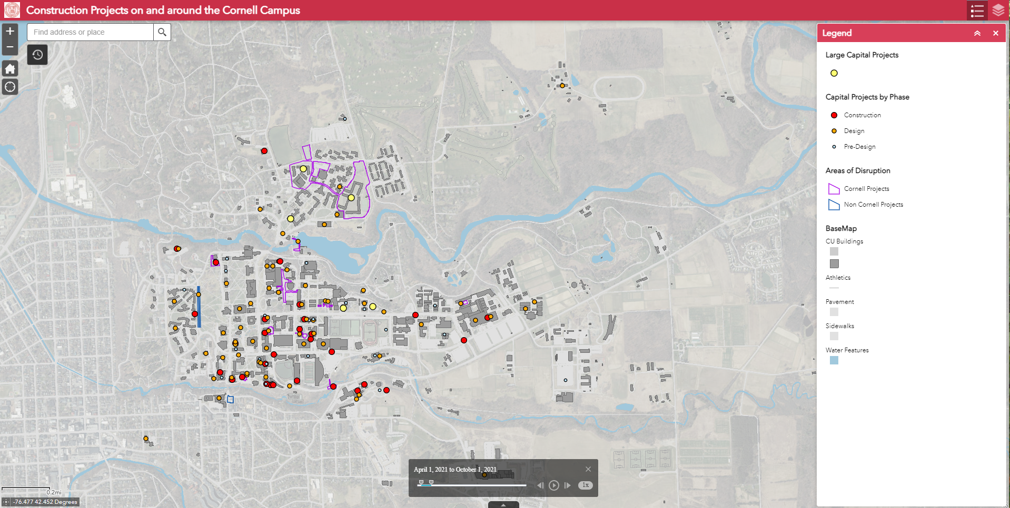
Summer Operations
-Large and Small Facility Projects
-Transport and Utility Projects
-Municipal Projects
Notes:
Disruptions from projects including to flow of vehicular and pedestrian traffic, staging and other effects highlighted

Slide 8
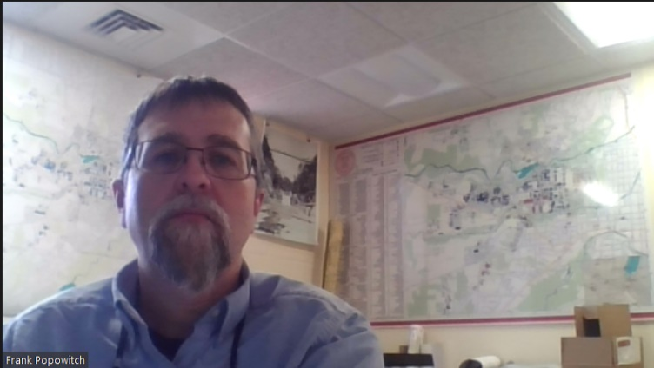
Please submit map updates by May 1
Questions about the Map:
Frank popowitch
GIS & Data Manager
Campus Planning Department
Cornell University
125B Humphreys Service Building
Ithaca, NY 14853-3701
Ph: (607) 254-1374
E-mail: fmp8@cornell.edu

