Slide 1
eB Minute
March 2021

Slide 2
Project Details-Custom Fields Glossary
One Outcome of the Data Quality Assurance Initiative
Published 02.04.2021
Available in e-Builder Resources:
Documents\User Resources\A Glossary of Project Details Fields

Slide 3
Project Details-Custom Fields Glossary
Field Name and Description
What roles have Edit Permissions and/or Edit Responsibility
What projects require the field be populated
What roles have View/Report Permissions
When/how it is populated or updated
Relevance of the field – why it is important or required; where used
Example/Sample entries or List of Options from which to choose

Slide 4
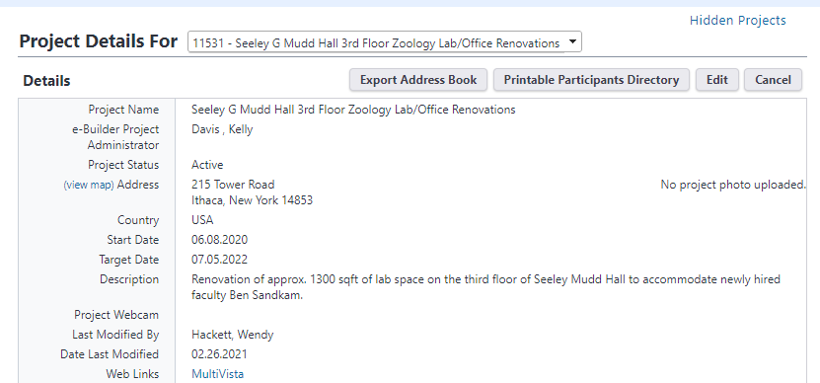
Project Details-Custom Fields Glossary

Slide 5
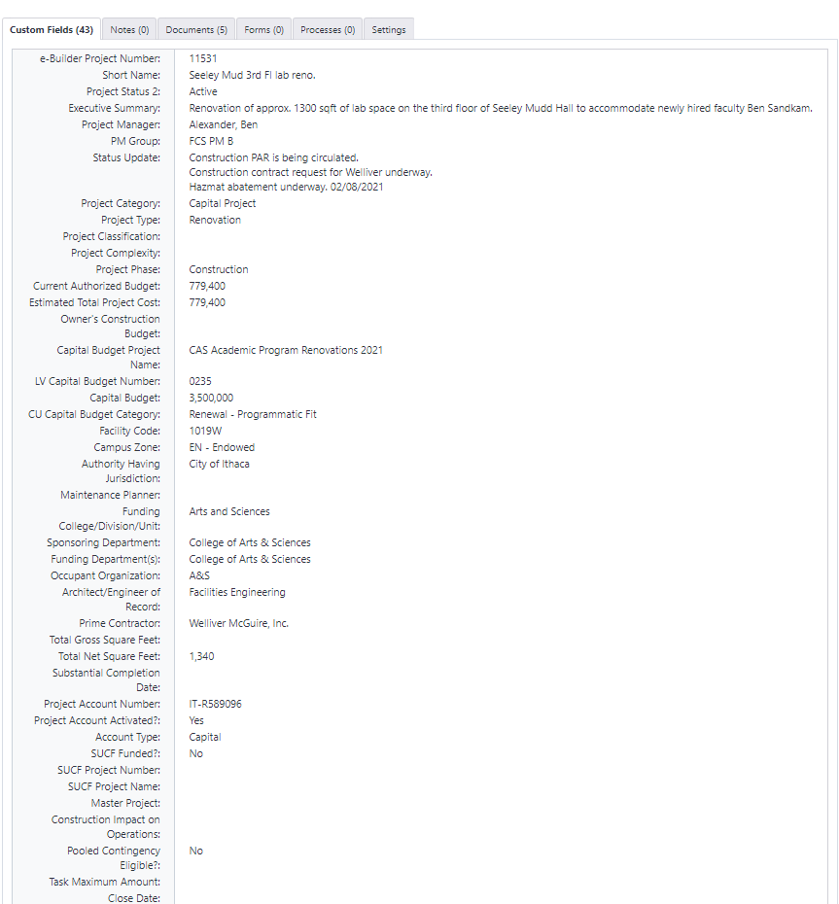
Project Details-Custom Fields Glossary

Slide 6
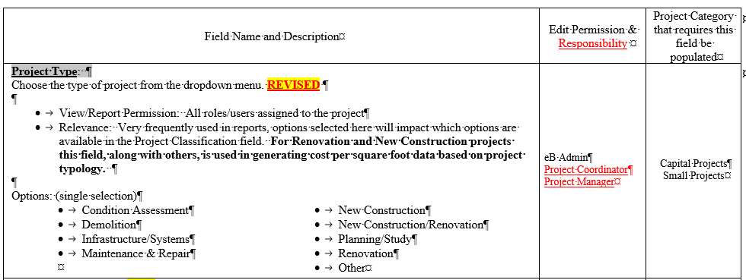
Project Details-Custom Fields Glossary

Slide 7
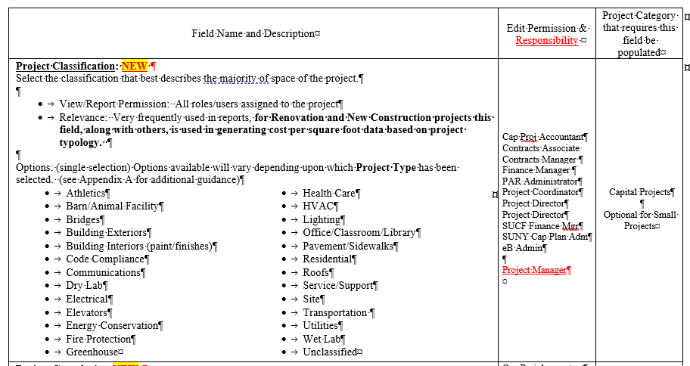
Project Details-Custom Fields Glossary

Slide 8
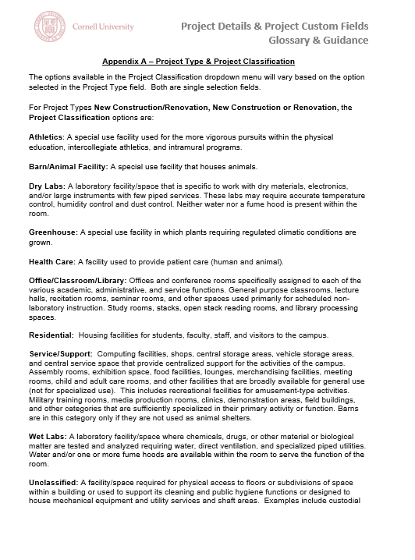
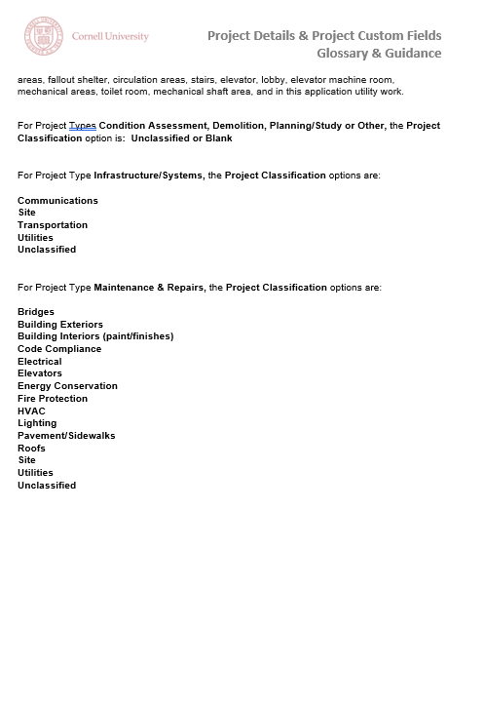
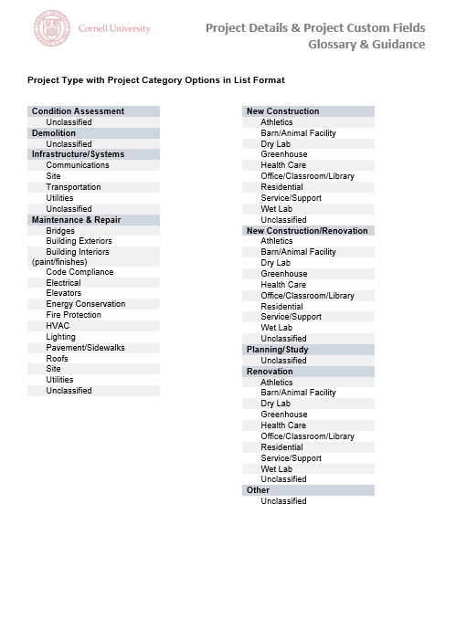
Appendix A

Slide 9
Project Details-Custom Fields Glossary
Ensure quality data for quality reporting
Anticipate additional changes will be needed
Feel free to provide feedback to:
e-buildergroup@cornell.edu

Slide 10
Questions?

