Slide 1
New Code Requirements for Higher Education Laboratories
Changes in Hazardous Material Storage, Handling and Use
March 2021

Slide 2
Presenters
Michael Niechwiadowicz – Building Code Program Manager
Elizabeth A. Kolacki, P.E. - Senior Mechanical Engineer

Slide 3
2020 NYS Code Changes
Effective May 12, 2020
Added Chapter 38 to the Fire Code
Applies to colleges and universities
Establishes additional categories for High Education Labs
Provides for additional options but…
  Additional requirements

Slide 4
What Changed?
Previous code
  Hazardous Occupancies
  Control Areas
  Established rights to an existing use
2020 Code
  Hazardous Occupancies
  Lab Suites
  Sprinklered Labs
  Unsprinklered Labs
  Control Areas
  Established rights to an existing use

Slide 5
When Does the New Code Apply?
New labs
Change of use of an existing space to a lab
Changes are made to an existing lab
  Changes to chemical usage
    Increase in quantities
    Different chemical used
  New equipment installed
  Lab is reconfigured

Slide 6
What About Grandfather Rights?
This has been a lab for 150 years, it is ‘grandfathered’.
  No such thing as ‘grandfathered’.
Established Rights
  Meets the requirements of a previous code
  Document the use and code compliance
  Exact same use continues
    No change in quantities
    No change in chemicals
    No change in size
    No change in configuration
There are retroactive requirements in the Fire Code that supersede established rights

Slide 7
Chemical Inventory

Slide 8
What are MAQs?
Maximum Allowable Quantities (MAQs) of Hazardous Materials:
CODES limit the amounts of hazardous materials (chemicals) in storage and use in certain occupancies. Since 2000, the New York State Codes hasn’t recognized Laboratories as an specific occupancy type despite the significantly different activities that are conducted within when compared to a general office or business building. This is mostly apparent in the storage and use of Hazardous Materials – aka Chemicals. These limitations have the potential to restrict research that can be conducted. The new Chapter on Higher Education Laboratories in the Fire Code eases these restrictions without having to classify an occupancy as High Hazard.

Slide 9
Chemical IFC Classification
Maximum Allowable Quantities (MAQs) are based on rating in the International Fire Code (IFC).
This data is not provided by the chemical supplier / manufacturer!
Vertére software can store this information and report using it
Notes:
Inventory is only the first piece
Materials then need to be grouped and totaled by ratings for each category
Unlike NFPA / HMIS / GHS ratings – IFC ratings are not generally provided by the manufacturer
Need an informed / trained individual to perform the rating. You ask, how is this accomplished?
1. FE has developed a procedural document to help with classification
2. FE also has a database of already classified materials (9000+)
3. The University is working with our chemical inventory system (Vertere) to hold classification data.

Slide 10
Compliance Options:
1 Existing and 3 New Compliance Options:
Chapter 50: General Hazardous Materials – Design and Number of Control Areas is unchanged from previous versions
Chapter 38: Design and Number of Laboratory Suites per Floor – NEW
Chapter 38: Design and number of Control Areas in Existing NonSprinklered Laboratories – NEW
Chapter 38: Design and Number of Control Areas in Existing Sprinklered Laboratories - NEW
Notes:
It is important to understand the sprinkler coverage in the facility. Just because the work area is sprinklered doesn’t mean the building is considered FULLY sprinklered.
Information needed to select the appropriate table:
Fully sprinklered/not fully sprinklered
Vertical fire separations in place (walls)
Horizontal fire separations in place (floors)

Slide 11
Lab Suites and Control Areas
CONTROL AREA. Spaces within a building where quantities of hazardous materials not exceeding the maximum allowable quantities per control area dispensed, used or handled.
In those facilities where control areas have not been formally established, a floor is typically considered the “control area” unless a project intends chooses to formally establish one.
Control areas are not required to be contiguous.
LABORATORY SUITE. A fire-rated enclosed laboratory area that will provide one or more laboratory spaces, within a Group B educational occupancy, that are permitted to include ancillary uses such as offices, bathrooms and corridors that are contiguous with the laboratory area, and are constructed in accordance with Chapter 38

Slide 12
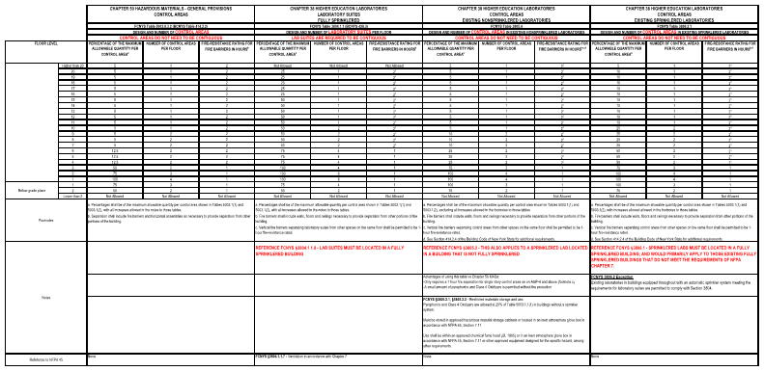
Comparison
Notes:
This chart compares the 4 available compliance options.
LAB Suites in Higher Education Lab Suites: MUST be located in a fully sprinklered building. Exhaust system meets the requirements of NPFA Chapter 7.
Control Areas in Higher Education Labs - Existing Nonsprinklered Labs: also applies to sprinklered labs located in a building that is not fully sprinklered. A good portion of the existing labs on campus fall into this category (so please SPRINKLER YOUR BUILDINGS!!)
Control Areas in Higher Education Labs in Existing Sprinklered Labs: MUST be located in a fully sprinklered building, BUT the exhaust system does not meet the requirements of NPFA 45 Chapter 7.
Control Areas: General Chapter 50 compliance can still be used.

Slide 13
Highlights
Chapter 38 allows 1-hour fire barrier separations between control areas / lab suites on upper levels vs 2-hour fire barriers under Chapter 50. Floors still need to have a 2-hour fire resistance rating
Chapter 38 generally allows additional storage and use over Chapter 50.
Lab Suites and Existing Sprinklered Laboratories must be located in a Fully Sprinklered Building
Quantity Adjustments for Storage in Approved Cabinets or Fume Hoods is not allowed in Existing Non Sprinklered Laboratories using Chapter 38.
The ventilation in Lab Suites must comply with Chapter 7 of NFPA 45 – Standard on Fire Protection for Laboratories Using Chemicals
A small amount of Pyrophorics and Class 4 Oxidizers are allowed to be stored/used in Non Sprinklered Buildings, where this is not allowed by Chapter 50.

Slide 14
Lab Suite Ventilation – NFPA 45
Exhaust ducts from each laboratory suite shall be separately ducted to a point outside the building, to a mechanical room, or to a shaft.
Exhaust ducts from chemical fume hoods and other exhaust systems within the same laboratory suite shall be permitted to be combined within the laboratory suite.

Slide 15
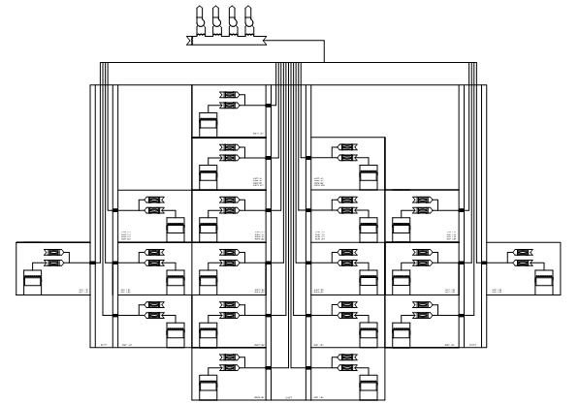
Preferred Fume Hood Exhaust Duct Configuration
Notes:
This detail summarizes a Building with Lab Suites with an exhaust system complying with NFPA 45 Chapter 7.

Slide 16
Documentation
Evaluation of MAQs is a CODE requirement. Maximum expected quantities subdivided into material classifications categories and the method of protection from chemical hazards (for example, control areas, laboratory suites, fire protection systems, storage location, Group H occupancies, and separations) is to be included on the construction documents and reviewed with the Authority Having Jurisdiction.
A good portion of our outside design consultants punt this review claiming lack of expertise. FE has resources to help you with this effort.
Start this process EARLY in the project. The result of this analysis CAN effect the final design.
THANK YOU

Slide 17
Questions?

Slide 18
Resiliency Presentation

