Slide 1
Project Management – Professional Development Series
Facilities and Campus Services Engineering and Project Management
January 28, 2021

Slide 2
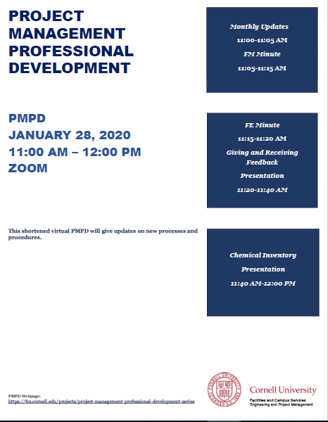
Today’s Agenda
Introduction by Andrew Magré
Quarterly Construction Report
Transaction Authorities
E-Builder Data Warehouse
FM Minute: Interesting Things to know about the SAMP
Jim Gibbs
FE Minute: Timing of Ithaca Green Building Code
Matthew Kozlowski
Giving and Receiving Feedback Presentation
Rob Parker
Chemical Inventory Presentation
Liz Kolacki and Mike N.

Slide 3
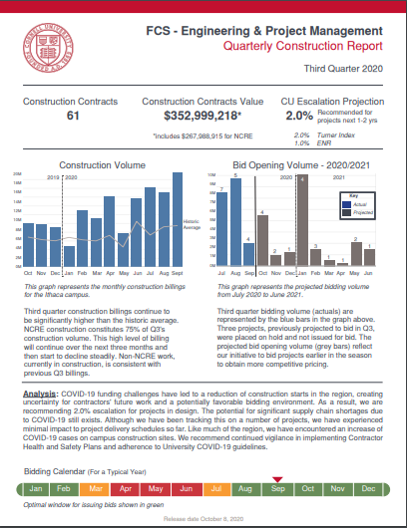
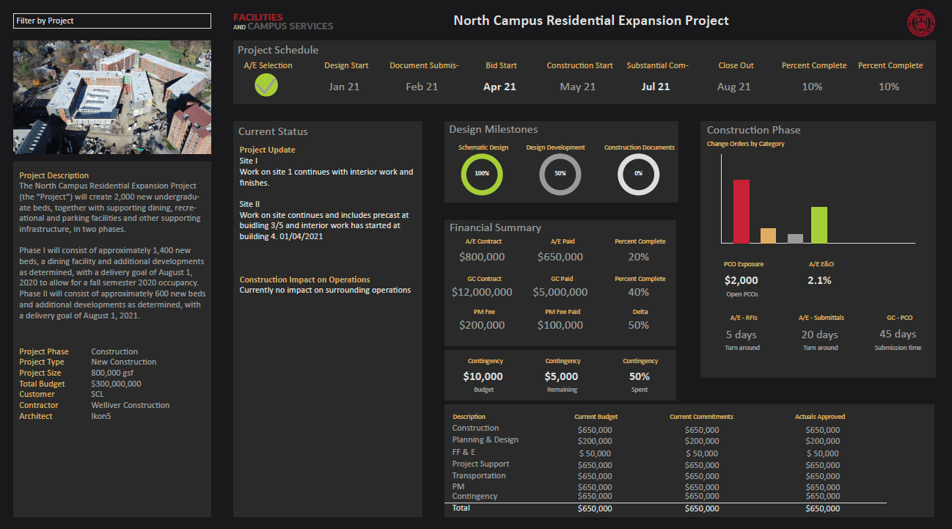
January Updates
Q4 Construction Report
Just released this week!
Transaction & Payment Policy 4.2
Friendly reminder
E-Builder Data Warehouse
Coming soon - Dashboards
You can find the Q4 report on the E&PM website
Project Specific Dashboard

Slide 4
FM Minute

Slide 5
Strategic Asset Management
Steps to creating a Foundation for Managing our Facilities:
Create individual programs for asset classes, consider:
Function
Tier
Uniformat
Failure Modes
Inventory, collect data, tag assets
Describe preventive maintenance programs
Estimate PM effort and modify programs to fit the funding
Load into CMMS (data in ONE place)

Slide 6
What is an “asset”?
Anything that has value to the institution – people, reputation, endowment, facilities……

Slide 7
So what! How does asset management apply to project managers?
Every project touches assets
Costs of not managing assets
Increased utility cost
Decreased service life
Increased maintenance cost
Decreased staff and faculty productivity
Decreased reliability

Slide 8
Strategic Asset Management Plan
Accurate and complete data is required to effectively manage assets. This requires everyone involved with assets to consider themselves a “data steward” and feel personally responsible for collecting and maintaining reliable data.
A written asset management plan (AMP) for each asset class, eg, roofs or backflow preventor, will document details about each asset class and how data will be used to manage the asset class. Appendix XX is a table of asset classes and individuals/organizations responsible for managing that asset class.

Slide 9
Asset Management Plans (AMP)
Asset or System Name | SME | Program Author
AC Drive |  | Jeff Parsons
Access Controls |  | Jeff Parsons
Air Handler Units | Eric Lepore, Liz Kolacki | Matt Johnston/Liz Kolacki
Air Stations (Compressors) | Mark Fossaceca | Kevin Samson
Backflow Preventer | Tom Jordan | Gibbs
Boilers | Liz Kolacki | Dan Decker
Bridges including means restriction | Rob Murray | Rob Murray
Carbon Monoxide Detector - not lab gas detection systems |  | Alex Chevallard
Chimney/Vent Systems |  | Shane Dunn/Rob Murray
Controls |  | Mark Howe/Cole Tucker/Jim Hatch
Cooling Tower | Vince Knapp | Steve Cobb
Cranes and Hoists |  | Marc Marinchak
Dampers / Actuators, including fire/smoke dampers/ lab airflow devices/ VAV boxes |  | Liz Kolacki
Dining Equipment |  | Marijane Johnson, Pat Graham, Forrest McCloud
Domestic Water Heater | Travis Fisher | Dan Decker
Doors and hardware | Michael Hingston | Alex Chevallard
Drapery and Curtain | Nadine Hachmann | Asa Schindler
Asset or System Name | SME | Program Author
Electric Motors
Emergency Light | Chris Wayman | Chris Wayman
Emergency Power Supply System (EPSS) (tier 1 for some facilties) | Chris Wayman | Chris Wayman
Emergency Egress Stairs
Evaporative Coolers (both pad and swamp coolers) | Vince Knapp | Steve Cobb
Exterior Enclosure (B20) |  | Quinn Olsen/Matt Reiter/Elisabete Godden/Shane Dunn
Fan Coil Units |  | Vince/Scott Burke/ Alyssa
Fans |  | Travis Fisher/Alyssa
Filter Racks |  | Tom Jordan
Fire Detection & Alarm System | Mark Scholeno | Mark Scholeno
Fire Escapes |  | Quinn Olsen and Matt Reiter
Fire Suppression Systems (sprinklers and halon and kitchen hood) | Tom Jordan | Tom Jordan
Fuel Tanks
Fume Hoods and fans |  | Liz Kolacki/Vince Knapp
Grease Laden Kitchen Exhaust Systems and fans | Pat Ockenfels | Dan Decker

Slide 10
More Asset Management Plans (AMP)
Asset or System Name | SME | Program Author
Greenhouse Shade Curtains | Deb Melanson | Steve Cobb
Heat Exchangers |  | Eric Lepore/ Travis Fisher
Heat Tracing (Electric & Hydronic)
Humidifiers both central and point | Liz Kolacki
HVAC related direct expansion refrigerant equipment (includes HVAC Chillers and window AC) | Eric Lepore | Steve Cobb
Ice Makers | Doug Keefe | Alex Chevallard
Light Fixtures |  | John Bell
Lighting Fixing Controls |  | John Bell
Overhead Doors | Jason Coolbaugh | Dan Decker
Parking Garage | Rob Murray | Rob Murray
Pavement | Jim Toft | Jim Tofte
Portable Fire Extinguishers |  | Alex Chevallard
Pressure Vessels |  | Vince Knapp/Travis Fisher
Primary & Secondary Elec. Switchgear | Erich Reichard, Jeff LaPar | Erich Reichard/ Jeff LaPar
Pumps |  | Travis Fisher/ Tom Jordan
Quality Water Systems (and softeners) | Travis Fisher | Matt Johnston
Asset or System Name | SME | Program Author
Refrigeration Equipment (Process, chambers, and walk-in coolers and ultralows) regardless of owner |  | Eric Lepore/Pat Ockenfels
Roof Panel | Shane Dunn | Shane Dunn
Sidewalks | Jim Toft | Jim Tofte
Site Lighting | Mark Scholeno | Mark Scholeno/ Matt Johnston
Site Stairs |  | Ellen Chase
Steam Condensate Stations
Steam Traps
Sterilizers and Auto Claves | Eric Lepore | Marc Marinchak
Strainers / Filters
Sump Pumps |  | Travis Fisher/ Vince Knapp
Swimming Pools | Roy Baker | Asa Schindler
Unit Heaters
Valves |  | Mark Howe/Cole Tucker?
Vertical Conveyance Systems | Kevin Samson | Kevin Samson
Vertical Enclosures |  | Quin Olsen/Matt Reiter/Shane Dunn/ Elisabete
Waste Water Discharge Systems |  | Matt Kozlowski/Vince Knapp/Travis Fisher
Bulk Petroleum Storage

Slide 11
Strategic Asset Management Plan
Aspirational Asset Audit & Update Process (work in progress):
Design teams will identify asset types included in the design documents and populate applicable characteristic information.
The contractor will then further update the list as they procure or install assets. They will also update asset types if they change in the course of construction. The construction team will attach operation and maintenance manuals to each individual asset.
The commissioning agent will audit the list and submit it to Facilities Management. Facilities Management will provide labels for installation by the contractor. The commissioning agent will audit the label installation.
Any volunteers to help with this?

Slide 12
Questions?

Slide 13
FE Minute

Slide 14
Ithaca Energy Code Supplement Update January 2021
Matthew Kozlowski
Facilities Engineering
Civil/Environmental Engineering Section Manager

Slide 15
Ithaca Energy Code Supplement (IECS) Purpose
“The requirements set forth give priority to electrification, renewable energy, and affordability”
Deliver measurable and immediate reductions in greenhouse gas (GHG) emissions
Promote best practices in the design of affordable buildings to deliver GHG reductions
Promote a rapid but orderly transition to buildings that do not use fossil fuels by 2030.
Reductions in GHGs go into effect in three steps 2021, 2025, and 2030
Notes:
The City of Ithaca recently, in preparation for a Planning and Economic Development Council meeting circulated a draft version of the proposed Ithaca Energy Code Supplement. Previously, this code supplement document was referred to as the Ithaca Green Building Standard. This document, a draft of the version that will be revised for release, was circulated publically as part of the January 20 PEDC agenda. This gives us a sneak peek into the IECS before it’s official public comment release date. A few details: The ordinance is a local code that is more stringent than state energy code. It prioritizes electrification of building heating and hot water generation as well as renewable energy systems. This is a progressive document that becomes more stringent over time, targeting an initial 40% reduction in building greenhouse gas emissions, which then scales to 80% in 2025, and then 100% reduction in greenhouse gas emissions (or net zero construction) in 2030.

Slide 16
IECS Applicability
City of Ithaca only (Town of Ithaca to follow)
Triggered by building permit application
New construction
Additions
>500 sf for 1-2 family dwellings
>1000 sf for other structures
Major Renovations
Work area exceeds 75 percent of conditioned floor area with impacts to two of three:
heating system
>50% of thermal envelope
lighting changes in >50% of the building)
Notes:
At this time, the IECS is only being proposed for adoption in the City of Ithaca. We anticipate that the town of Ithaca will follow in adopting the standard at a later time. The code supplement is triggered during the building permit process. A compliance plan and any required technical analysis backup documentation will be required for submission. Compliance with the program will be required for the issuance of a Certificate of Occupancy/completion. The code applies to new construction, additions over 1000 sf, and major renovations that alter at least 75% of the conditioned floor space of a building that impact two of the three criteria listed above.

Slide 17
IECS Timeline
August 2019 Draft document circulated for comment.
September 2019 CU team provides approx. 40 comments.
Optimistic timeline - Cornell comments - COVID happens – City furloughs – Original adoption target of early 2020 is deferred.
January 20, 2021 Plan discussed for public release at PEDC meeting
February 2021 - Public Comment Period
March 2021 - PEDC public hearing
March/April 2021 – Common Council consider adoption, if adopted file with NYS Department of State
Upon adoption – 3 month grace period.
Notes:
Cornell has been involved as a stakeholder and has been providing comments since before the issuance of the August 2019 initial draft document that was circulated for public comment. A Cornell technical review team that included FE, E&S, Council, Community/govt relations provided very specific comments and recommendations on the draft document. The city initially proposed to finalize the document in early 2020, but this optimistic timeline was waylaid as the document needed major revisions, then COVID and furloughs. Now the effort has been reengaged, and a new optimistic timeline has been laid out by the City, with the goal of adoption this spring. Our technical team is already working to digest and comment on the new draft document and will provide feedback to the city once the actual public comment period is announced.

Slide 18
IECS Summary
“Easy Path”
Awards points for specific design decisions such as heat pumps for heating, window to wall ratio, renewable energy systems, as well as site based credits.
Points scale over time (2021, 2025, 2030)
Whole Building Path
Energy modeling and green building system (LEED, PassiveHouse) focused.
Greenhouse gas accounting option
Notes:
I won’t go into the details, but compliance with the current draft has two general categories. An “easy path” based on design decisions heavily weighted towards electrification, energy use reduction, and renewable energy use. There is also a whole building path that utilizes energy modeling, existing third-party green building certification systems such as LEED and PassiveHouse, and greenhouse gas accounting options. Following closely on the completion of this new code adoption we will be providing a revised Cornell Green Building Design and Construction Standard to assist in compliance with these new requirements.

Slide 19
Questions?

Slide 20
Giving and Receiving Feedback Presentation

Slide 21
Questions?

