Slide 1
You only need to send Paula your net ID if you are dialing in using a cell phone

Slide 2
Project Management – Professional Development Series
Facilities and Campus Services Engineering and Project Management
December 3, 2020

Slide 3
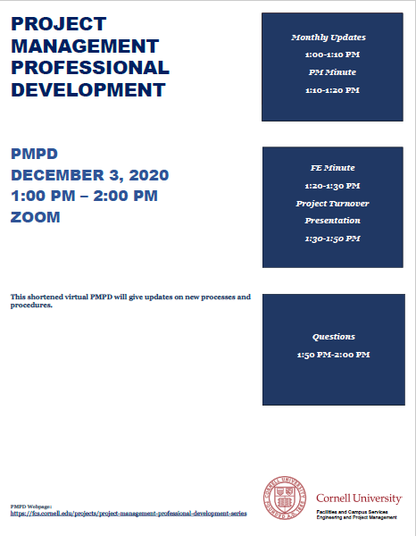
Today’s Agenda
Monthly Updates by Andrew Magré
Resources Page Revamp
Building Permit Process Reminder
Submittal Reminder
Fire Protection Shutdowns
PM Minute: Bid Cross Functional Group
Andrew Germain
FE Minute: Code Update on Fire Protection Standpipe Systems
Tom Jordan
Mike Niechwiadowicz
Project Turnover Presentation
Erik Eshelman
Paul Heliseva
Paul Stemkoski

Slide 4
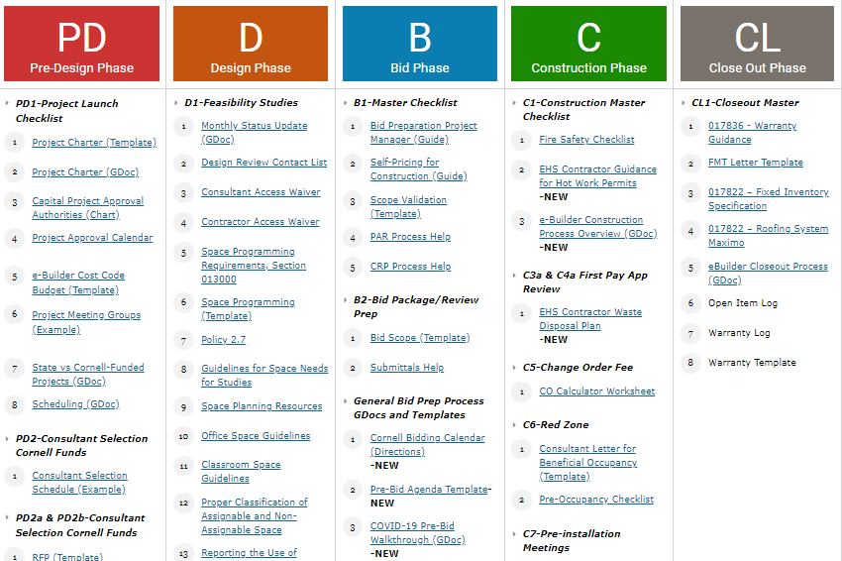
Update – PM Resources Page
New layout showcasing 96 Project Management Resource Documents and Templates.

Slide 5
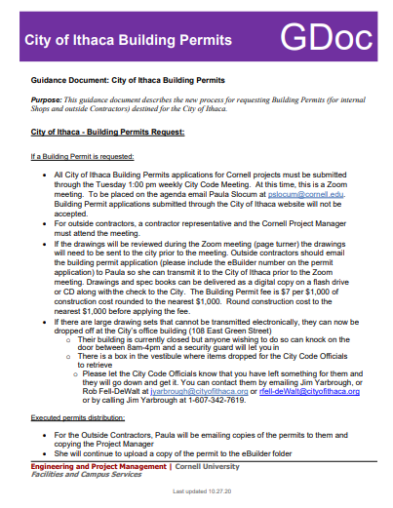
Reminder - Building Permit Process
All City of Ithaca Building Permits applications must be submitted through the Tuesday 1:00 pm weekly City Code Meeting (don’t use City online portal)
For projects with outside contractors, a Contractor Representative and CU PM must attend the Zoom meeting
Drawings, that will be reviewed during page turner, must be sent to City by Monday
Contact Paula Slocum if you have any questions: pms11 or 255-4504

Slide 6
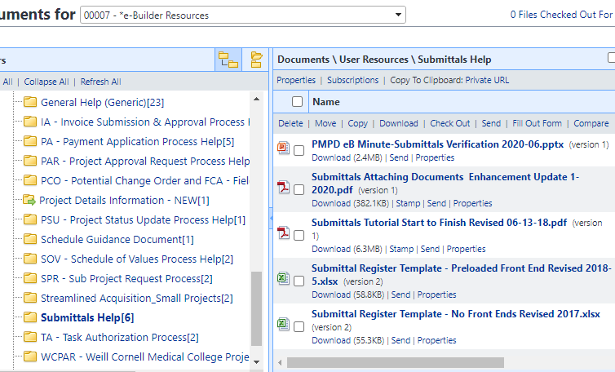
Reminder - Submittals
Please invite Kelly Davis to your construction kickoff meeting to provide Submittals training

Slide 7
Reminder - Holiday Break FP Shutdowns
For Fire Protection Shutdowns
Dec 24th through Dec 31st
Submit request to Customer Service by December 15, 2020
Notes:
That way Fire Protection and Emergency Services can review staffing levels and make sure they have staff available to accommodate these requests.

