Slide 1
Project Turnover Presentation “Red Zone”

Slide 2
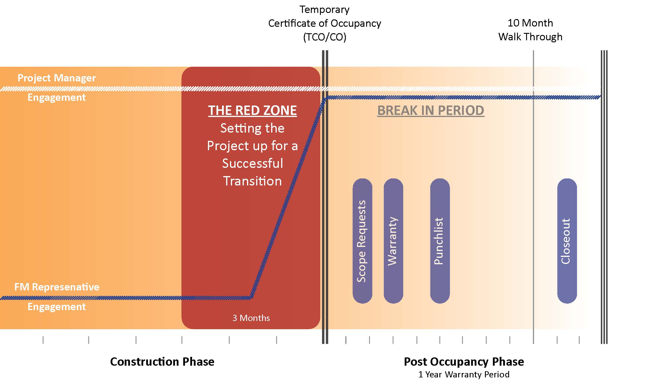
Project Turnover – Large Projects

Slide 3
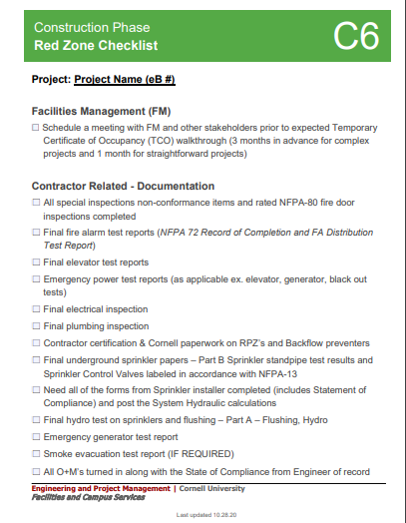
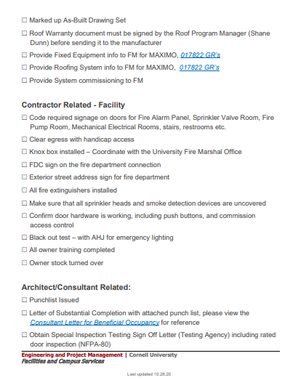
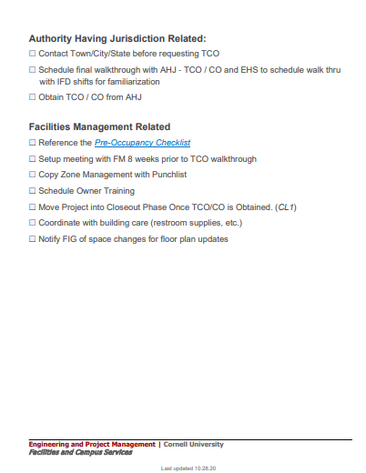
“The Red Zone” – Checklist
Free your mind, use the Checklist!

Slide 4
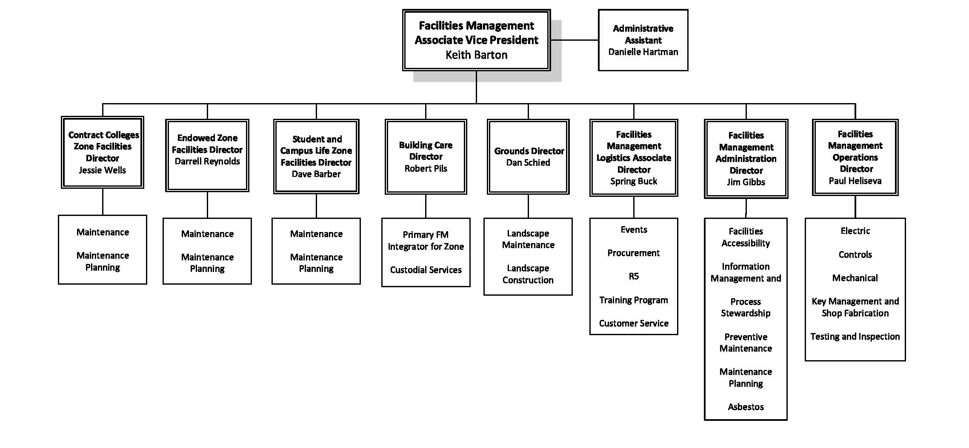
NCRE – FM Engagement
Dan Decker
SCL Zone Maintenance Planner

Slide 5
Quality Assurance Quality Control
For projects that exceed $250K Facilities Management will perform a chargeable QA/QC service which will include four phases:
Contract document review
Field inspections
Discrepancy documentation review
Training

Slide 6
Contract Documentation Review
Zone management will distribute contract documents and drawings to the appropriate area/asset teams for review.
The area/asset teams will review the drawings during the review period.
Zone management will collate the information and communicate the documentation to the PM/CM.

Slide 7
Field Inspections
Zone management will schedule and manage the weekly/bi-weekly inspections by ensuring that the appropriate trades are scheduled and attend the inspections:
Trades performing the inspections as determined by the Zone Facility Manager (ZFM) managing the trade:
Pipe – plumbing/heating Sheet metal
Insulation Electrical
Line crew Fire alarm/card access
Sprinkler Controls
Architecture hardware consulting
Roofing program manager.
Emergency power systems
The zone representative will document the discrepancies and email them to the project manager.

Slide 8
Discrepancy Documentation Review
Zone management will aggregate the discrepancy documentation developed by the inspection process and facilitate the resolution of the discrepancies with the project team
Zone management will attend a discrepancy meeting with the Cornell project and contractor project teams. The project manager will decide how the discrepancies will be resolved.

Slide 9
Training
Project Manager will prepare a list of trainings and schedule and coordinate with Zone management to identify the appropriate trades to attend the trainings.

Slide 10
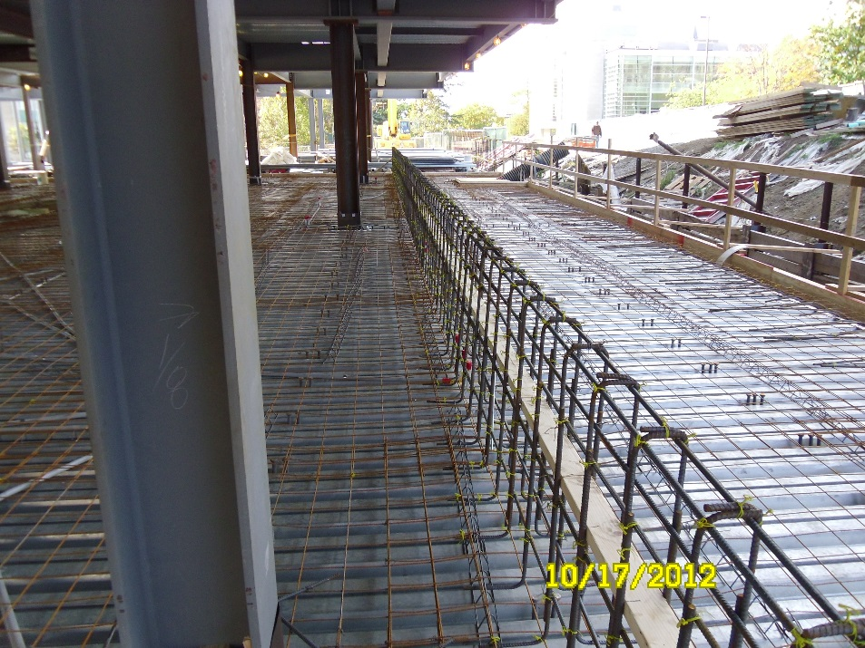
Project Support – Construction SME Support
-
Scope: FE SME’s available for review and response to project issues during construction
Contact: PM reach out to FE Section Managers
Duration: 2 - 4 hours per issue
Deliverable: email/memo as required
Notes:
Lessons learned

Slide 11
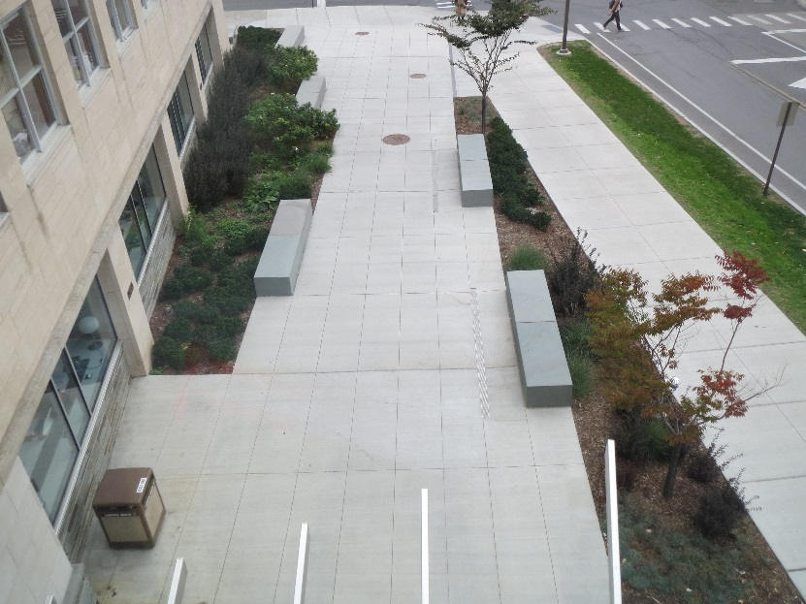
Project Support – 10 Month Warranty Walkthrough
Scope: Participation in 10 month warranty walkthrough
Contact: PM reach out to Casey Keech for scheduling
Duration: 2 - 4 hours per project
Deliverable: Coordinate comments with list developed by project team
Notes:
Lessons learned

Slide 12
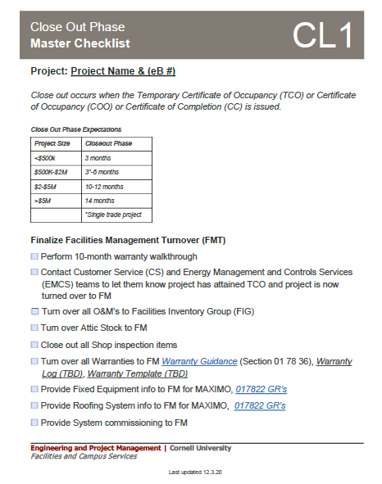
Project Support – 10 Month Warranty Walkthrough
Notes:
Lessons learned

Slide 13
Thank You
Questions?

