Slide 1
PM Minute

Slide 2
Bid Phase Cross-Functional Group
Mission Vision:
Leverage the expertise, perspectives, and experience of a cross functional group to develop improvements to the Bid Phase process at Cornell University;
Proactively Engaging the Contracting Community
Cornell Processes – Education & Training
Campus Wide Bidding Strategy

Slide 3
Bid Phase Cross-Functional Group
Focus Areas
Cornell Processes – Education & Training
Bid Document Front Ends
MWBE Update (Cornell Funded)
Proactively Engaging the Contracting Community
Contractor Database
Development of Bidder Shortlist

Slide 4
Cornell Processes – Education & Training
Bid Document Fronts End Review
How many Sections are there in the Front-End Electronic Documents?
Can you name them?
Hint PM Checklist B2 & B3
Please respond in the Chat…

Slide 5
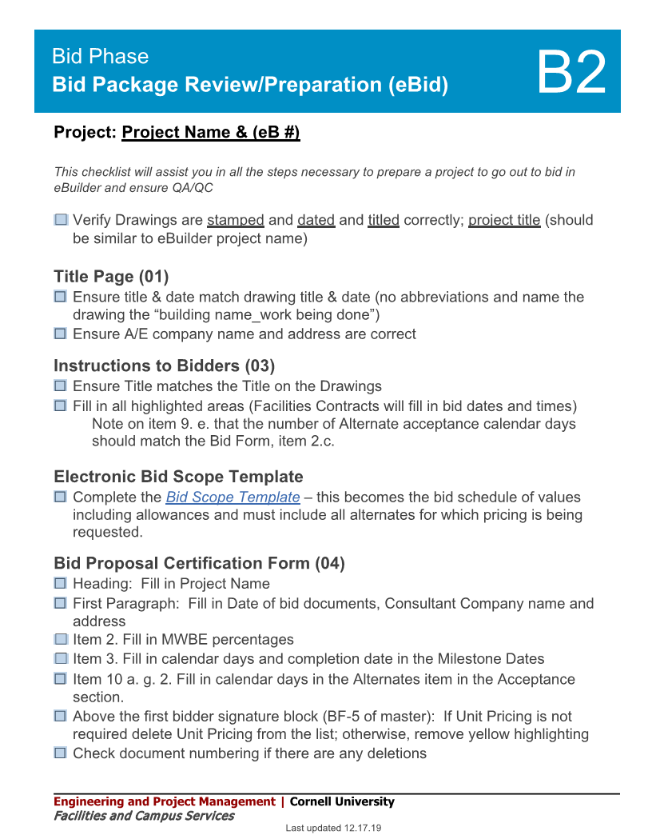
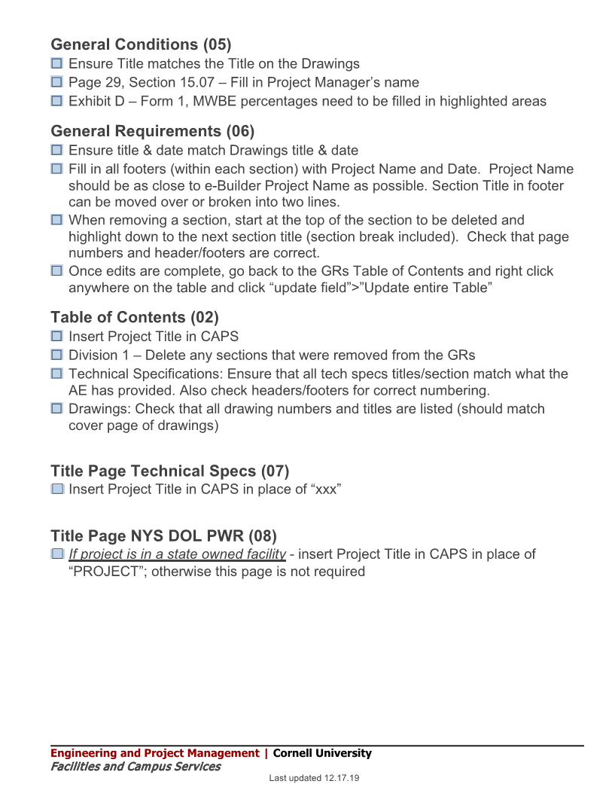
Cornell Processes – Education & Training
Free your mind, use the Checklist!

Slide 6
Cornell Processes – Education & Training
Bid Document Fronts End Review
Reviewed Sections (01) – (05)
Starting Review of (06) GR’s
The team looked for old or dated information within the documents.
Found & Updated…
Inconsistencies within (05) GC’s
Broken Hyperlinks,
Dated References,
Deleted Articles, or missing forms
Team Lead: Deb Melanson
Supported by Jessie Dimick , Ruth Howell, Randy Nesbitt
Notes:
Q/A by Jessie and her team is going very well of the completed Bid Documents. (B2)
Recently we had a project out to bid two days after it was issued to the Contracts office! That is progress!
01 – 05 edits / Updates have been shared with Facilities Contacts Office.
Please expect the role out of new documents from the Contracts Office in January 2021.
Stored Materials Invoicing Documentation was one form that was identified.

Slide 7
Cornell Processes – Education & Training
Current Initiatives:
MWBE Update: Cornell Funded Projects
CCF & Facilities Contracts Office are working with the University Counsel's Office to draft revised contract language requirements.
Labor Rate Audit:
Development of a Guidance Document
What goes into a labor rate
Development of a labor rate database; and standardize its use.
Notes:
MWBE – updates
Brenda/Keith are on the home stretch expect language to be included in next iteration of Contract documents. So MWBE Percentages requirement won’t be required for Endowed projects.
Jessie shared the proposed content for the contract with the team.

Slide 8
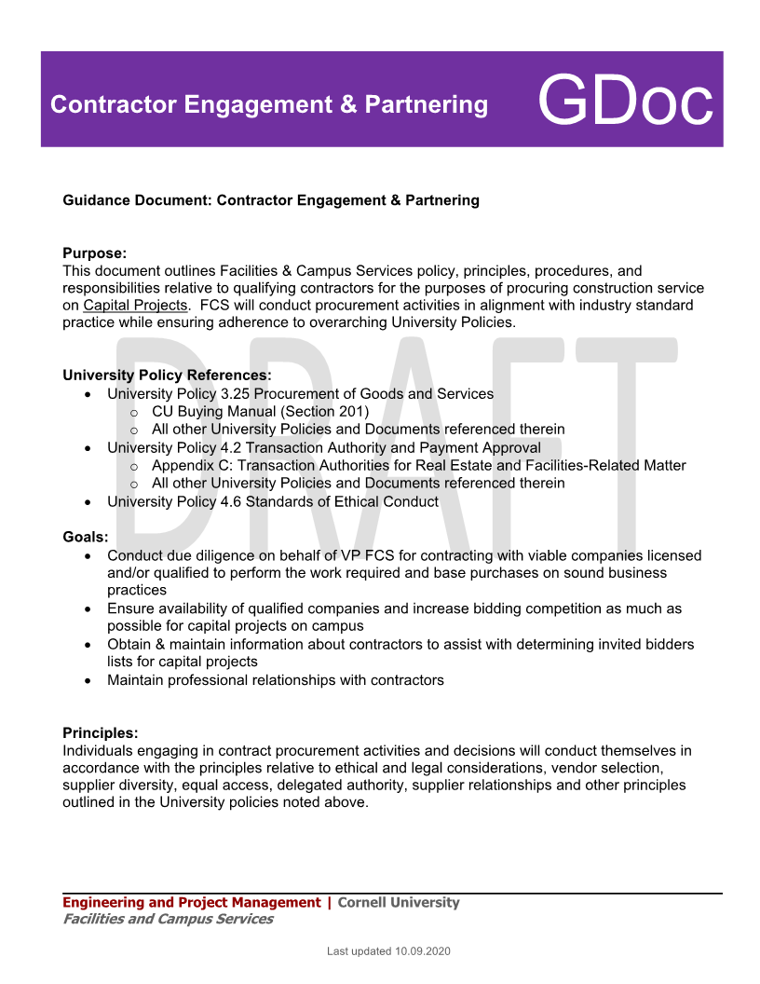
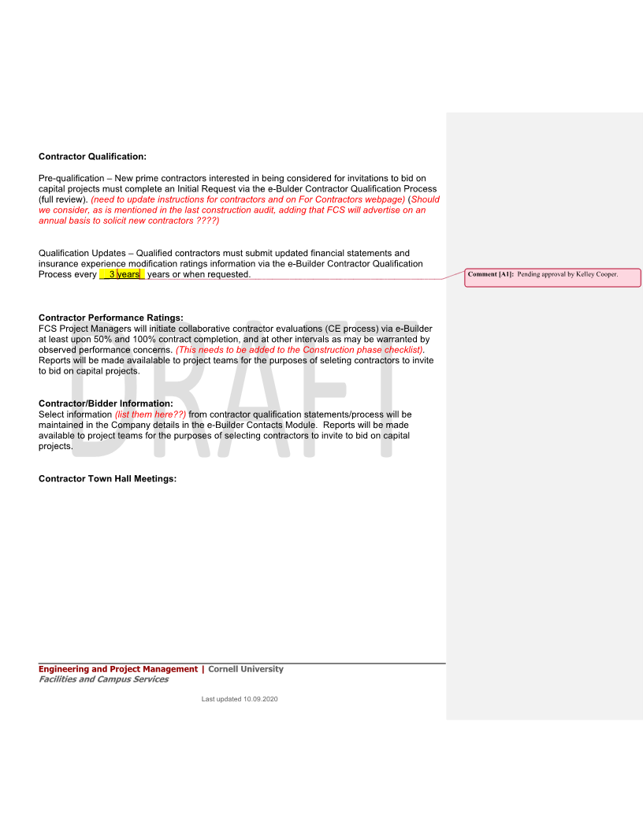
Proactively Engaging the Contracting Community
Current Initiatives:
Contractor Engagement and Partnering GDoc
Contractor Qualification Process
Contractor Evaluation Process
Contacts Module (Bidder Information)
Bid Short List Selection Process
Contractor Town Hall (Virtual)
Team Lead: Donna Sutliff
Supported by Gregg Crossett, Kelly Davis, Andrew Germain
Notes:
Initiative Started with how do I get on the “List”
Quickly during the discussion we realized that we collectively were talking about two different lists
The Qualified Contactor List
The “Bidder Short List” for a project.

Slide 9
Bid Phase Cross-Functional Group
Please share your thoughts and ideas!
These initiatives were developed from brainstorming sessions within the group to improve the Bid Phase Process.
We are always looking for more…
Want to join the Team?
We have set up a collaborative working space using MS Teams , and are always looking for support.
Looking for different initiatives or wrinkles in the Bid Phase that we can improve upon.
Group meets every three weeks
Next Session: (December 10, 2020; 9:00 MS Teams)
Notes:
Memo – Signed Back in January 2020
- Planned Maintenance Projects will utilize a pooled contingency

