Slide 1
FE Minute

Slide 2
Retroactive Standpipe Installation Requirement
Fire Code Chapter 11 Construction Requirements for Existing Buildings
1101.1 Scope The provisions of this chapter shall apply to existing buildings and structures constructed prior to the adoption of this code. Sections 1103, 1105, and 1106 shall apply to existing buildings and structures undergoing construction and only to the extent as required by other sections of this code, the 2015 EBCNY, or the 2015 BCNY. Means of egress in existing buildings and structures shall comply with the minimum egress requirements of Section 1104.
CONSTRUCTION TRIGGERS Alteration Level 1
Alteration Level 2
Alteration Level 3

Slide 3
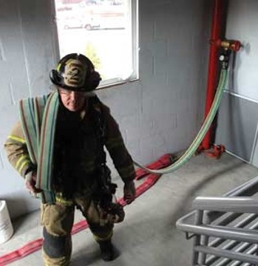
Retroactive Standpipe Installation Requirement
Fire Code Chapter 11 Construction Requirements for Existing Buildings
1103.6 Standpipes Existing structures shall be equipped with standpipes installed in accordance with Section 905 where required in Sections 1103.6.1 and 1103.6.2 The fire code official is authorized to approve the installation of manual standpipe systems to achieve compliance with this section where the responding fire department is capable of providing the required hose flow at the highest standpipe outlet.

Slide 4
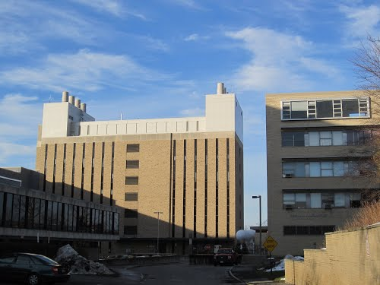
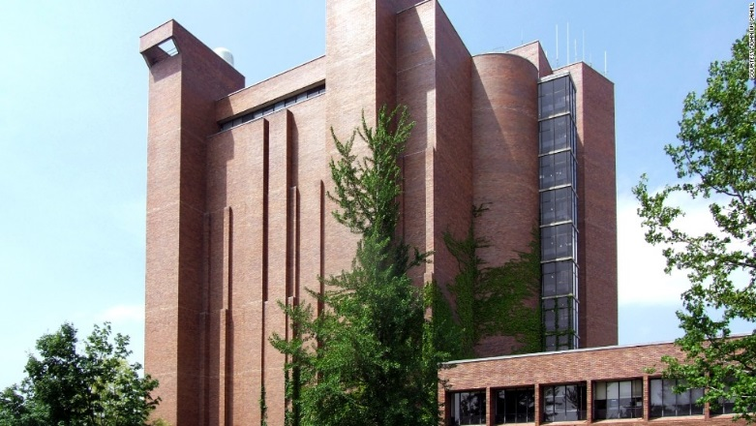
Retroactive Standpipe Installation Requirement
Fire Code Chapter 11 Construction Requirements for Existing Buildings
1103.6.1 Existing Multiple-Story Buildings Existing buildings with occupied floors located more than 50 feet (15 240 mm) above the lowest level of fire department access or more than 50 feet (15 240 mm) below the highest level of fire department access shall be equipped with standpipes.

Slide 5
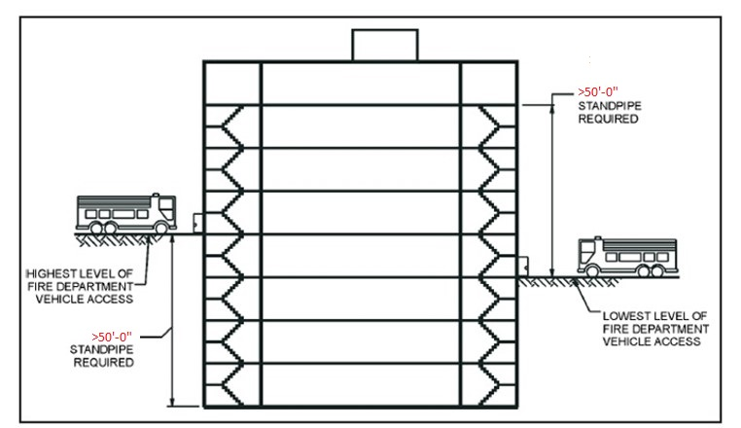
Retroactive Standpipe Installation Requirement
1103.6.1 Existing Multiple-Story Buildings

Slide 6
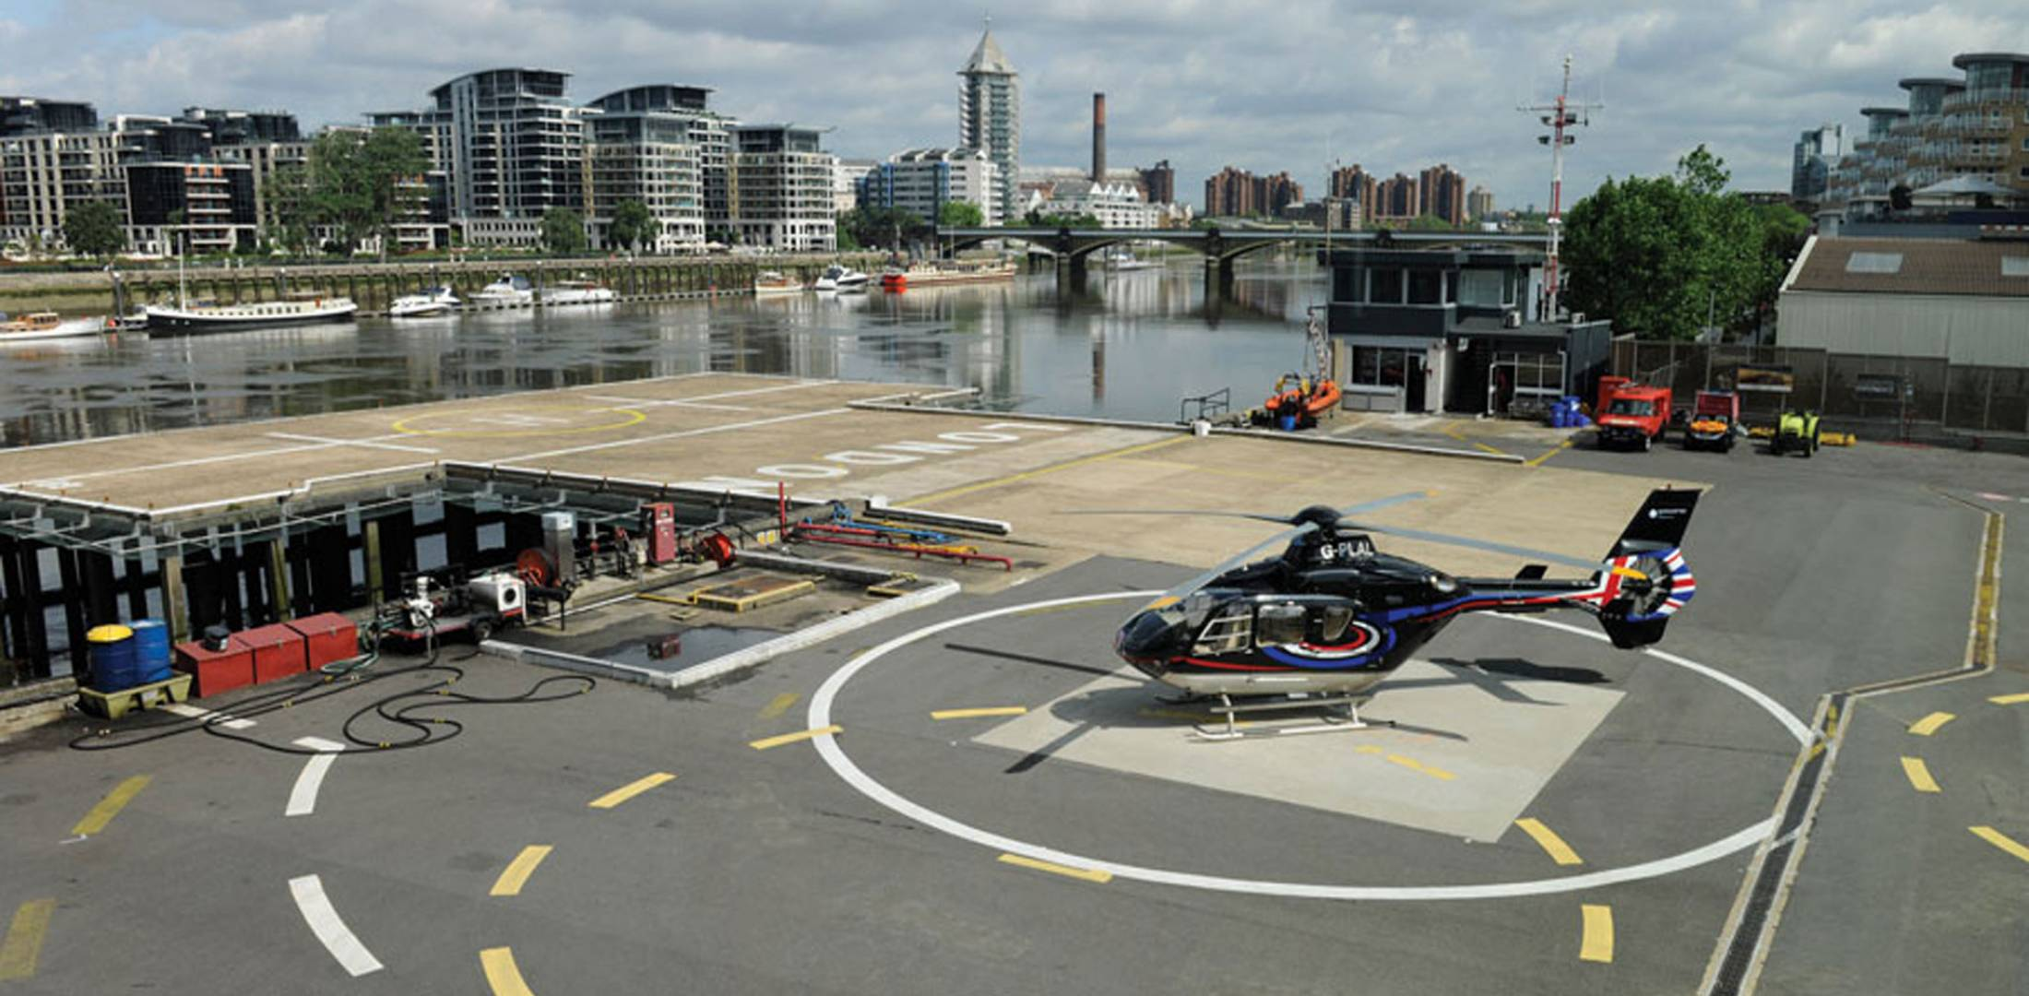
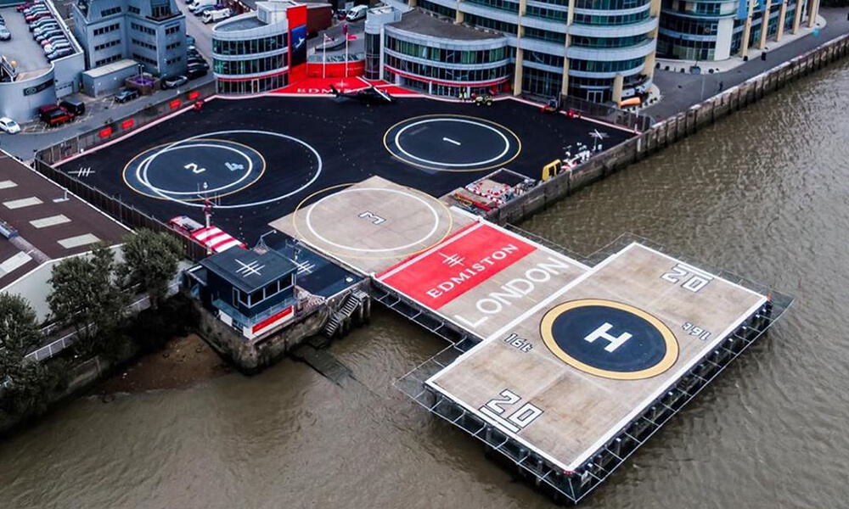
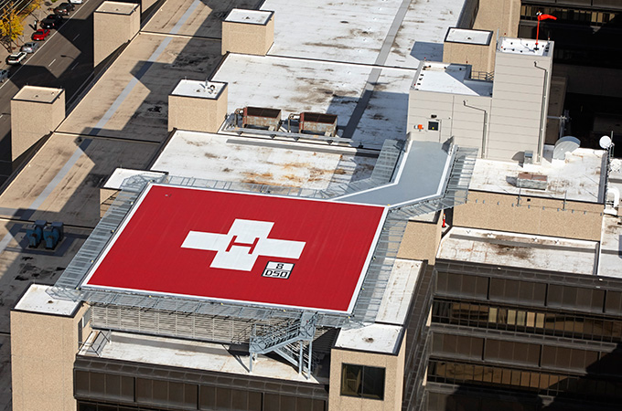
Retroactive Standpipe Installation Requirement
1103.6.2 Existing Helistops and Heliports Does not Apply at CU

Slide 7
Retroactive Standpipe Installation Requirement
Existing Buildings Over 50 feet without standpipes:
Willard Straight
McGraw
The Good News is CU doesn’t have too many buildings like this.
A forthcoming FE evaluation will confirm.
Phew….

