Slide 1
Project Management – Professional Development Series
Facilities and Campus Services Engineering and Project Management
December 3, 2020

Slide 2
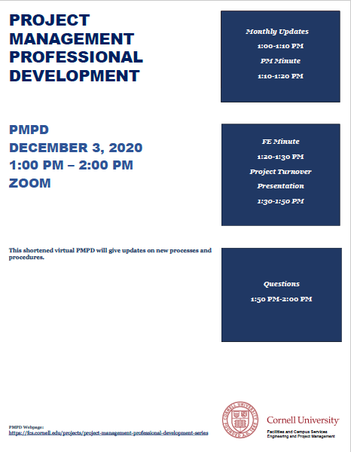
Today’s Agenda
Monthly Updates by Andrew Magré
Resources Page Revamp
Building Permit Process Reminder
Submittal Reminder
Fire Protection Shutdowns
PM Minute: Bid Cross Functional Group
Andrew Germain
FE Minute: Code Update on Fire Protection Standpipe Systems
Tom Jordan
Mike Niechwiadowicz
Project Turnover Presentation
Erik Eshelman
Paul Heliseva
Paul Stemkoski

