Slide 1
Today’s Agenda
Introduction – Andrew Magre
Virtual Walkthroughs
Quarterly Construction Report
Bidding Calendar
Facilities Contracts Office Hours
FE Minute: Ceiling Standard
Matthew Reiter
Access Control Presentation
Peggy Matta
Timothy Petriwsky
Adam Manke
Lisa Clark
Breakout Session
Brad Newhouse

Slide 2
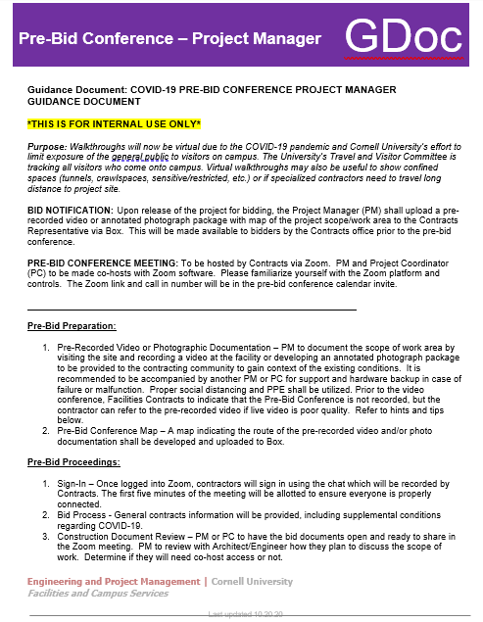
Virtual Pre-Bid Walkthroughs
***All pre-bid walkthroughs are now virtual***
Due to the COVID-19 pandemic and Cornell University’s effort to limit exposure of the general public to visitors on campus.
Work closely with the A/E team to pull the virtual walkthrough materials together
Checkout the GDoc on E&PM Resources page for more tips
GDocs are for internal use only
Notes:
Exceptions – process – Travel and Visitors committee
All walkthroughs including self pricing
Criteria is venders who are not under contract

Slide 3
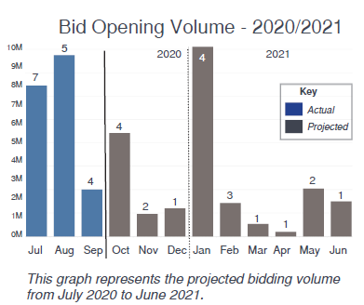
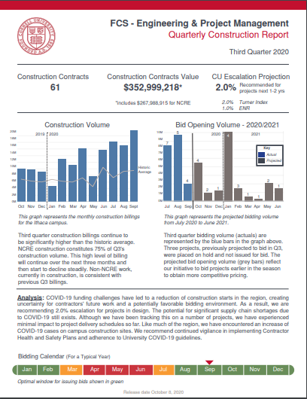
Q3 Construction Report
You can find the Q3 report on the E&PM website

Slide 4
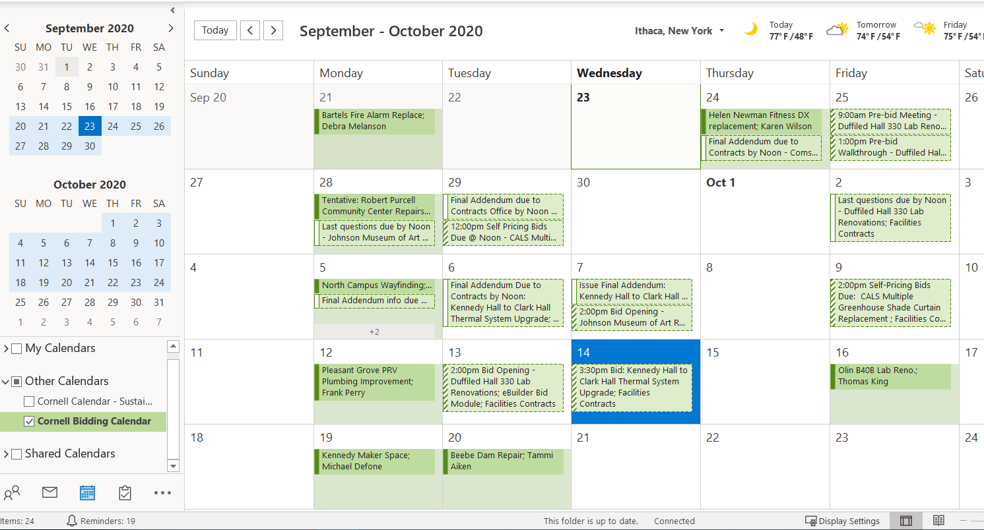
Cornell Bidding Calendar & Monthly Bidding Meeting
Search for “Cornell Bidding Calendar” in Outlook
eBuilder Dates (schedule Module)
Docs Submitted to Contracts
Facilities Contracts Actual Dates
Bid Invite
Pre- Bid walk through
Last day for questions
Addendum
Bid opening
Monthly Bidding Review Meetings
Strategize Bid timing
Workload leveling

Slide 5
Facilities Contracts Customer Service Hours
FC is using Microsoft Teams – provide a “virtual” office visit
Between the hours of 8-11am and 1-3pm you can IM one of us to see if we are available – note, use the colored icon to see if we are busy or not
FC will reply:
We are busy and will get back to you in x minutes or at X time
We will call you in a minute – this allows to share screens, etc.

