Slide 1
Special Ceiling Systems Update
CU Standard 095400
Facilities Engineering
Ithaca, NY
272133
Notes:
IntroductionSpecialty ceilings include interior open metal mesh ceilings, linear metal ceilings, linear wood “grille” ceilings, decorative “cloud” wood panel ceilings with concealed fasteners, custom wood ceilings and channeled plank ceilings. Suspended or specialty ceilings systems are typically heavier than standard acoustical tile ceilings and require additional considerations due to the risk to the public and consequences of failure of an attachment. The intent of the standard is to establish a higher standard of care for detailing and securing ceiling system to the structure.

Slide 2
CU Design Standard 095400 - Scope
Interior open metal mesh ceilings,
Linear metal ceilings
Linear wood “grille” ceilings
Decorative “cloud” wood panel ceilings
Custom wood ceilings
Channeled plank ceilings
Notes:
Product requirements, materials, execution, installtion

Slide 3
CU Design Standard 095400 - Goals
Quality
Access/maintenance
Demounting/reinstallation
Higher standard of care detailing/installation
Notes:
Product requirements, materials, execution, installtion

Slide 4
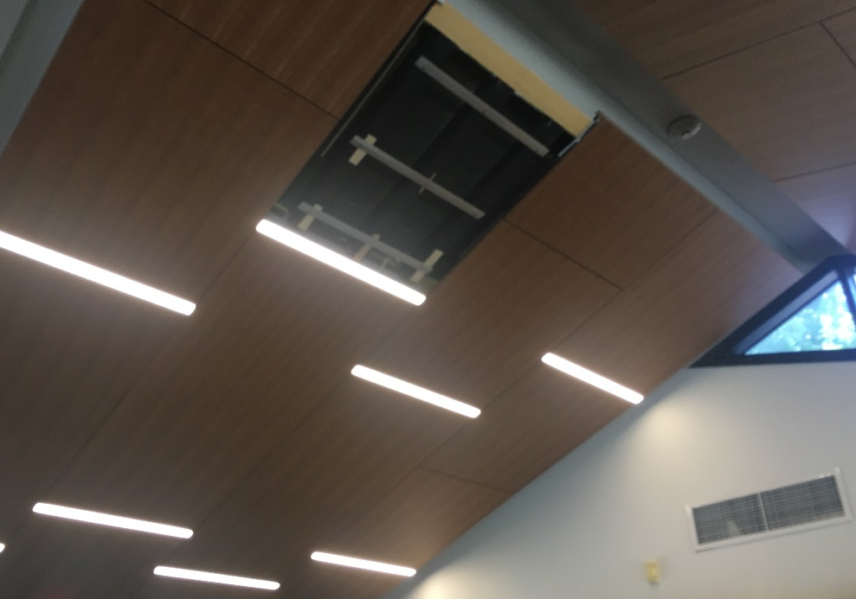
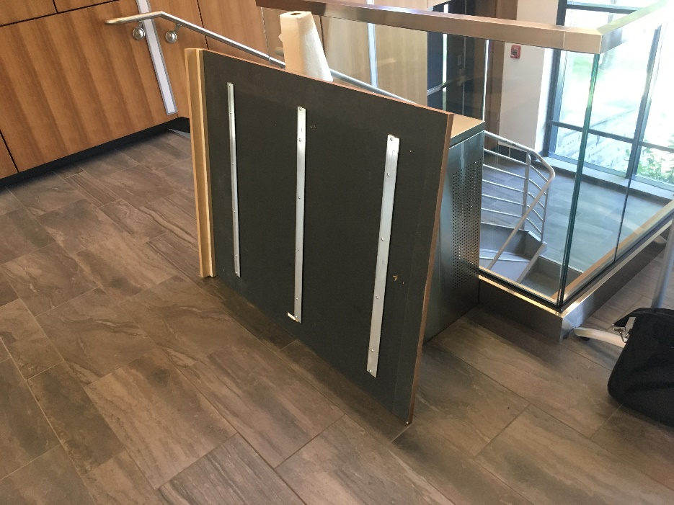
Noyes Lodge – Welcome Center
Z Clips

Slide 5
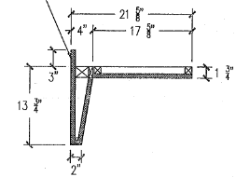
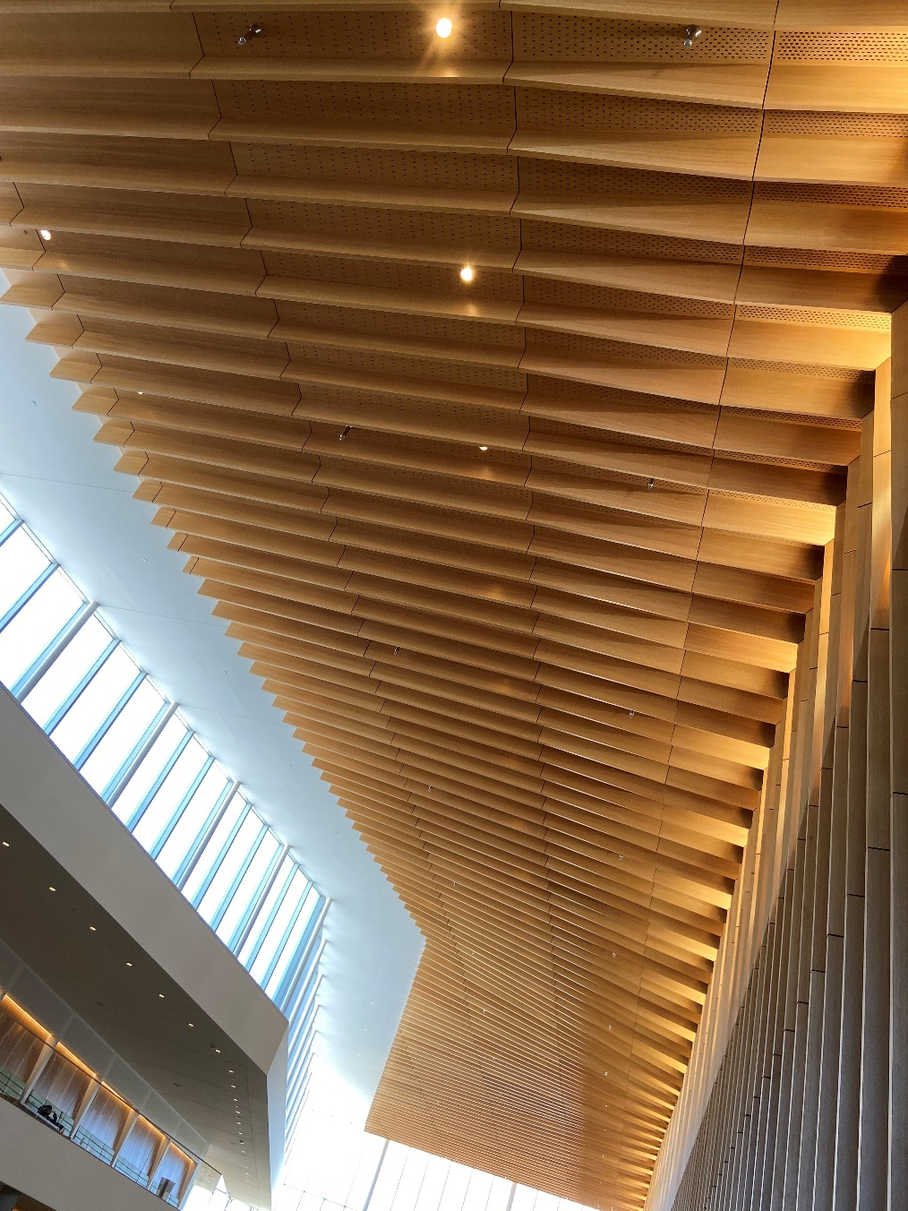
VMC Class Expansion – Atrium Ceiling
ZCLIP
SCREWS

Slide 6
CU Design Standard 095400 Updates
Components, supports, and attachments shall be designed by a licensed engineer in accordance with ASCE 7
Specialty ceilings shall include positive attachment to the suspension system; Z-clip without mechanical fasteners are not permitted.
Specialty ceilings and their attachments shall be included in the Statement of Special Inspections provided by the Structural Engineer.
Notes:
Industry Standard Construction for Acoustical Tile or Lay-in Panel Ceilings, Seismic Design Categories D through F

Slide 7
Thank you
272133
Notes:
Introduction

