Slide 1
eB Minute
September 2020

Slide 2
Reports Tab in Processes
When you have filtered for a specific type of process within a project, there is a reports tab available
Click on the Report tab
Click on the report name, depending on report configuration, the report generated will be for the project you are in.

Slide 3
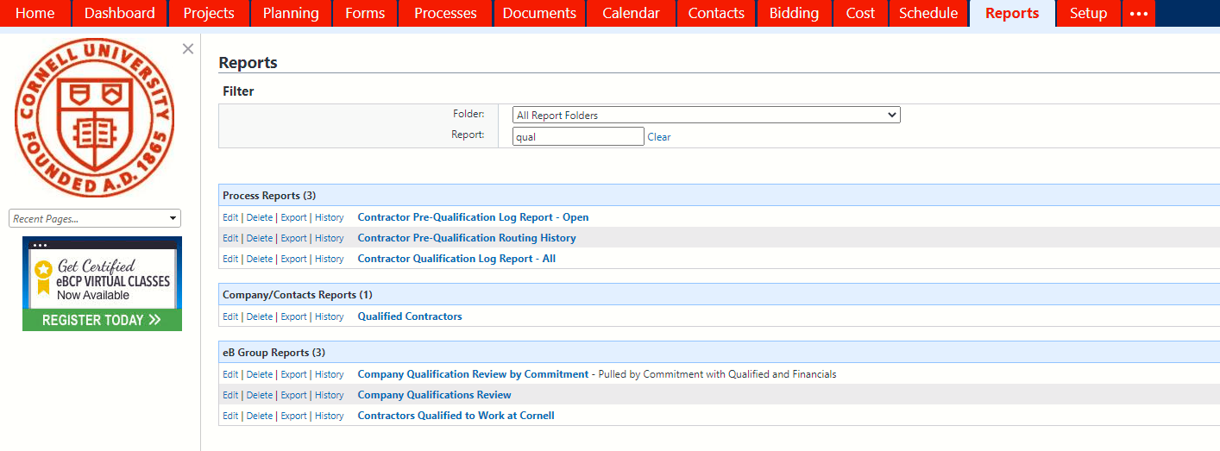
Qualified Contractors Report
We have made some reports available to the project teams to assist with determining which bidders to potentially invite.
Qualified Contractors report, click on Reports tab, search for “qual” which will display the Qualified Contractors report.

Slide 4
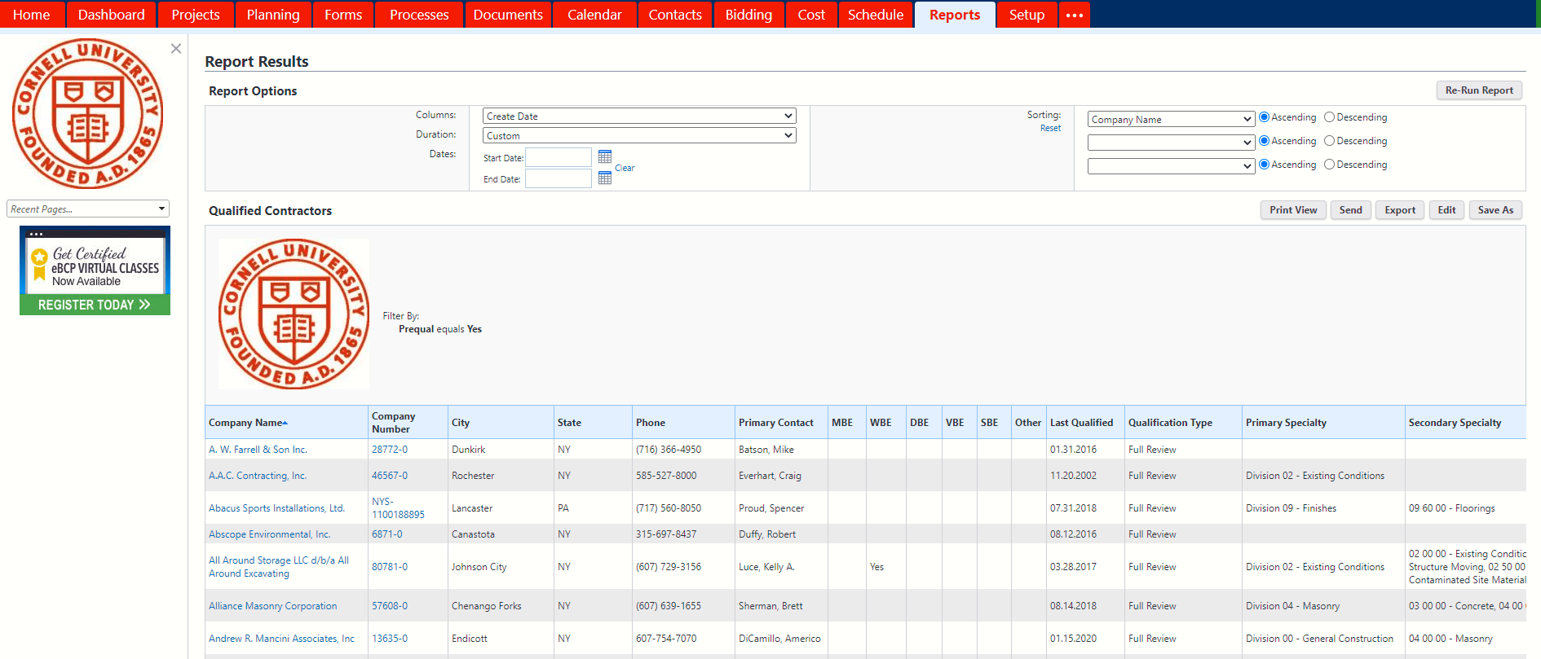
Qualified Contractors Report
This report has the Primary and Secondary Specialty for each company that is Prequalified along with the date of the most recent qualification review.

Slide 5
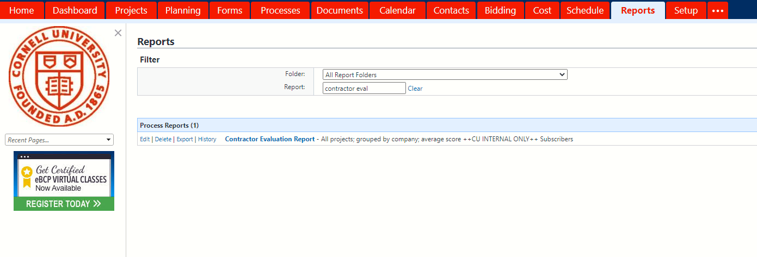
Contractor Evaluation Report
Contractor Evaluation Report, click on Reports tab, search for “evaluation” which will display the report.

Slide 6
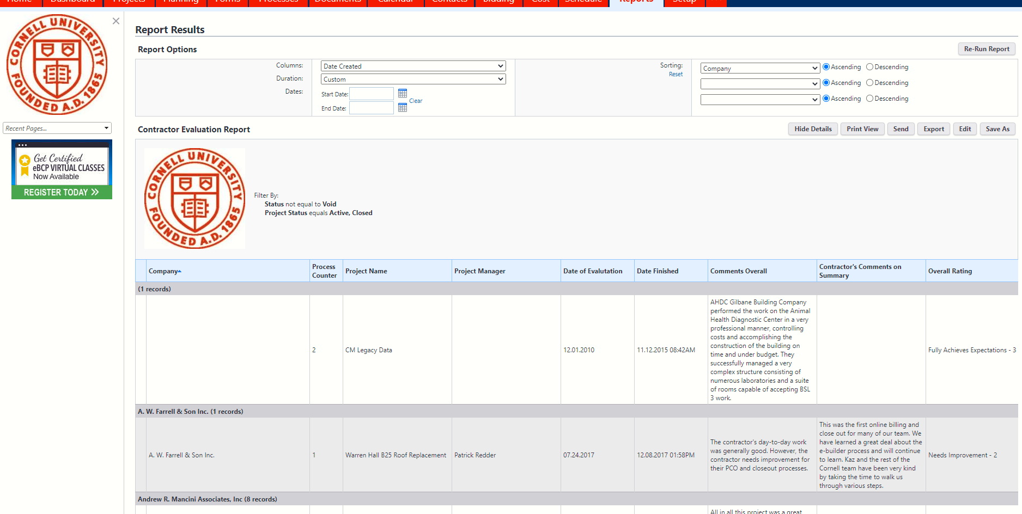
Contractor Evaluation Report
Roles with permissions can view all completed evaluations for each contractor.

Slide 7
Questions?

