Slide 1
*As you sign on, please send your net ID to Paula Slocum via a private chat so she can mark you as attended

Slide 2
Project Management – Professional Development Series
Facilities and Campus Services Engineering and Project Management
September 24, 2020

Slide 3
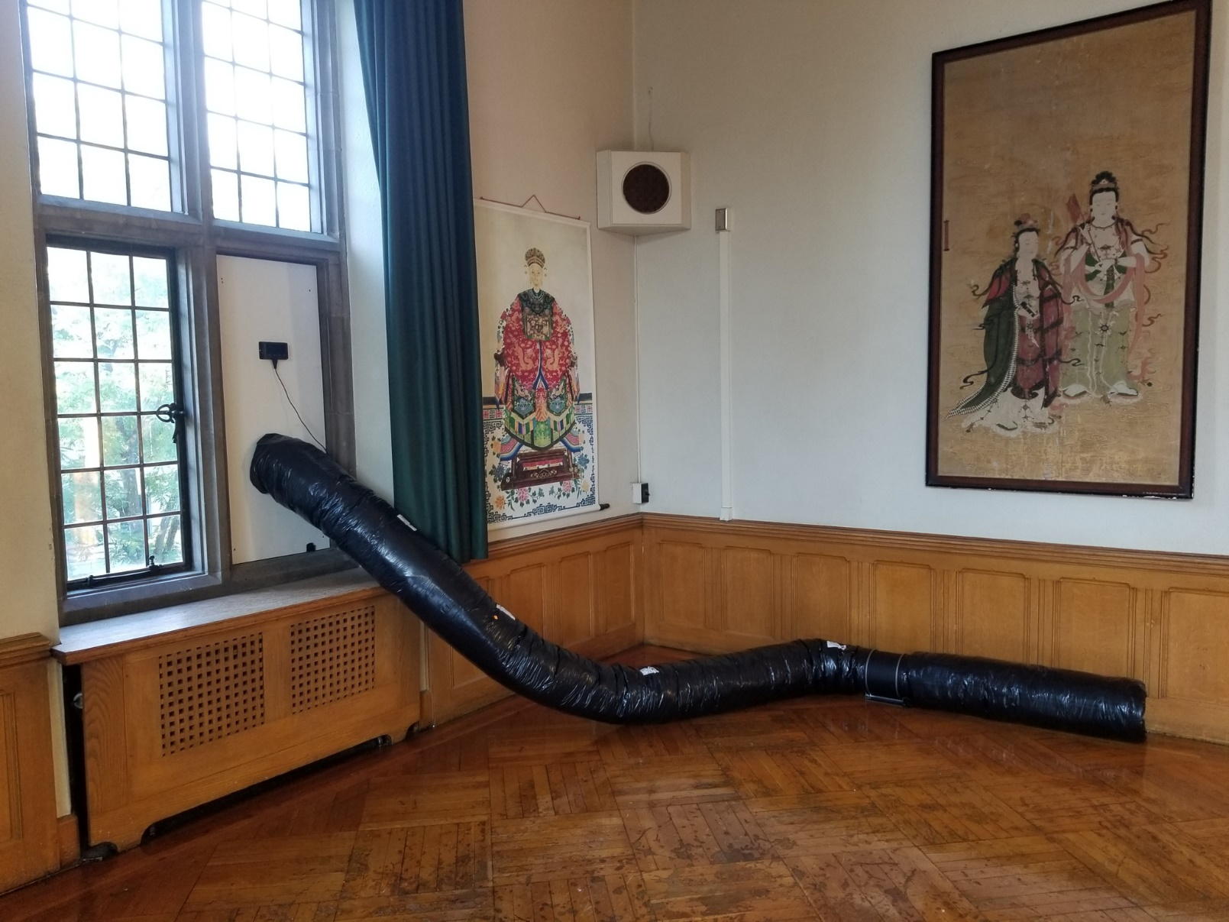
Willard Straight 414
FE Minute: Temporary Ventilation

Slide 4
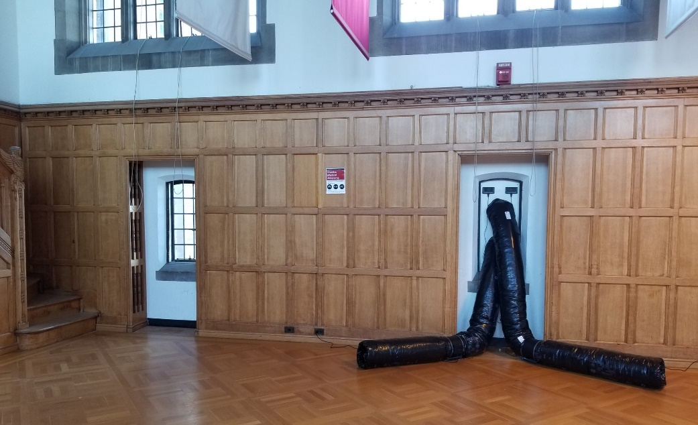
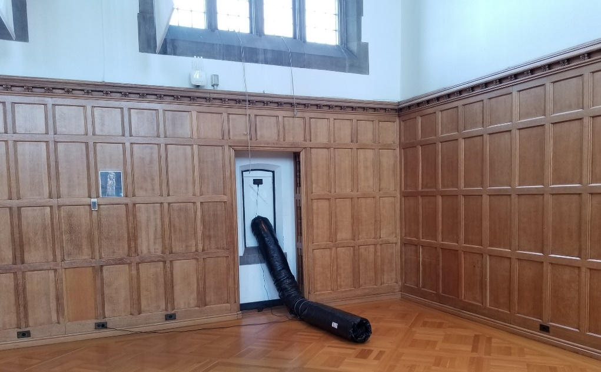
Willard Straight Memorial Room
FE Minute: Temporary Ventilation
Project Overview
Project Manager - Elisabete Godden
Designers – Steve Beyer and Scott Burke
Construction Manager – Pat Conrad
Schedule
20 days from project introduction to final delivery
Scope
Installation of temporary ventilation systems and
related equipment at various spaces for use during
the COVID Pandemic to increase air flow
(in classrooms without mechanical ventilation)
Budget
$100,000~
4

Slide 5
FE Minute: Temporary Ventilation
Contract
Stand Alone Contract for T&M with W L Klein
Goals
30 min. max PM response time to campus partners and team members
24 hrs notice to building occupants of access requirements to their facilities
Committed to 50 spaces designed and installed in 20 days
Execution
Daily core team check in and constant communication with contractors
Daily status updates to Stakeholders team with succinct information
Number of spaces flagged for ventilation on OUR (central registrar)
Number of spaces designed
Number of spaces installed
Number of working days left to fall classes 2020
5

Slide 6
FE Minute: Temporary Ventilation
Risks and Challenges
List of classrooms needing temporary ventilation was not yet complete
Had to help campus partners determine where mechanical ventilation was not available or not functioning
Class list was a moving target, some spaces were still not laid out for COVID Occupancy for design calculations
Setting up the entire project in 24hrs (PIR, eBuilder, Self-Pricing Invitation to Bid, and Contract) so materials could be ordered ASAP
Quick decisions about ordering materials prior to number of spaces known or design complete
Hire contractor and order materials prior to design documents due to potential equipment shortages and delays in delivery
Accessing spaces during a pandemic on short notice
6

Slide 7
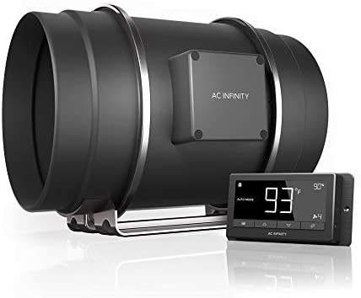
FE Minute: Temporary Ventilation
System Design Concept
Design consisted of inline fans, window panels, window vents, insulated flexible ductwork and fan speed controllers
Met NYS Mechanical Code minimum (ASHRAE 62.1)
Maintained building pressurization
Intake and Exhaust Vent locations carefully considered
Supply air to front of classroom where possible
Install timers to reduce energy use when ventilation is not needed

Slide 8
Plant Sciences G22
FE Minute: Temporary Ventilation
Design Diagram Example

Slide 9
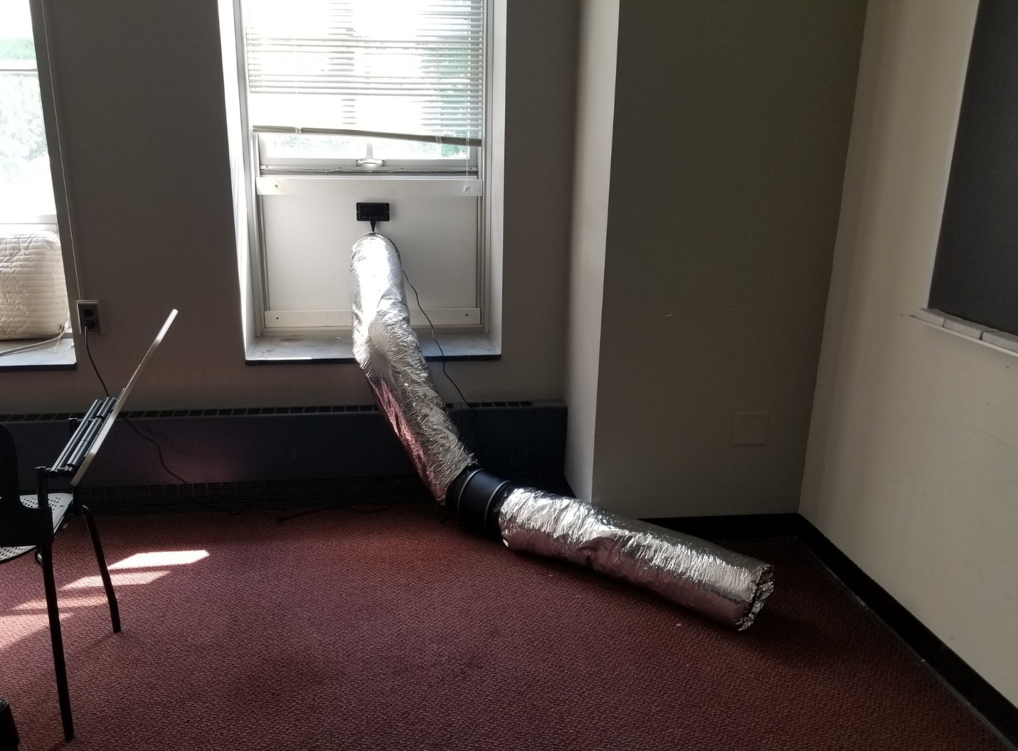
FE Minute: Temporary Ventilation
Typical Installation Example (Interior)
CONTROLLER
FAN
Morill 111

Slide 10
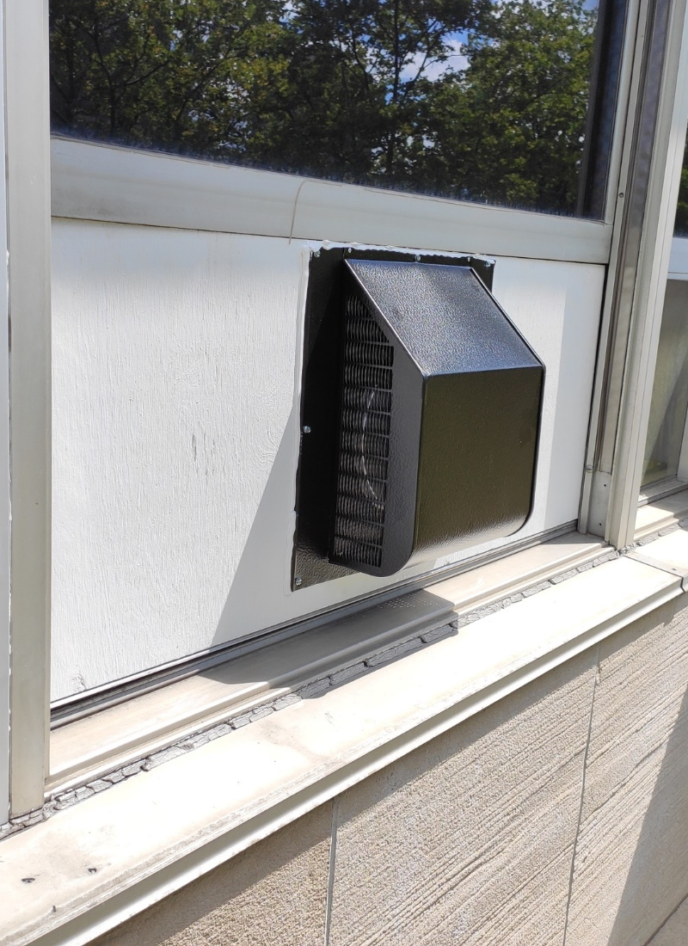
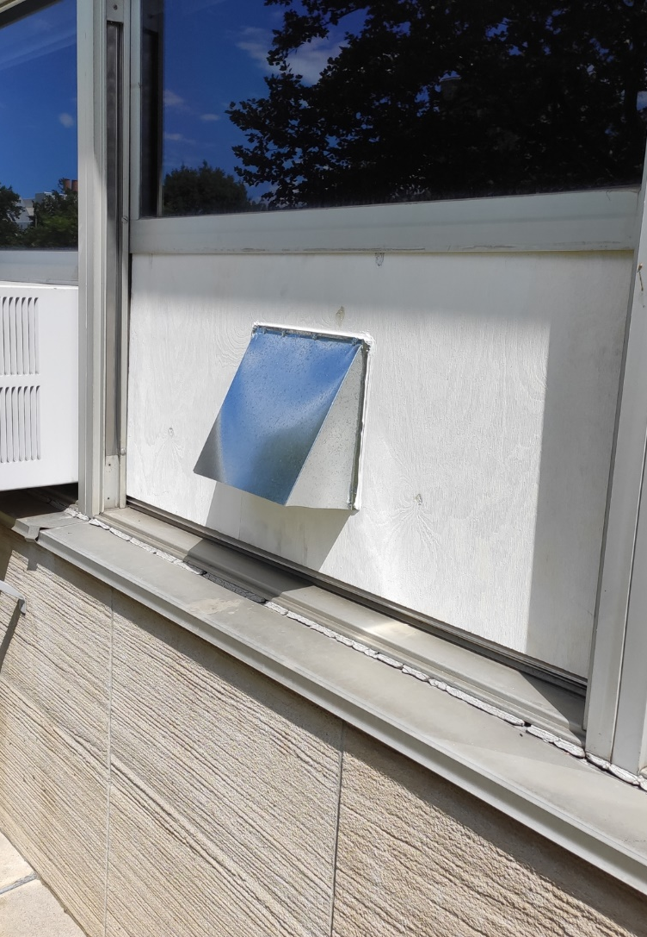
Hollister Hall
FE Minute: Temporary Ventilation
Typical Installation Example (Exterior)
INTAKE VENT
EXHAUST VENT

Slide 11
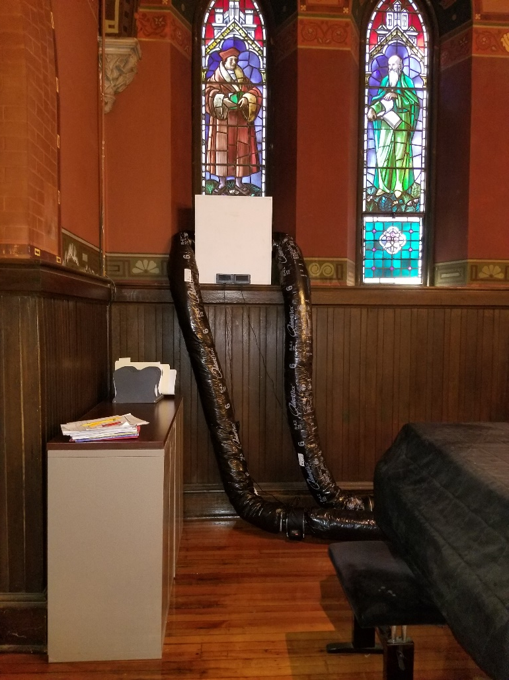
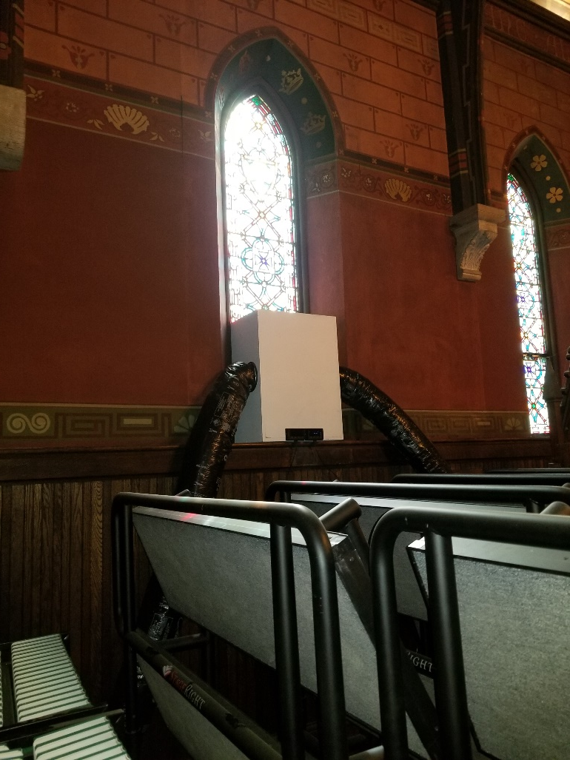
Sage Chapel
FE Minute: Temporary Ventilation
Unusual Installation Example
Notes:
Exhaust Plenum Box Thank Steve Beyers

Slide 12
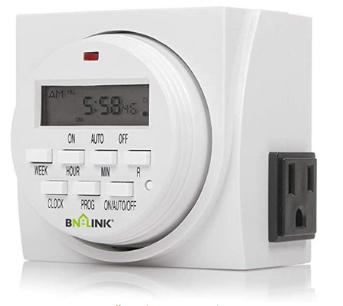
FE Minute: Temporary Ventilation
Lessons Learned, Successes and Outcomes
Timers in fan controller were not reoccurring
Its best to determine and test controls upfront
Timely and clear communication is key
Challenges need to be addressed ASAP
Making decisions based on best-practices is ok
Think ahead and prepare for plan b, c, d…
Surplus materials can be used for replacements
When given the opportunity exceed expectations:
This contract is also helping SCL install temporary ventilation at an additional 160 spaces
Notes:
Thanks John Bell and Erich Riecard

Slide 13
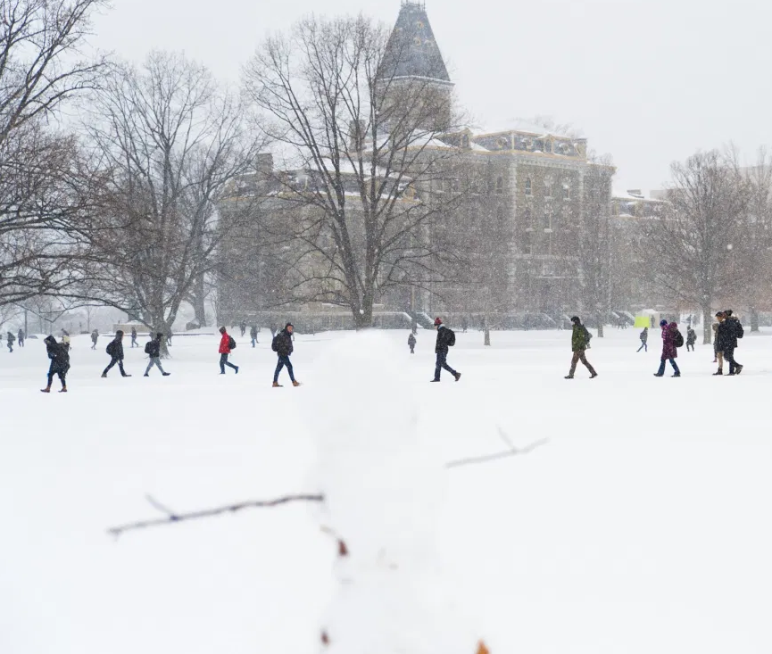
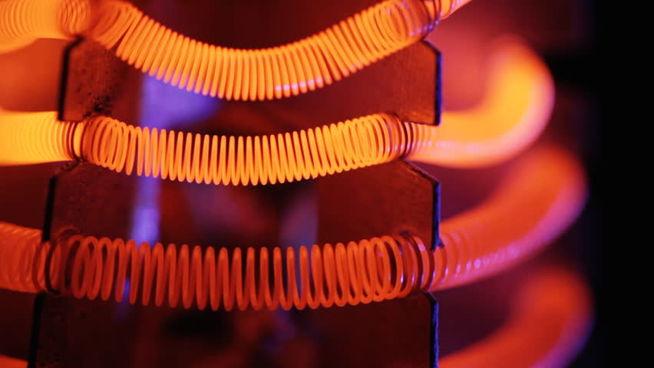
FE Minute: Temporary Ventilation
Next Steps, Looking Ahead
Prepare for cold season and brainstorm air tempering with campus partners
Consider various solutions for different spaces and uses
Test installs in SCL lounge spaces that are used 24/7
Notes:
Thank Vince and Mechanical Team Thank Erich Eschellman

Slide 14
Thank You
Questions?

