Slide 2
OUA Minute

Slide 3
COVID Impacts- Instructional Space Capacity and Layout Initiative
Design Team
Margaret Carney
J. Shermeta
Jeanne Boodley-Buchannan
Zac Stevenson
Data Management
Lisa Ciaschi
Furniture Logistics
Leslie Schill

Slide 4
Original Scope
1. Establish Guidelines for determining maximum allowable seating capacities within proposed list of spaces to inform Fall ‘20 scheduling.
Use NYState guidelines for physical distancing
-Minimum of 6’-0” apart
-Max 50 person gatherings
2. Lead a process of creating seating plans to confirm calculated estimates, working with UFD’s.
Engage Units to develop seating plans
Provide guidelines, templates, examples, and consultation
3. Review plans for compliance with guidelines and upload to 25Live for use by OUR and Faculty.
4

Slide 5
Completed Scope
Task | Description | Status | Notes
Seating Plan Guidelines | Develop specific guidelines for physical distancing to be used in various types of instructional spaces |  | Completed 7/9
Communications Process | Establish process to assist Units in development of plans based on available technology and capability |  | Established
Seating Examples | Develop examples of seat spacing guidelines applied to 40-50 instructional spaces of various types; create and distribute CAD and PDF templates of various generic seating plans to assist in production of plans |  | Completed 7/31
Create COVID seating plans for OUR list of 600 potential instructional spaces and others from list of 3200 | Review and finalize capacity plans from OUA team and Units as they are completed; uploaded to 25Live, including centrally and locally scheduled spaces |  | Complete 8/14
Preliminary Ventilation Assessment and Resolution of Centrally Scheduled spaces from 600 list (C-1) | Work with Steve Beyers, FE, and Units to complete assessment and documentation of ventilation status for all 600 spaces on OUR list. Identify spaces that can be resolved. Send to OUR COB |  | Complete 8/31
Preliminary Ventilation Assessment and Resolution of locally scheduled spaces and special requests | Work with Steve Beyers, FE, Units to complete assessment & documentation of ventilation status for additional spaces from OUR and Units |  | Complete 8/31
Develop Classroom Cleaning Plan | Work with Bob Pils and OUR to integrate cleaning into class schedule; conduct time trials to inform plan |  | Complete
Establish procedures/guidelines for excess furniture moves and storage: Assist with Implementation. | Work with Units to identify available resources and needs for each unit to manage furniture movements created by classroom strategy. Establish clear procedure as needed to assist, support, implement. |  | Complete: Monitoring

Slide 6
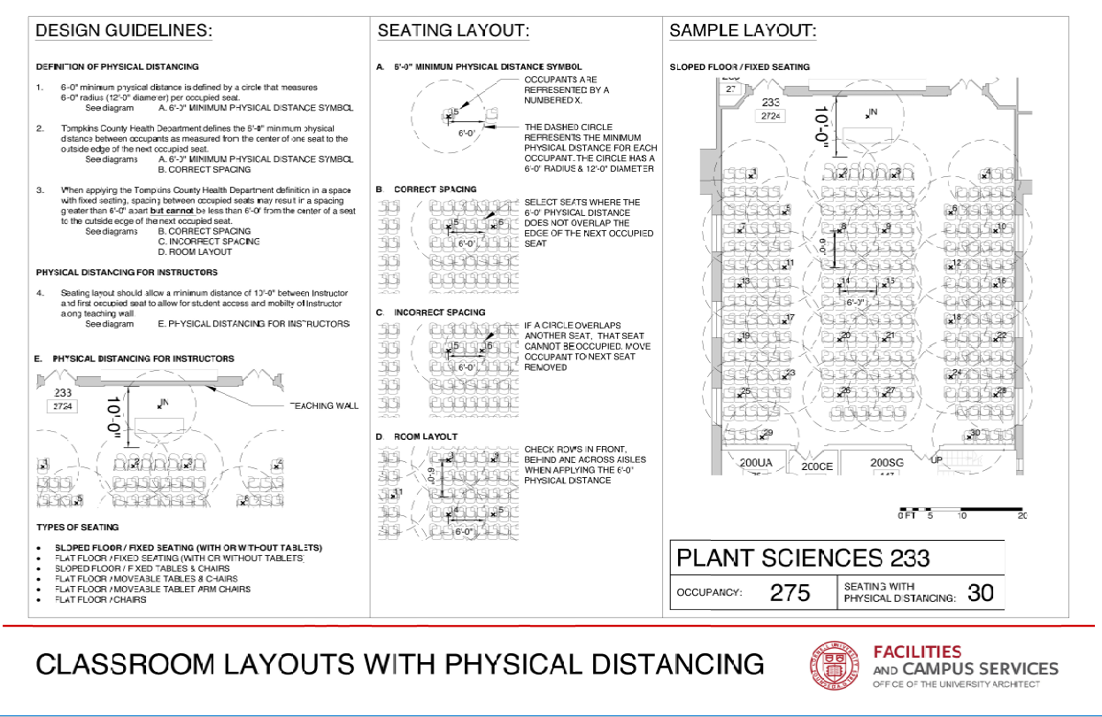
Guidelines: Sloped Floor Fixed Seats

Slide 7
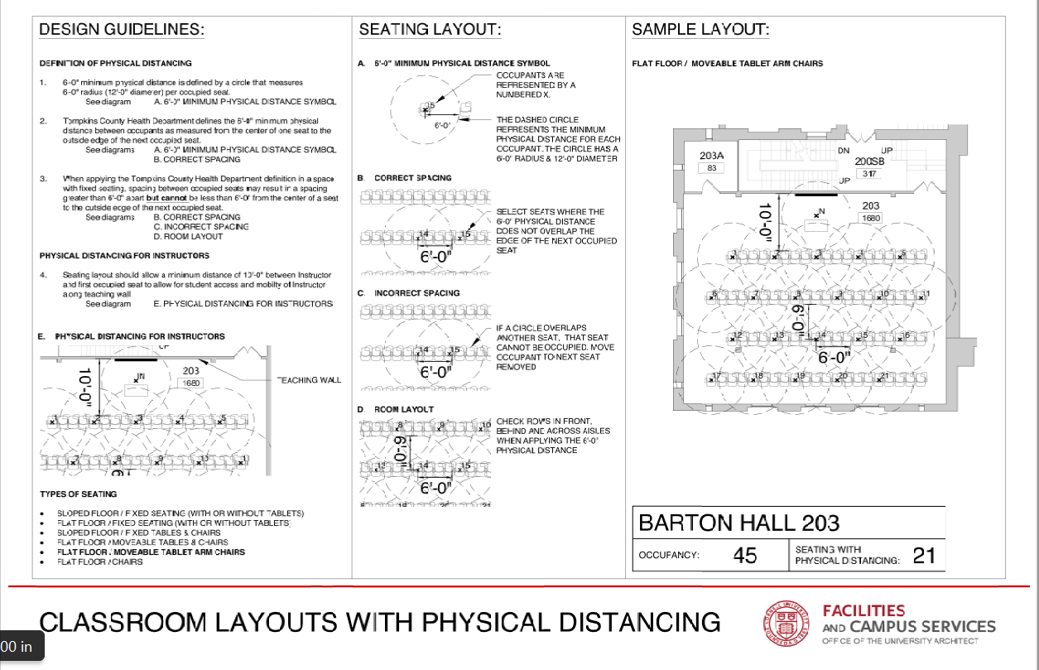
Guidelines: Flat Floor Tablet Chairs

Slide 8
Guidelines: Flat Floor Tables & Chairs

Slide 9
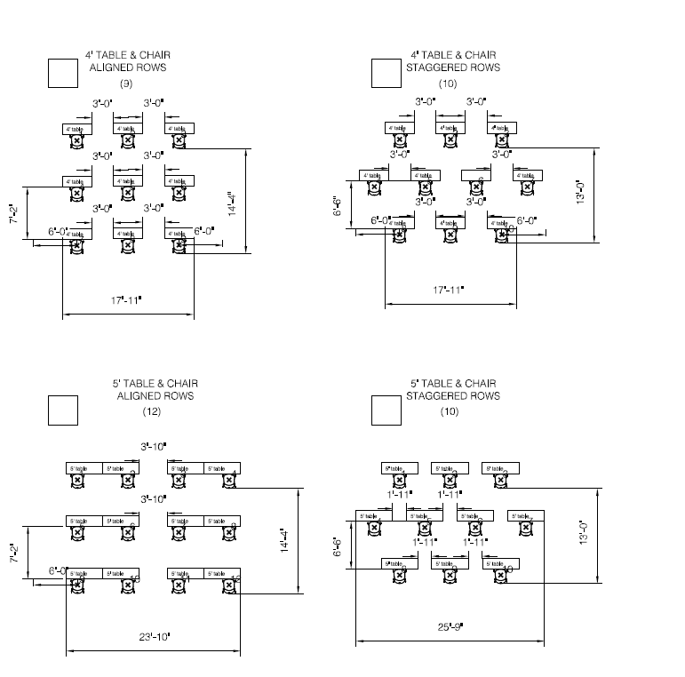
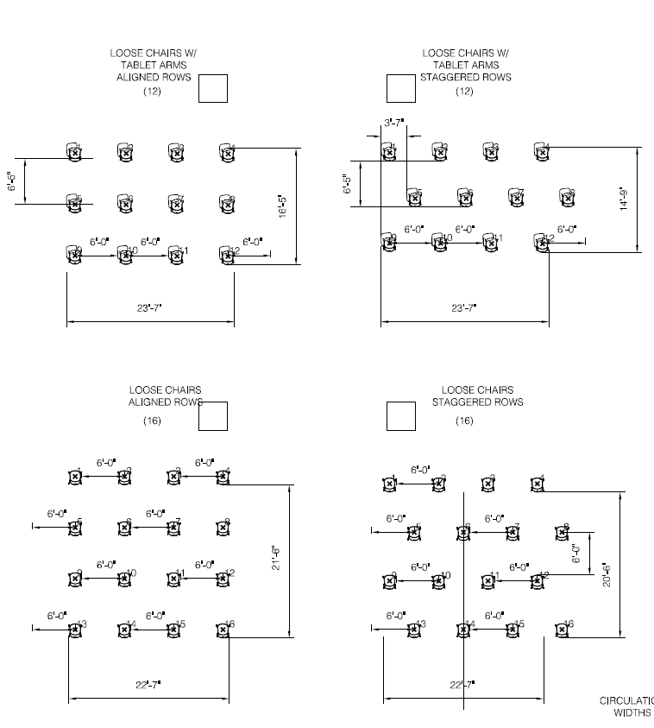
Templates

Slide 10
Completed Scope
Academic Unit | # Spaces
Arts and Sciences | 93
Art Architecture and Planning | 22
CALS | 73
Engineering/CIS | 94
Graduate School | 1
Human Ecology | 13
ILR | 17
Law | 15
Provost | 16
Office of Research | 8
SCI College of Business | 57
Student Campus Life | 112
University Libraries | 34
Veterinary Medicine | 24
TOTAL | 579
OUR List | # Spaces
Central-1 | 255
Central-2 | 22
Central-3 | 5
Locally Scheduled | 93
Locally Scheduled/Central Pending | 14
Not Available for use | 20
Local 40 Hr Swap | 15
TBD Team | 19
Locally Scheduled Pending | 12
Blank (TA Office Hours) | 3
Listed but not on spreadsheet | 5
Total | 463

Slide 11
Findings
Pre COVID CAP
Pre COVID CAP
OUA COVID CAP
100% 24%

Slide 12
Findings
Pre COVID CAP
Pre COVID CAP
OUA COVID CAP
OUR MAX
100% 24% 29%

Slide 13
Findings
Pre COVID CAP
Pre COVID CAP
OUA COVID CAP
OUR MAX
OUR Min CAP
100% 24% 29% 16%

Slide 14
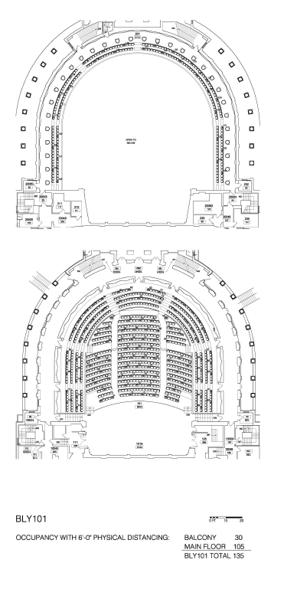
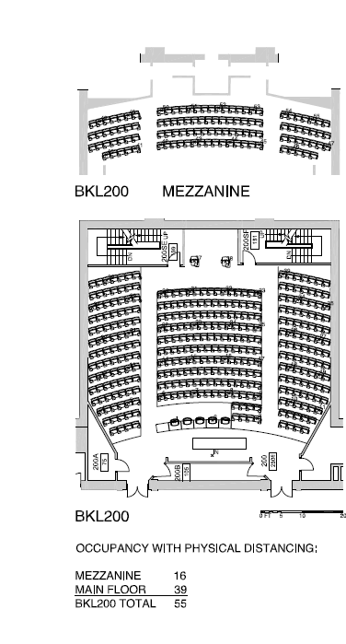
Archive

Slide 15
Partners
Office of the University Registrar Team
Architecture Student Interns
Engineering Student Optimization Team
Steve Beyers, Elisabete Godden, FE staff
Bob Pils and Building Care Staff
Andy Paige and CIT Staff in Units
Print Shop
UFD’s
Erik Gray
Tom King
Kristi Mahoney
Frank Parish
Peter Meixell
Mike Pado
David Lippincott
Kevin Baradet
Jon Ladley
Lisa Anderson
Danny Disidoro
Wayne Davenport
David Taylor
Andy Vail
Todd Pfeiffer

Slide 16
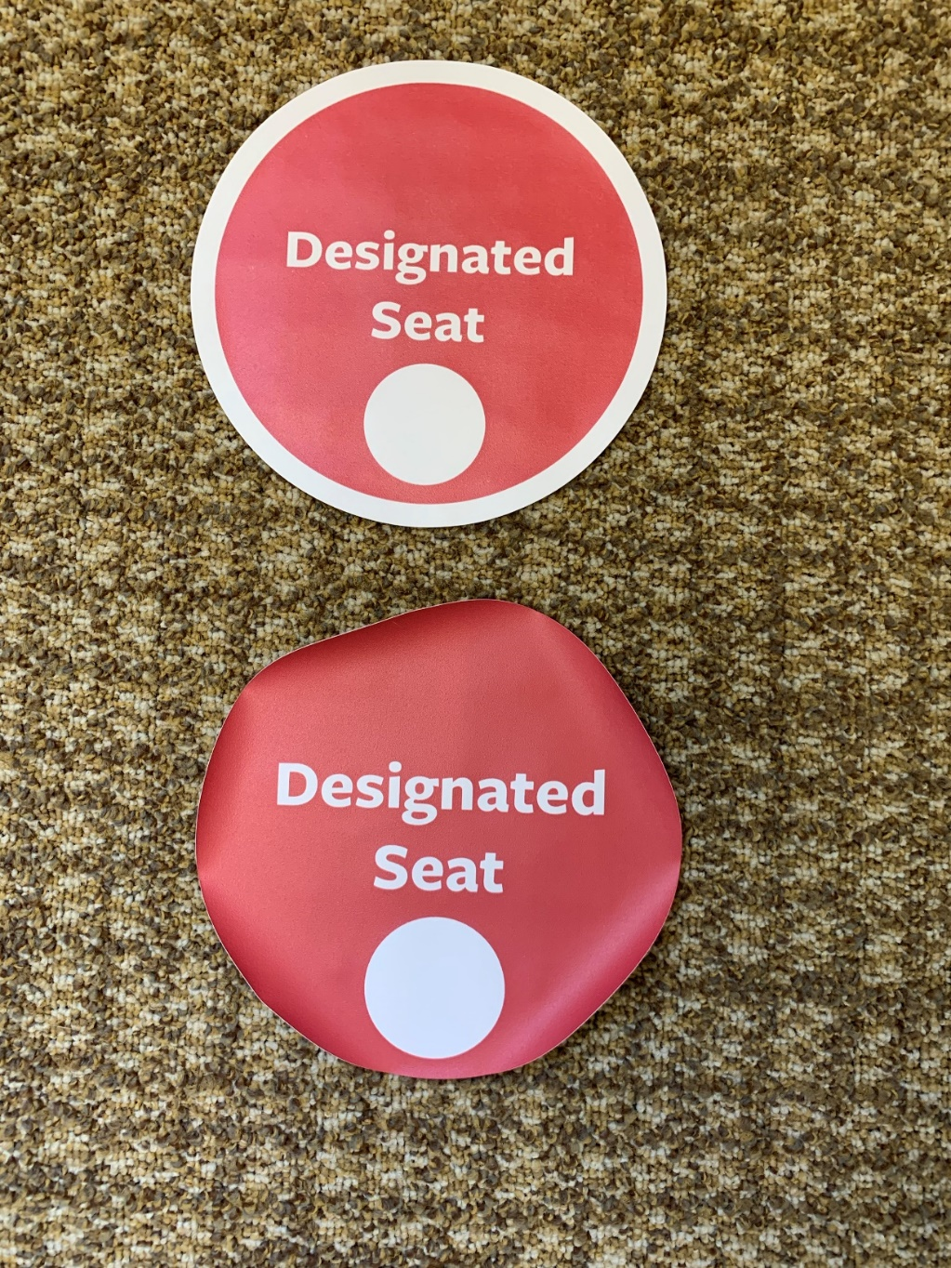
Lessons Learned

