Slide 1
*As you sign on, please send your net ID to Paula Slocum via a private chat so she can mark you as attended

Slide 2
Project Management – Professional Development Series
Facilities and Campus Services Engineering and Project Management
September 24, 2020

Slide 3
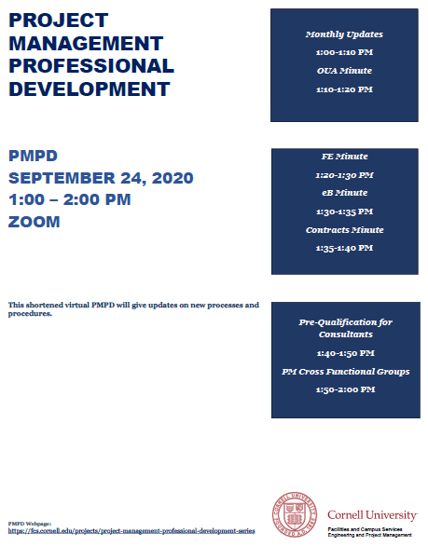
Today’s Agenda
Introduction by Andrew Magré
NCRE Project
FM Global Reminder
New Guidance Documents
e-Builder Data
OUA Minute: COVID Impacts – Instructional Space Layout Process
Margaret Carney
FE Minute: Temporary Ventilation Update
Scott Burke and Elisabete Godden
e-B Minute: Reports Tab in the Process Module
Kelly Davis
Contracts Minute: IUOE Bidding Update
Brenda Frank
Pre-Qualification for Consultants
Keith Barton and Brenda Frank
Bid Cross Functional Group
Andrew Germain

Slide 4
COVID-19 Update
Active Cases on Projects
Two cases identified at NCRE project site
Contact tracing implemented
Exposed individuals quarantined and tested immediately
What Should You Do (as a PM) ?
Make sure Contractor Health and Safety Plan is in place
Follow University Guidelines - if you’re unsure ask
Be Vigilant - see something/say something
Take care of yourself, follow daily check and get tested
Communicate any occurrences to your PM Directors and EHS
Reminder: anything associated with COVID-19 is responsibility of Contractor
4
Notes:
This is real – impacting projects
Make sure COVID plan is in place and reviewed by EHS
Make sure workers are complying with University guidelines when outside construction area

Slide 5
FM Global Reminder
Projects Requiring Full Review
Projects Requiring Quick Review
Projects Not Typically Reviewed
Early FM Global Engagement
FM Plan Review Process
FM Plan Review Guidelines
- Plan review flow chart
- eBuilder review process
Resources
5
Notes:
Our insurance carrier
Feedback loop (FM global tour of Campus) three projects they did not review
When in doubt contact FM global
Three pages

Slide 6
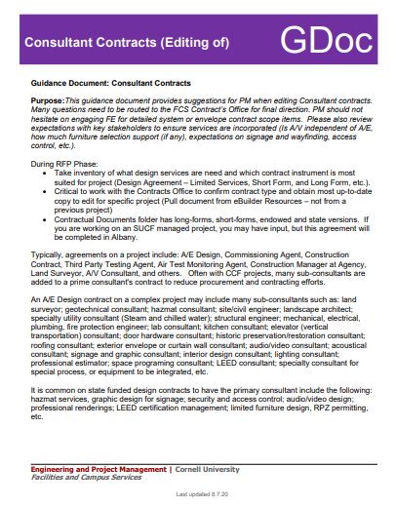
New Pre-Design Phase Resources
State vs Cornell-Funded Projects (GDoc)
Editing Consultant Contracts (GDoc)
FCS Asbestos Program Services (GDoc)
Consultant Selection Sign In Sheet (Template)
Project Communication Plan Example (Template)
6
Notes:
Cross Functional Teams for Design, Bid and Construction have been very productive recently and I would like to highlight resources that have been added recently
Guidance document outlines unique aspects of State-funded projects versus Cornell-Funded. Information is also contained within State checklists.
This guidance document provides suggestions for PM when editing Consultant contracts.
Provide compliance with Cornell University’s Asbestos Written Program (HS-16), NYS and Federal asbestos regulations related to mitigating asbestos exposure risk to students, faculty, staff, and the general public. This is accomplished through coordinated asbestos surveys, abatement design, project and air monitoring services, and post-construction asbestos surveys utilizing the Program’s pre-approved and licensed Environmental Consultants and Contractors.

Slide 7
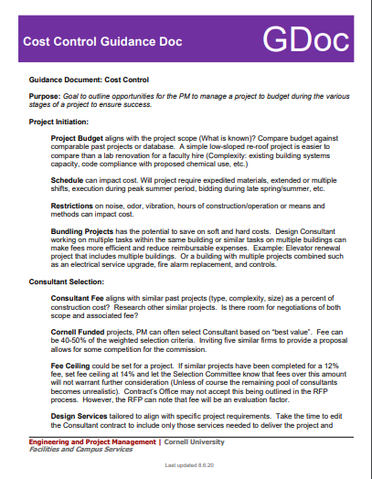
New Design Phase Resources
Monthly Status Update (GDoc)
Facilities Inventory Group Services (GDoc)
Site Design & Impacts (GDoc)
FM Global (GDoc)
Site Selection (GDoc)
Low Sloped Roofing (GDoc)
Cost Control (GDoc)
Project Hazmat Procedures (GDoc)
Project Meeting Groups Example (Template)
State Project IFD Informational Meeting (Letter Template)
Consultant Phase Authorization Letter (Template)
Municipal Approvals - Storage Containers (MOU)
7
Notes:
Monthly Status Update (GDoc)
Facilities Inventory Group Services (GDoc)
Site Design & Impacts (GDoc)
FM Global (GDoc)
Site Selection (GDoc)
Low Sloped Roofing (GDoc)
Cost Control (GDoc)
Project Hazmat Procedures (GDoc)
Project Meeting Groups Example (Template)
State Project IFD Informational Meeting (Letter Template)
Consultant Phase Authorization Letter (Template)
Municipal Approvals - Storage Containers (MOU)

Slide 8
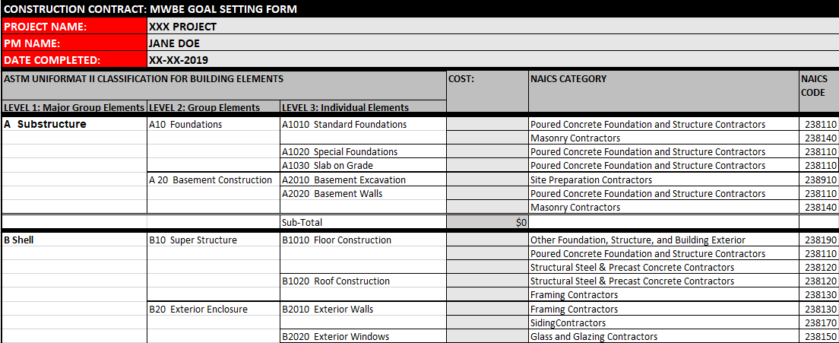
Newly Added Bid Resources
MWBE Goal Setting (Template)
8
Notes:
MWBE Goal Setting Template
Hot Work Permits

Slide 9
Benefits of e-Builder Data!!
Schedule Module Data
Document Reviews
Outlook Bidding Calendar
Quarterly Construction Report
Status Updates (Communication!!)
Emailed to FCS and College & Unit partners (monthly)
Project Construction Impacts pushed out to partners and used for mapping and program impact coordination
Financial Data
Quarterly Capital Project Actuals Report
Quarterly Construction Report
Monthly Commitments on Projects (track health of project)
Next steps: Leverage Bidding Module Data
9

