Slide 1
*As you sign on, please send your net ID to Paula Slocum via a private chat so she can mark you as attended

Slide 2
Project Management – Professional Development Series
Facilities and Campus Services Engineering and Project Management
September 24, 2020

Slide 3
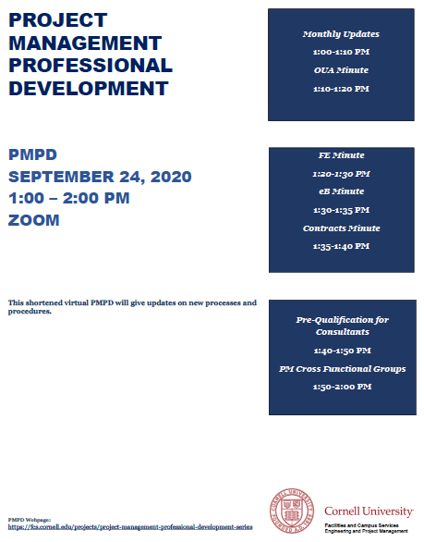
Today’s Agenda
Introduction by Andrew Magré
NCRE Project
FM Global Reminder
New Guidance Documents
e-Builder Data
OUA Minute: COVID Impacts – Instructional Space Layout Process
Margaret Carney
FE Minute: Temporary Ventilation Update
Scott Burke and Elisabete Godden
e-B Minute: Reports Tab in the Process Module
Kelly Davis
Contracts Minute: IUOE Bidding Update
Brenda Frank
Pre-Qualification for Consultants
Keith Barton and Brenda Frank
Bid Cross Functional Group
Andrew Germain

Slide 4
COVID-19 Update
Active Cases on Projects
Two cases identified at NCRE project site
Contact tracing implemented
Exposed individuals quarantined and tested immediately
What Should You Do (as a PM) ?
Make sure Contractor Health and Safety Plan is in place
Follow University Guidelines - if you’re unsure ask
Be Vigilant - see something/say something
Take care of yourself, follow daily check and get tested
Communicate any occurrences to your PM Directors and EHS
Reminder: anything associated with COVID-19 is responsibility of Contractor
4
Notes:
This is real – impacting projects
Make sure COVID plan is in place and reviewed by EHS
Make sure workers are complying with University guidelines when outside construction area

Slide 5
FM Global Reminder
Projects Requiring Full Review
Projects Requiring Quick Review
Projects Not Typically Reviewed
Early FM Global Engagement
FM Plan Review Process
FM Plan Review Guidelines
- Plan review flow chart
- eBuilder review process
Resources
5
Notes:
Our insurance carrier
Feedback loop (FM global tour of Campus) three projects they did not review
When in doubt contact FM global
Three pages

Slide 6
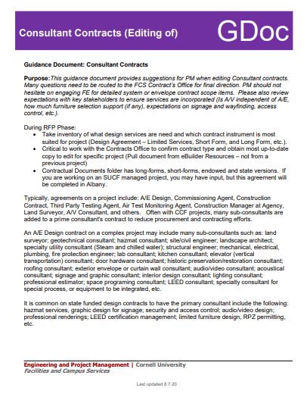
New Pre-Design Phase Resources
State vs Cornell-Funded Projects (GDoc)
Editing Consultant Contracts (GDoc)
FCS Asbestos Program Services (GDoc)
Consultant Selection Sign In Sheet (Template)
Project Communication Plan Example (Template)
6
Notes:
Cross Functional Teams for Design, Bid and Construction have been very productive recently and I would like to highlight resources that have been added recently
Guidance document outlines unique aspects of State-funded projects versus Cornell-Funded. Information is also contained within State checklists.
This guidance document provides suggestions for PM when editing Consultant contracts.
Provide compliance with Cornell University’s Asbestos Written Program (HS-16), NYS and Federal asbestos regulations related to mitigating asbestos exposure risk to students, faculty, staff, and the general public. This is accomplished through coordinated asbestos surveys, abatement design, project and air monitoring services, and post-construction asbestos surveys utilizing the Program’s pre-approved and licensed Environmental Consultants and Contractors.

Slide 7
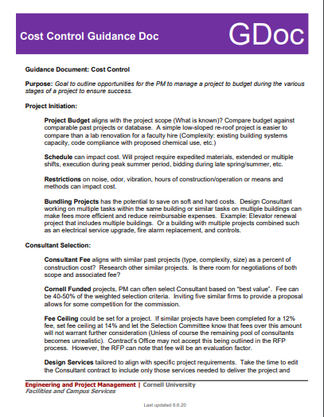
New Design Phase Resources
Monthly Status Update (GDoc)
Facilities Inventory Group Services (GDoc)
Site Design & Impacts (GDoc)
FM Global (GDoc)
Site Selection (GDoc)
Low Sloped Roofing (GDoc)
Cost Control (GDoc)
Project Hazmat Procedures (GDoc)
Project Meeting Groups Example (Template)
State Project IFD Informational Meeting (Letter Template)
Consultant Phase Authorization Letter (Template)
Municipal Approvals - Storage Containers (MOU)
7
Notes:
Monthly Status Update (GDoc)
Facilities Inventory Group Services (GDoc)
Site Design & Impacts (GDoc)
FM Global (GDoc)
Site Selection (GDoc)
Low Sloped Roofing (GDoc)
Cost Control (GDoc)
Project Hazmat Procedures (GDoc)
Project Meeting Groups Example (Template)
State Project IFD Informational Meeting (Letter Template)
Consultant Phase Authorization Letter (Template)
Municipal Approvals - Storage Containers (MOU)

Slide 8
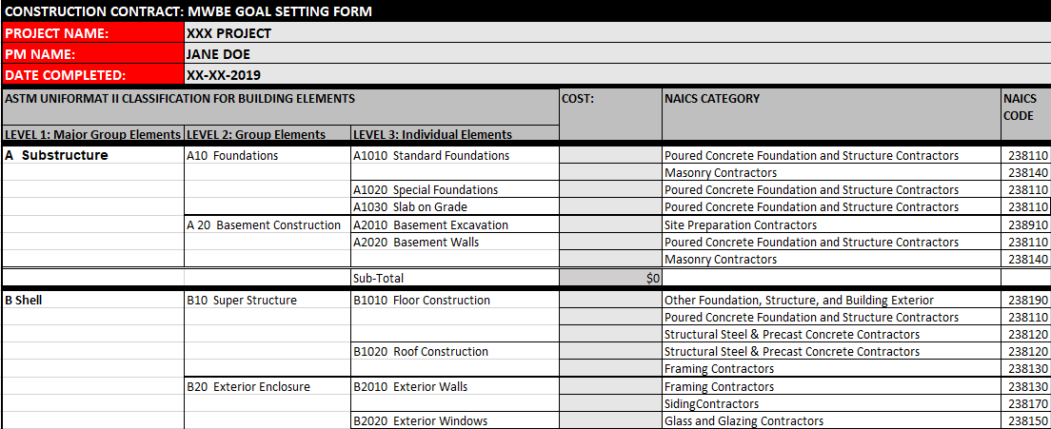
Newly Added Bid Resources
MWBE Goal Setting (Template)
8
Notes:
MWBE Goal Setting Template
Hot Work Permits

Slide 9
Benefits of e-Builder Data!!
Schedule Module Data
Document Reviews
Outlook Bidding Calendar
Quarterly Construction Report
Status Updates (Communication!!)
Emailed to FCS and College & Unit partners (monthly)
Project Construction Impacts pushed out to partners and used for mapping and program impact coordination
Financial Data
Quarterly Capital Project Actuals Report
Quarterly Construction Report
Monthly Commitments on Projects (track health of project)
Next steps: Leverage Bidding Module Data
9

Slide 10
OUA Minute

Slide 11
COVID Impacts- Instructional Space Capacity and Layout Initiative
Design Team
Margaret Carney
J. Shermeta
Jeanne Boodley-Buchannan
Zac Stevenson
Data Management
Lisa Ciaschi
Furniture Logistics
Leslie Schill

Slide 12
Original Scope
1. Establish Guidelines for determining maximum allowable seating capacities within proposed list of spaces to inform Fall ‘20 scheduling.
Use NYState guidelines for physical distancing
-Minimum of 6’-0” apart
-Max 50 person gatherings
2. Lead a process of creating seating plans to confirm calculated estimates, working with UFD’s.
Engage Units to develop seating plans
Provide guidelines, templates, examples, and consultation
3. Review plans for compliance with guidelines and upload to 25Live for use by OUR and Faculty.
12

Slide 13
Completed Scope
Task | Description | Status | Notes
Seating Plan Guidelines | Develop specific guidelines for physical distancing to be used in various types of instructional spaces |  | Completed 7/9
Communications Process | Establish process to assist Units in development of plans based on available technology and capability |  | Established
Seating Examples | Develop examples of seat spacing guidelines applied to 40-50 instructional spaces of various types; create and distribute CAD and PDF templates of various generic seating plans to assist in production of plans |  | Completed 7/31
Create COVID seating plans for OUR list of 600 potential instructional spaces and others from list of 3200 | Review and finalize capacity plans from OUA team and Units as they are completed; uploaded to 25Live, including centrally and locally scheduled spaces |  | Complete 8/14
Preliminary Ventilation Assessment and Resolution of Centrally Scheduled spaces from 600 list (C-1) | Work with Steve Beyers, FE, and Units to complete assessment and documentation of ventilation status for all 600 spaces on OUR list. Identify spaces that can be resolved. Send to OUR COB |  | Complete 8/31
Preliminary Ventilation Assessment and Resolution of locally scheduled spaces and special requests | Work with Steve Beyers, FE, Units to complete assessment & documentation of ventilation status for additional spaces from OUR and Units |  | Complete 8/31
Develop Classroom Cleaning Plan | Work with Bob Pils and OUR to integrate cleaning into class schedule; conduct time trials to inform plan |  | Complete
Establish procedures/guidelines for excess furniture moves and storage: Assist with Implementation. | Work with Units to identify available resources and needs for each unit to manage furniture movements created by classroom strategy. Establish clear procedure as needed to assist, support, implement. |  | Complete: Monitoring

Slide 14
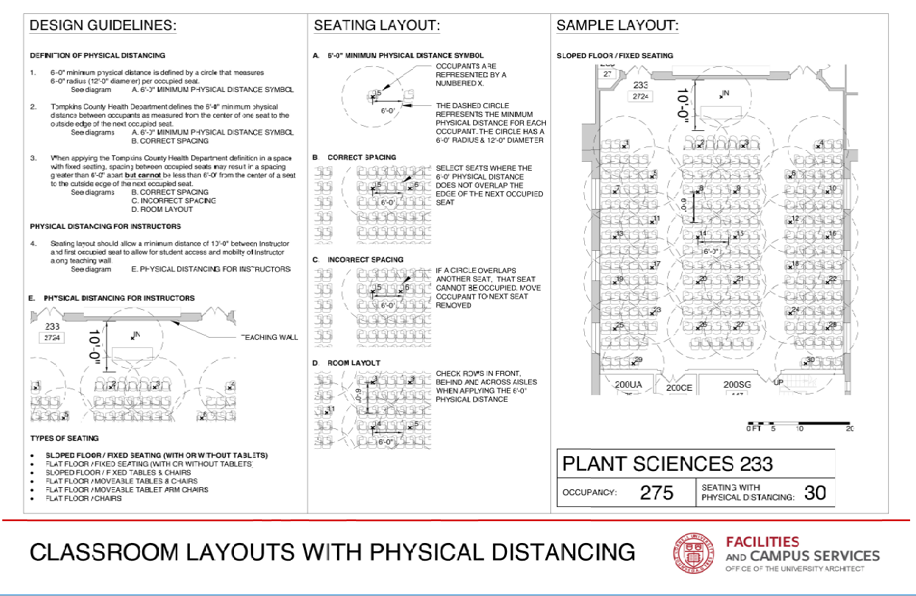
Guidelines: Sloped Floor Fixed Seats

Slide 15
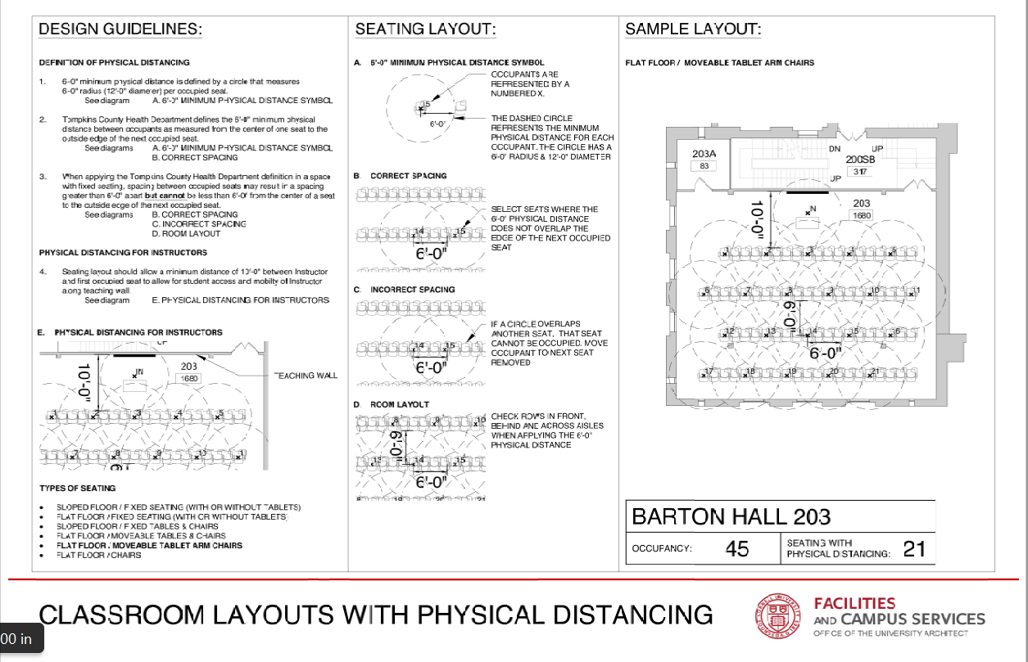
Guidelines: Flat Floor Tablet Chairs

Slide 16
Guidelines: Flat Floor Tables & Chairs

Slide 17
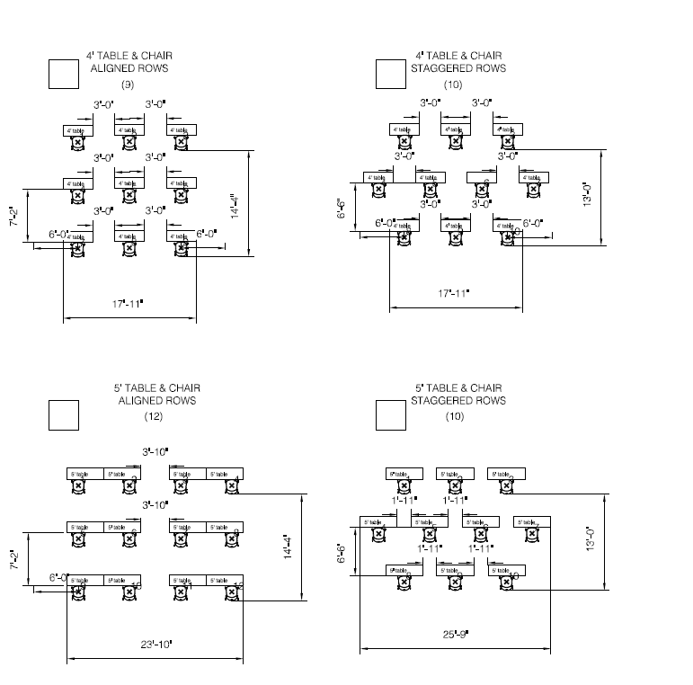
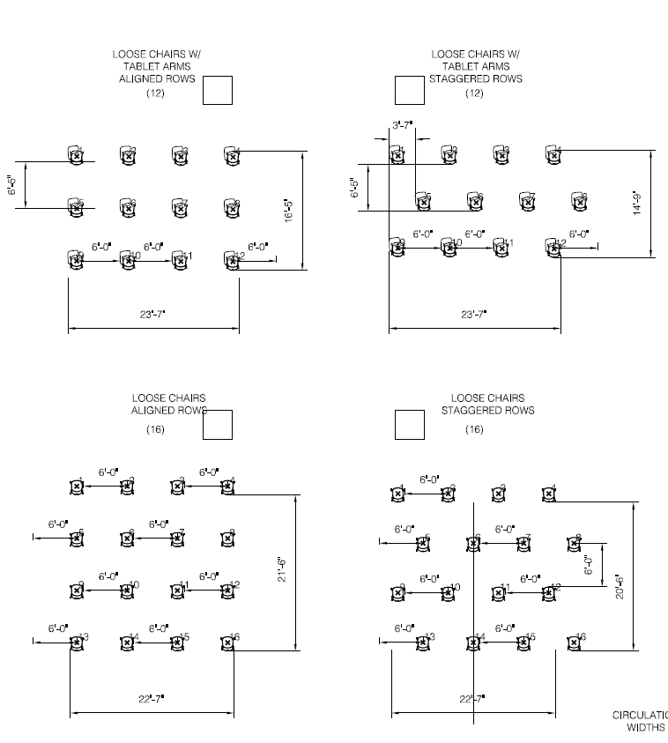
Templates

Slide 18
Completed Scope
Academic Unit | # Spaces
Arts and Sciences | 93
Art Architecture and Planning | 22
CALS | 73
Engineering/CIS | 94
Graduate School | 1
Human Ecology | 13
ILR | 17
Law | 15
Provost | 16
Office of Research | 8
SCI College of Business | 57
Student Campus Life | 112
University Libraries | 34
Veterinary Medicine | 24
TOTAL | 579
OUR List | # Spaces
Central-1 | 255
Central-2 | 22
Central-3 | 5
Locally Scheduled | 93
Locally Scheduled/Central Pending | 14
Not Available for use | 20
Local 40 Hr Swap | 15
TBD Team | 19
Locally Scheduled Pending | 12
Blank (TA Office Hours) | 3
Listed but not on spreadsheet | 5
Total | 463

Slide 19
Findings
Pre COVID CAP
Pre COVID CAP
OUA COVID CAP
100% 24%

Slide 20
Findings
Pre COVID CAP
Pre COVID CAP
OUA COVID CAP
OUR MAX
100% 24% 29%

Slide 21
Findings
Pre COVID CAP
Pre COVID CAP
OUA COVID CAP
OUR MAX
OUR Min CAP
100% 24% 29% 16%

Slide 22
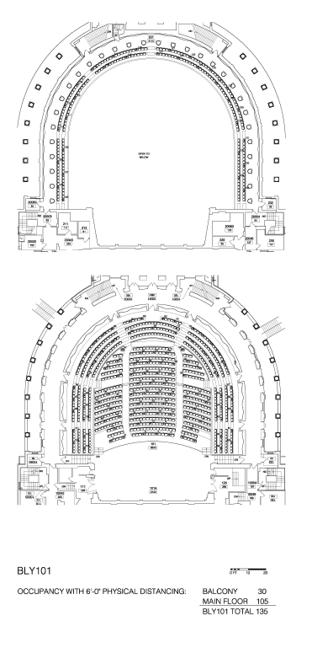
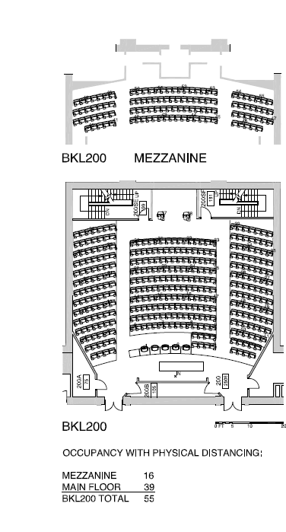
Archive

Slide 23
Partners
Office of the University Registrar Team
Architecture Student Interns
Engineering Student Optimization Team
Steve Beyers, Elisabete Godden, FE staff
Bob Pils and Building Care Staff
Andy Paige and CIT Staff in Units
Print Shop
UFD’s
Erik Gray
Tom King
Kristi Mahoney
Frank Parish
Peter Meixell
Mike Pado
David Lippincott
Kevin Baradet
Jon Ladley
Lisa Anderson
Danny Disidoro
Wayne Davenport
David Taylor
Andy Vail
Todd Pfeiffer

Slide 24
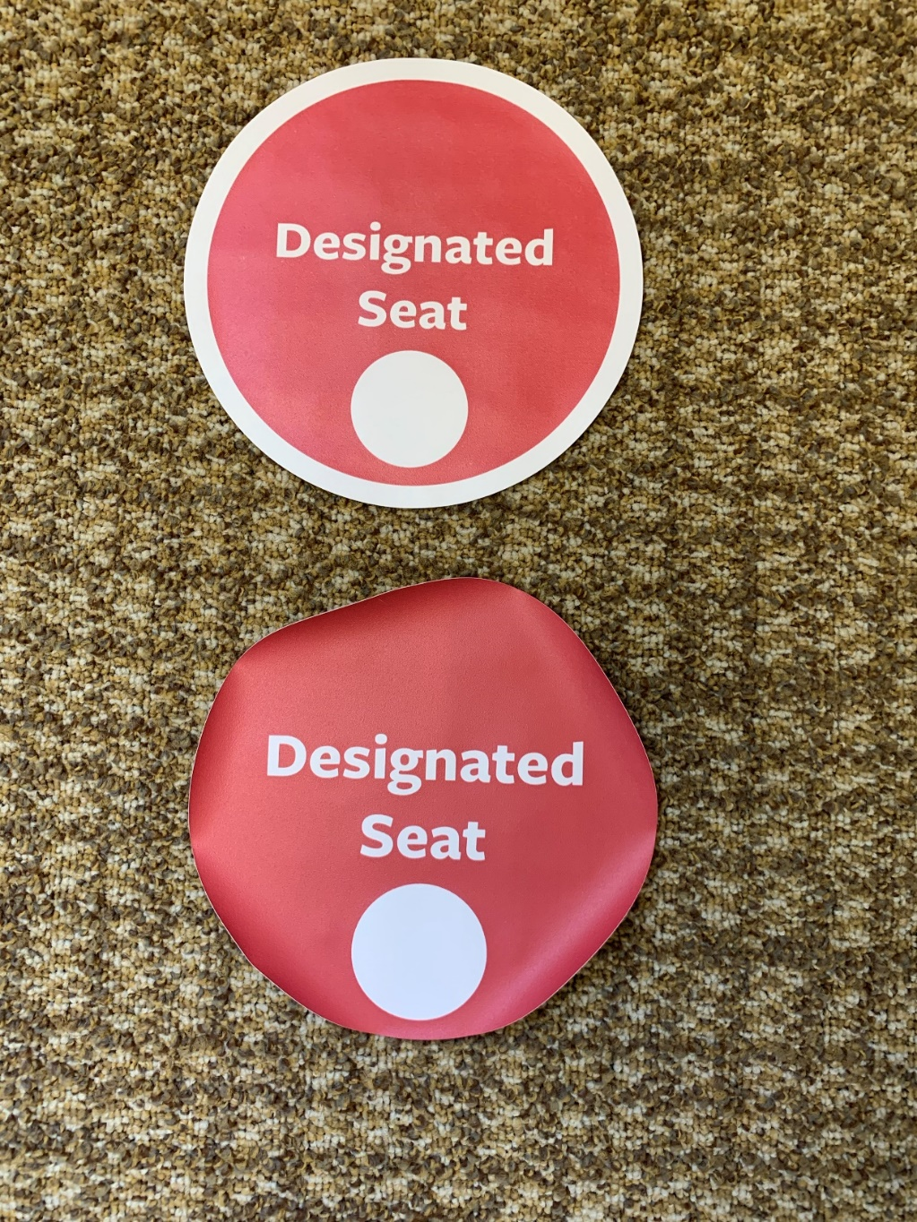
Lessons Learned

Slide 25
Questions?

Slide 26
FE Minute

Slide 27
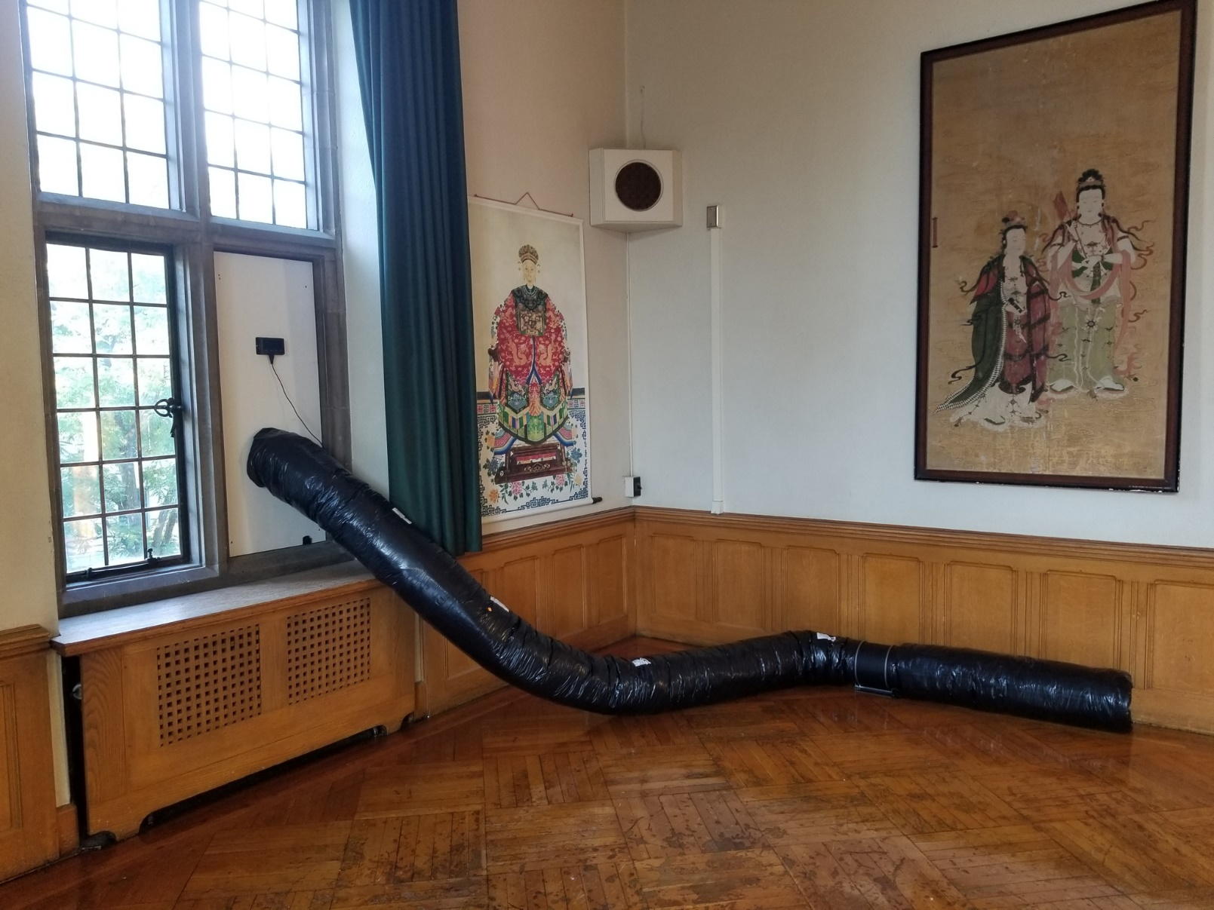
Willard Straight 414
FE Minute: Temporary Ventilation

Slide 28
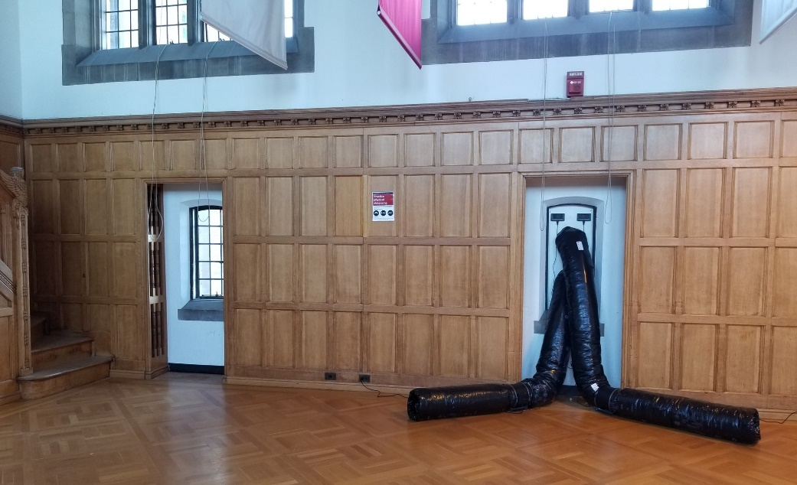
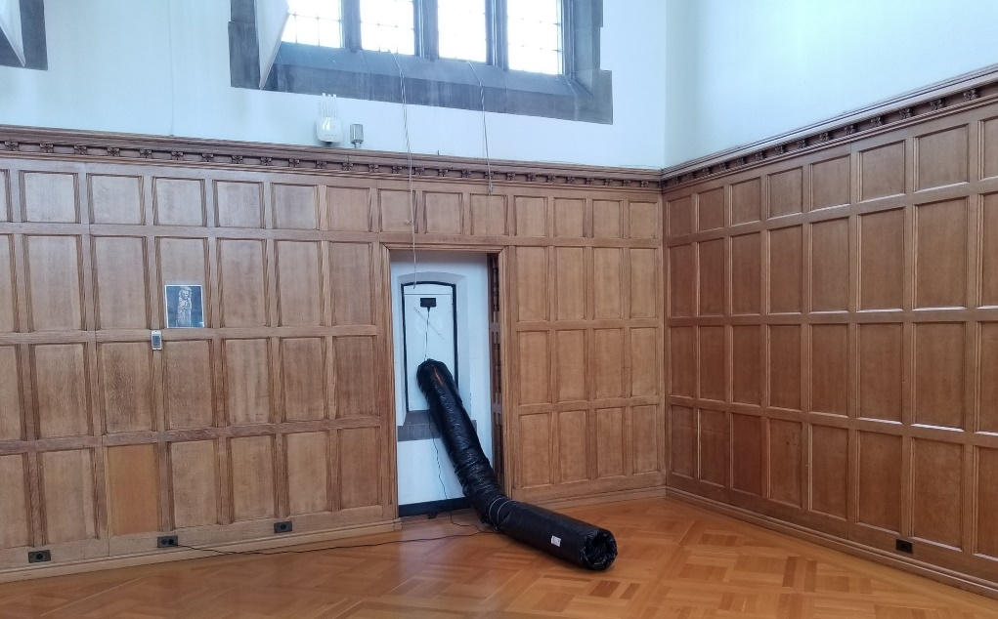
Willard Straight Memorial Room
FE Minute: Temporary Ventilation
Project Overview
Project Manager - Elisabete Godden
Designers – Steve Beyer and Scott Burke
Construction Manager – Pat Conrad
Schedule
20 days from project introduction to final delivery
Scope
Installation of temporary ventilation systems and
related equipment at various spaces for use during
the COVID Pandemic to increase air flow
(in classrooms without mechanical ventilation)
Budget
$100,000~
28

Slide 29
FE Minute: Temporary Ventilation
Contract
Stand Alone Contract for T&M with W L Klein
Goals
30 min. max PM response time to campus partners and team members
24 hrs notice to building occupants of access requirements to their facilities
Committed to 50 spaces designed and installed in 20 days
Execution
Daily core team check in and constant communication with contractors
Daily status updates to Stakeholders team with succinct information
Number of spaces flagged for ventilation on OUR (central registrar)
Number of spaces designed
Number of spaces installed
Number of working days left to fall classes 2020
29

Slide 30
FE Minute: Temporary Ventilation
Risks and Challenges
List of classrooms needing temporary ventilation was not yet complete
Had to help campus partners determine where mechanical ventilation was not available or not functioning
Class list was a moving target, some spaces were still not laid out for COVID Occupancy for design calculations
Setting up the entire project in 24hrs (PIR, eBuilder, Self-Pricing Invitation to Bid, and Contract) so materials could be ordered ASAP
Quick decisions about ordering materials prior to number of spaces known or design complete
Hire contractor and order materials prior to design documents due to potential equipment shortages and delays in delivery
Accessing spaces during a pandemic on short notice
30

Slide 31
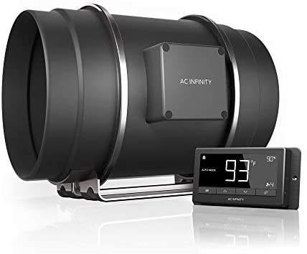
FE Minute: Temporary Ventilation
System Design Concept
Design consisted of inline fans, window panels, window vents, insulated flexible ductwork and fan speed controllers
Met NYS Mechanical Code minimum (ASHRAE 62.1)
Maintained building pressurization
Intake and Exhaust Vent locations carefully considered
Supply air to front of classroom where possible
Install timers to reduce energy use when ventilation is not needed

Slide 32
Plant Sciences G22
FE Minute: Temporary Ventilation
Design Diagram Example

Slide 33
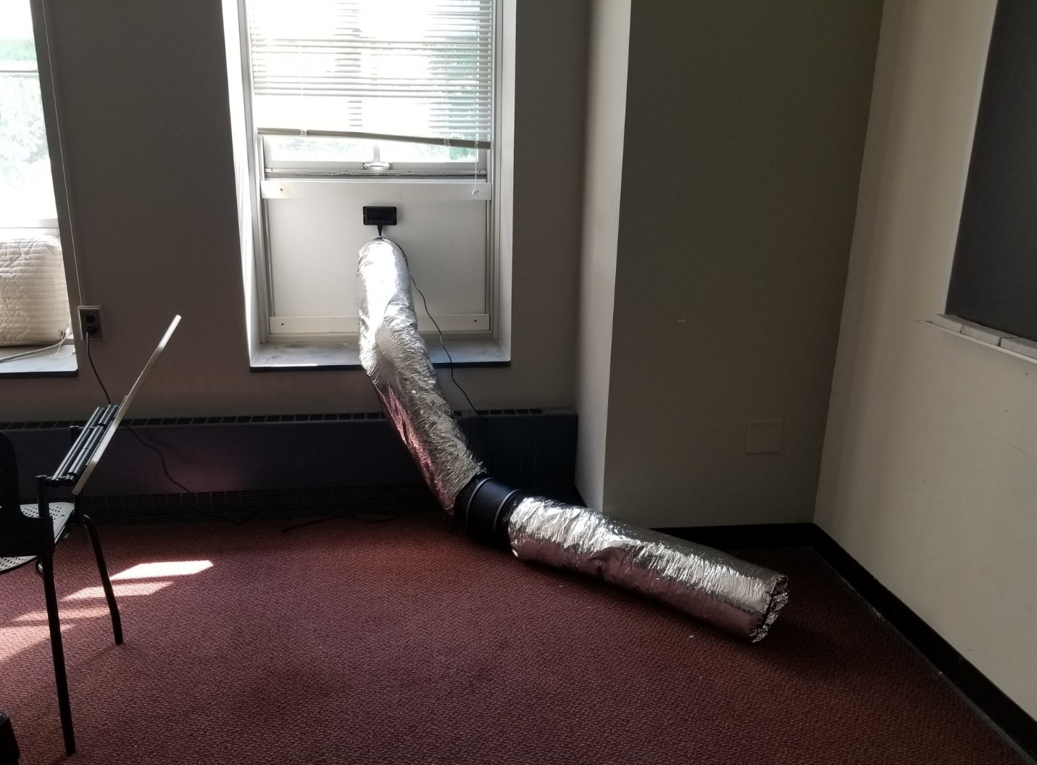
FE Minute: Temporary Ventilation
Typical Installation Example (Interior)
CONTROLLER
FAN
Morill 111

Slide 34
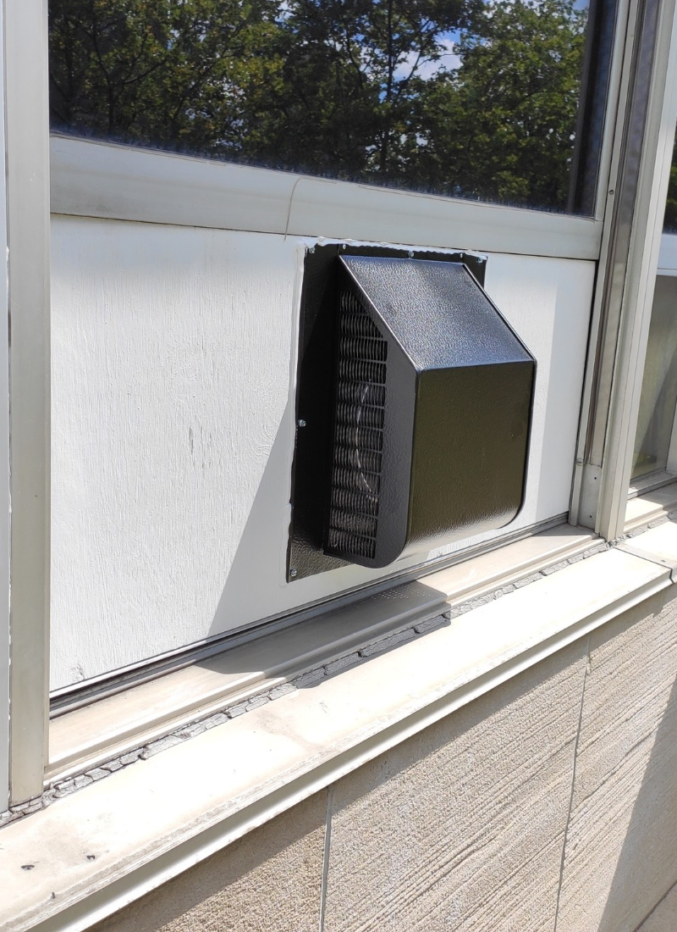
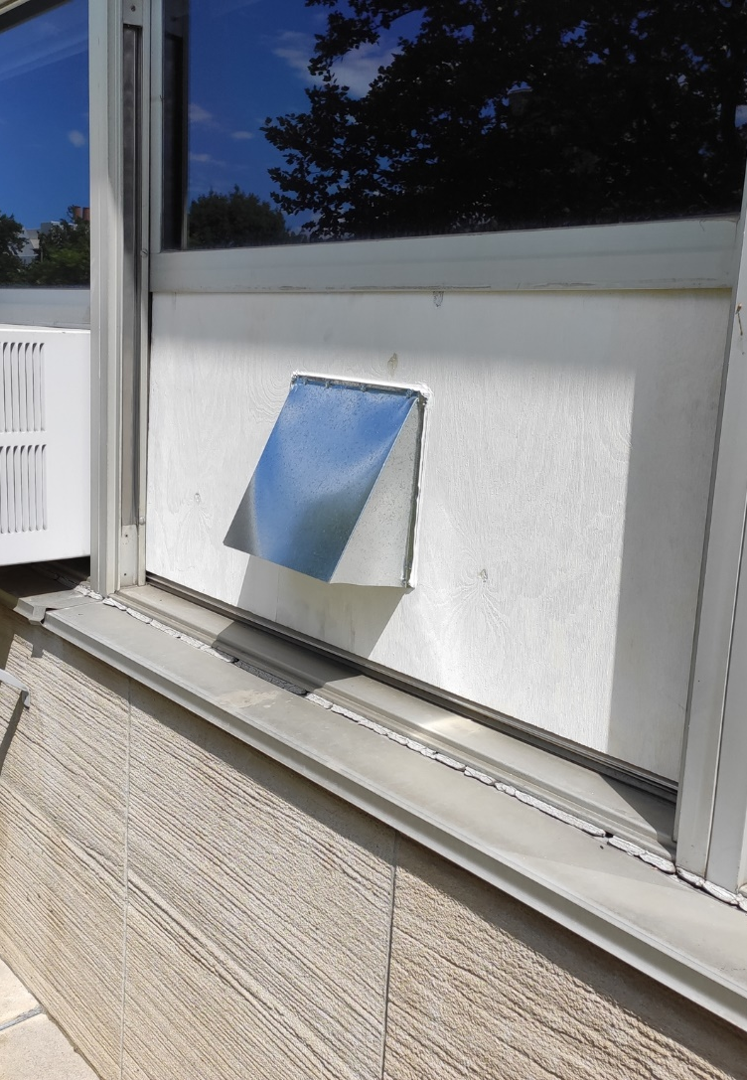
Hollister Hall
FE Minute: Temporary Ventilation
Typical Installation Example (Exterior)
INTAKE VENT
EXHAUST VENT

Slide 35
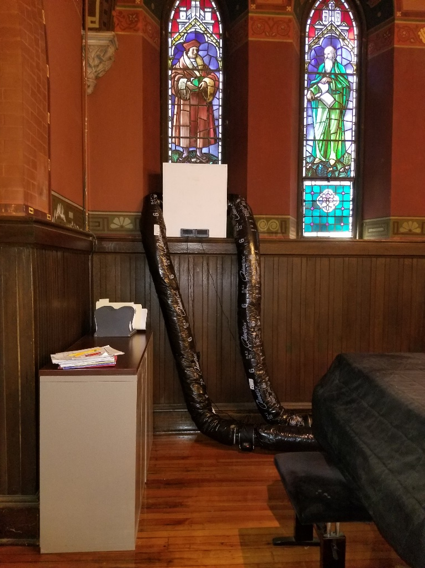
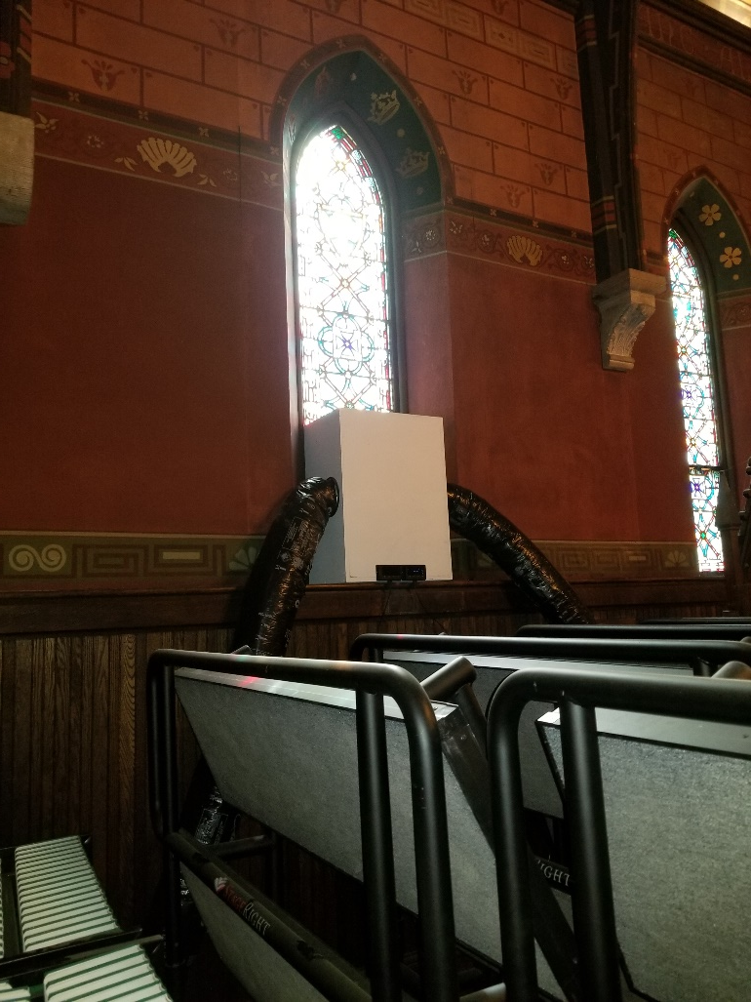
Sage Chapel
FE Minute: Temporary Ventilation
Unusual Installation Example
Notes:
Exhaust Plenum Box Thank Steve Beyers

Slide 36
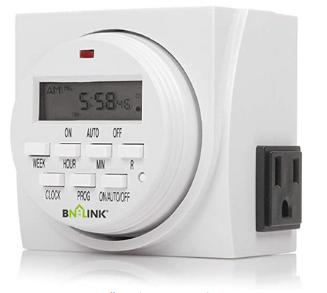
FE Minute: Temporary Ventilation
Lessons Learned, Successes and Outcomes
Timers in fan controller were not reoccurring
Its best to determine and test controls upfront
Timely and clear communication is key
Challenges need to be addressed ASAP
Making decisions based on best-practices is ok
Think ahead and prepare for plan b, c, d…
Surplus materials can be used for replacements
When given the opportunity exceed expectations:
This contract is also helping SCL install temporary ventilation at an additional 160 spaces
Notes:
Thanks John Bell and Erich Riecard

Slide 37
FE Minute: Temporary Ventilation
Next Steps, Looking Ahead
Prepare for cold season and brainstorm air tempering with campus partners
Consider various solutions for different spaces and uses
Test installs in SCL lounge spaces that are used 24/7
Notes:
Thank Vince and Mechanical Team Thank Erich Eschellman

Slide 38
Questions?

Slide 39
E-Builder Minute

Slide 40
eB Minute
September 2020

Slide 41
Reports Tab in Processes
When you have filtered for a specific type of process within a project, there is a reports tab available
Click on the Report tab
Click on the report name, depending on report configuration, the report generated will be for the project you are in.

Slide 42
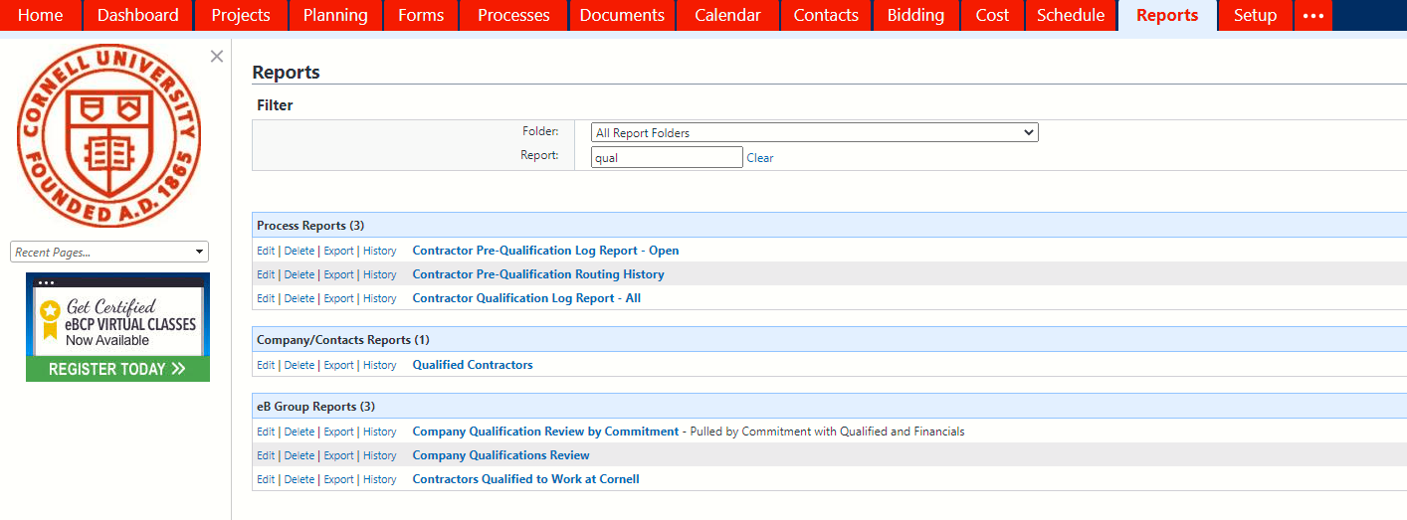
Qualified Contractors Report
We have made some reports available to the project teams to assist with determining which bidders to potentially invite.
Qualified Contractors report, click on Reports tab, search for “qual” which will display the Qualified Contractors report.

Slide 43
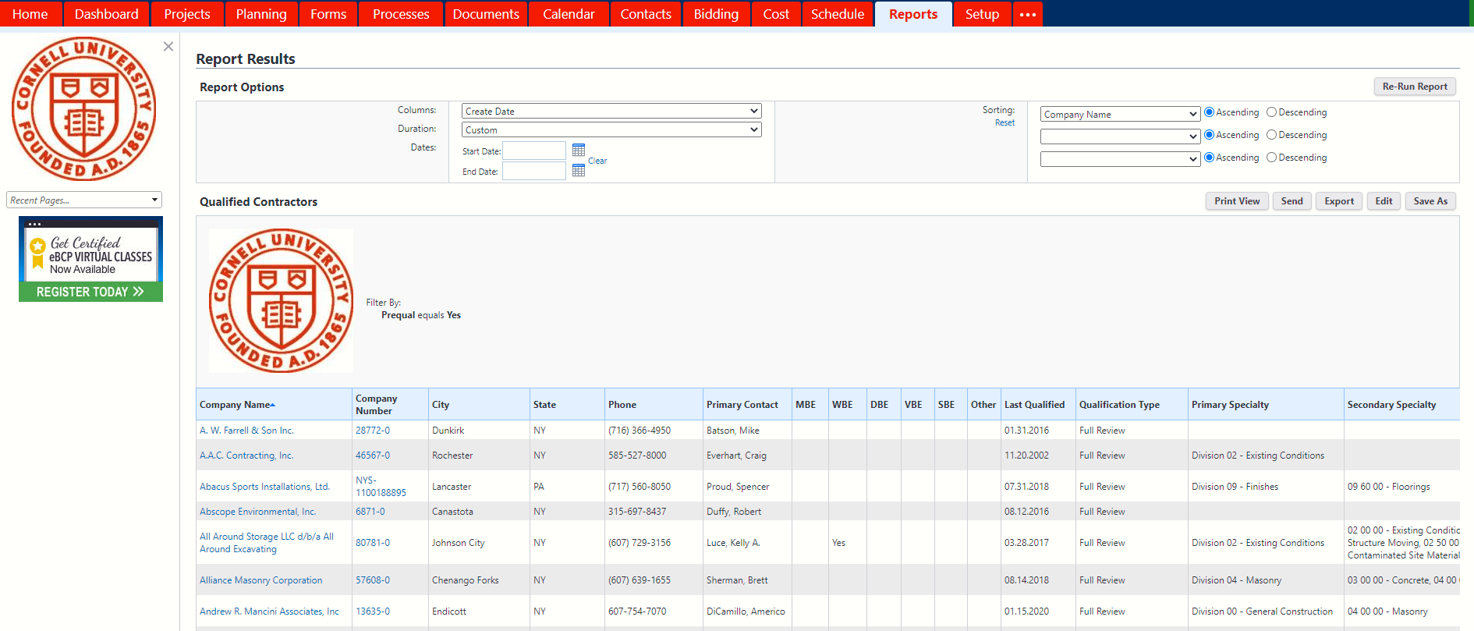
Qualified Contractors Report
This report has the Primary and Secondary Specialty for each company that is Prequalified along with the date of the most recent qualification review.

Slide 44
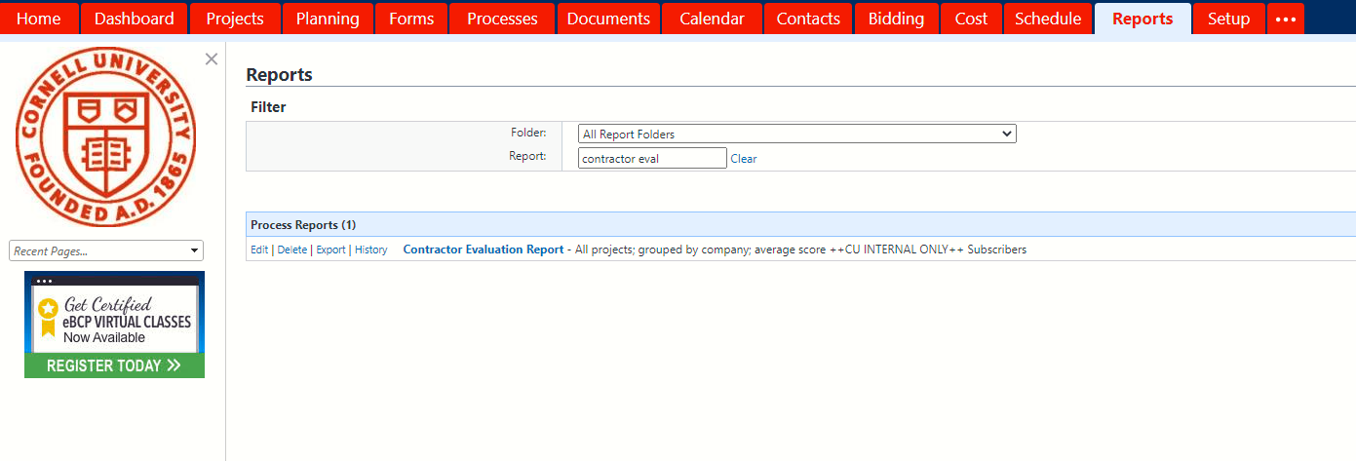
Contractor Evaluation Report
Contractor Evaluation Report, click on Reports tab, search for “evaluation” which will display the report.

Slide 45
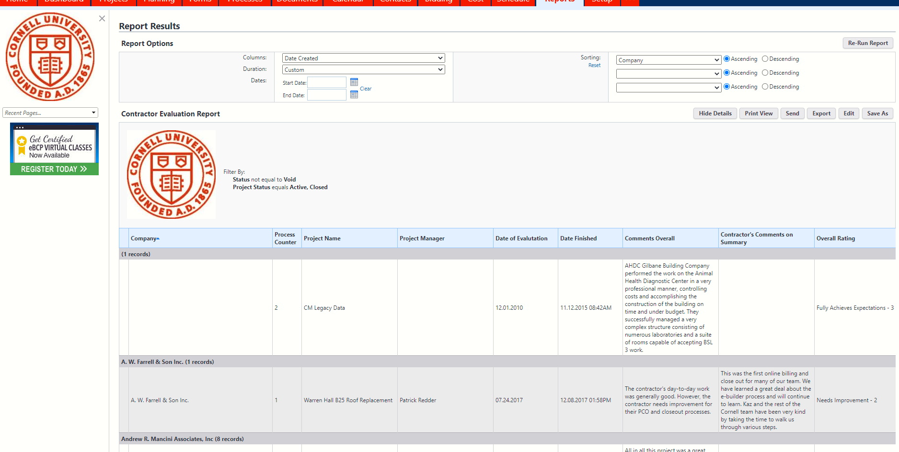
Contractor Evaluation Report
Roles with permissions can view all completed evaluations for each contractor.

Slide 46
Questions?

Slide 47
Facilities Contract Minute

Slide 48
Facilities Contracts Minute
International Union of Operating Engineers (IUOE)
Memorandum of Agreement (MOA)

Slide 49
Background
The IUOE has asked Cornell to be included in projects to provide site preparation, including excavation, moving, and grading earth with the use of heavy equipment and other work usually within the jurisdiction of the operating engineers.

Slide 50
Memorandum of Agreement
Cornell has entered into an MOA with the IUOE effective April 2020
IUOE will be required for Sitework on projects that meet the criteria in the MOA.
The IUOE can either be the Prime or a Sub.
The MOA is for five pilot projects.
50

Slide 51
IUOE Requirements for Subcontractors
IUOE shall provide each of the invited bidders with a minimum of three (3) subcontractors who are signatory to the IUOE.
If the invited bidders do not receive a minimum of three (3) bids from the subcontractors, the memorandum of agreement will not take affect.

Slide 52
Current Status
We are working through the implementation of this process.
We have bid one project with IUOE as prime and are in the process of bidding one with IUOE as a subcontractor.
After the five projects are complete there will be a debrief and we will report out what the next steps will be.

Slide 53
Questions?

Slide 54
Pre-Qualification for Consultants

Slide 55
Pre-Qualified
Academic Facility Rehabilitation (PQ-AFR)
Design Services

Slide 56
PQ-AFR
Goal: Streamline project delivery, especially in support of new faculty hires
Issued RFQ for Academic Facilities Renovations Design Services for repair, rehabilitation, renovation, and improvement of University faculty offices, classrooms and research and teaching laboratory facilities.
Competitive selection process, pre-qualified four consultants:
Ashley McGraw Architects
Chiang O’Brien Architects
Richard McElhiney Architects
SWBR Architects
Notes:
The projects are predominantly for new faculty hires and programs that would consist of research and instructional labs (computational and wet labs), classrooms, office space and other interior renovations necessary for the seamless continuation of programs.

Slide 57
PQ-AFR
Academic Facilities Renovation
Total project budget less than $2M
Amount includes design, construction, FFE, etc.
Projects will vary in size and complexity; however, all will have an accelerated timeline as many will support new faculty hires
This is for use on Cornell Funded projects only, NOT FOR STATE FUNDED PROJECTS
Projects will be distributed equitably among the qualified Consultants
Facilities Contracts will track usage, distribution
You may request a specific consultant; include the justification in your Project Intake Request

Slide 58
Project Parameters
This is a fast track process; Consultants will have one week to provide the fee proposal.
It is expected that a Contract or Letter of Intent will be issued within one week of receipt of proposal.
It is expected that a PAR will either be approved or in process prior to the RFP being sent out.

Slide 59
Process
Request to use PQ-AFR in your PIR
Once request is approved and PAR is in process:
Use the RFP form for PQ-AFR
Edit the appropriate Contract for the project
Send the RFP, edited Contract and any attachments to the Facilities Contracts mailbox for review and issuance to the Consultant.

Slide 60
Process
Once reviewed, Facilities Contracts will issue the RFP to the selected Consultant
FC will send the RFP, Contract, attachments and a Fee Breakdown that has the agreed hourly rates and subconsultants already filled in.
RFI’s will still be required and go through Facilities Contracts mailbox and an RFI Log will be required.

Slide 61
Process
Once the response is received, the PM should review and negotiate if necessary (# of hours, etc.)
When entering the CRP, for the Commitment type select “PQ_AFR”
The Contract and Design process is the same as normal form this point forward
A guidance document is being finalized and will be available in the eBuilder Resources and PM Checklist

Slide 62
Questions?

Slide 63
Bid Cross Functional Team

Slide 64
Bid Phase Cross-Functional Group
Mission Vision:
Leverage the expertise, perspectives, and experience of a cross functional group to develop improvements to the Bid Phase process at Cornell University;
Proactively Engaging the Contracting Community
Cornell Processes – Education & Training
Campus Wide Bidding Strategy
Notes:
Proactively Engaging the Contracting Community
Contracting forum
Bidder Selection
Contac
Education & Training of Cornell Processes
Development of a Bidding Strategy

Slide 65
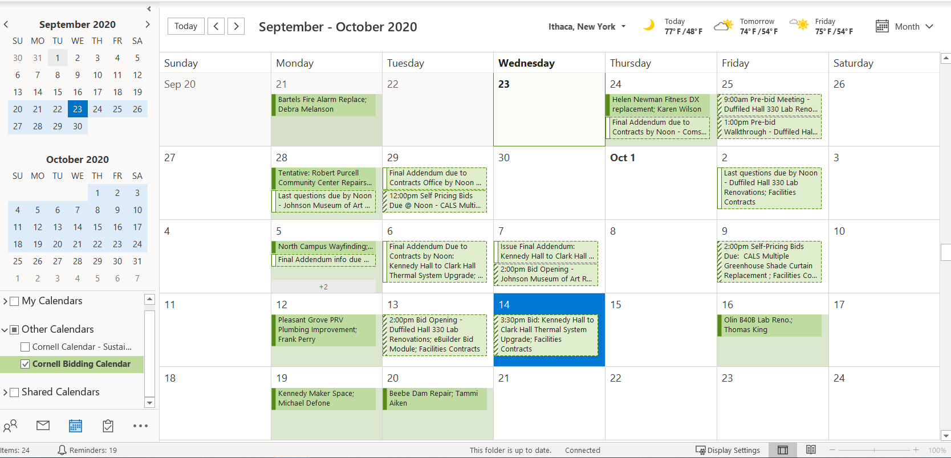
Campus Wide Bidding Strategy & Reporting
Cornell Bidding Calendar: Outlook Tool
Notes:
Memo – Signed Back in January 2020
- Planned Maintenance Projects will utilize a pooled contingency

Slide 66
Cornell Bidding Calendar
“Develop a more proactive, transparent, and streamlined, bidding strategy for our scheduled projects.”

Slide 67
Cornell Bidding Calendar – Why & What?
Improve Bid Timing:
- Optimize our proposed bid timing of projects.
Workload Leveling:
- Internally with our FCS partners.
Externally with work force labor projections.
Collaborate on Proposed & Actual Bid Info:
Proposed Dates (eBuilder): Schedule Module
Actual Dates (FCS Contracts Calendar)
Notes:
Reduce stacking of bids.
Stager projects of similar scope
Cornell Cost Factor

Slide 68
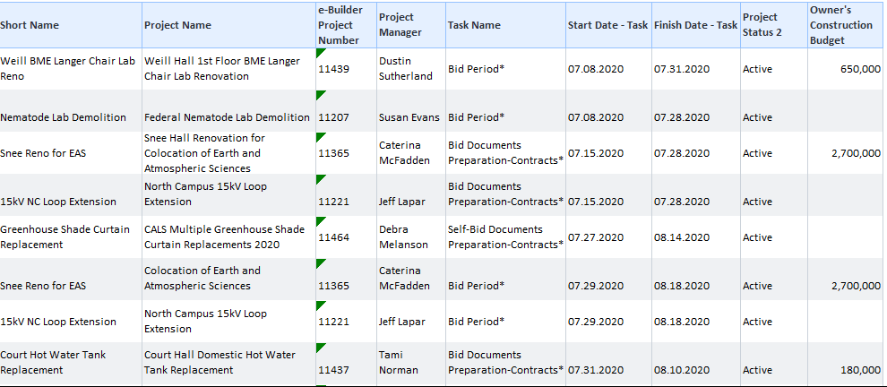
Cornell Bidding Calendar – What?
Communication & Planning Tool –
Proposed Data (eBuilder Schedule Module)
Notes:
Tools:
Proposed Data: ( PM Task of Documents to Contactor)
Outlook - Exchange Account to share Calendar that all PM's have access to PM Proposed Bid Calendar
Data is pulled from ebuilder schedule module
Published to Outlook for PM centers to communicate proposed bids
80/20 rule - This goal is to be transparent not another gate.
If there is a project…. Push it through
that slipped through the cracks We
Or was unplanned
We can then communicate its urgency or priority vs those that are planned, and jockey dates accordingly
Actual Data: (FCS Contracts Office Published Data
They use Outlook Exchange Account's generic e-mail Account to share dates for each bid period
Bid Invite
Pre- Bid walk through
Last day for questions
Addendum
Bid opening
Monthly Meeting:
Strategize & Plan then share with Contacts

Slide 69
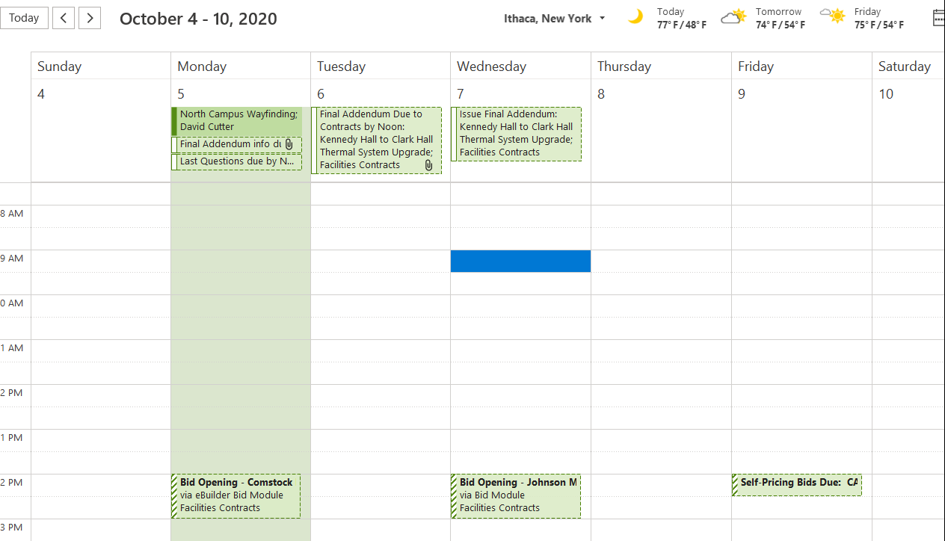
Cornell Bidding Calendar – What?
Communication & Planning Tool –
Actual Dates (Facilities Contacts Office Calendar)
Actual Meeting invitations for projects out to bid
Notes:
Tools:
Proposed Data: ( PM Task of Documents to Contactor)
Outlook - Exchange Account to share Calendar that all PM's have access to PM Proposed Bid Calendar
Data is pulled from ebuilder schedule module
Published to Outlook for PM centers to communicate proposed bids
80/20 rule - This goal is to be transparent not another gate.
If there is a project…. Push it through
that slipped through the cracks We
Or was unplanned
We can then communicate its urgency or priority vs those that are planned, and jockey dates accordingly
Actual Data: (FCS Contracts Office Published Data
They use Outlook Exchange Account's generic e-mail Account to share dates for each bid period
Bid Invite
Pre- Bid walk through
Last day for questions
Addendum
Bid opening
Monthly Meeting:
Strategize & Plan then share with Contacts

Slide 70
Cornell Bidding Calendar – Who?
Communication & Planning Tool –
Project Managers:
Planning Tool when developing your project schedules.
PM Directors & College Representatives:
Strategize bid timing across the Campus Community.
Monthly Meeting (Next one October 20th)
Transparent discussions on proposed bid schedules and prioritized needs and limitations across campus.
Facilities Contracts:
Workload leveling – forecasted workload for Bid Periods
Actual Dates – sharing bid current bid activity across campus
Notes:
Tools:
Proposed Data: ( PM Task of Documents to Contactor)
Outlook - Exchange Account to share Calendar that all PM's have access to PM Proposed Bid Calendar
Data is pulled from ebuilder schedule module
Published to Outlook for PM centers to communicate proposed bids
80/20 rule - This goal is to be transparent not another gate.
If there is a project…. Push it through
that slipped through the cracks We
Or was unplanned
We can then communicate its urgency or priority vs those that are planned, and jockey dates accordingly
Actual Data: (FCS Contracts Office Published Data
They use Outlook Exchange Account's generic e-mail Account to share dates for each bid period
Bid Invite
Pre- Bid walk through
Last day for questions
Addendum
Bid opening
Monthly Meeting:
Strategize & Plan then share with Contacts

Slide 71
Cornell Bidding Calendar – When & How?
Monthly Bid Planning Meeting:
Next Scheduled Meeting: October 20, 2020
Intent: Proactive Strategic Discussion
Not meant to be another “Gate” (80/20 Rule)
PM’s to validate the next 3-4 weeks of proposed bids prior to meeting (Update Schedule Modules)
Directors discuss proposed bid cycle, discuss options to level workload for bidding community and optimize bids.
Notes:
Tools:
Proposed Data: ( PM Task of Documents to Contactor)
Outlook - Exchange Account to share Calendar that all PM's have access to PM Proposed Bid Calendar
Data is pulled from ebuilder schedule module
Published to Outlook for PM centers to communicate proposed bids
80/20 rule - This goal is to be transparent not another gate.
If there is a project…. Push it through
that slipped through the cracks We
Or was unplanned
We can then communicate its urgency or priority vs those that are planned, and jockey dates accordingly
Actual Data: (FCS Contracts Office Published Data
They use Outlook Exchange Account's generic e-mail Account to share dates for each bid period
Bid Invite
Pre- Bid walk through
Last day for questions
Addendum
Bid opening
Monthly Meeting:
Strategize & Plan then share with Contacts

Slide 72
Live Demonstration – Outlook Calendar

Slide 73
Questions?

