Slide 1
Project Management – Professional Development Series
Facilities and Campus Services
Engineering and Project Management
September 24, 2020

Slide 2
Bid Phase Cross-Functional Group
Mission Vision:
Leverage the expertise, perspectives, and experience of a cross functional group to develop improvements to the Bid Phase process at Cornell University;
Proactively Engaging the Contracting Community
Cornell Processes – Education & Training
Campus Wide Bidding Strategy
Notes:
Proactively Engaging the Contracting Community
Contracting forum
Bidder Selection
Contac
Education & Training of Cornell Processes
Development of a Bidding Strategy

Slide 3
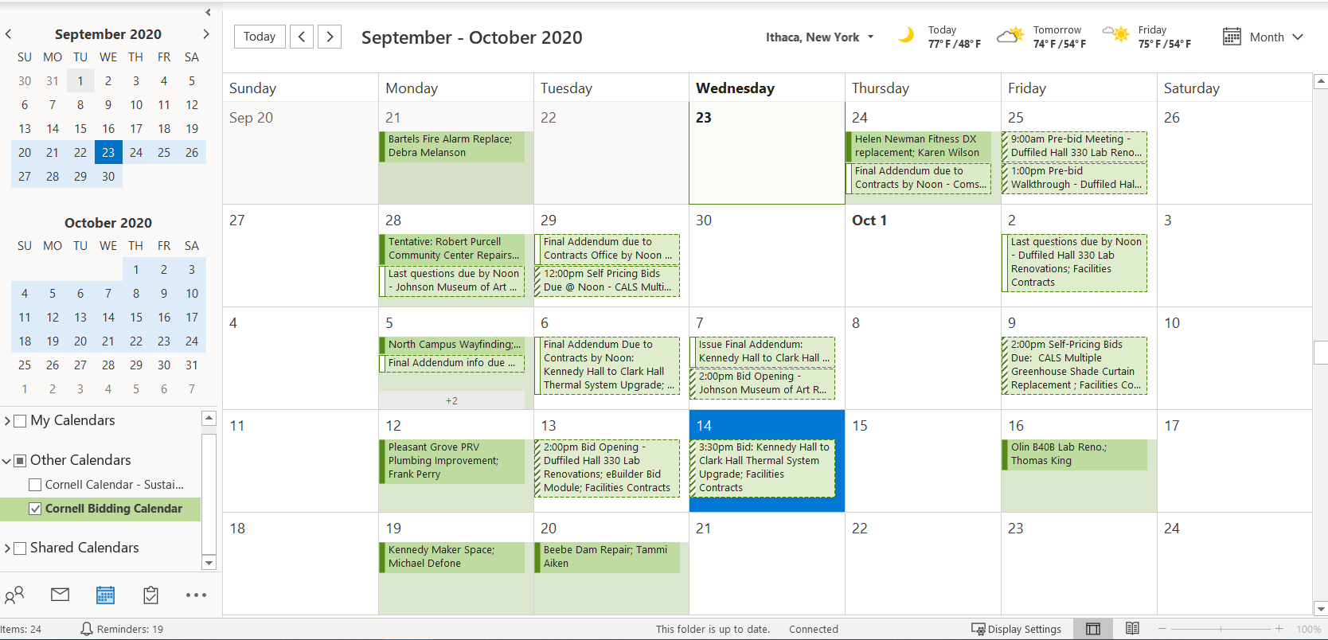
Campus Wide Bidding Strategy & Reporting
Cornell Bidding Calendar: Outlook Tool
Notes:
Memo – Signed Back in January 2020
- Planned Maintenance Projects will utilize a pooled contingency

Slide 4
Cornell Bidding Calendar
“Develop a more proactive, transparent, and streamlined, bidding strategy for our scheduled projects.”

Slide 5
Cornell Bidding Calendar – Why?
Improve Bid Timing:
- Optimize our proposed bid timing of projects.
Workload Leveling:
- Internally with our FCS partners.
Externally with work force labor projections.
Collaborate on Proposed Projects:
Provide insight on the proposed projects coming to bid in the next 6 mo. - 1 yr.
Notes:
Reduce stacking of bids.
Stager projects of similar scope
Cornell Cost Factor

Slide 6
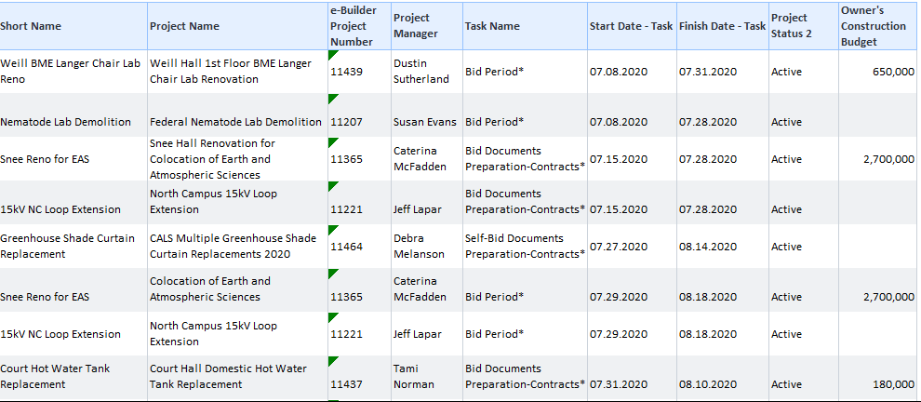
Cornell Bidding Calendar – What?
Communication & Planning Tool –
Proposed Data (eBuilder Schedule Module)
eBuilder Report – “Bidding Schedule Start and Finish v3”
Notes:
Tools:
Proposed Data: ( PM Task of Documents to Contactor)
Outlook - Exchange Account to share Calendar that all PM's have access to PM Proposed Bid Calendar
Data is pulled from ebuilder schedule module
Published to Outlook for PM centers to communicate proposed bids
80/20 rule - This goal is to be transparent not another gate.
If there is a project…. Push it through
that slipped through the cracks We
Or was unplanned
We can then communicate its urgency or priority vs those that are planned, and jockey dates accordingly
Actual Data: (FCS Contracts Office Published Data
They use Outlook Exchange Account's generic e-mail Account to share dates for each bid period
Bid Invite
Pre- Bid walk through
Last day for questions
Addendum
Bid opening
Monthly Meeting:
Strategize & Plan then share with Contacts

Slide 7
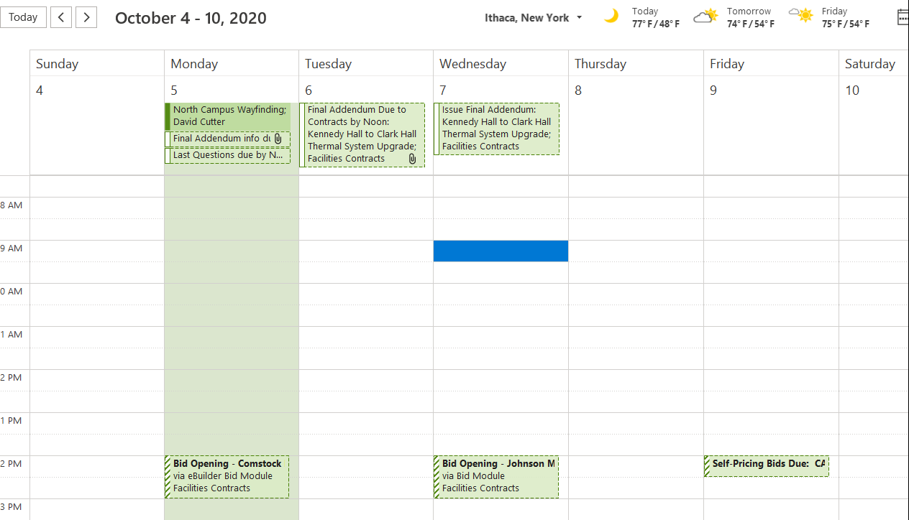
Cornell Bidding Calendar – What?
Communication & Planning Tool –
Actual Dates (Facilities Contacts Office Calendar)
Actual Meeting invitations for projects out to bid
Notes:
Tools:
Proposed Data: ( PM Task of Documents to Contactor)
Outlook - Exchange Account to share Calendar that all PM's have access to PM Proposed Bid Calendar
Data is pulled from ebuilder schedule module
Published to Outlook for PM centers to communicate proposed bids
80/20 rule - This goal is to be transparent not another gate.
If there is a project…. Push it through
that slipped through the cracks We
Or was unplanned
We can then communicate its urgency or priority vs those that are planned, and jockey dates accordingly
Actual Data: (FCS Contracts Office Published Data
They use Outlook Exchange Account's generic e-mail Account to share dates for each bid period
Bid Invite
Pre- Bid walk through
Last day for questions
Addendum
Bid opening
Monthly Meeting:
Strategize & Plan then share with Contacts

Slide 8
Cornell Bidding Calendar – Who?
Communication & Planning Tool –
Project Managers:
Planning Tool when developing your project schedules.
PM Directors & College Representatives:
Strategize bid timing across the Campus Community.
Monthly Meeting (Next one October 20th)
Transparent discussions on proposed bid schedules and prioritized needs and limitations across campus.
Facilities Contracts:
Workload leveling – forecasted workload for Bid Periods
Actual Dates – sharing bid current bid activity across campus
Notes:
Tools:
Proposed Data: ( PM Task of Documents to Contactor)
Outlook - Exchange Account to share Calendar that all PM's have access to PM Proposed Bid Calendar
Data is pulled from ebuilder schedule module
Published to Outlook for PM centers to communicate proposed bids
80/20 rule - This goal is to be transparent not another gate.
If there is a project…. Push it through
that slipped through the cracks We
Or was unplanned
We can then communicate its urgency or priority vs those that are planned, and jockey dates accordingly
Actual Data: (FCS Contracts Office Published Data
They use Outlook Exchange Account's generic e-mail Account to share dates for each bid period
Bid Invite
Pre- Bid walk through
Last day for questions
Addendum
Bid opening
Monthly Meeting:
Strategize & Plan then share with Contacts

Slide 9
Cornell Bidding Calendar – When?
Monthly Bid Planning Meeting:
Next Scheduled Meeting: October 20, 2020
Intent: Proactive Strategic Discussion
Not meant to be another “Gate” (80/20 Rule)
PM’s to validate the next 3-4 weeks of proposed bids prior to meeting (Update Schedule Modules)
Directors discuss proposed bid cycle, discuss options to level workload for bidding community and optimize bids.
Notes:
Tools:
Proposed Data: ( PM Task of Documents to Contactor)
Outlook - Exchange Account to share Calendar that all PM's have access to PM Proposed Bid Calendar
Data is pulled from ebuilder schedule module
Published to Outlook for PM centers to communicate proposed bids
80/20 rule - This goal is to be transparent not another gate.
If there is a project…. Push it through
that slipped through the cracks We
Or was unplanned
We can then communicate its urgency or priority vs those that are planned, and jockey dates accordingly
Actual Data: (FCS Contracts Office Published Data
They use Outlook Exchange Account's generic e-mail Account to share dates for each bid period
Bid Invite
Pre- Bid walk through
Last day for questions
Addendum
Bid opening
Monthly Meeting:
Strategize & Plan then share with Contacts

Slide 10
Cornell Bidding Calendar – Where & How ?
First for to “Add Calendar” in your Outlook
10

Slide 11
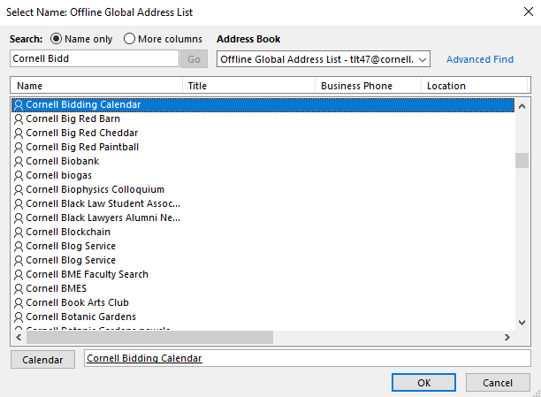
Cornell Bidding Calendar – Where & How ?
2. Search for “Cornell Bidding Calendar” and add it to your calendars by double clicking on it and then hitting OK
11

Slide 12
Cornell Bidding Calendar – Where & How ?
3. When creating meetings on the Facilities Contracts calendar, please add pmbidcalendar@cornell.edu as an attendee so the meetings will show up on our Cornell Bidding Calendar
12

