Slide 1
e-Builder tips of the month
October 2019

Slide 2
e-Builder Schedule Details
Tip 1: Schedule Details
Notes:
Problems with Schedule view Details
Manager Role & Manager User – Not you? Have it changed to you
Check Calendar Default Settings
Start Date = Correct Date? If not change it and Save
Hours Per Day = 8
Hours Per Week = 40
Days Per Month = 20
Work Day Start Time = 8:00am
Work Day End Time = 4:00pm
Work Week = Monday – Friday
Another area to look at is Predecesor Tasks, - If not in use in schedule Remove and Save

Slide 3
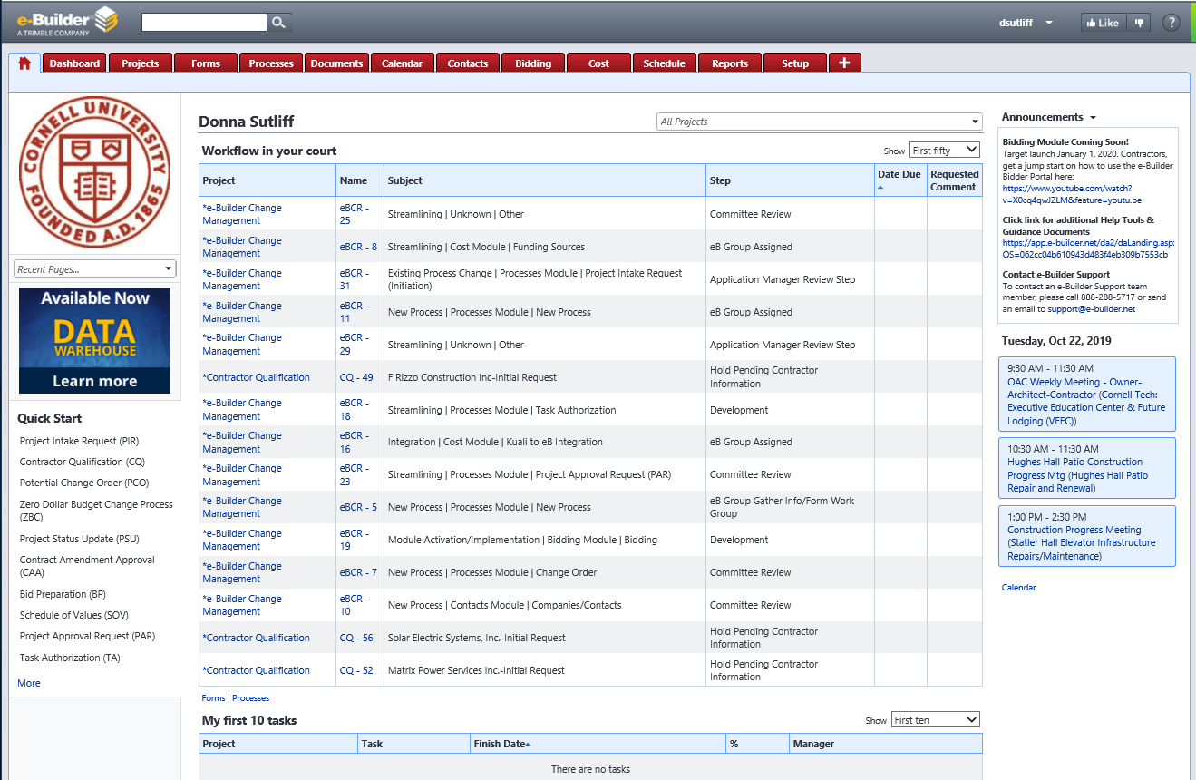
e-Builder Classic Style – Home Page
Tip 2: New Look & Navigation Coming Soon!
Notes:
Navigation changes – page listing location

Slide 4
e-Builder Modern Style – Home Page
Tip 2: New Look & Navigation Coming Soon!
Notes:
Modern Visual Style
Color palette changes
Blue Bar (not gray)
Blue Tabs (not red)
Page rids/tables increased white space
Color contrasts comply with Accessibility WCAG Level II

Slide 5
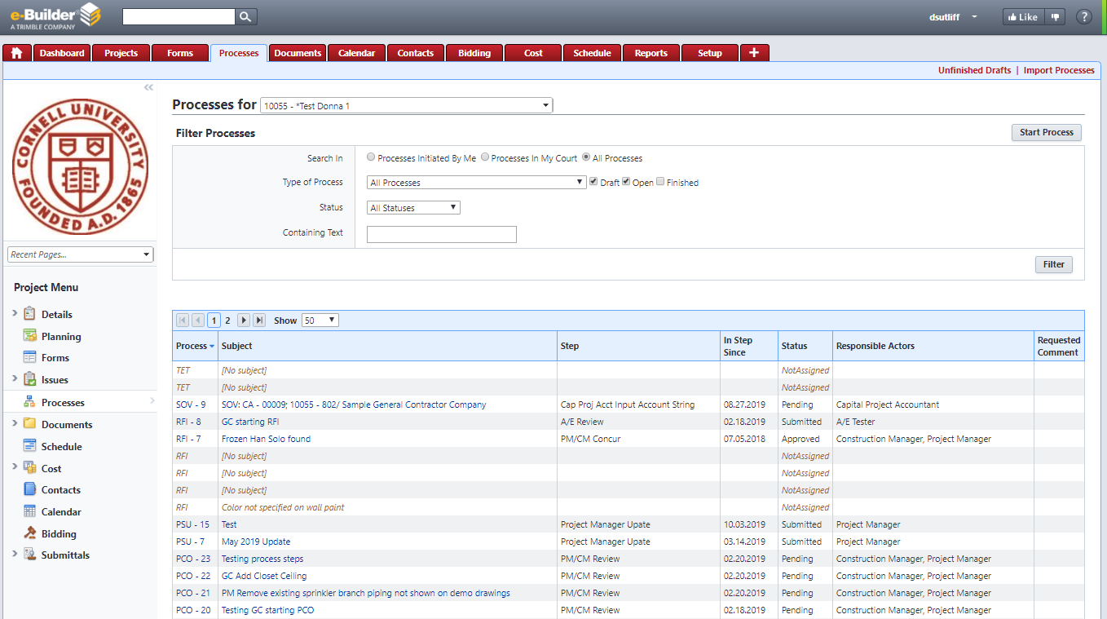
e-Builder Classic Style – Processes Tab
Tip 2: New Look & Navigation Coming Soon!

Slide 6
e-Builder Modern Style – Processes Tab
Tip 2: New Look & Navigation Coming Soon!
Notes:
Note navigation changes
eBuilder is calling it the Modern Style

Slide 7
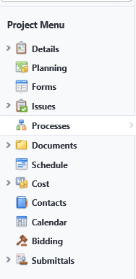
e-Builder Classic vs. Modern – Project Menu
Tip 2: New Look & Navigation Coming Soon!

Slide 8
e-Builder Classic vs. Modern Style
Tip 2: New Look & Navigation Coming Soon!
Notes:
Sometime in November – a “switch” button will appear
Switch to Modern Style
Switch to Classic Style
Sometime in 2020 – the Modern Style will become permanent change.

Slide 9
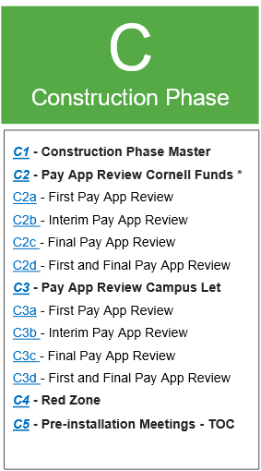
e-Builder Payment Application Review
Tip 3: Payment Application Review
Notes:
We have been working on Payment Application Review Checklists
Have found some discrepancies among contract documents and the standard submittals template regarding what exactly must be submitted prior to a first payment and prior to final payment.

Slide 10
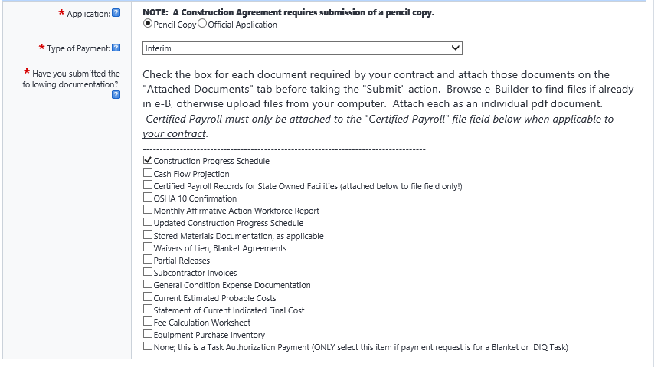
e-Builder Payment Application Review
Tip 3: Payment Application Review
Notes:
Today, we just want to remind folks that: Before taking the approve action on the payment application, PMs/CMs are expected to review the checklist and verify that the required documentation has been submitted.
Requirements change based on a several variables:
Contract Type: Cornell Contract or Campus Let Contract
e-Builder Commitment Type – Blanket Agreement-Trades, Short Form Construction Contract, or Construction Agreement
Construction Agreement could be GMC/GMP (very few)
Type of Payment -- First, Interim, Last OR First & Final Payment
However, the list that pops up is only based on Type of Payment; therefore, it is incumbent upon the PM/CM to:
know what the contract requirements are and
verify that the contractor is in compliance prior to approving a payment application
We will be working to provide clarity in the new Pay App Review checklists around what actually MUST be attached to a Payment Application.
We will also be reviewing the eBuilder payment application process layouts to provide more clarity there as well.

Slide 11
e-Builder Questions?
October 2019

