Slide 1
Asbestos Project Manager / Facility Manager Training
Occupational Health Safety Injury Prevention
Environment Health and Safety
Greg Smith

Slide 2
Agenda: - Background - HS16 requirements - Project Manager Responsibilities - Facility Manager Responsibilities - Facility Survey Webpage - Incidental disturbance

Slide 3
Background
Asbestos is a naturally occurring mineral.
Asbestos used in variety of building materials
- purpose was as binder, fire/heat/chemical resistance, an insulator
- some materials that asbestos maybe found in: floor tile, sheet goods, mastics, roofing, pipe insulation, ceiling tiles, drywall and taping compounds
Asbestos is a material that is regulated by OSHA, EPA, NYS DOL, and Cornell Asbestos Management Program.

Slide 4
Environment Health and Safety
Developed the Cornell University asbestos program titled HS16 Asbestos Management Program
Covers roles and responsibilities for various groups
Regulatory requirements pertaining to surveys/abatement
Notifications
Training
Refer to the following link to review the Asbestos Management Program https://ehs.cornell.edu/system/files/private/resource-files/HS16_AsbestosManagementProgram_0.pdf

Slide 5
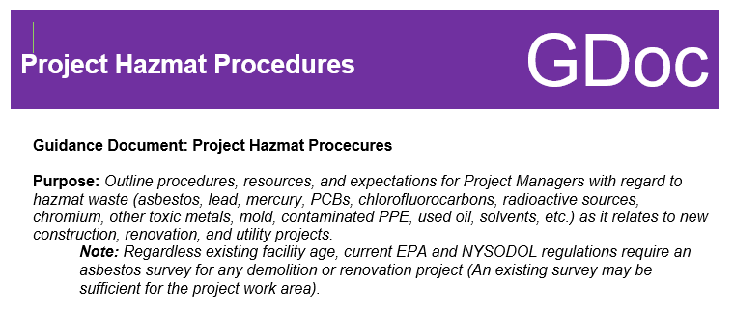
PM Guidance Document
Brad Newhouse created this guidance document for dealing with hazmat material and capital projects from a PM perspective
Covers – phases of the project primarily for asbestos but also PCBs, Universal Waste, Mercury, etc.
Resources
General Environmental Requirements
tips

Slide 6
Project Manager responsibilities
Cornell University project managers overseeing maintenance, renovation, or other activity where asbestos containing materials may be present have the following specific responsibilities:
Identifying, with the assistance of the Asbestos Coordinator, asbestos containing building materials prior to maintenance, renovation or other activities where asbestos containing materials may be disturbed
Notifying prospective contractors bidding for work whose employees can be expected to work in areas containing ACM of the presence, location and quantity of ACM.
Contracting with approved licensed asbestos consulting firms and abatement contractors in close consultation with the Asbestos Coordinator
Issuing service requests for asbestos-related services

Slide 7
Immediately report any incidental disturbances of asbestos containing material as defined section 5.4
Schedule project dates with sufficient lead times for asbestos abatement
Ensuring contractor provides documentation to support all new buildings and building renovation projects are asbestos-free as specified in section 7 and submit such documents to the Asbestos Coordinator
Pre-installed or installed materials are to be surveyed and sampled by third party asbestos certified inspection firm for verification all building materials are asbestos-free material
Submit all asbestos survey, pre and post asbestos abatement and inventory documentation to the FM Asbestos Coordinator, this is to be electronically

Slide 8
Facility Manager responsibilities
Review work requests and evaluate potential for work requested to impact ACM/PACM
Promote accomplishment of facilities work in accordance with this program
Identifying, with the assistance of the Asbestos Coordinator, asbestos containing building materials prior to maintenance, renovation or other activities where asbestos containing materials may be disturbed
Scheduling project dates with sufficient lead times for asbestos abatement
Where projects may impact or disturb ACM notify contractor or Cornell personnel performing the work of presence of ACM
Maintain required asbestos signage as specified in section 6.0
Posted asbestos project occupant notifications on entrances to facility
Posted signage on mechanical room entrances

Slide 9
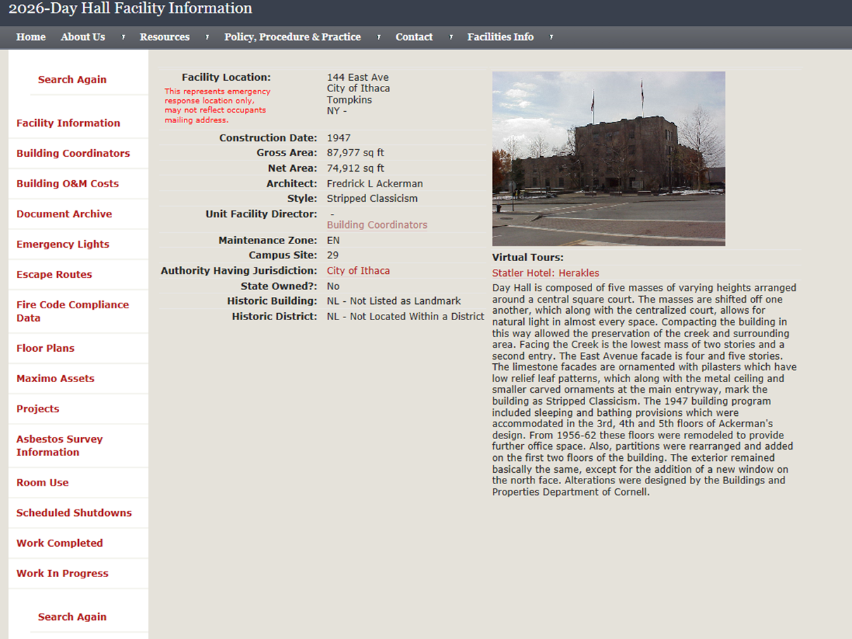
Facilities Asbestos Survey Webpage
To access the specific building information go to Find Facility Information http://www.fs.cornell.edu/fs_facilFind.cfm type in the building code or name
Click on Asbestos Survey Info tab

Slide 10
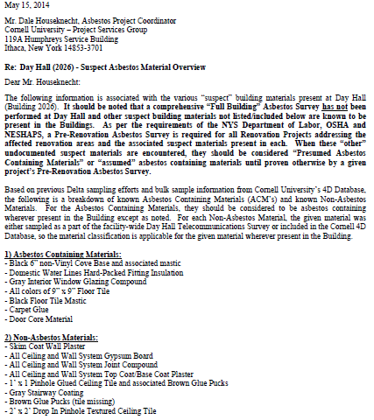
Facility Survey webpage cont’d
After reviewing the building asbestos summary information if material is not listed then contact FCS Asbestos coordinator
A work order request will need to be issued to the FCS Asbestos coordinator
Once received the Asbestos coordinator will contact the Environmental contractor to preform the survey and sampling for asbestos material
The results will be relayed to the requestor

Slide 11
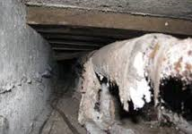
Incidental Disturbance
Defined as the unintentional disturbance of asbestos containing material (ACM) or presumed asbestos containing material (PACM).
NYS Regulation for the property owner upon discovery to contract with licensed abatement contractor to isolate the area, done by Asbestos Coordinator or consultant
The clean-up of an incidental disturbance must be conducted by a licensed asbestos abatement contractor.
An environmental consultant under the direction of the Asbestos Coordinator will oversee the clean-up response.

Slide 12
Incidental disturbance cont’d
In the event an incidental disturbance of asbestos is encountered, the following protocol shall be followed:
Do not attempt to clean up the ACM or PACM
Immediately vacate the room and restrict access to room using signage and barrier/caution tape
Issue an emergency Request for Service to the Asbestos Coordinator by contacting Customer Service at 255-5322. State that you have an “asbestos incidental disturbance”
Outside of normal business hours, call CU Police at 255-1111 to report an asbestos incidental disturbance or emergency

Slide 13
References located
Visit EHS web page
Under the Occupational Safety Health and Injury Prevention tab is the Asbestos program
https://ehs.cornell.edu/campus-health-safety/occupational-health/asbestos

