Slide 1
eB MINUTE
July 2020
Upcoming Security Changes

Slide 2
Upcoming Security Changes
Concurrent Session Restriction – July 2020
Limited to a total of Two (2):
2 devices
2 different browsers
Across all platforms
Error Message:
“The entered login credentials are currently being used for multiple sessions. Please log out of one or more of the sessions to continue.”
Notes:
e-Builder/Trimble has indicated this will happen in July 2020, so we expect it any day now – Cornell e-B Group has no control over these settings.

Slide 3
Upcoming Security Changes
Password Policy – Monday, July 27, 2020
8 character minimum
1 letter, 1 number, 1 special character
Expires every 90 days & the system will remember past 5 passwords used
5 failed log in attempts will result in 30-minute lockout period*
60-minute automatic inactivity timeout
Notes:
Stricter options are available, Cornell will keep these default settings, and these will take effect on Monday, July 27, 2020. (eB/Trimble say sometime in August 2020; we are being proactive)
*eB Admins will be able to send a Reset Password email if 30-minute lockout causes critical delay

Slide 4
Reminder: New Look & Navigation Coming Soon!
Classic vs. Compass (Modern) Style – Any Day Now!
October 2019 PMPD e-Builder Tips Presentation
e-Builder has made modifications to the new look based on user feedback over the past several months
Sometime in 2020 the Classic style will be retired
Recommend switching to Compass style now

Slide 5
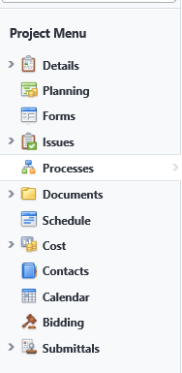
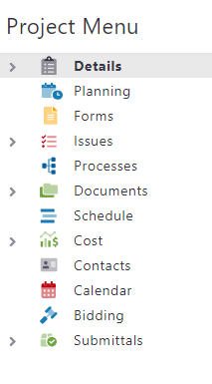
Classic vs. Compass (Modern) Style – Any Day Now!
Reminder: New Look & Navigation Coming Soon!
Notes:
Color contrasts comply with Accessibility WCAG Level II

Slide 6
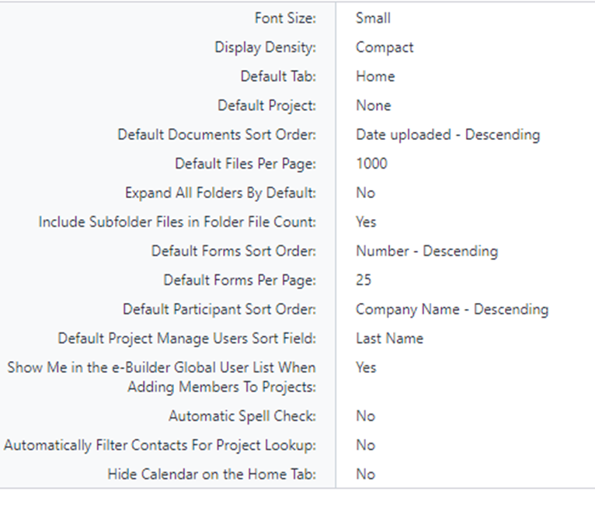
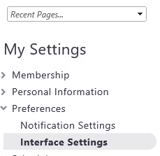
Setup Tab: My Settings/Preferences/Interface Settings
Reminder: New Look & Navigation Coming Soon!
Notes:
Setup Tab, My Settings, Preferences, Interface Settings, Click the Update button and configure any of the items listed.

Slide 7
Questions?

