Slide 1
*As you sign on, please send your net ID to Paula Slocum via a private chat so she can mark you as attended

Slide 2
Project Management – Professional Development Series
Facilities and Campus Services Engineering and Project Management
July 23, 2020

Slide 3
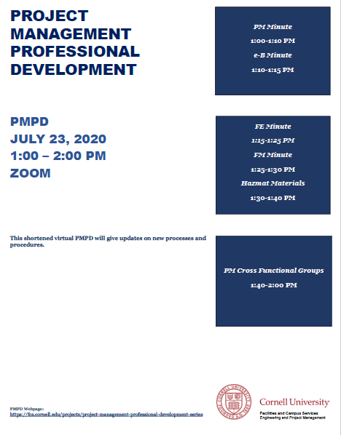
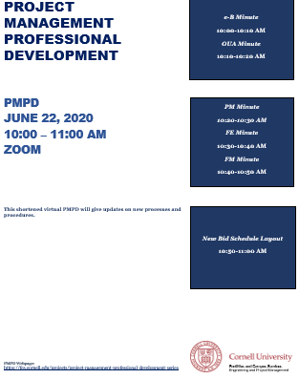
Today’s Agenda
PM Minute: Quarterly Construction Report
Andrew Magré
e-B Minute: e-Builder Security Changes
Donna Sutliff
FE Minute:
Building Code Program Manager Office Hours
Mike Niechwiadowicz
Inspection Report
Rob Murray and Jake Duell
FM Minute: Pooled Contingency Plan
Keith Barton and Jim Gibbs
PM Cross Functional Groups
Brad Newhouse (Design Phase)
Andrew Germain (Bid Phase)
Hazmat Materials
Greg Smith

Slide 5
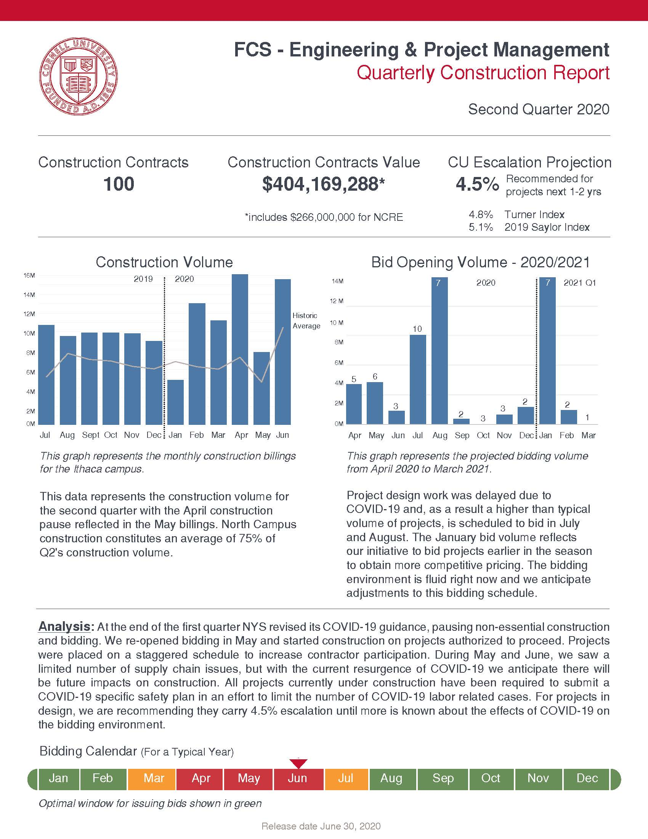
Q2 Report

Slide 6
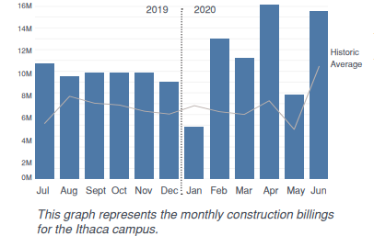
Construction Volume

Slide 7
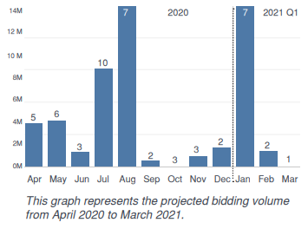
Bid Opening Volume - 2020/2021

Slide 8
Questions?
Notes:
Questions?

Slide 9
eB MINUTE
July 2020
Upcoming Security Changes

Slide 10
Upcoming Security Changes
Concurrent Session Restriction – July 2020
Limited to a total of Two (2):
2 devices
2 different browsers
Across all platforms
Error Message:
“The entered login credentials are currently being used for multiple sessions. Please log out of one or more of the sessions to continue.”
Notes:
e-Builder/Trimble has indicated this will happen in July 2020, so we expect it any day now – Cornell e-B Group has no control over these settings.

Slide 11
Upcoming Security Changes
Password Policy – Monday, July 27, 2020
8 character minimum
1 letter, 1 number, 1 special character
Expires every 90 days & the system will remember past 5 passwords used
5 failed log in attempts will result in 30-minute lockout period*
60-minute automatic inactivity timeout
Notes:
Stricter options are available, Cornell will keep these default settings, and these will take effect on Monday, July 27, 2020. (eB/Trimble say sometime in August 2020; we are being proactive)
*eB Admins will be able to send a Reset Password email if 30-minute lockout causes critical delay

Slide 12
Reminder: New Look & Navigation Coming Soon!
Classic vs. Compass (Modern) Style – Any Day Now!
October 2019 PMPD e-Builder Tips Presentation
e-Builder has made modifications to the new look based on user feedback over the past several months
Sometime in 2020 the Classic style will be retired
Recommend switching to Compass style now

Slide 13
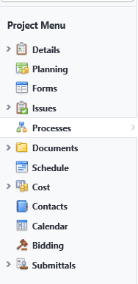
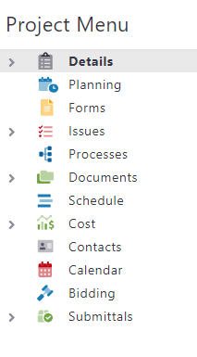
Classic vs. Compass (Modern) Style – Any Day Now!
Reminder: New Look & Navigation Coming Soon!
Notes:
Color contrasts comply with Accessibility WCAG Level II

Slide 14
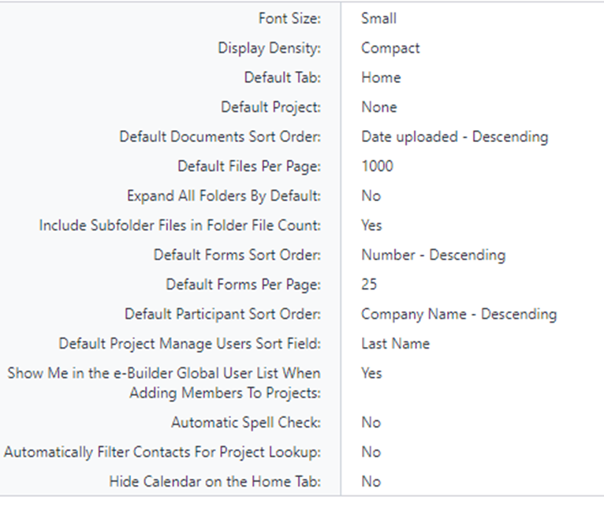
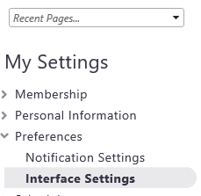
Setup Tab: My Settings/Preferences/Interface Settings
Reminder: New Look & Navigation Coming Soon!
Notes:
Setup Tab, My Settings, Preferences, Interface Settings, Click the Update button and configure any of the items listed.

Slide 15
Questions?

Slide 16
Centrally Funded Planned Maintenance Pooled Contingency
Goal- Spend Planned Maintenance funding more quickly
Strategy- Avoid sequestering funding unnecessarily, such as individual project contingencies…
Effective 7/1/2020, FM administered, centrally funded planned maintenance project’s contingency amount is capped at 3.5% for projects less than $2 million.
FM has created a separate contingency pool in the event specific projects need additional contingency funding.
“Signature PARs” will be the mechanism for projects to increase contingency funding- only the E&PM Project Director and Gibbs need approve. Magre and Barton are alternates.
EVP approved plan is found here in e-Builder

Slide 17
Cross Functional Teams Update (Design)
Focused on Pre-Design and Design phases – from PM perspective
- Best Practices, Lessons Learned, Items to Consider
Meet twice a month
Current Team:
- Elisabete Godden, Susan Evans, Tammy Johnson, David Vanderpoorten,
Ram Vankat, Brad Newhouse, Taylor Thompson
Create/Update Templates, Checklists, and Guidance Documents in collaboration with SMEs
Notes:
-Where and why behind cross functional teams
-Starting with construction management (combining PM and CM)
-Want to join a group?
-leadership representation or interest
-interest in contributing
-Reference FE
-Link to SPDs and opportunities to leverage interest, subject matter expertise, and skillsets
-Reaching out to appropriate stakeholders and getting buy in
-Checklists act as a resource to disseminate info to PMs

Slide 18
Cross Functional Teams Update (Design)
Items Accomplished:
Updated RFP Checklists
Municipal Approvals
State vs Cornell Funded
Preliminary Site Guidelines
FCS Asbestos Program Services
Project Hazmat Procedures
Monthly Status Update Guidance Doc
FIG and PM Related Activities
Items Nearly Complete:
Low-Sloped Roofing Projects
Site Guidance (Temporary and Permanent)
Historic Municipal Approvals
Classroom Projects
Lab Renewal Projects
Cost Control Guidance Document
Scope Validation Agenda (Bid Group)

Slide 19
Cross Functional Teams Update (Design)
In the Works:
CIT - Guidance Document
A/V - Guidance Document
Security and Access Control – Guidance Document
ADA – Guidance Document
Space Programming – Guidance Document
SWPPP - Guidance Document
Elevator Renewal – Guidance Document
Shops Construction – Guidance Document
Moving/Surge/Phasing Plans – Guidance Document
Building Envelop Renewal Projects
Biannual Art Projects
Suggestions/Recommendations?

Slide 20
Bid Phase Cross-Functional Group
Mission Vision:
Leverage the expertise, perspectives, and experience of a cross functional group to develop improvements to the Bid Phase process at Cornell University;
Proactively Engaging the Contracting Community
Cornell Processes – Education & Training
Campus Wide Bidding Strategy
Notes:
Proactively Engaging the Contracting Community
Contracting forum
Bidder Selection
Contac
Education & Training of Cornell Processes
Development of a Bidding Strategy

Slide 21
Bid Phase Cross-Functional Group
Cross Functional Group Members:
PM Groups
eBuilder Hub
FCS Contracts Office
?????
Expectations:
Brainstorm Initiatives – “Identify Friction Points”
Working Sessions (every two weeks)
Lead & Support roles on prioritized initiatives
Next Session: (August 13, 2020)
Notes:
Memo – Signed Back in January 2020
- Planned Maintenance Projects will utilize a pooled contingency

