Slide 1
Ebuilder closeouts
FIG Archiving

Slide 2
This resource provides:
a foundation for campus maintenance and repair work
historic context for future development
academic resource for those interested in studying campus projects or building designs
WHY?
Cornell building maintenance support
Project managers
Designers
Faculty
Students
WHO?

Slide 3
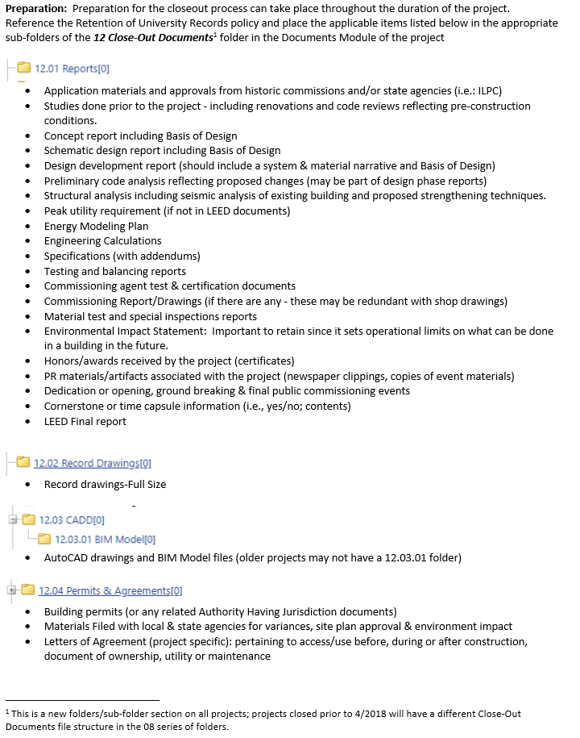
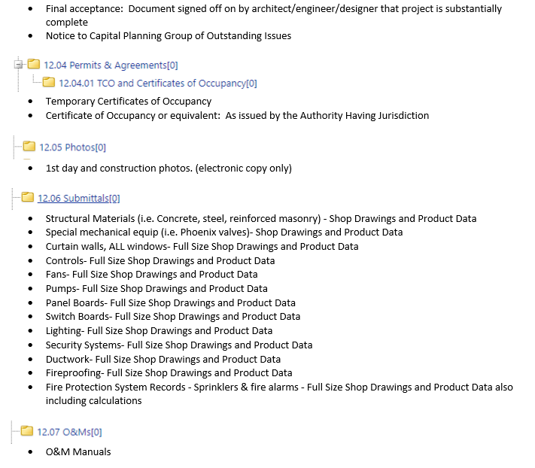
00007 - *e-Builder Resources

Slide 4
Close Out process - Submit
Archiving

Slide 5
Actors will receive an email notifying “Action is Required”:
Jane Van Derzee and Rebecca Merritt

Slide 6
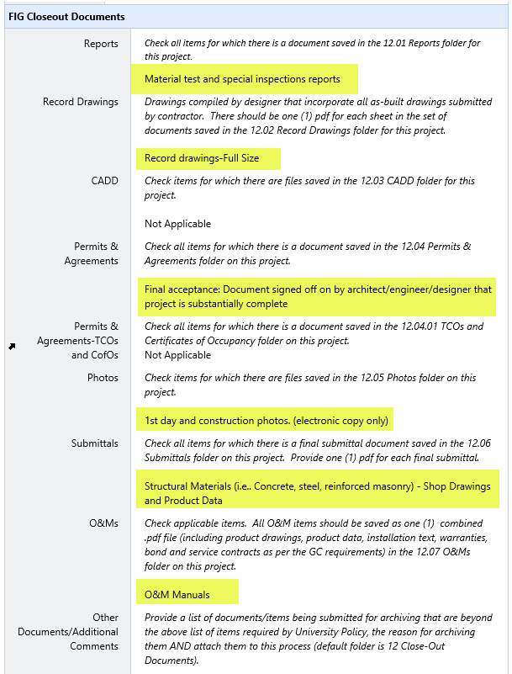
Email notice will identify the documents you have selected to be archived

Slide 7
Additional Comments Or
Specialty Documents to Archive
Example: You select Record Drawings but only have Construction Drawings or
Why there is nothing to archive, “this project was code compliance only and done by shops”
*Great Resources:
Patrick Conrad for Documents and types to Archive
Randy Nesbitt and Linda Adams for “Specialty” Documents to Archive

Slide 8
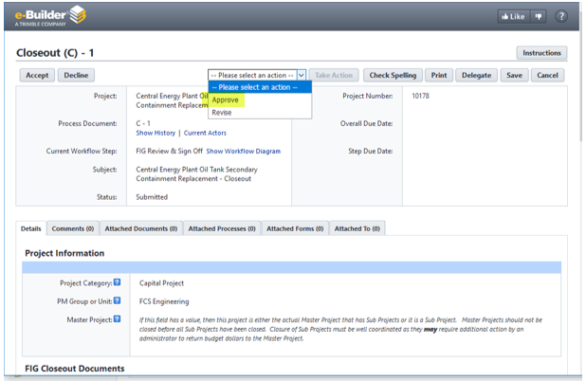
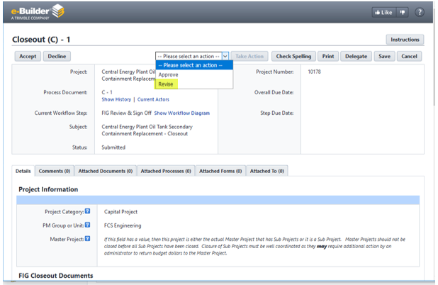
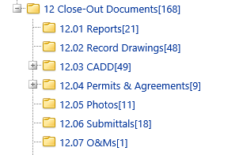
If Selected items are in closeout folders: FIG Approve
If Selected items are missing or questions: FIG Revise
FIG Archiving Close-Out Folders

Slide 9
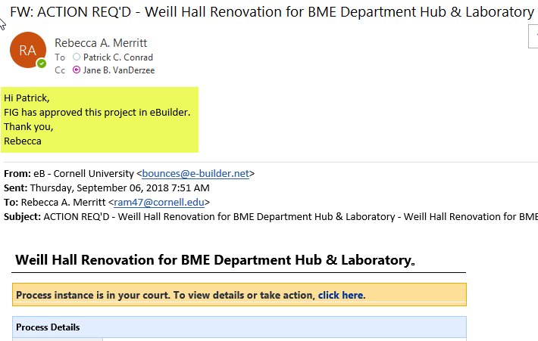
Email notice when FIG has Approved

Slide 10
If “Revised” project will be back in your court

Slide 11
What’s New?
BIM – Copy files to 12.03.01 BIM Model
MultiVista Photos – In “Other Documents/Additional Comments” field type MultiVista Photos

