Slide 1
eB MINUTE
May 2020
Project Details Custom Fields:
Architect/Engineer of Record
Prime Contractor
Comment V. Request Comment

Slide 2
Project Details Page Items Updated
via the Contract Approval Process
Project Custom Fields are auto populated with Company Name upon approval of a Contract Approval (CA) Process (as of 4/24/2020):
Architect/Engineer of Record
If commitment is for a design services where construction documents are a deliverable
Prime Contractor
If CA is for a Construction Agreement commitment type
Notes:
PM’s no longer need to manually update these particular project custom fields, In fact, for Capital Projects we ask that you do not manually update.
If more than 1 Construction Agreement on same project, more than one Company will be listed as Prime Contractor on details page

Slide 3
Comment V. Request Comment
Notes:
When do I use Comment?
When do I use Request Comment?

Slide 4
Comment V. Request Comment
Comment:
Any user who can view a process can add a comment at any time; in some cases even after the process is complete.
A comment made using this button does not automatically alert any actor/user that a comment has been made.
Notes:
Use it to make comments that you want other actors to see going forward in the process.
Actors in the process going forward and anyone who can view the process can read all comments that have been made.

Slide 5
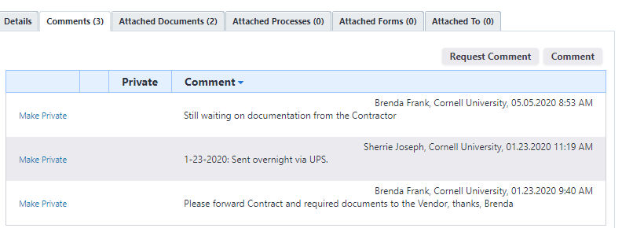
Comment
Notes:
Here’s what a Comment looks like:
Indicates who made the comment and exactly when it was made
Facilities Contracts staff making comments as a process moves forward AND also why it is not moving forward as reference to anyone who might look and wonder why is this process stuck?
Comments will also look like this whenever actors are prompted/required to make a comment when taking a Revise, Reject, or Void action as well.

Slide 6
Comment V. Request Comment
Request Comment:
An actor on a process may Request Comment from Users on the project or from external via email address.
Requestor has option of allowing files to be attached (must designate the document folder) and including a respond by date.
Sends email to the person from whom you have requested comment.

Slide 7
Comment V. Request Comment
Request Comment:
Users assigned a role on the Project will also have an action in their court (eB Home Page).
Externals must respond via the “click here” link embedded in the email notification.
Request is only “active” while the process remains in the step from which the request was made.
Notes:
If process moves forward without a response; the ability to respond directly via the action item or the “click here” link is no longer an option for the responder – error message will be generated.
DR process is a great example of when this has often occurred.

Slide 8
Requested Comment
Joe Manager, Cornell University, 05.05.2020 1:21 PM
Requested comment on step Error Code Step #2 from Jane Administrator xxxx@cornell.edu. Hi Jane, This is the CO I've been asking about on this project. I submitted a ZBC to move contingency into the construction line, which was approved. There should be money, so I'm not sure why I'm getting this error message. Help? Thanks! Joe
Notes:
Here’s what a Requested Comment looks like:
Indicates who made the request for comment and exactly when they made the request
Indicates which step it was in when the request was made and who was asked to make a comment.
By the way, Salutations, extra spacing, and Signatures are not required

Slide 9
Requested Comment
Joe Manager, Cornell University, 05.05.2020 1:21 PM
Requested comment on step Error Code Step #2 from Jane Administrator xxxx@cornell.edu. This is the CO I've been asking about on this project. I submitted a ZBC to move contingency into the construction line, which was approved. There should be money, so I'm not sure why I'm getting this error message. Can you help? Thanks.
Notes:
It is OK to save yourself a few key strokes – people will know who it came from and who it was addressed to from both the email message that was received and by the requestor / requestee info.

Slide 10
Questions?

