Slide 1
Return to Work Health and Safety Training for COVID-19
Cornell University
Environment, Health and Safety

Slide 2
Objectives:
SARS-CoV-2 and COVID-19 Background
Transmission and Symptoms
Safe Work Practices
Hierarchy of Controls, Employee Health Protection Procedure, Face Coverings and Masks
The Chain of Infection
Community Update
Information and Resources
Notes:
The goal of this training is to provide the viewer with an overview of the virus, SARS-CoV-2 and provide a health and safety training for employees returning to work.

Slide 3
SARS-CoV-2 Background
First reported in late 2019
Over 1 million cases within the U.S.
New York State highest number of confirmed cases
Notes:
SCRIPT:
Severe acute respiratory syndrome coronavirus 2 (SARS-CoV-2) is a virus that causes COVID-19 infection in humans. Coronaviruses are enveloped viruses that contain positive-sense single-stranded RNA. SARS-CoV-2 is a newly emergent virus first reported as pneumonia of unknown etiology in late 2019. The virus has since spread globally and has been reported in at least 187 countries. In the United States, there have been over 1 million COVID-19 cases with New York State having the highest number of confirmed cases.

Slide 4
Route of Exposure
The virus spreads person-to-person
Like influenza and other respiratory viruses, transmission of COVID-19 spreads through respiratory droplets exchanged among close contacts.
Close contact is defined as “being within 6 ft of a person displaying symptoms of COVID-19 or someone who has tested positive of COVID-19”.
Notes:
SCRIPT:
SARS-CoV-2 exact routes of exposure are still under investigation. The most common form of transmission from person to person is through respiratory droplets. These droplets can be produced while talking, coughing, or sneezing. For transmission to occur, the virus needs to have contact with mucus membranes, which include eyes, mouth or possibly be inhaled into the lungs. COVID-19 may be spread by people who are not showing symptoms. Another form of transmission is through fomites. Fomites are objects or materials which are likely to carry diseases, such as doorknobs.
--------------------------------------------------------------------------------------------------------
Routes of exposure – the exact routes are still under investigation
Contact with mucus membranes via
Respiratory Droplets – most common form of transmission
Fomites

Slide 5
Virus Stability
SARS-CoV-2 can remain infectious for hours to days on surfaces.
A recent study found that viable virus is reduced after 72 hours.
In the study it was found:
Material | Tissue or Printing Paper | Copper | Cardboard | Wood or Cloth | Glass | Plastic or Stainless Steel
No viable virus after: | 3 hours | 4 hours | 24 hours | 2 days | 4 days | 7 days
Notes:
SARS-CoV-2 can remain infectious on surfaces for hours to days. A recent study found that viable virus is reduced after 72.
In the study they found:
No viable virus after three hours on tissue or printing paper.
No viable virus after four hours on copper surfaces.
No viable virus after 24 hours on cardboard surfaces.
No viable virus after two days on wood or cloth*.
No viable virus after four days on banknote or glass.
No viable virus after seven days on plastic or stainless steel

Slide 6
Travel Risk & Guidance
There is an increased risk for virus exposure when traveling.
For students and employees, “All Cornell-related travel is currently restricted to reduce the spread of COVID-19.”
Keep yourself informed on updates related to travel via Cornell University’s Coronavirus website under the Travel Restrictions heading.
Notes:
There is an increased risk for virus exposure when traveling.
For students and employees, all Cornell-related travel is currently restricted to reduce the spread of COVID-19. Continue to keep yourself informed on updates related to travel via Cornell Universities Coronavirus website

Slide 7
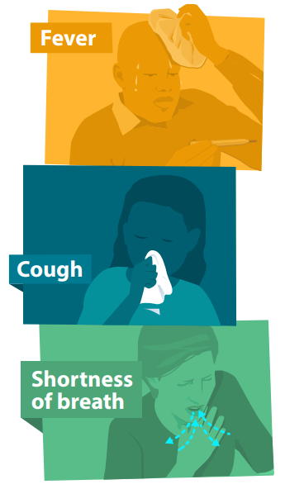
COVID-19 Symptoms
Wide-Range of Symptoms and Severity.
May appear 2-14 days after exposure to the virus.
Cough
Shortness of breath or difficulty breathing
Fever
Chills
Muscle Pain
Sore throat
New loss of taste or smell
Other less common symptoms, include gastrointestinal symptoms like nausea, vomiting, or diarrhea.
CDC NCIRD, 2020
Notes:
SCRIPT:
The symptoms for COVID-19 are still not fully understood. After exposure to the virus, symptoms may occur 2-14 day later.
The symptoms provided are described by the CDC and symptom severity can range from absent or mild to severe.
Symptoms can include fever, chills, muscle pain, cough, shortness of breath or difficulty breathing, headache, sore throat, and/or new loss of taste or smell. If you experience these symptoms or combinations of symptoms, you may have COVID-19.
Please review the SARS-CoV-2 BARS and The Centers for Disease Control and Prevention (CDC) for additional information on the agent.
------------------------------------------------------------------------------------------------
Picture Source https://www.cdc.gov/coronavirus/2019-ncov/downloads/COVID19-symptoms.pdf
Symptoms - may occur 2-14 days after exposure
The symptoms of COVID-19 are still not fully understood – the symptoms provided are described by the CDC. Symptoms severity can range from absent/mild to severe illness.
Fever, chills, muscle pain, cough, shortness of breath or difficulty breathing, headache, sore throat, and/or new loss of taste or smell
Please review the SARS-CoV-2 BARS and The Centers for Disease Control and Prevention (CDC) for additional information on the agent.

Slide 8
Hierarchy of Controls for COVID-19
For more information, visit:
COVID-19 Hierarchy of Controls
Notes:
SCRIPT:
The Hierarchy of Controls is a system used to deploy effective controls within an organization, workplace, or community to identify the most effective ways to control a hazard. Depicted within the inverted pyramid, the most effective controls are at the top and the least effective controls are on the bottom. This hierarchy of control is being used to identify the best practices for controlling a person’s exposure to SARS-CoV-2. No one control alone is perfect and that why it imperative you incorporate all of the controls into your day’s activities
For more information on the control methods, please visit EHS’s COVID-19 webpage. https://ehs.cornell.edu/campus-health-safety/occupational-health/covid-19/covid-19-hierarchy-controls

Slide 9
Elimination
Remote Work
New York State on PAUSE
Virtual Meetings
Avoid Scheduling in-person meetings
Avoid Public Places
Notes:
SCRIPT
The most effective method to reduce a person’s risk of exposure is through elimination. To eliminate risk of employee exposure to COVID-19, it is important to evaluate work that could and should continue to be performed remotely. Following the "New York State on PAUSE" executive order, effective March 22, only those who have been specifically informed they are to work on-site are allowed to do so. Everyone else must stay home and work remotely, where possible. In addition, avoid scheduling meetings that require physical attendance. Meetings, site visits, and training can be done using web conferencing applications, like zoom or skype, or video calls.

Slide 10
Hierarchy of Controls for COVID-19
For more information, visit:
COVID-19 Hierarchy of Controls
Notes:
SCRIPT:
The Hierarchy of Controls is a system used to deploy effective controls within an organization, workplace, or community to identify the most effective ways to control a hazard. Depicted within the inverted pyramid, the most effective controls are at the top and the least effective controls are on the bottom. This hierarchy of control is being used to identify the best practices for controlling a person’s exposure to SARS-CoV-2. No one control alone is perfect and that why it imperative you incorporate all of the controls into your day’s activities
For more information on the control methods, please visit EHS’s COVID-19 webpage. https://ehs.cornell.edu/campus-health-safety/occupational-health/covid-19/covid-19-hierarchy-controls

Slide 11
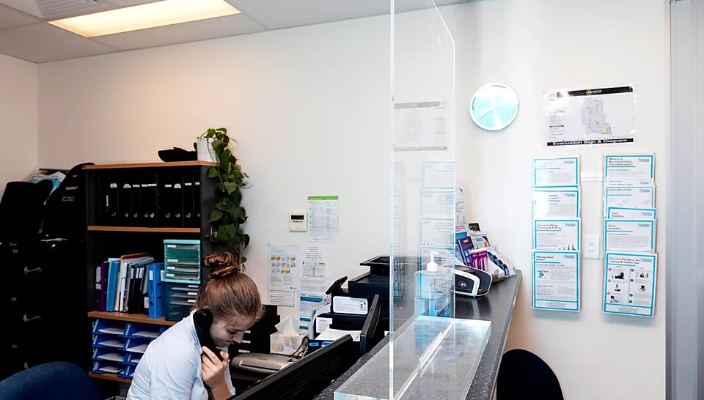
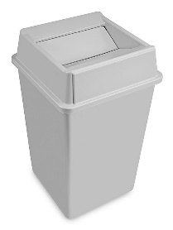
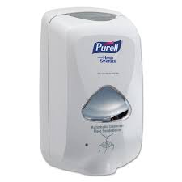
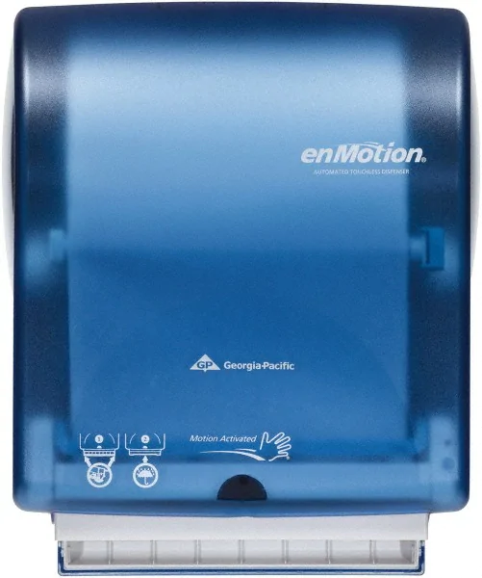
Engineering Controls
Installation of physical barriers.
Sneeze Guards, Plexiglass Screens, Drive-Thru Style Windows
Channelizing devices
Hands-free equipment, e.g. self-dispensing soap/sanitizers/ towels, hand-free trash cans/doors, etc.
EPA-Registered Disinfectants from List N. To be effective you need procedures.
Biosafety Cabinets in SARS-CoV-2 research facilities.
Notes:
SCRIPT:
Engineering controls are methods designed to protect workers by placing a barrier between them and the hazard, in this case, reduce risk of exposure to COVID-19. There are numerous engineering controls that can be implemented to protect essential staff on-campus.
Barriers, partitions, or ropes to separate employees from public or building occupants can be used to increase social distancing. For positions that have staff and customer interfaces, a physical barrier, like a clear plastic sneeze guard, should be installed.
2. Trash receptables and other similar equipment should be made hands-free [maybe explain why]
3. EPA-Registered Disinfectants from List N. To be effective you need disinfection procedures for facilities, shared equipment and spaces, work area, and personal electronics.
4. Researchers working with SARS-CoV-2 should do so in a Biosafety Safety Cabinet

Slide 12
Hierarchy of Controls for COVID-19
For more information, visit:
COVID-19 Hierarchy of Controls
Notes:
SCRIPT:
The Hierarchy of Controls is a system used to deploy effective controls within an organization, workplace, or community to identify the most effective ways to control a hazard. Depicted within the inverted pyramid, the most effective controls are at the top and the least effective controls are on the bottom. This hierarchy of control is being used to identify the best practices for controlling a person’s exposure to SARS-CoV-2. No one control alone is perfect and that why it imperative you incorporate all of the controls into your day’s activities
For more information on the control methods, please visit EHS’s COVID-19 webpage. https://ehs.cornell.edu/campus-health-safety/occupational-health/covid-19/covid-19-hierarchy-controls

Slide 13
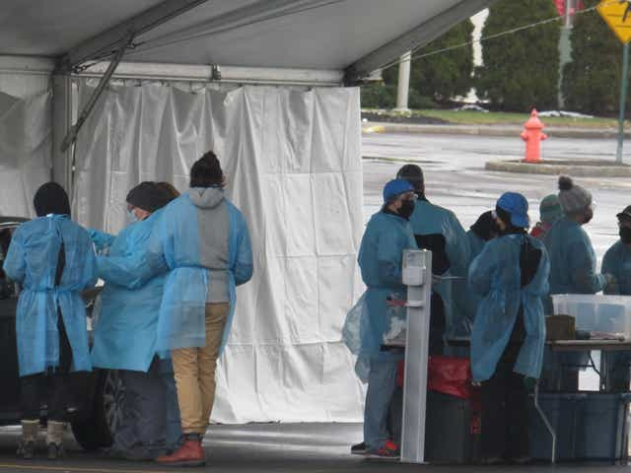
Employee Health Protection Procedure
Administrative Controls
Employee Health Protection Procedure
If you are sick, Stay Home
If you become sick at work, distance yourself from others, contact your supervisor, and go home.
Tompkins County Testing Location
Register to be tested at the Cayuga Health Sampling Site; online at cayugahealthsystem.org or call 607-319-5708.
April 25, Gov. Cuomo expanded testing to Essential Employees.
Ithaca Journal, 2020
Notes:
All employees should perform the health protection procedure – this procedure entails:
Employee Self-Monitoring
One-hour prior to an employees’ shift, the employee is required to take their body temperature with a thermometer and assess their health for other symptom
Employees who exhibit a temperature at or above 100.4° Fahrenheit or 2 degrees higher than their normal body temperature, should contact their supervisor immediately, and shall not report to work until employee has been fever-free for 72 hours (without fever reducing medicines) and other symptoms have resolved.
The requirements for this procedure are available online at ehs.cornell.edu or via the link provided.
The health protection procedures are as follows. If you are sick, it is important that you stay home. If you become to feel unwell while at work, you are to isolate yourself from others and immediately notify your supervisor. Testing for COVID-19 is available in Tompkins County. The Tompkins County health department provides the Cayuga Health Sampling Site information on their website. The link for that information is provided in this slide and in the handout following this presentation.
--------------------------------------------------------------
Sick Stay Home, If you become sick at work isolate yourself from others and notify your supervisor.
Employees should perform HPP.
TC Testing Location
Cayuga Health Sampling Site for Tompkins County Residents

Slide 14
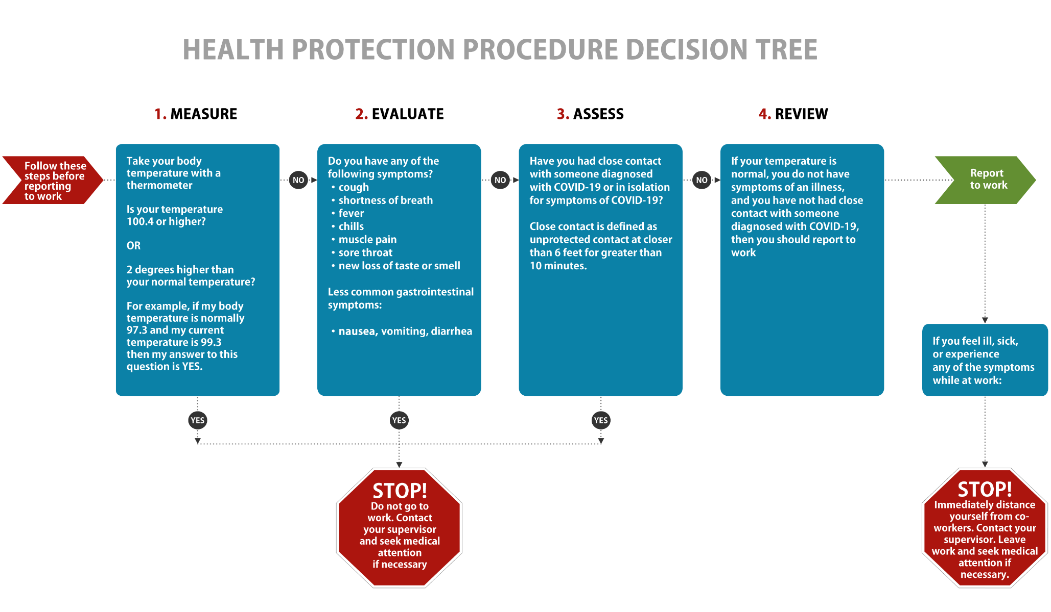
Notes:
This flow chart demonstrates the Pre-work decision tree from the Health Protection Procedure. These steps should be followed everyday before reporting to work.
The steps are measure, evaluate, assess, and review. If the responses are no to all the question provided – employees can report to work.

Slide 15
Social Distancing Guidelines
Administrative Controls
Stay at least 6-foot from other people
Arrange office space to ensure social distancing
Tape off and add signage to high traffic areas
Install visual floor markings at potential queuing areas
Establish occupancy restrictions
Notes:
SCRIPT:
There are several social distancing guidelines that employees are responsible to adhere to. It is important that all employees follow the 6-foot distance rule. This rule requires that 6-foot distance (or 2 arms lengths) is between every person. To ensure this guidance is followed, office space may need to be arranged. Removing or rearranging chairs and furniture will be done to ensure social distancing.
Taping off and addition of signage in high traffic spaces like kitchens, restrooms, elevator needs to be performed. As shown in the image provided, installation of visual floor markings at any potential queuing area such as circulation desk, cafes, cashier station ensures social distancing. Signage is available through the Environment, health and safety department. Finally, establishment of occupancy restrictions to maintain safe population density
-------------------------------------------------
Social Distancing Guidelines
Follow 6-foot social distancing guidelines
Add signage on the ground that demonstrate directionality
Taping off and add signage in high traffic spaces – to increase social distancing compliance - areas like kitchens, restrooms, elevator
Removing or rearranging chairs and furniture to ensure social distance
Installation visual floor markings at any potential queuing area such as circulation desk, cafes, cashier station, etc.
Establishment of occupancy restrictions to maintain safe population density

Slide 16
Hygiene Practices
Administrative Controls
Frequent hand washing
Washing should be performed for at least 20 seconds
If soap and water are not available, use hand sanitize (>60% ethanol)
Avoid touching your hands to your face
Cover mouth when coughing or sneezing
Notes:
SCRIPT:
To prevent the spread of COVID-19, it is important that all employees do frequent handwashing. Washing should be performed with soap and take around 20 seconds. If soap and water are not available, use hand sanitizer that contains at least 60% ethanol. If you find a sanitizer or soap dispenser that are empty – XXXX [what happens?]XX
Because of transmission of COVID-19 occurring through the mucus membranes (eyes, nose, and mouth) it is important to avoid touching your hands to your face. Also, to reduce the risk of spread, cover mouth and nose when coughing.
---------------------------------------------------------
Best Hygiene Practices
Frequent Hand Washing [Link]
Washing should be performed for at least 20 seconds
If soap and water are not available, use hand sanitize (>60% ethanol)
How to report absence of soap or sanitizer
How to get soap and sanitizer?
Avoid touching your hands to your face
Cover mouth when you cough or sneeze

Slide 17
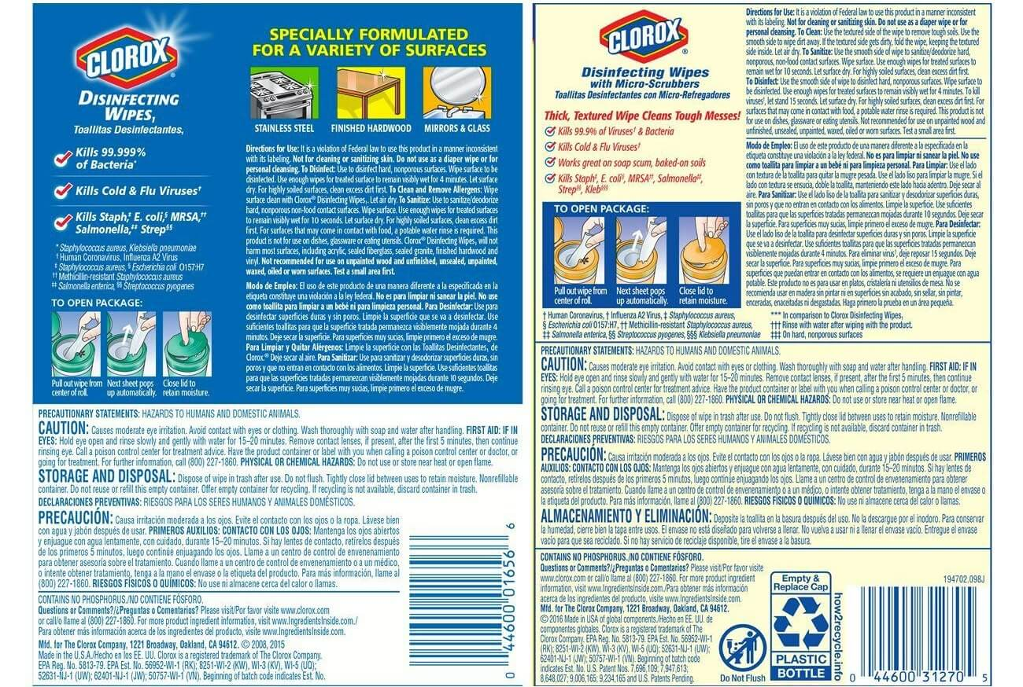
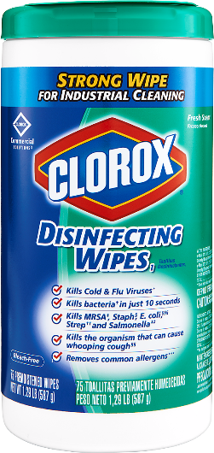
Disinfectant products and procedures
Administrative Controls
The SARS-CoV-2 virus can be easily inactivated with EPA’s N-list disinfectants
Dwell Time?
Building Care has Elevated their Disinfection Practices
Units must develop periodic procedures to disinfect personal and shared spaces, and equipment.
Focus on High touch surfaces
Keyboards
Telephones
Personal Handheld Devices
Remotes
Notes:
SCRIPT:
It is important that disinfectant products are found on the EPA’s List N disinfectants and that procedures are developed. SARS-CoV-2 virus can be readily inactivated with the disinfectants provided on the List N.
It is important to understand building care disinfectant practices and identify areas that are not routinely being cleaned. [additional information-Levi]
Personal spaces and high touch surfaces, like desk, keyboard, telephones need to be routinely disinfected.
[2 slides]
------------------------------------------------------------------
Disinfection Products and Procedures
The SARS-CoV-2 virus can be readily inactivated with EPA’s N-list disinfectants
Building Care Disinfection Practices
Items in your workplace not routinely cleaned by building care
Clean personal office spaces and surfaces with List N disinfectants at least 2X per day
High touch surfaces
Keyboards
Telephones
Personal Handheld Devices
Additional Procedures for Shared Areas, Equipment, and Tooling

Slide 18
Visitors and Shift Change Procedures
Administrative Controls
Visitors
“Effective Sunday, March 22 and until further notice, only students who have permission to remain in on-campus housing and essential personnel are allowed on campus.”
Establish shift change procedures.
Alternate days
Staggered start times
Extra shifts to reduce the total number of employees in a facility
This Photo by Unknown Author is licensed under CC BY-NC
Notes:
SCRIPT:
To better ensure the compliance of social distancing, establishing alternating days or extra shifts for employees will reduce the total amount within a facility.
To reduce non-employees from entering facilities, department visitation policies should be re-visited. – Maybe not include?
---------------------------------------------------------------------------------------
Shift Change Procedures and Visitation Policy
Establishing alternating days or extra shifts that reduce the total number of employees in a facility at a given time

Slide 19
Hierarchy of Controls for COVID-19
For more information, visit:
COVID-19 Hierarchy of Controls
Notes:
SCRIPT:
The Hierarchy of Controls is a system used to deploy effective controls within an organization, workplace, or community to identify the most effective ways to control a hazard. Depicted within the inverted pyramid, the most effective controls are at the top and the least effective controls are on the bottom. This hierarchy of control is being used to identify the best practices for controlling a person’s exposure to SARS-CoV-2. No one control alone is perfect and that why it imperative you incorporate all of the controls into your day’s activities
For more information on the control methods, please visit EHS’s COVID-19 webpage. https://ehs.cornell.edu/campus-health-safety/occupational-health/covid-19/covid-19-hierarchy-controls

Slide 20
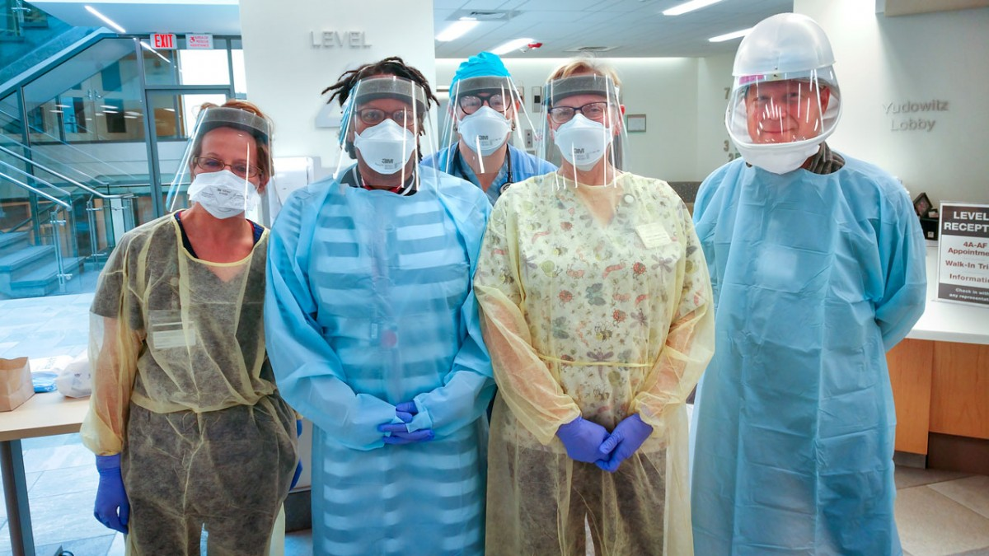
Personal Protective Equipment
PPE requirements for SARS-CoV-2 exist for:
Patient Contact
PUI Transport to Isolation Room
Isolation Room Entry
COVID-19 Research
N95 use by employees shall comply with the Respiratory Protection Program Requirements
COVID-19 Pandemic does not overrule Respiratory Protection Program requirements.
Notes:
Script:
For persons whose jobs require contact with materials which may be suspected of harboring SARS-CoV-2, personal protective equipment will be provided. Depending on the job task, the PPE prescribed may be different as relative risk changes. If your job requires you to wear an N-95 mask, PAPR, half-mask or full-mask respirator, employees must follow Cornell’s respiratory protection program requirements. There is a Voluntary Use Form available at ehs.cornell.edu
N95 respirators and KN95 respirators are critical supplies that must be reserved for healthcare workers, medical first responders and those performing the limited high-risk tasks directly supporting the continuity of healthcare, public safety or essential research.
---------------------------------------------------
Personal Protective Equipment @Joshua E. Turse Add a description. Press tab when you are done.
PPE requirements for COVID – only use for COVID-research & at health facilities (for clinicians)
Respiratory Protection Requirements
COVID-19 Pandemic does not overrule Respiratory Protection Program requirements.
Voluntary Use Form

Slide 21
Hierarchy of Controls for COVID-19
For more information, visit:
COVID-19 Hierarchy of Controls
Notes:
SCRIPT:
The Hierarchy of Controls is a system used to deploy effective controls within an organization, workplace, or community to identify the most effective ways to control a hazard. Depicted within the inverted pyramid, the most effective controls are at the top and the least effective controls are on the bottom. This hierarchy of control is being used to identify the best practices for controlling a person’s exposure to SARS-CoV-2. No one control alone is perfect and that why it imperative you incorporate all of the controls into your day’s activities
For more information on the control methods, please visit EHS’s COVID-19 webpage. https://ehs.cornell.edu/campus-health-safety/occupational-health/covid-19/covid-19-hierarchy-controls

Slide 22
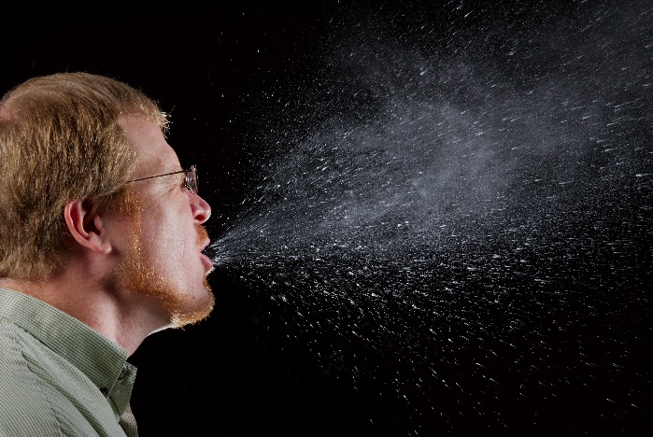
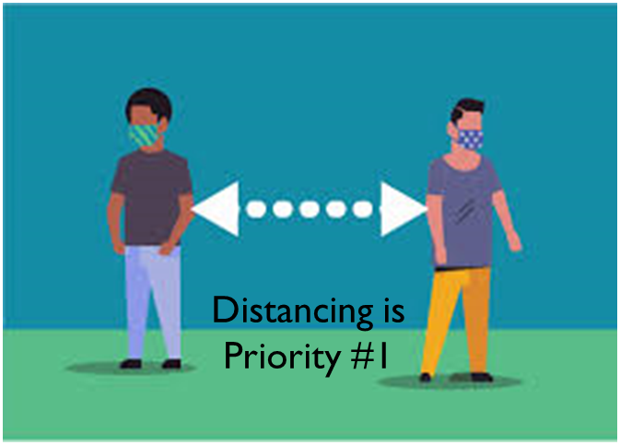
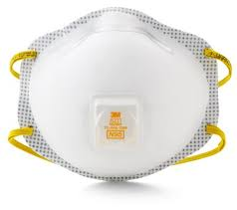
Community Protective Equipment (CPE)
Worn as a community effort to prevent asymptomatic carriers of COVID-19 from spreading the virus.
Employees and public are required to wear a cloth face covering when it is not feasible to maintain social distancing measures at work.
Face Covering or Mask at all times on Construction sites.
Wearing a face covering does not replace the need for social distancing or other measures.
Guidance for Face Coverings on EHS webpage
Notes:
SCRIPT:
Community Protective Equipment does not prevent the wearer from getting sick. It prevents the spread of the virus in the community.
Wearing face coverings and masks can help to prevent asymptomatic carriers of the virus from spreading the COVID-19 to others. All employees are required to wear a cloth face covering or mask when it is NOT feasible to maintain social distancing measures between coworkers, customers, and the public.

Slide 23
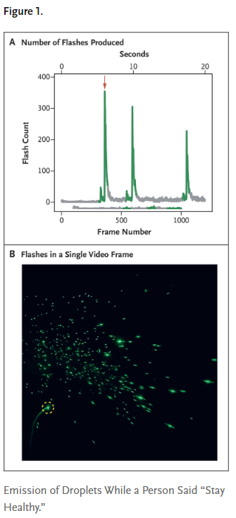
Effectiveness of Face Coverings
Visualizing Speech-generated Oral Fluid Droplets with Laser Light Scattering: New England Journal of Medicine. P. Anfinrud, V. Stadnytskyi, C. Bax, A. Bax - https://www.nejm.org/doi/full/10.1056/NEJMc2007800
Notes:
Visualizing Speech-Generated Oral Fluid Droplets with Laser Light Scattering - The second ½ researcher uttered the same phrase 3X through a slightly damp washcloth over the speaker’s mouth, the flash count remained close to the background level (mean, 0.1 flashes); this showed a decrease in the number of forward-moving droplets https://www.nejm.org/doi/full/10.1056/NEJMc2007800

Slide 24
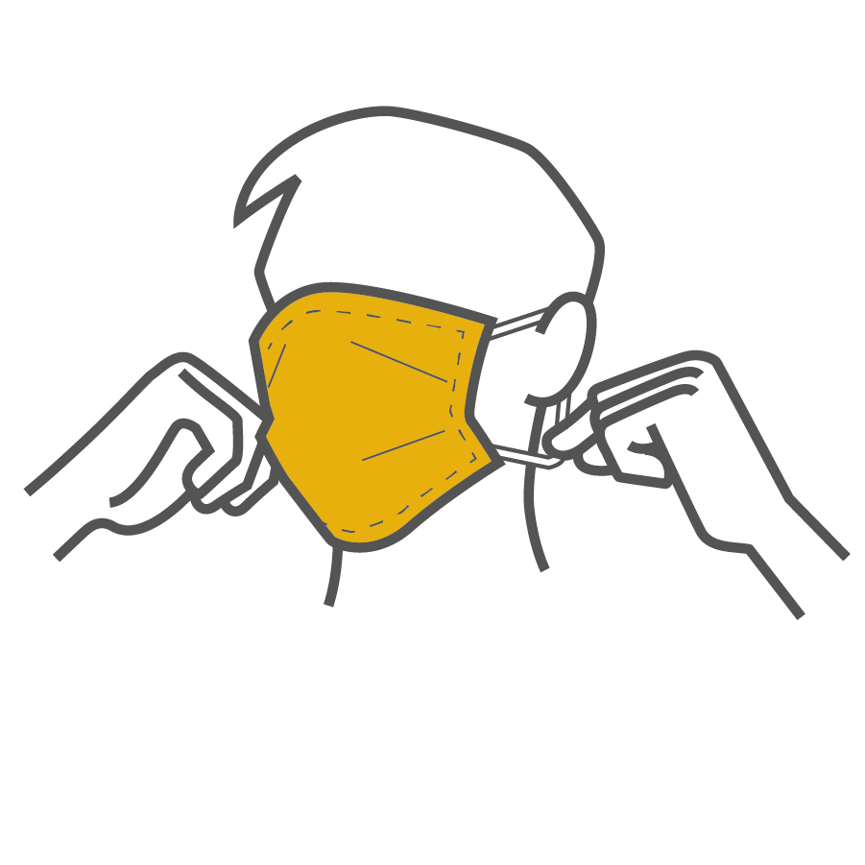
Community Protective Equipment continued…
Face Coverings and Masks – Donning and Doffing Procedures
Always clean hands with soap and water or an alcohol-based hand sanitizer with at least 60% alcohol prior to donning (put on), touching covering, or doffing (remove) your face covering.
When doffing face-covering use the ear loops, straps, or equivalent from behind the head to doff face covering, do not touch the front of the covering.
Supervisors can request face coverings or masks for their team. Follow process outlined in Coronavirus FAQs
Notes:
SCRIPT:
Always clean hands with soap and water or an alcohol-based hand sanitizer with at least 60% alcohol prior to donning (put on), touching covering, or doffing (remove) your face covering.
When doffing face-covering use the ear loops, straps, or equivalent from behind the head to doff face covering, do not touch the front of the covering.

Slide 25
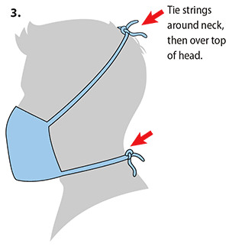
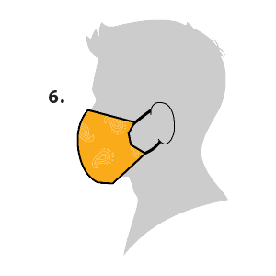
Community Protective Equipment continued…
Face coverings and masks, should:
Fit snugly but comfortably against the side of the face and cover from the bridge of the nose to the bottom of the chin.
Be secured with ties or ear loops
Include multiple layers of fabric
Allow for breathing without restriction
Notes:
SCRIPT:
Always clean hands with soap and water or an alcohol-based hand sanitizer with at least 60% alcohol prior to donning (put on), touching covering, or doffing (remove) your face covering.
When doffing face-covering use the ear loops, straps, or equivalent from behind the head to doff face covering, do not touch the front of the covering.

Slide 26
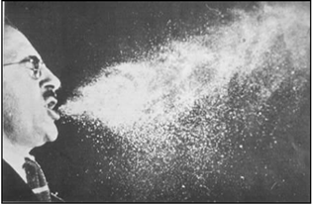
Breaking the Chain
Reservoir of pathogen
Portal of escape
Transmission
Route of entry/infectious dose
Susceptible host
Immune Response
Illness
Face Coverings and Masks
Quarantine, Isolation
Education, Closures,
Gathering & Travel Restrictions
Distancing, Time, Handwashing, Disinfection
Physical Barriers
Personal Protective Equipment
Public Health
Authorities
Contact Tracing
Reporting
Vaccination
Wellness Actions
Surveillance Testing
Medical Treatment
Individuals

Slide 27
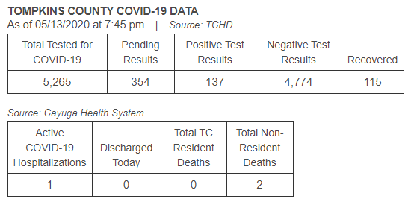
Community Update
Cornell University
5/11 Update, “For the time being, everyone who has been working remotely should continue to do so.”
Tompkins County
2.79% PUIs are confirmed cases
Total Confirmed Cases 137
.13% of Tompkins County Population
New York State
NY Forward starting May 15th
Established 7 Metrics for Regional restarts
Southern Tier region has the Green Light.
Four Phase Plan
Phase 1: Eligible for regional reopening 5/15.
Notes:
May 11th The Provost, Michael Kotlikoff, and CHRO Mary Opperman addressed the Cornell Community. It said “Importantly, for the time being, everyone who has been working remotely should continue to do so. However, for those of you who rely on university facilities, we are working on phased re-activation plans that will enable the safe resumption of activities, consistent with the governor’s directives”
NY Forward Metric includes criteria such as; 14-day decline in hospitalization and deaths, rate of new hospitalizations, total hospital beds, testing capabilities, and contact tracers

Slide 28
Resources
Cornell University:
Coronavirus Updates and FAQ
Human Resources COVID-19 Workplace Guidance
EHS COVID-19 Webpage
SARS-CoV-2 BARS, Employee Health Protection Procedure, Hierarchy of Controls, Employee Guidance for Face Coverings and Masks, Guidance for Facilities Staff, and Guidance for Essential Lab Work during the COVID-19 Pandemic
Government:
Tompkins County Health Department
New York State
New York Forward, and NYS DOH COVID-19 Tracker
Centers for Disease Control and Prevention
Notes:
SCRIPT:
There are additional resources for accessing Cornell and Tompkins Country specific information. Those resources are linked on this page and will be made available in a handout following this training.
In addition, it is important that departments develop an action plan for reintroducing employees back to an in-office setting. A COVID-19 Safe Work Plan template has been developed to help facilitate developing that action plan.

Slide 29
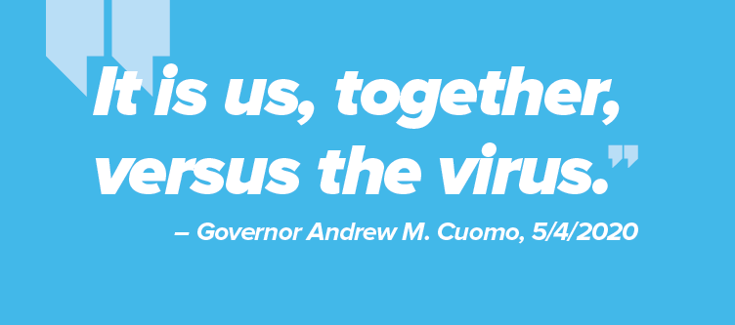
Questions
Write AskEHS@cornell.edu or by phone at 607-255-8200.
Notes:
Thank you for attending this training. Please contact askEHS@cornell.edu for any additional questions

