Slide 1
Project Management – Professional Development Series
Facilities and Campus Services Engineering and Project Management May 14, 2020

Slide 2
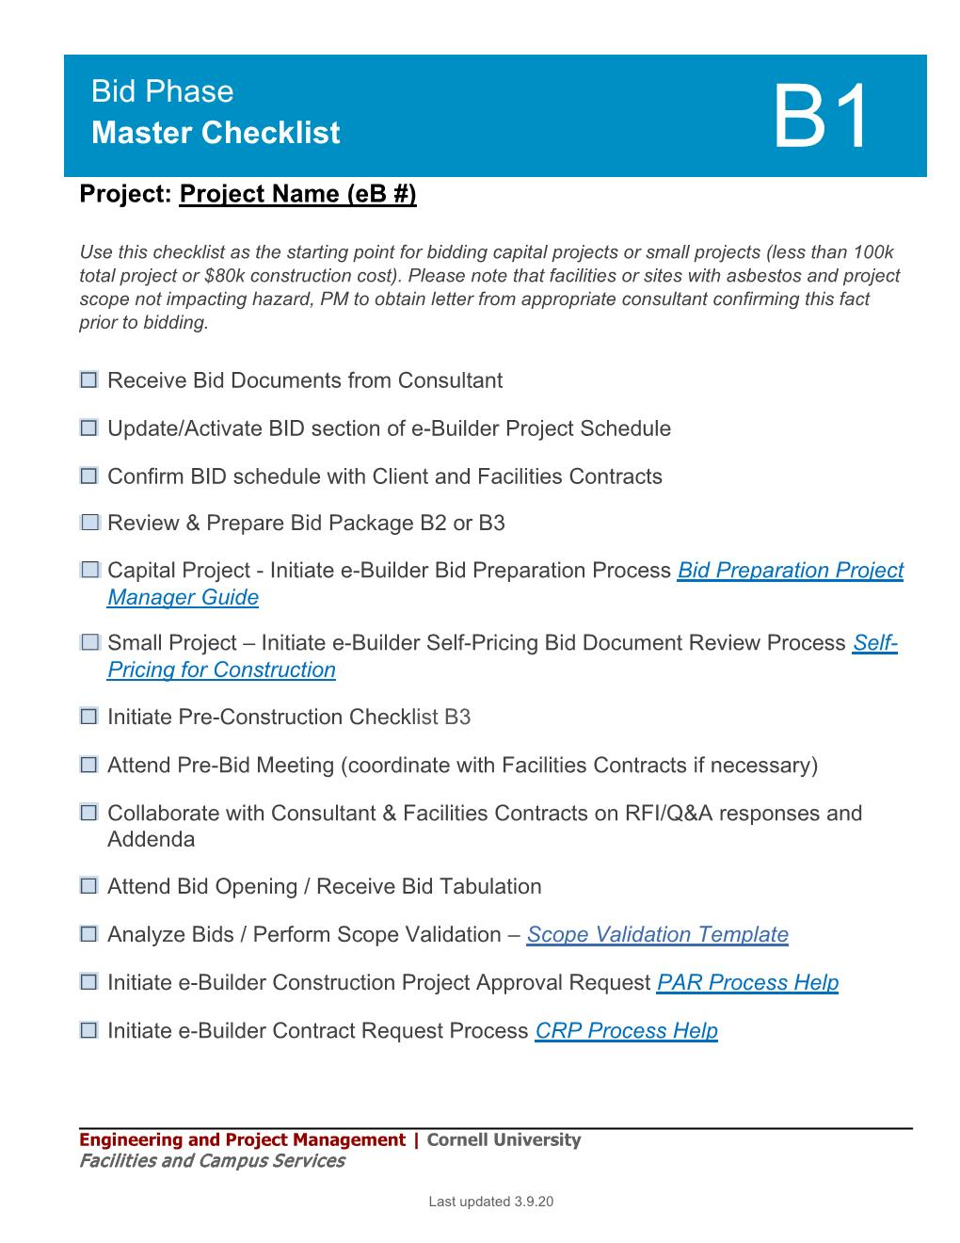
Bid Phase – Bid Phase Master Checklist
Bid Preparation Process (BP)
What is a success Bid Process?
Construction Document Package
Drawings and Specifications
Contractual Documentation & Requirements - “Front Ends”
Instructions to Bidders
Bid Form
GC’s & GR’s
Project Schedule & Approvals
Notes:
Instructions to Bidders
Bid form
General Conditions
General Req
Push and Pull on reasources and unclear expectations…..

Slide 3
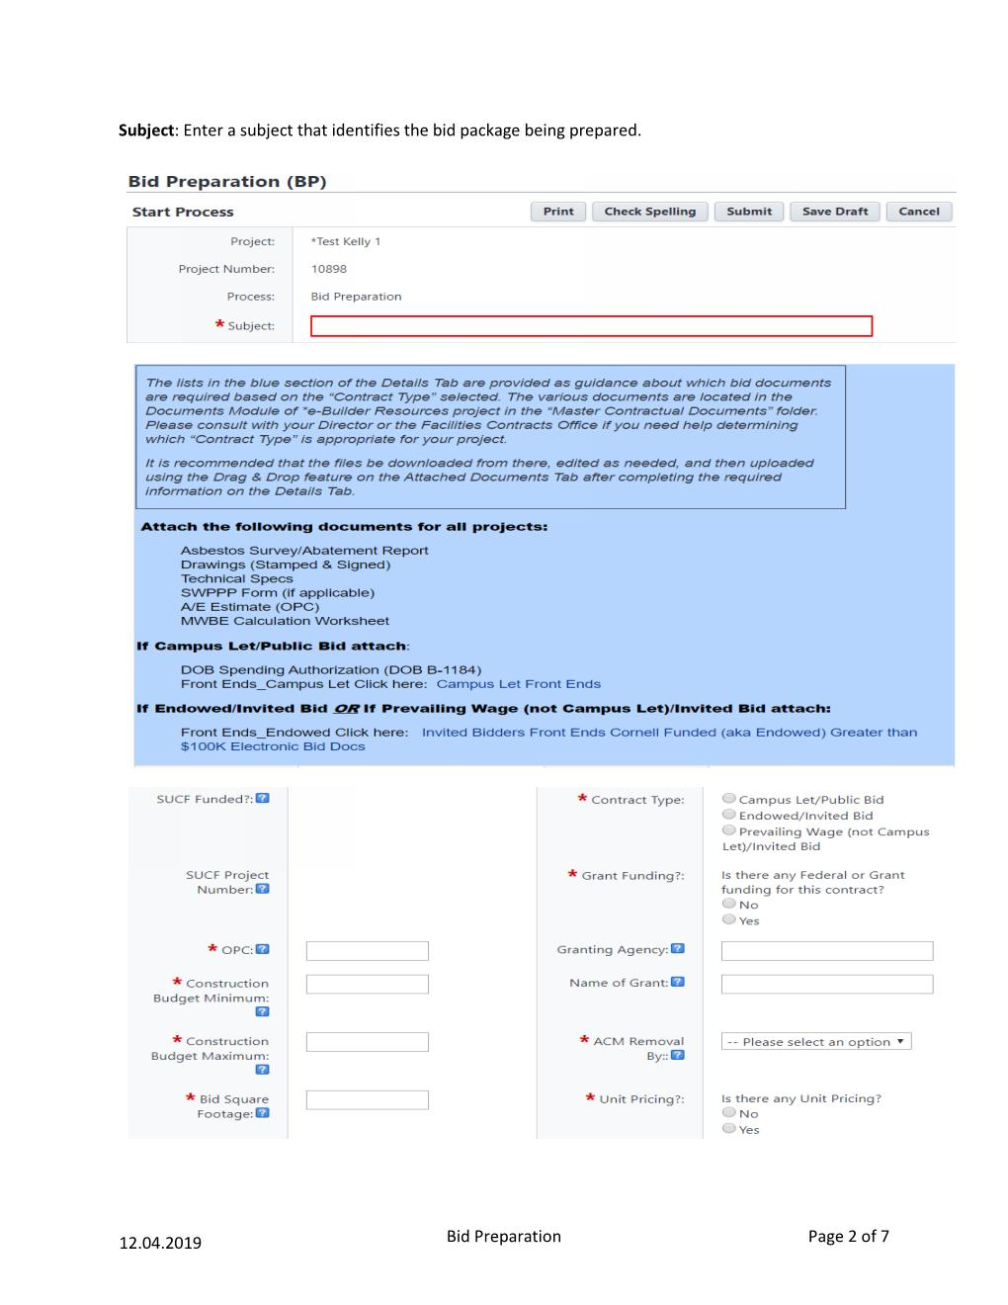
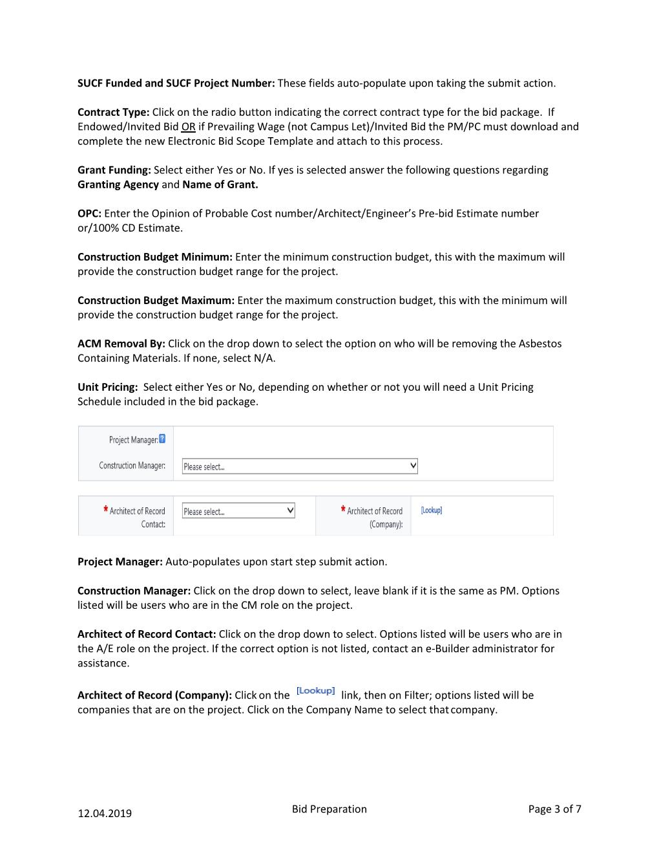
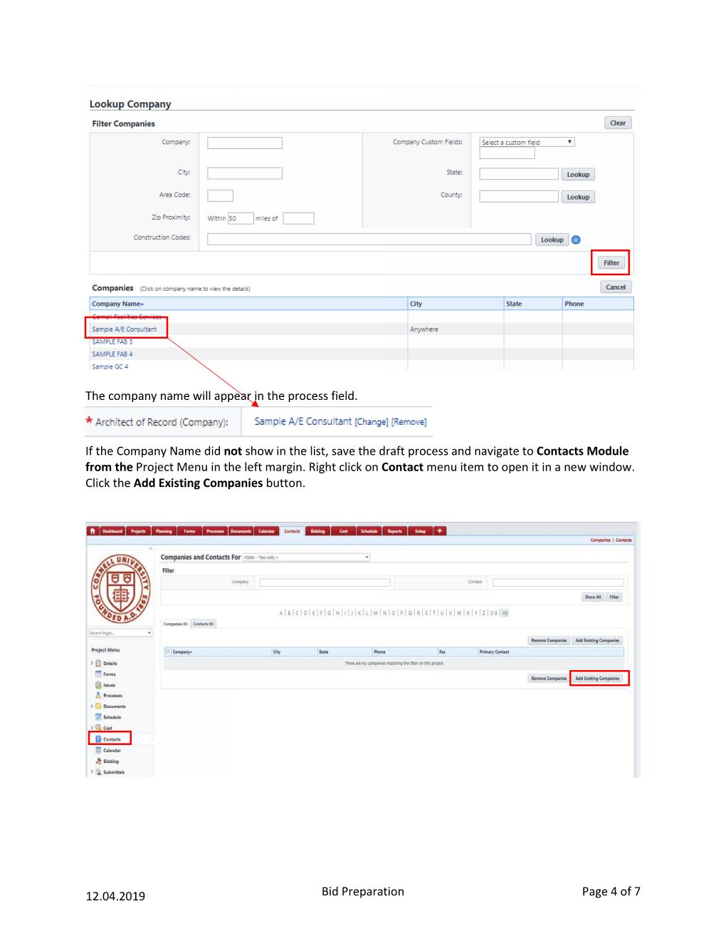
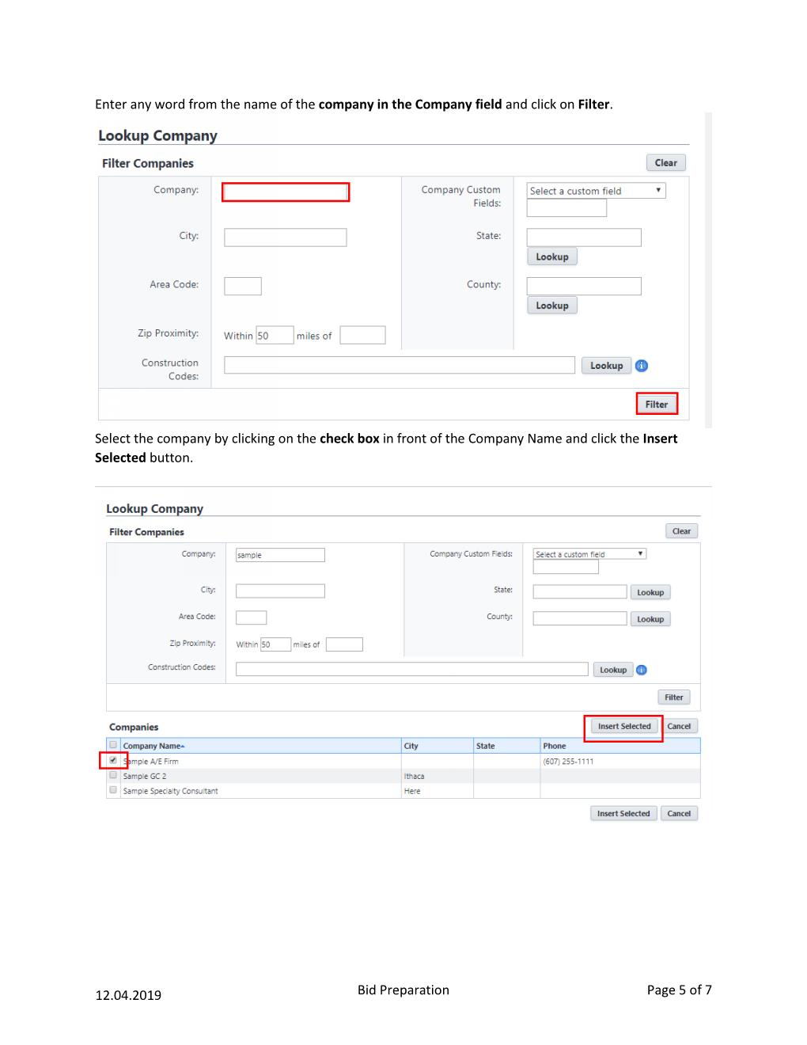
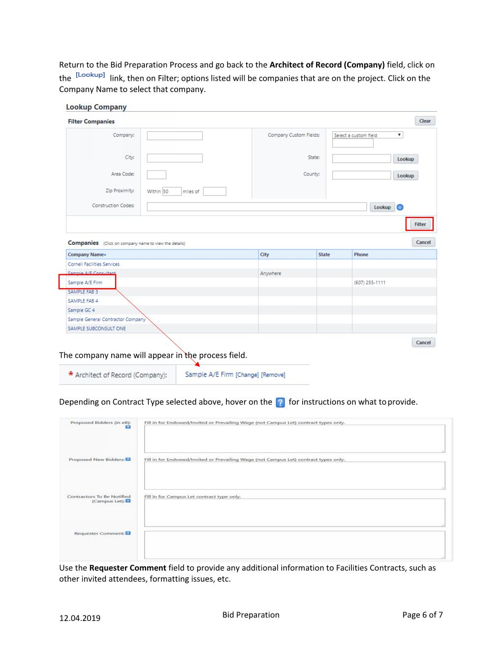
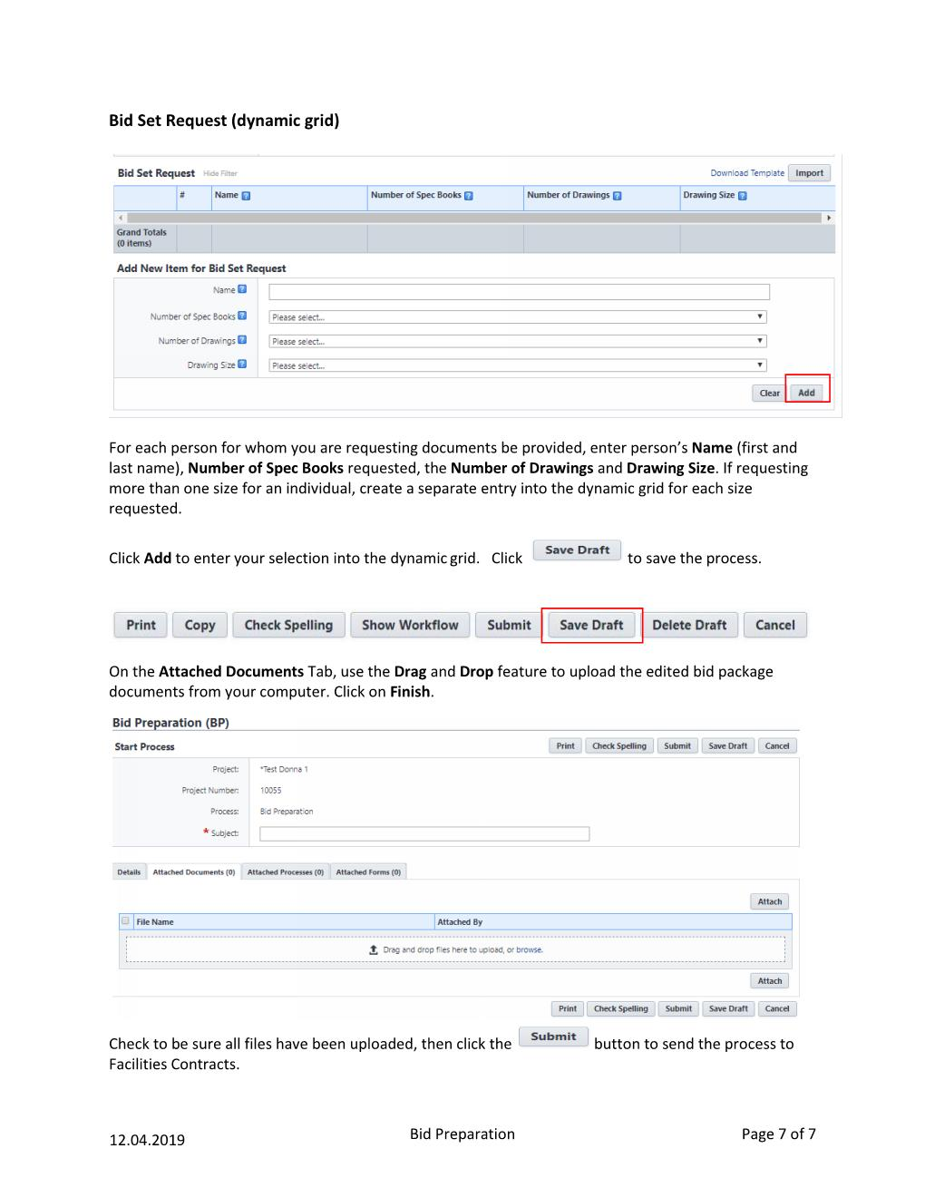
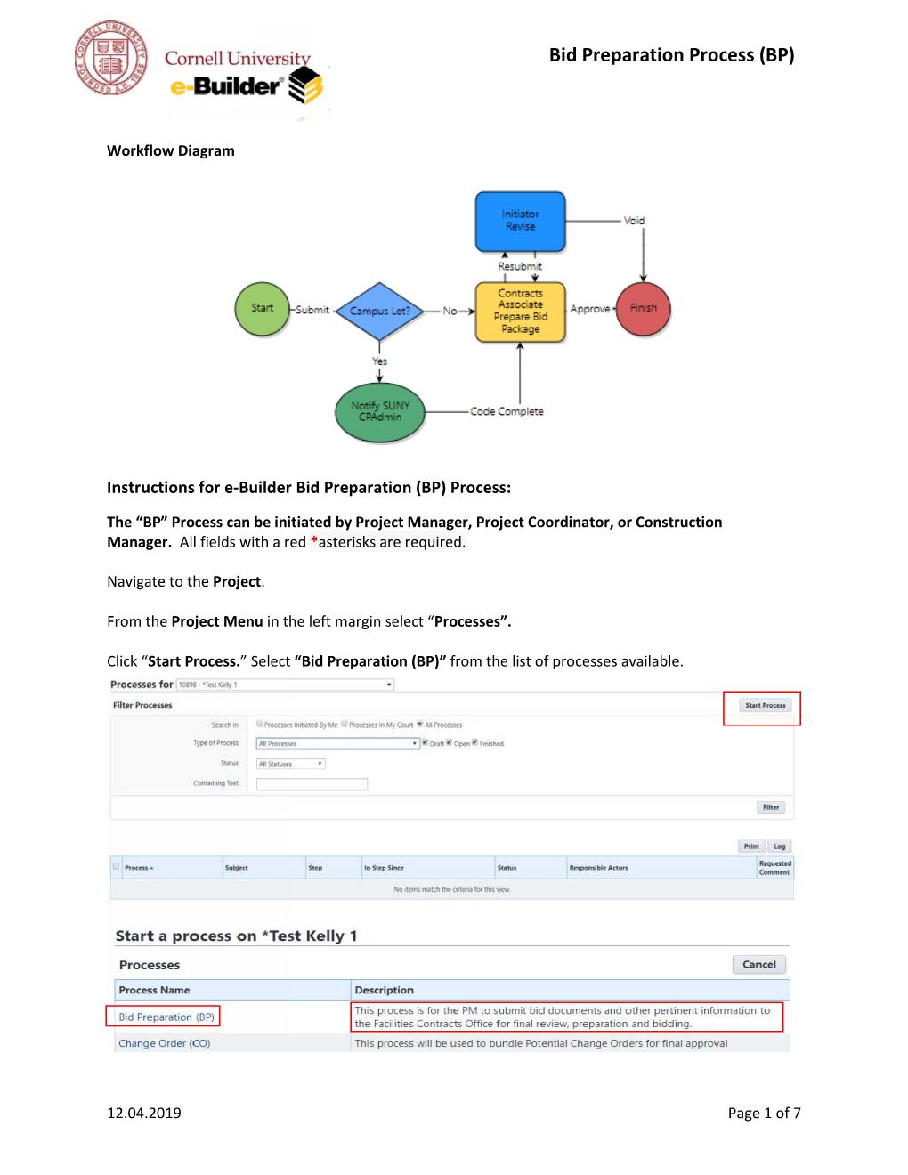
Bid Phase – Bid Preparation Process (BP)
Front End Doc Preparation:
When to process?
How complete to the process?
Document Review:
What to look for?
Who is looking for what?
Projected Bid Schedule:
eBuilder Data (Planning)
Project Schedule - “Bid Documents to Contracts”
Bid Preparation Process
Bid Dates: (Reporting)
Dates assigned by Contacts
Completion of Bid Preparation Process

Slide 4
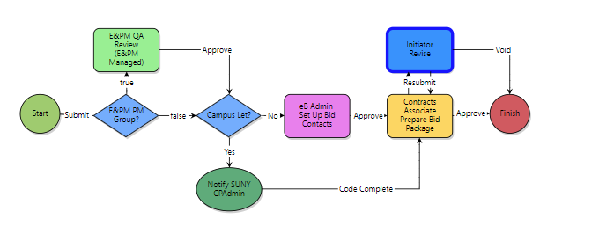
Bid Phase – Bid Prep Workflow
Added Step: “Improve our Game” - Accountability & Consistency

Slide 5
Bid Package Review/Prep
Bid Package QA review should not add time to your schedule if you do the following:
Engage project support staff at the beginning of CDs
We can assist you with your Bid Prep Process!
We can help gather documentation required
Front Ends share the fun let us do the editing for/with you! ☺
Don’t wait until you receive the final CD Submission to engage us…then you will be adding time ☹
We are here to help, please reach out to Jessie
We follow the steps outlined in the Bid Prep Process
2

Slide 6
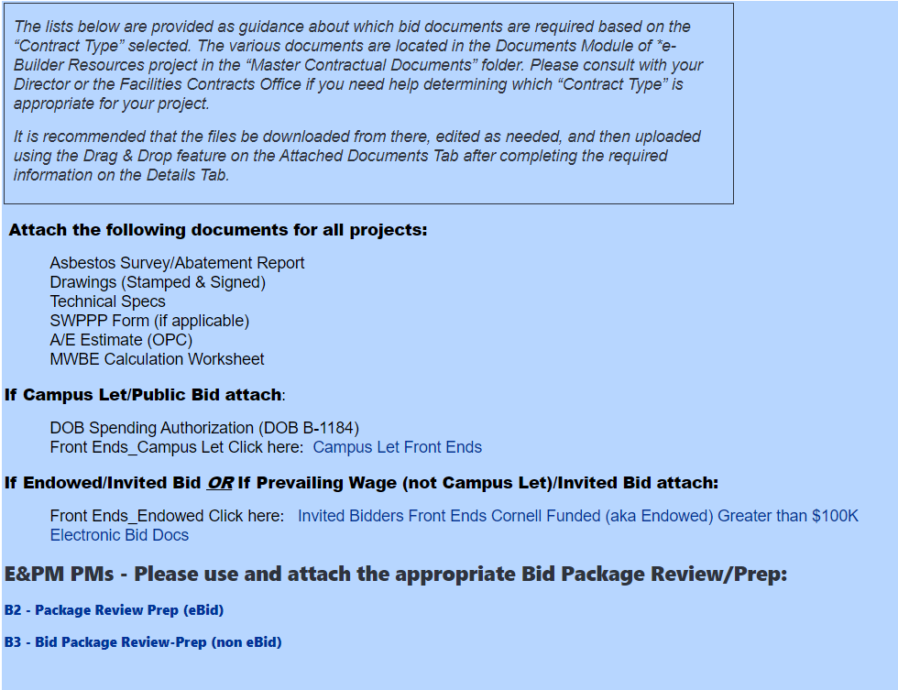
2

