Slide 1
Project Management – Professional Development Series
Facilities and Campus Services Engineering and Project Management April 14, 2020

Slide 2
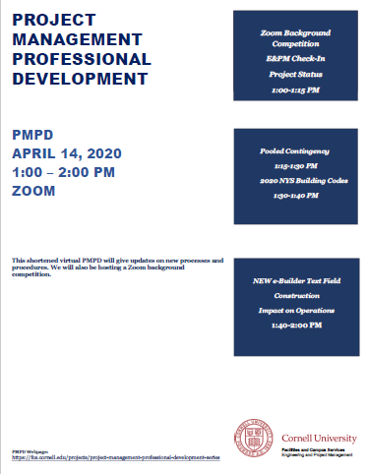
Today’s Agenda
Opening Remarks:
Zoom Background Competition
Project Status Process Update
Andrew Magré
Tool Kit:
Pooled Contingency
Jim Gibbs, Andrew Germain, and Donna Sutliff
2020 NYS Building Codes
Mike Niechwiadowicz
Construction Impact on Operations
Donna Sutliff and Andrew Germain
Sharing of Content: (Cornell Net ID Required)
– https://fcs.cornell.edu/projects/project-management-professional-development-series

Slide 3
Zoom Background Competition
Review everyone’s background
Pick your favorite
Vote for your favorite by typing in the person’s name in the chat
Winner is the person with the most votes!

Slide 4
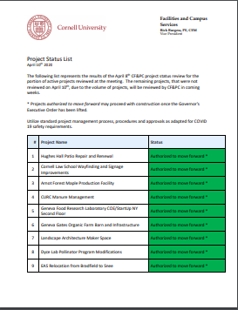
Project Status Process Update
Authorized to move forward *
Complete Bid Phase. Hold prior to awarding bid
Hold and Reassess - Ideas Master task added to schedules - hold and reassess - Donna Adding
Hold and reassess in three to four months

Slide 5
Project Status 2 Field
Based upon the April 10 Project List, each updated project status is now on the project details page in the project status 2 field. Please see below.

Slide 6
Pooled Contingency Jim Gibbs, Andrew Germain, and Donna Sutliff

Slide 7
2020 NYS Building Codes Mike Niechwiadowicz

Slide 8
Construction Impact on Operations Donna Sutliff and Andrew Germain

