Slide 1
Project Management – Professional Development Series
Facilities and Campus Services
Engineering and Project Management
April 14, 2020

Slide 2
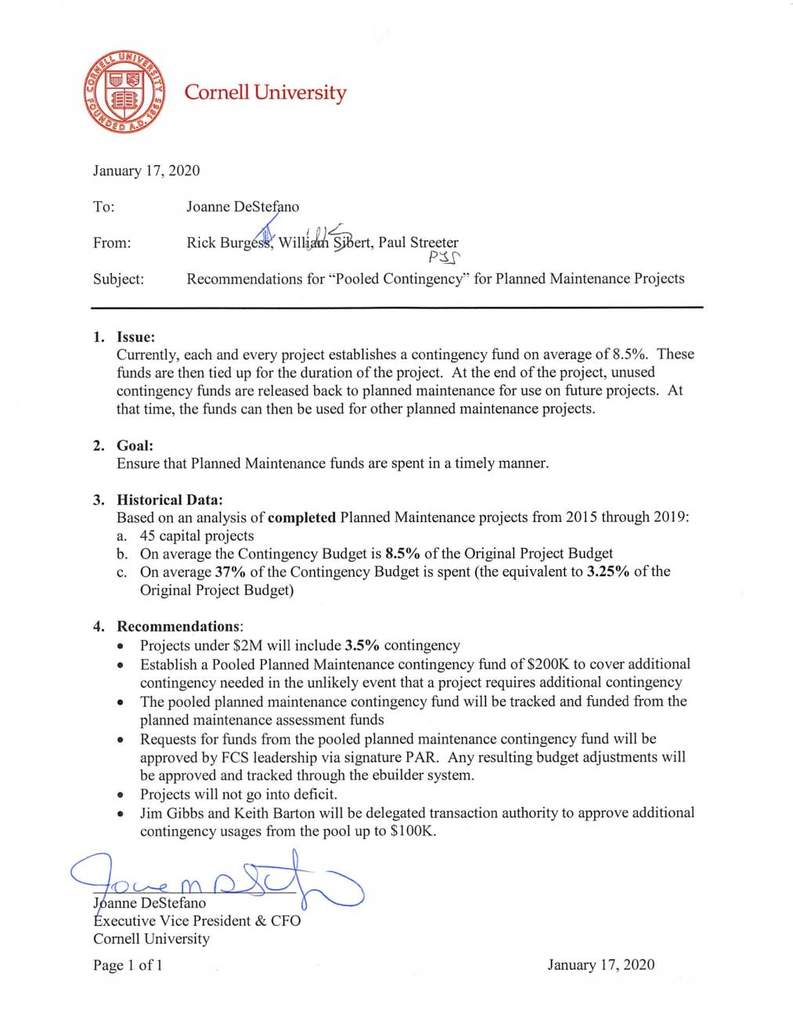
Pooled Contingency
Why
Issue
Goal
What
Historical Data
Recommendations
How
Budgeting
Approvals
Notes:
Memo – Signed Back in January 2020
- Planned Maintenance Projects will utilize a pooled contingency

Slide 3
Why -
Issue:
Unused Contingency Funds tied up for the duration of a project
Goal:
Ensure that Planned Maintenance funds are spent in a timely manner.
Historical Data: Planned Maintenance
Average Contingency 8.5%
37% spent on average (~ 3.5%)

Slide 4
What -
Recommendations:
Projects Under $2M
3.5% Contingency Budgeted
Establish Pooled Contingency
Pool to be Tracked & Managed
Requests for funds via signature PAR
Gibbs & Barton delegated Transaction Authority up $100k
Notes:
Audience:
Who is this for?
Stakeholders, Project Directors, and Administration
Goal of the Project Status Update is to fully inform the project directors / Executives and Stakeholders of your project's status and overall direction without having to get involved themselves.
Directors/Stakeholders should be able to read the project status without having to reach out to the PM directly to find out where things are. A project manager is to create clarity from confusion for the project team and for management. Essentially, the task of a project status update is one of analysis and communication.

Slide 5
How -
Leverage PM Tool eBuilder
Details Page
Is project eligible
Budgets
Establishing your Project Budget
Approval Process & Cornell Policy
eBuilder Process TBD
Revised Pooled Contingency PAR
Pooled Contingency Budget Change?
Notes:
Audience:
Who is this for?
Stakeholders, Project Directors, and Administration
Goal of the Project Status Update is to fully inform the project directors / Executives and Stakeholders of your project's status and overall direction without having to get involved themselves.
Directors/Stakeholders should be able to read the project status without having to reach out to the PM directly to find out where things are. A project manager is to create clarity from confusion for the project team and for management. Essentially, the task of a project status update is one of analysis and communication.

