Slide 1
Project Management – Professional Development Series
Facilities and Campus Services
Engineering and Project Management
April 14, 2020

Slide 2
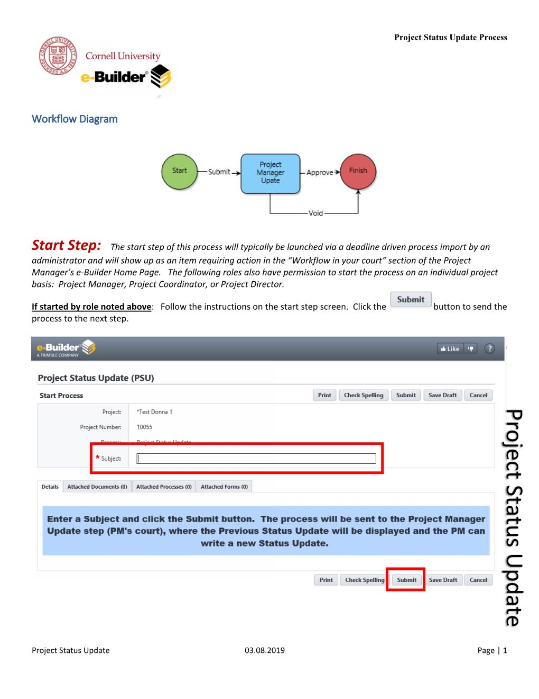
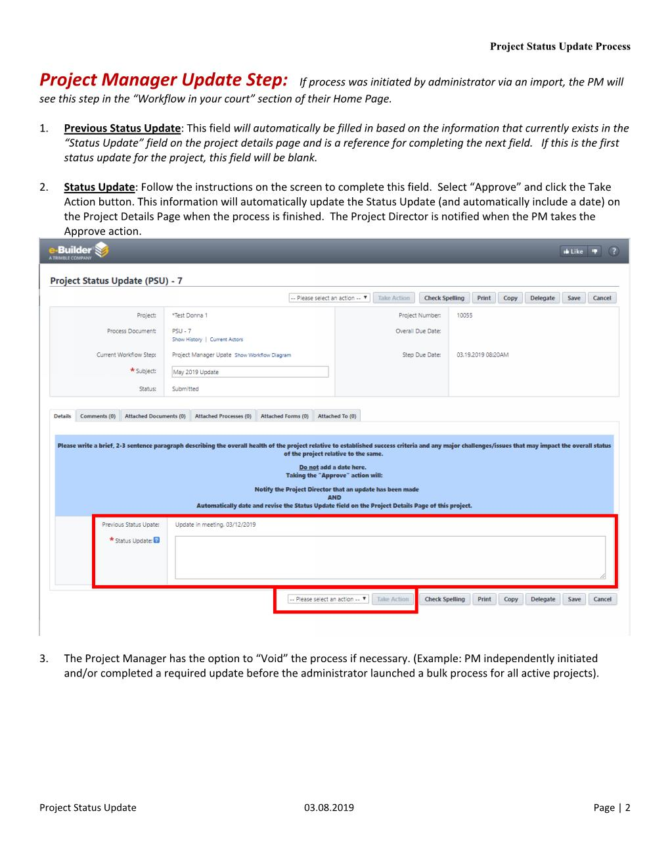
Project Status Update (PSU) Process (v1.0)
Timeline
April 2019: Pilot Phase
June 2019: Go Live – Monthly
September 2019: Guidance Doc.
Feedback
“…helped streamlined the update process…”
“…has improved project reporting...”
“… a need to emphasize key data points…”
Next Steps – Refine PSU Format
Key Data Points
Consistency
Reporting
Success!
Notes:
Audience:
Who is this for?
Stakeholders, Project Directors, and Administration
Goal of the Project Status Update is to fully inform the project directors / Executives and Stakeholders of your project's status and overall direction without having to get involved themselves.
Directors/Stakeholders should be able to read the project status without having to reach out to the PM directly to find out where things are. A project manager is to create clarity from confusion for the project team and for management. Essentially, the task of a project status update is one of analysis and communication.
Minor tweaks to improve the tool for the Project Managers
Project Phase: Added to the Process Page:
Previous Months Update is Shown for PM to provide consistency from month to month:
Monthly PSU push has been established from our PM admin to provide a consistent reminder to update the status of our projects.
Colleges and Unit PM Centers have adopted the process to help with their reporting.

Slide 3
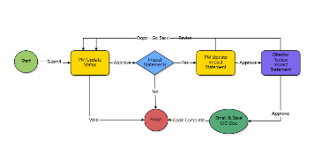
Project Status Update (PSU) Process (v2.0) Construction Impact on Operations
Refinement of Monthly Project Status Update –
Process & Expectations
Monthly PSU & Schedule Updates
Key Data Points
Data Field Added - Project Phase
Consistency & Reporting
Colleges & Units adopted practice
Opportunity: Partner w/ FM & OUA
Leverage PSU Process – Improve Campus
Communication
“Summer Operations” - Impacts
Timeline:
April/May 2020: Pilot Phase
Summer 2020: Guidance Doc.
Notes:
Audience:
Who is this for?
Stakeholders, Project Directors, and Administration
Goal of the Project Status Update is to fully inform the project directors / Executives and Stakeholders of your project's status and overall direction without having to get involved themselves.
Directors/Stakeholders should be able to read the project status without having to reach out to the PM directly to find out where things are. A project manager is to create clarity from confusion for the project team and for management. Essentially, the task of a project status update is one of analysis and communication.

Slide 4
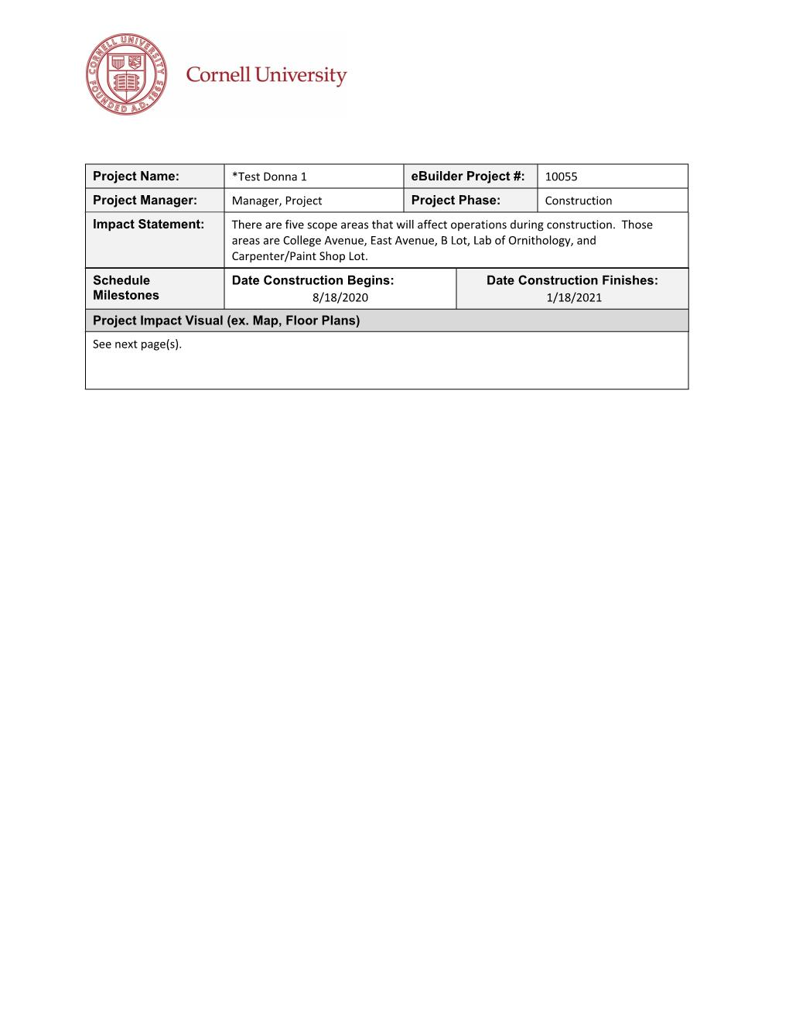
Construction Phase Impact Statement
Purpose & Need:
Project Specific Info.
Schedule Information
Project Limit Lines
Share with Campus Community
Consistent Deliverable (PDF):
Project Details Page
Project Status Update
Project Schedule Module
Annotated Image
Notes:
e-Builder Mail Merge
Project Details Page
Project Name
Project Manager
eBuilder number
Project Phase
Project Status Update
Impact Statement
Project Schedule Module
Construction Begins
Construction Finishes
Annotated Image
- Google Earth

Slide 5
Workflow: Project Status Update (v1.0) vs. (v2.0)
Project Status Update (v 1.0)
-Schedule
- Budget
- Milestones
- Key Issues
Project Status Update (v 2.0)
ADDED
Construction
Phase Impact
Statement

Slide 6
Process & Expectations:
Process – PSU
Added Impact Statement Field
Expectations – Update with monthly PSU
Impact Statement (Optional)
Schedule (Construction Phase) Updated
Annotate Map with proposed contact limit lines

Slide 7
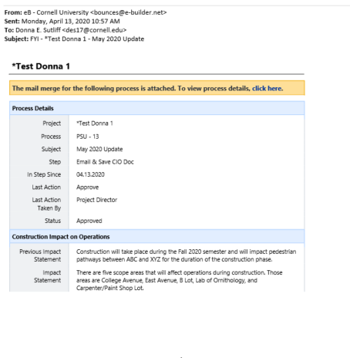
Automation –
eBuilder Mail Merge
Pull project data
Create deliverable
eBuilder Notification
Document Saved in eBuilder File Structure
Message sent to OUA
ARC GIS – MAPs
Link project data to Map

Slide 8
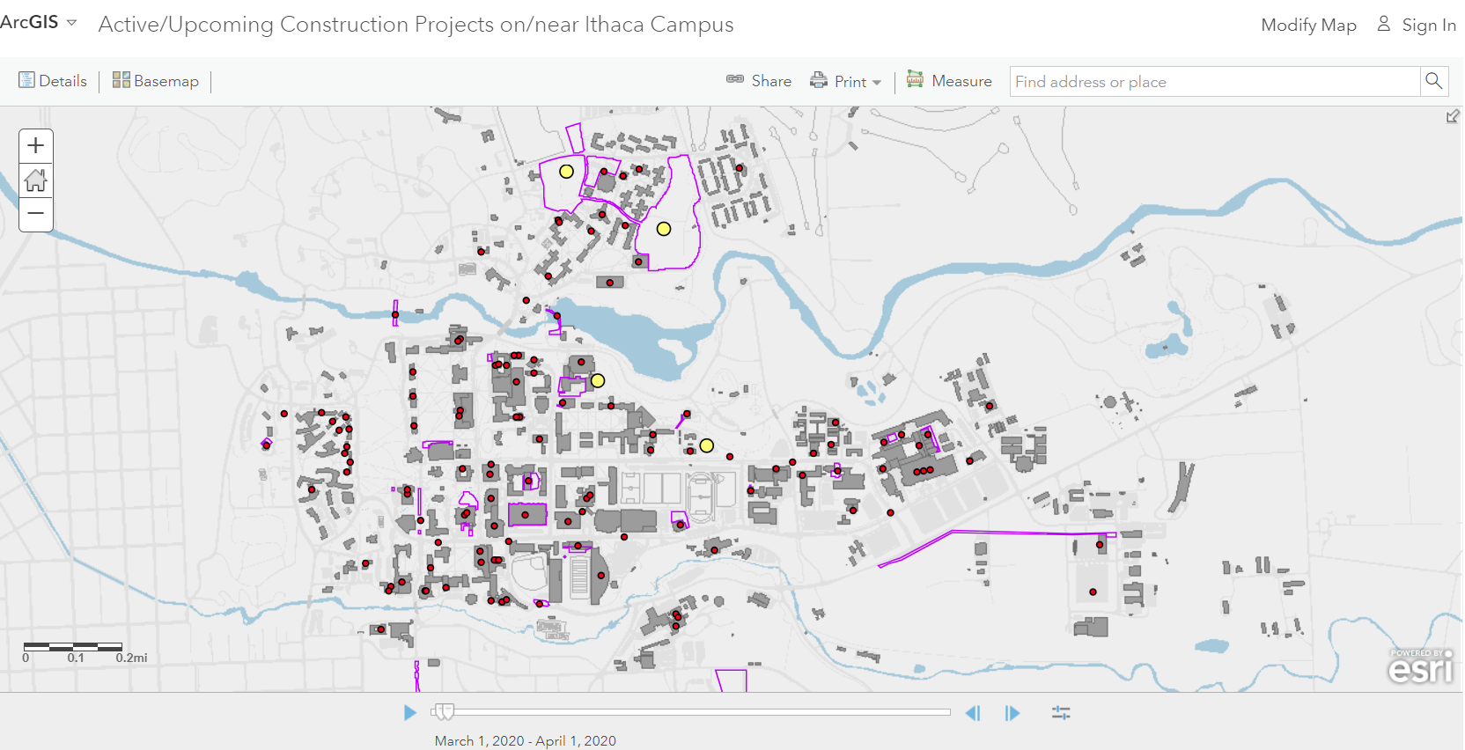
ArcGIS – Construction Impact Map
Notes:
Audience:
Who is this for?
Stakeholders, Project Directors, and Administration
Goal of the Project Status Update is to fully inform the project directors / Executives and Stakeholders of your project's status and overall direction without having to get involved themselves.
Directors/Stakeholders should be able to read the project status without having to reach out to the PM directly to find out where things are. A project manager is to create clarity from confusion for the project team and for management. Essentially, the task of a project status update is one of analysis and communication.

