Slide 1
e-Builder tip of the month
February 2020

Slide 2
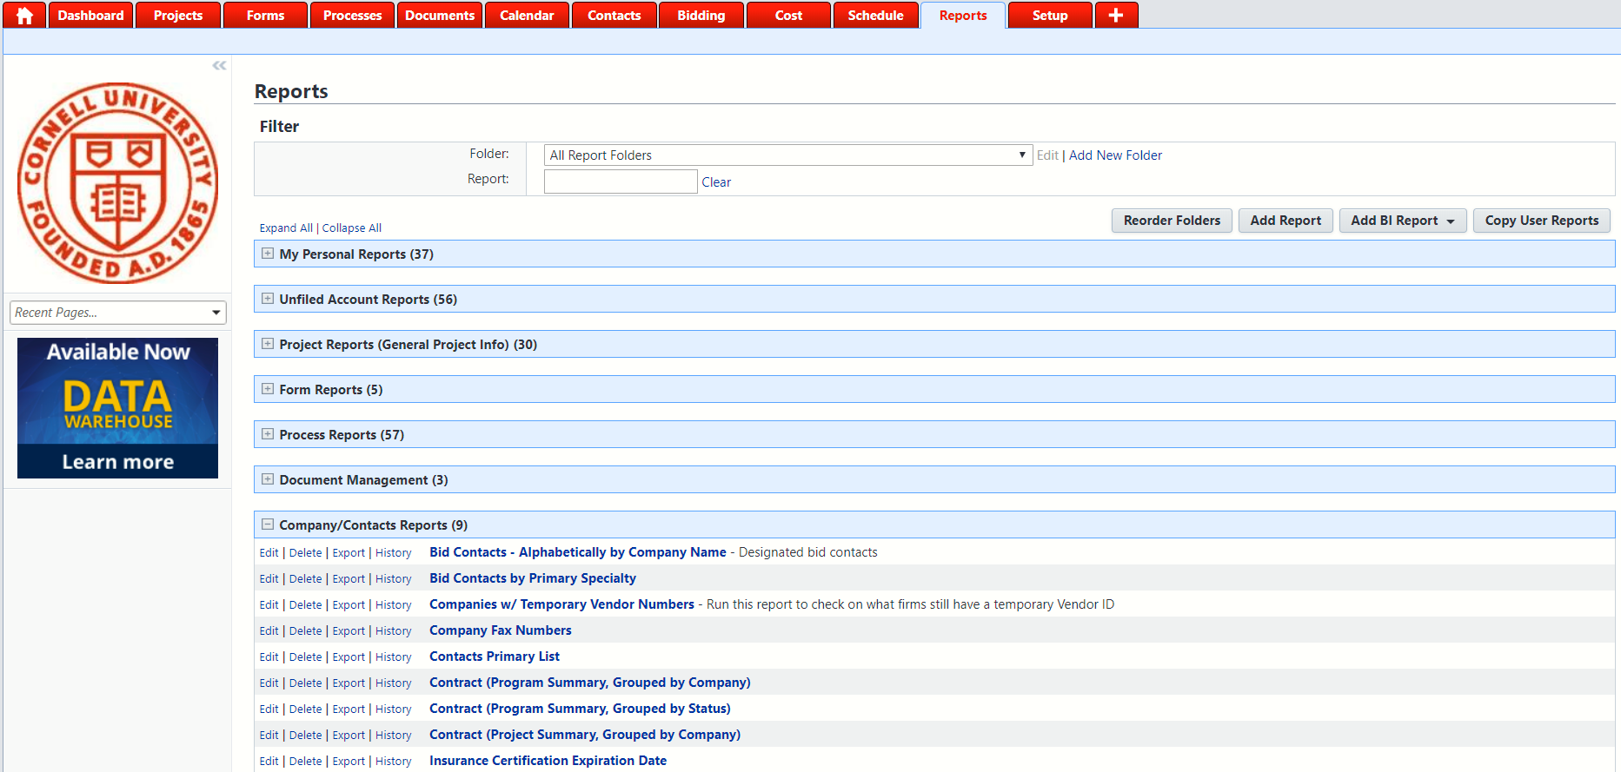
Tip 1: Report Bid Contacts
Reports tab
Click on opens Company/Contacts Reports
Click Bid Contacts – Alphabetically by Company Name or
on Bid Contacts by Primary Specialty
Notes:
Reports give you the Designated Bid Contacts for the Companies and Primary Specialty that is currently listed in e-Builder

Slide 3
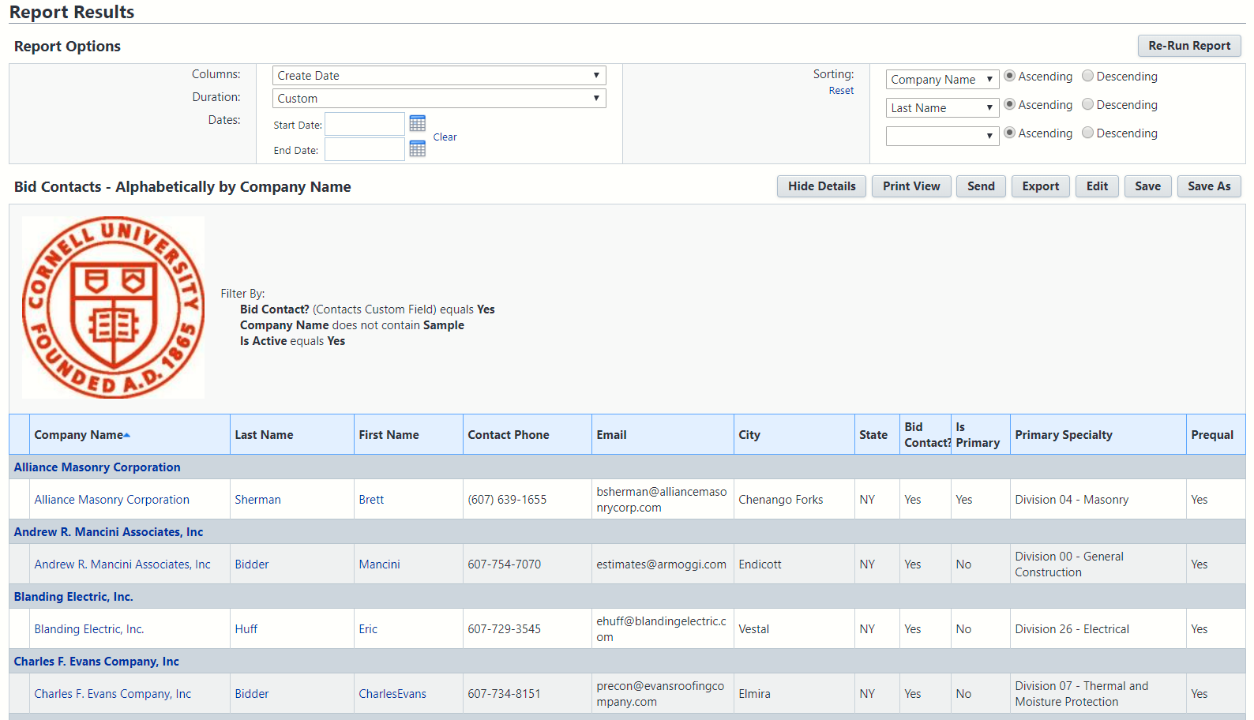
Tip 1: Report Bid Contacts
Bid Contacts - Alphabetically by Company Report indicates who Bid Contact is and the Primary Specialty
Notes:
Bid Contacts - Alphabetically by Company Report sorted by Company Name and lists Bid Contact and Primary Specialty

Slide 4
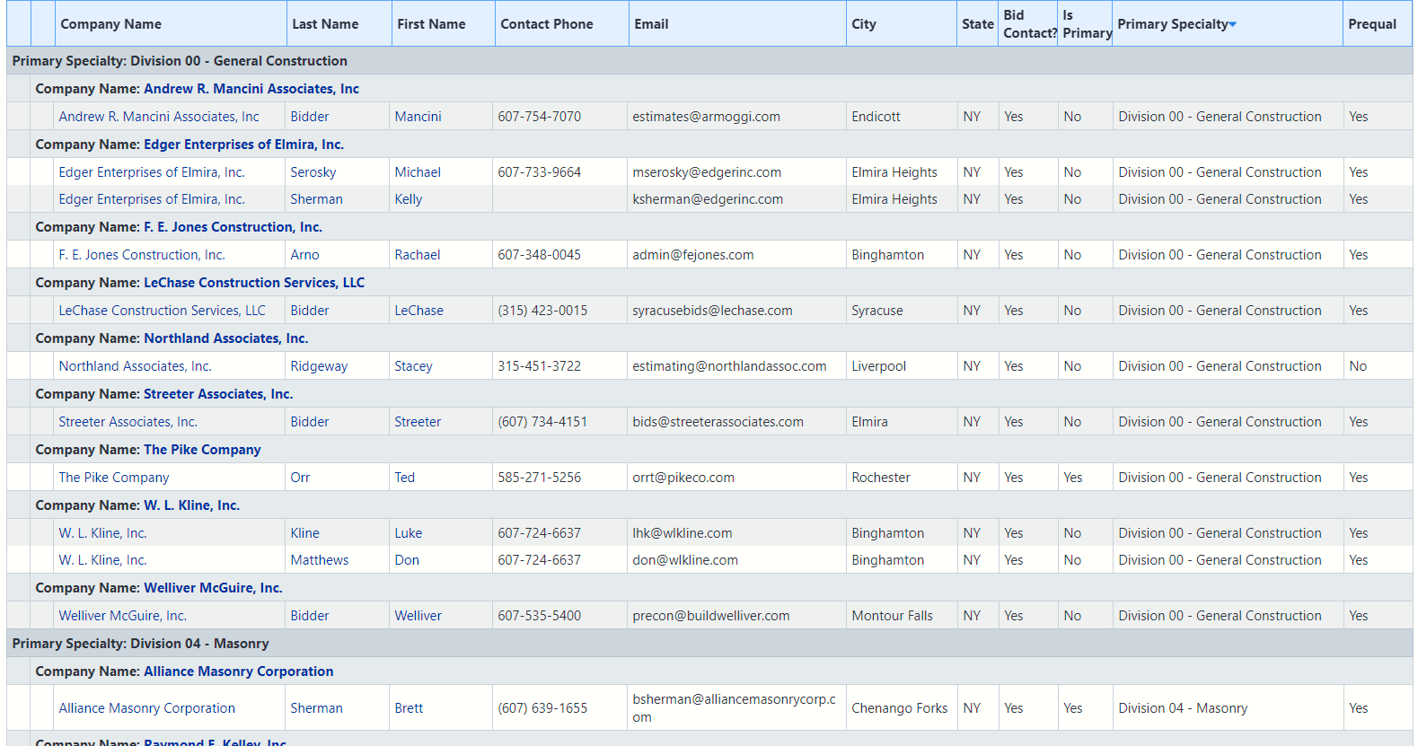
Tip 1: Report Bid Contacts
Bid Contacts by Primary Specialty is sorted by Primary Specialty
Notes:
Bid Contacts by Primary Specialty is sorted by Primary Specialty

Slide 5
e-Builder Questions?
February 2020

