Slide 1
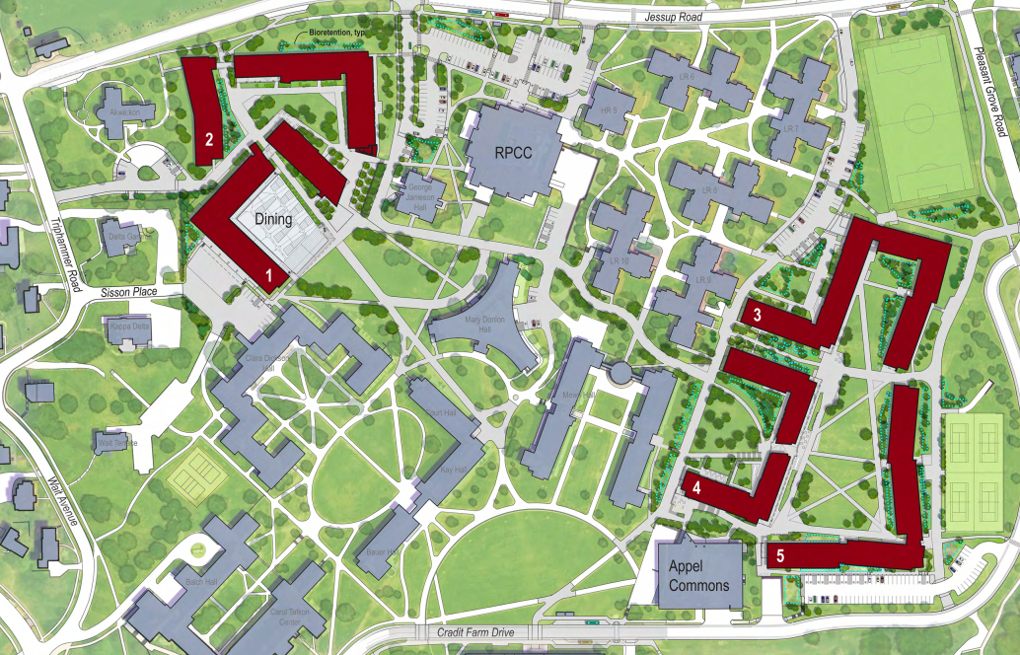
North Campus Residential Expansion
February PMPD – NCRE PROJECT UPdate
February 13, 2020

Slide 2
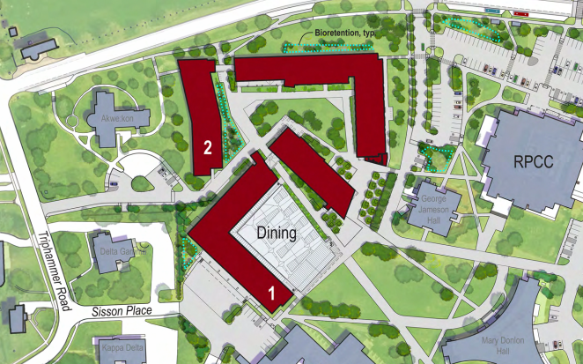
Site 1 – Sophomore Village
Situated at the current CC Parking Lot
Roughly 380,000 sf of new building spaces
~800 new student beds
1,000 seat dining/catering hall
16 Station Food Laboratory
4,000 sf Fitness Center
Outdoor Gathering Spaces
Green Quad Spaces
Construction began in early 2019
Completion of Site 1 Construction – Summer 2021
For more project information visit ncre.cornell.edu

Slide 3
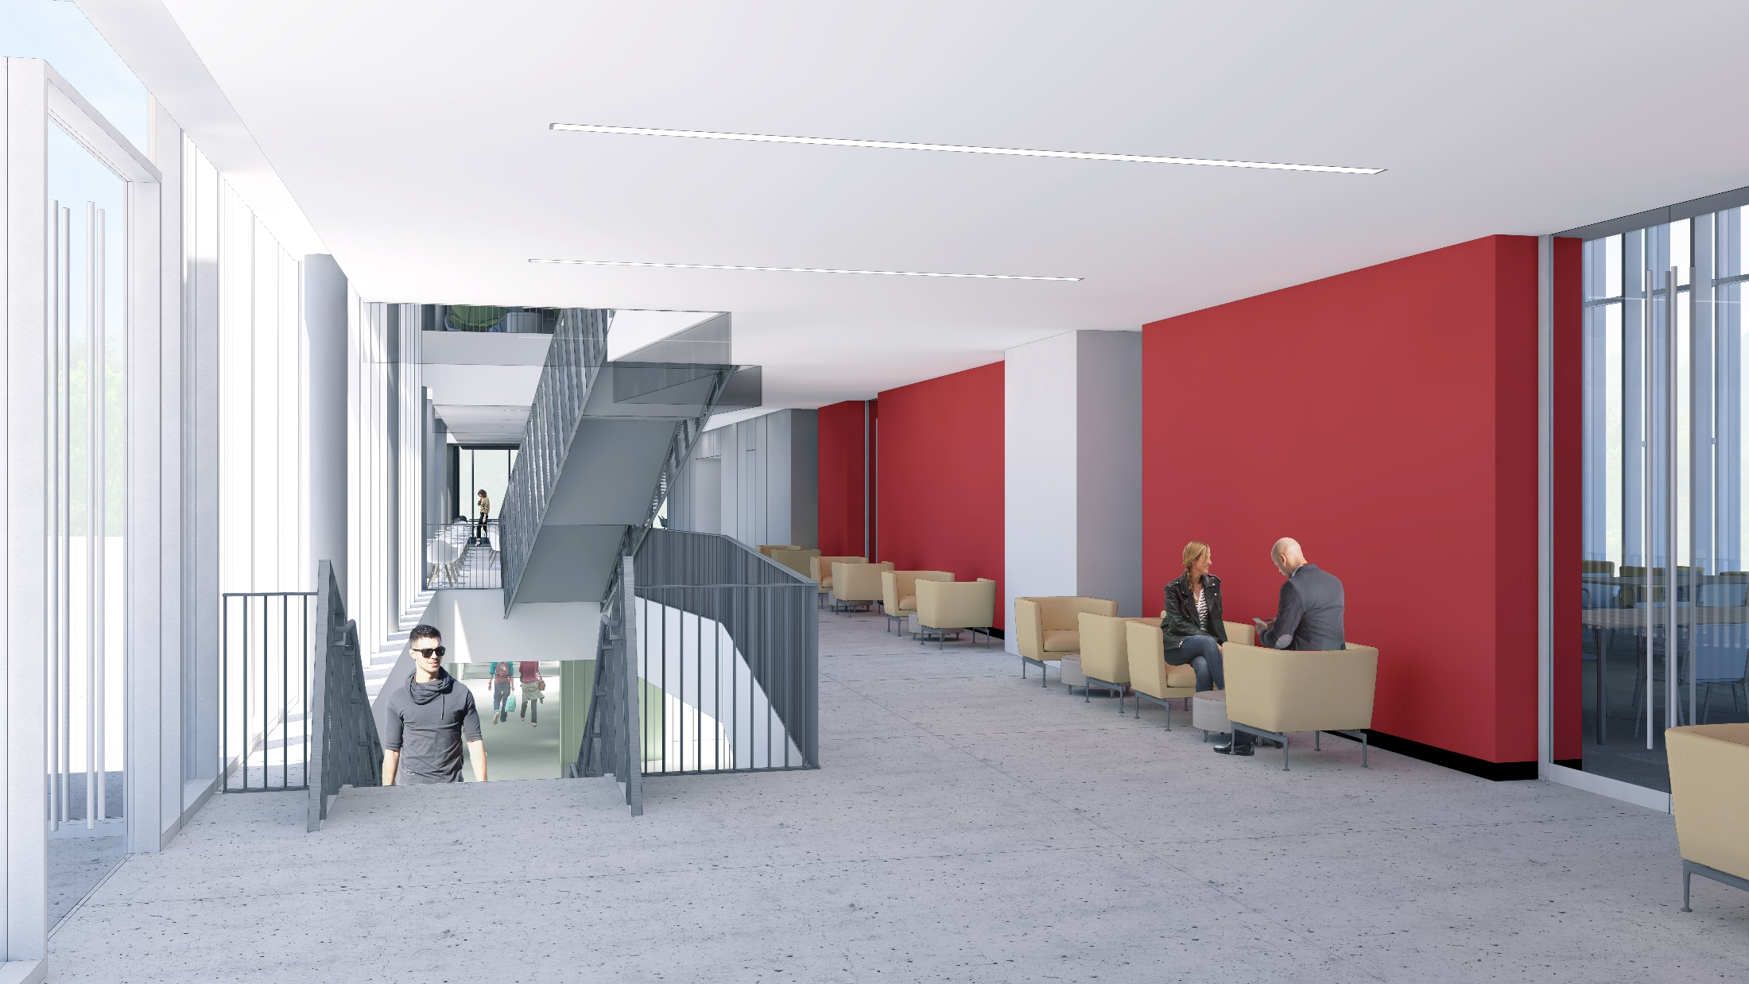
NCRE Interior Renderings

Slide 4
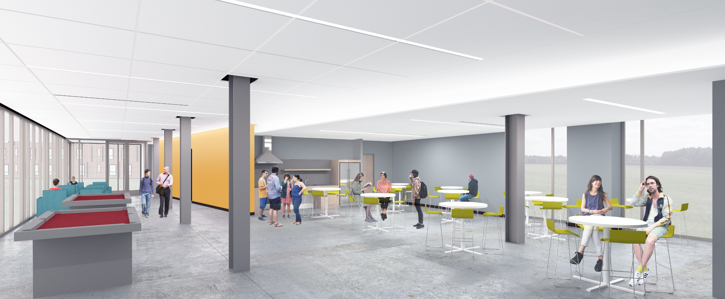
NCRE Interior Renderings

Slide 5
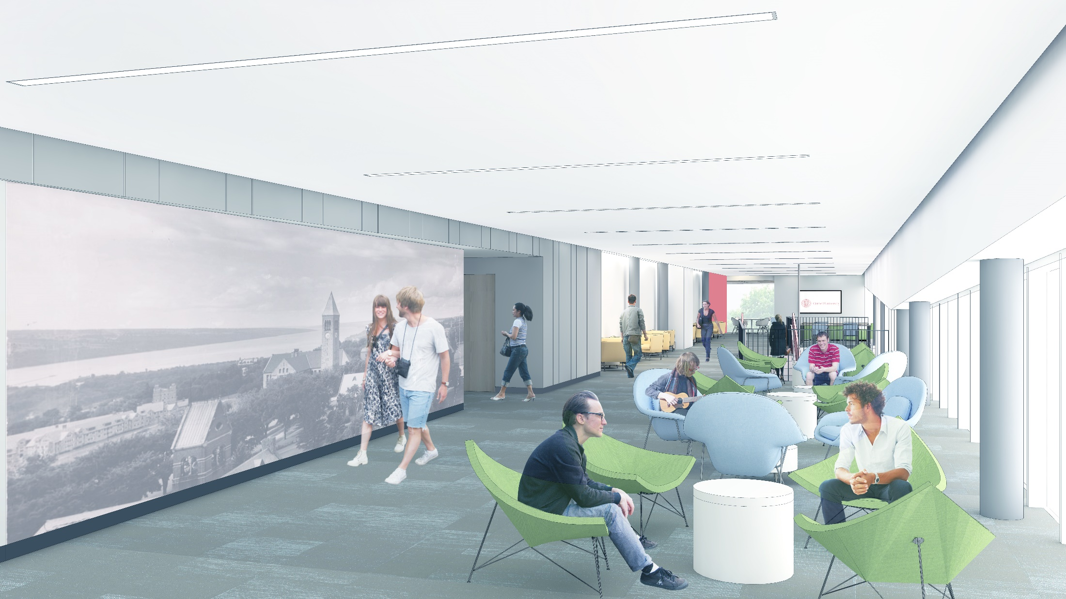
NCRE Interior Renderings

Slide 6
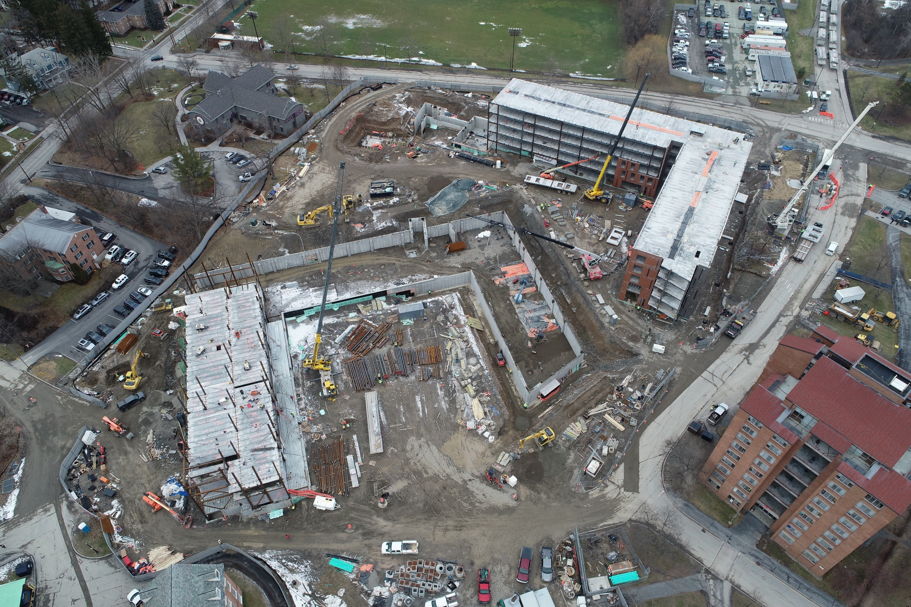
NCRE Site 1
Notes:
Steel & plank installation on building 2D & 2C is “complete”
Steel & plank installation has moved into Building 1 sector A/B
Precast Wall panel installation is on going at building 2B
Concrete Foundations at Building 1 are complete.
Concrete/Steel/Wall Panels will continue through Summer 2020.

Slide 7
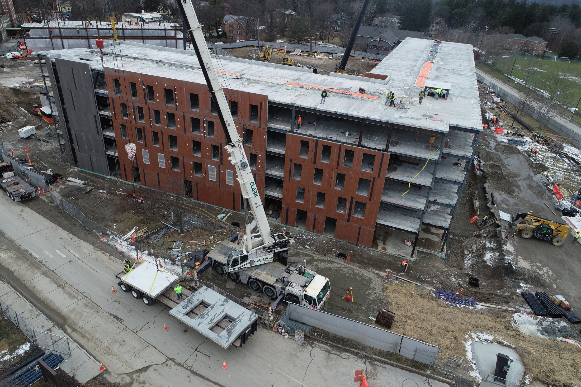
NCRE Site 1

Slide 8
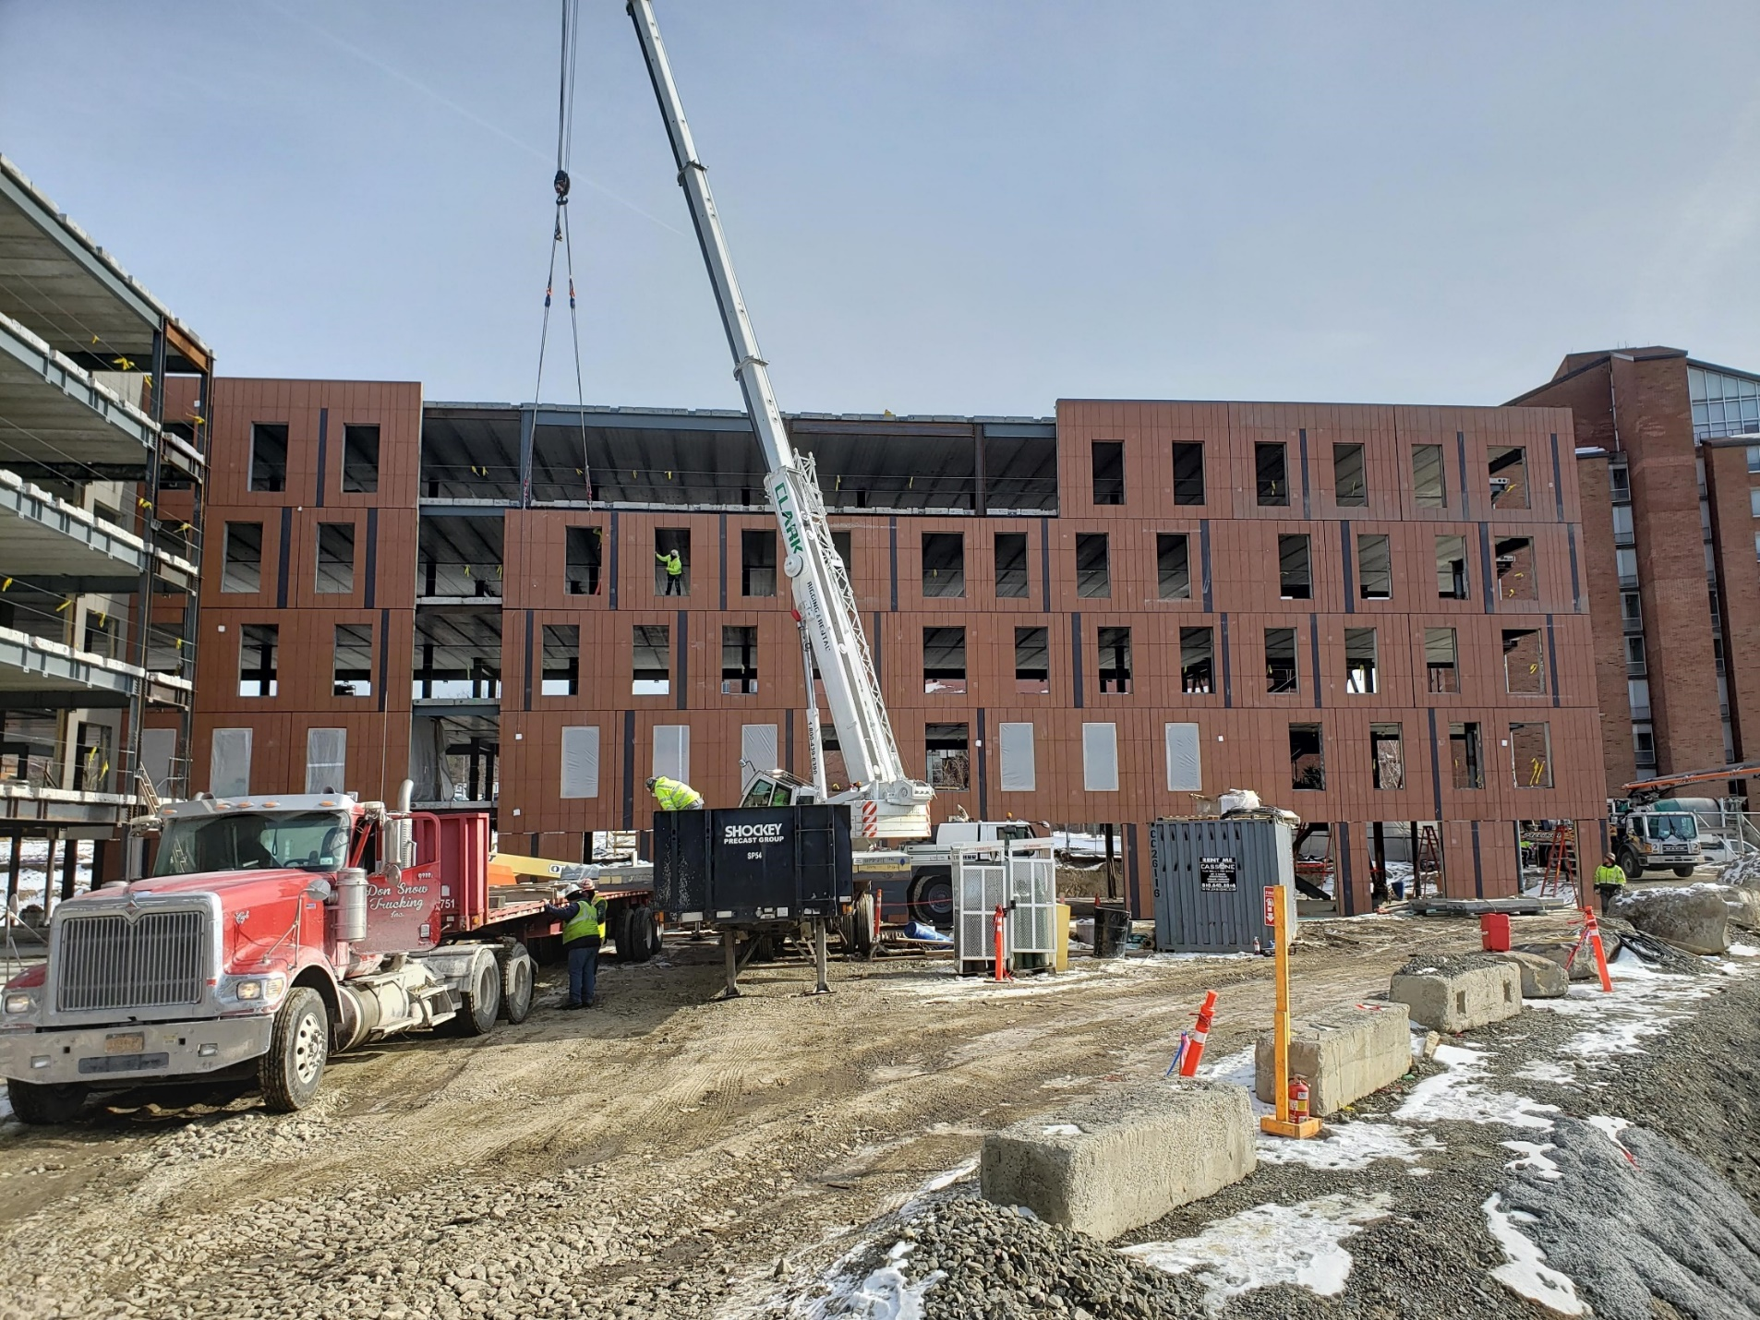
NCRE Site 1

Slide 9
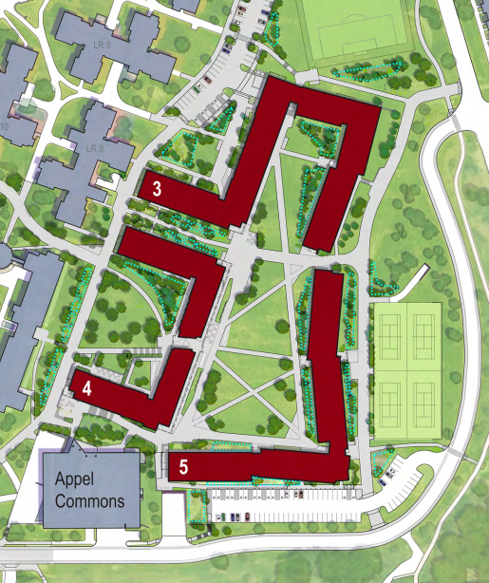
Site 2 – 1st year site
Situated at the current recreation fields near Appel Commons
Roughly 370,000 sf of new building spaces
~1,200 new student beds
Cafe
Outdoor Artificial Turf Playing Field
Outdoor Gathering Spaces
Green Quad Spaces
Construction began in mid 2019
Completion of Site 2 Construction – Summer 2022

Slide 10
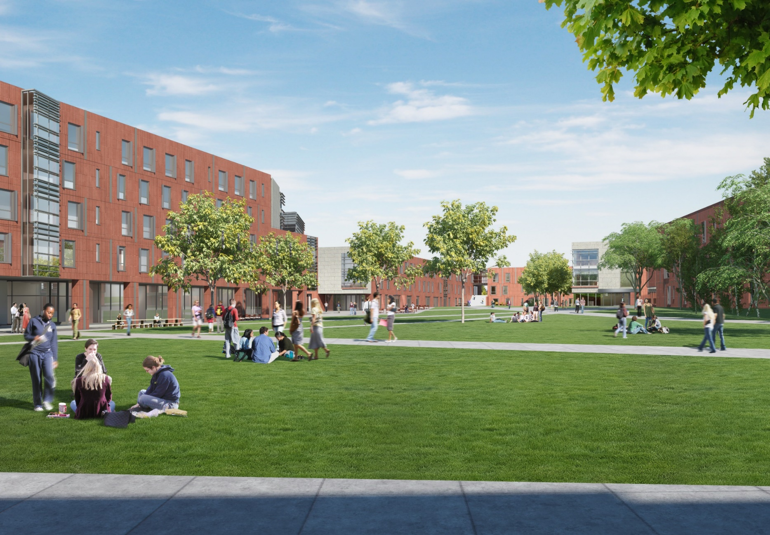
Site 2 – 1st year site

Slide 11
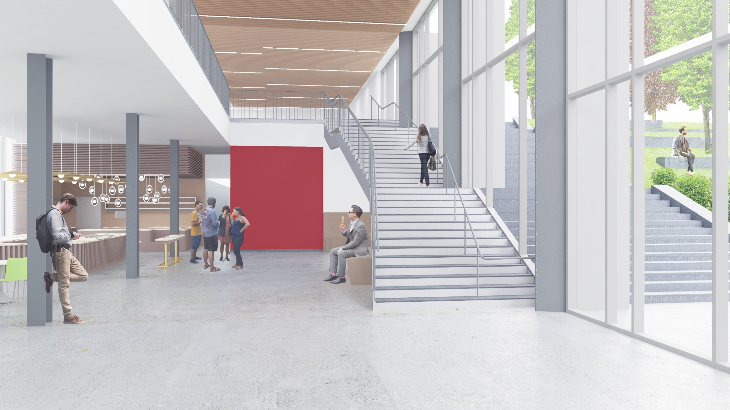
NCRE Interior Renderings

Slide 12
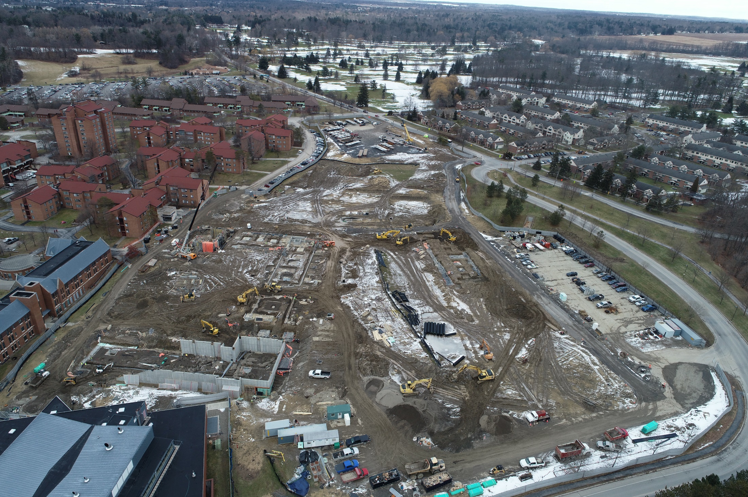
NCRE Interior Renderings
Notes:
Earthwork and site utilities (domestic water, storm, sewer and fire water) on-going.
Building 4 concrete foundations (nearest Appel) are complete.
Building 3 & 5 concrete foundations are underway.
Structural Steel erection at building 4 will begin in Spring of 2020.

Slide 13
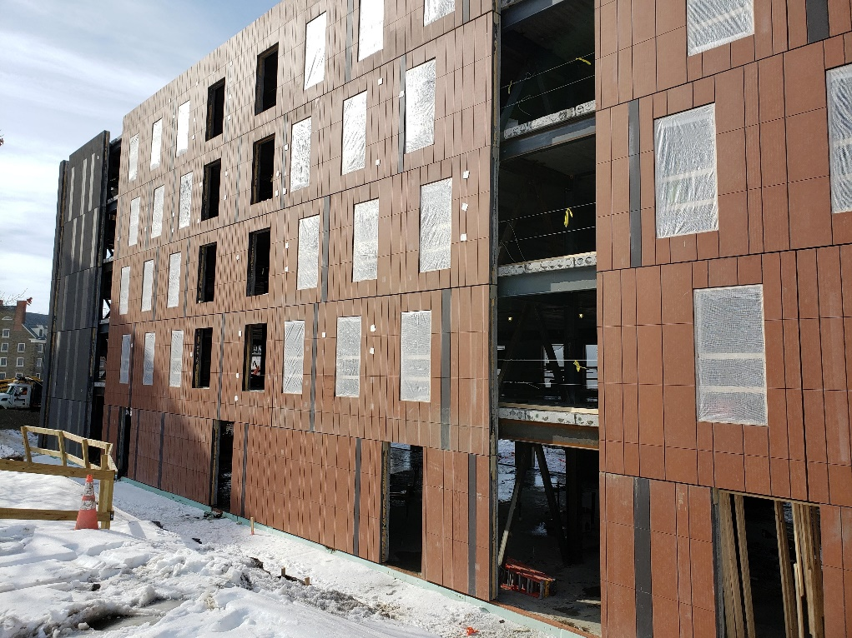
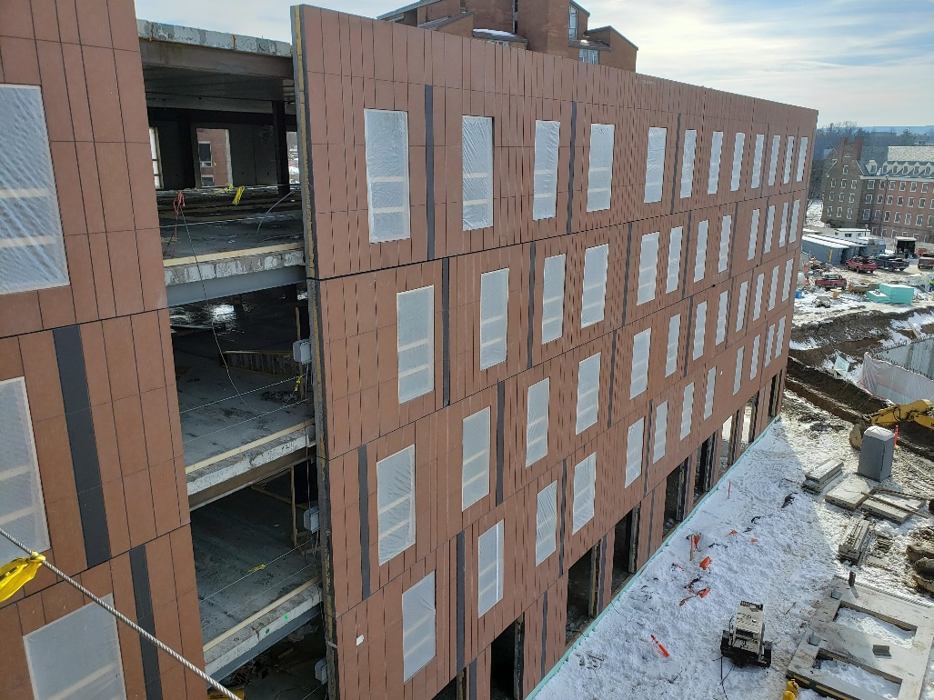
NCRE FUN Facts
Average daily work force on site is around 125. The project will top out around 350 later this year.
There are 3,178 tons of steel on the project. To date, we have installed roughly 600 tons.
The project has placed over 5,000 yards of concrete to date.
The typical precast wall façade panel weights roughly 18,000 pounds. The largest panel on the project weights 33,300 pounds.
The terra cotta panels were manufactured in Schwarzenfeld, Germany and shipped to Winchester, VA for placement in the precast system.
There are over 72,000 individual tiles of terra cotta on the project.

Slide 14
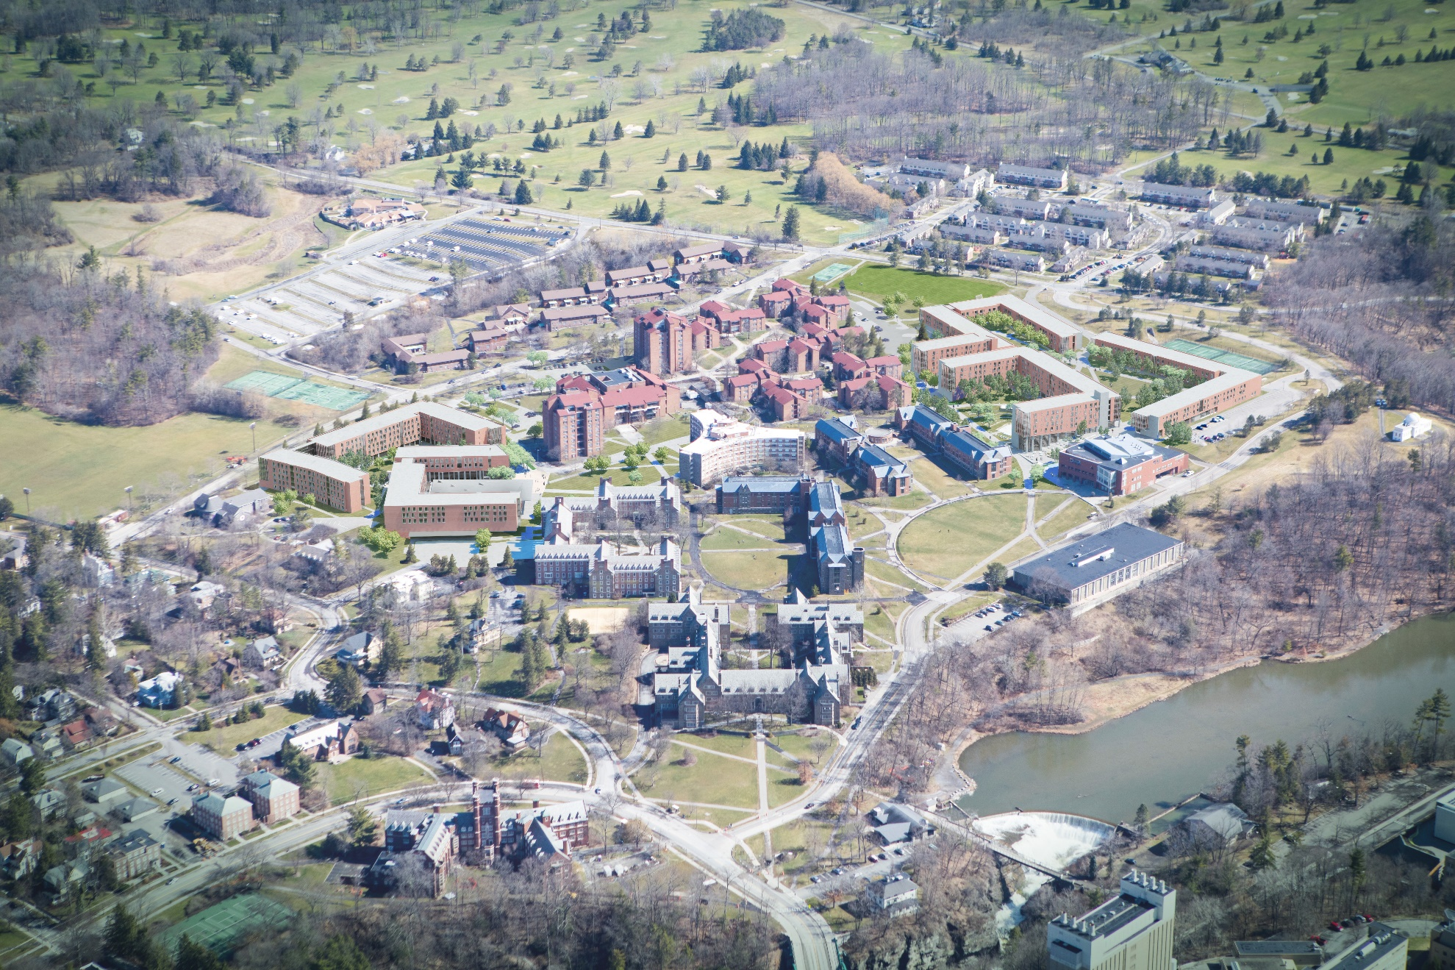
NCRE – Aerial view

