Slide 1
BIM:
eBuilder and Facilities Archiving
UA Minute
February 13, 2020
Notes:
J Shermeta, AUA
Overview of the steps for PMs to take in eBuilder
Facilities Archiving Services then is notified and can transfer BIM to Facilities Inventory.

Slide 2
BIM:
Starting the discussion MORE TO come !
FCS PMs handle a wide variety of project scopes and budgets, some include BIM, many do not include BIM
Understanding contractual obligations of consultants for BIM delivery during Design Phase, project scope and budget dependent
Understanding contractual obligations of contractors for BIM delivery during Construction Phase, project scope and budget dependent
As builts – Record Drawings – CAD, PDF, BIM ?
Potential, future uses for BIM after close out :
FE designing a renovation
OUA working on a planning study
Maintenance planners/facilities directors accessing a model to understand MEP systems, etc
Notes:
J Shermeta, AUA
Big picture thinking about BIM

Slide 3
BUS SHELTER STANDARD
UA Minute
February 13, 2020

Slide 4
Finding the Bus Shelter Standard on the Cornell Design and Construction Standards website
POSTED NOVEMBER 2019
Division 10 Specialties: Section 107343

Slide 5
Scope and Purpose
The goal of this section is to establish the standard for bus shelters on the Cornell University Ithaca Campus. The intent is to serve a variety of sizes to fit in different locations on the campus through modular, adaptable design.

Slide 6
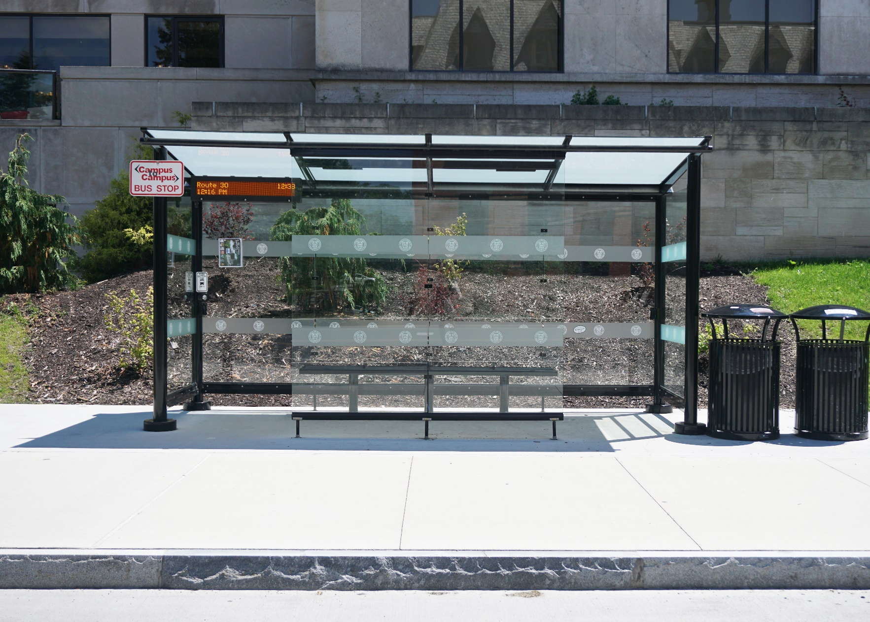
East Avenue Bus Shelters Installed Summer 2018

Slide 7
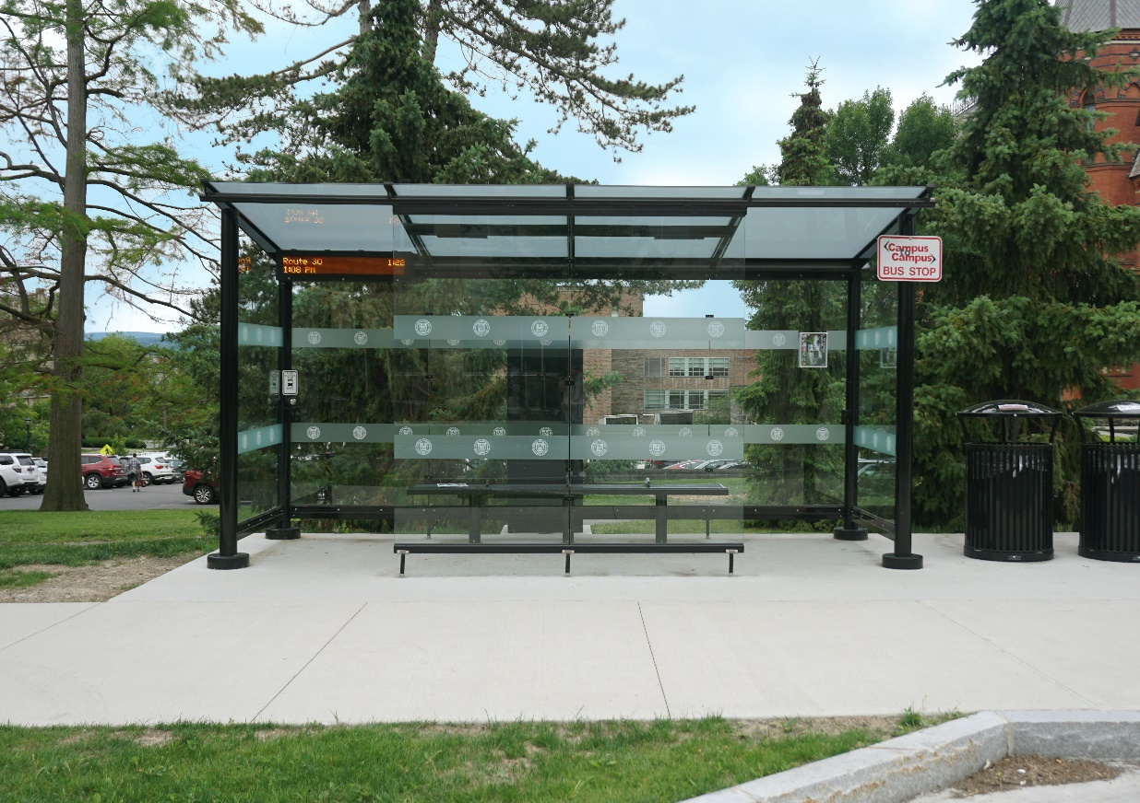
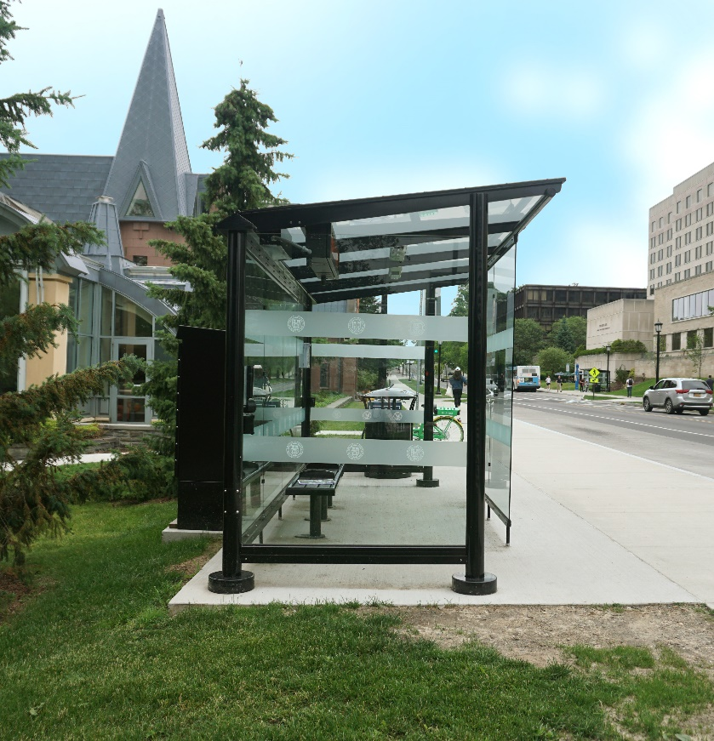
East Avenue Bus Shelters Installed Summer 2018

Slide 8
Base Model Features
Basis of Design – Tolar 16390 16’-0” Signature non-advertising transit shelter “Orion” Model
A bus stop shelter manufactured by Tolar Manufacturing Company (TMC) is referenced in this document and referred to as the “basis of design”.
This reference is provided for the convenience of the Designer in understanding our expectations for quality. To comply with bidding and procurement standards for the University and ensure fair pricing, the Designer shall provide a performance-based design. Designer shall provide clear performance-based requirements to determine acceptable alternates; the description of one manufacturer’s product and subsequent use of language such as “or approved equal” without such criteria is not acceptable. The listing of multiple manufacturers with shelter products equal to TMC and acceptable to the University Architect’s Office is preferred.

Slide 9
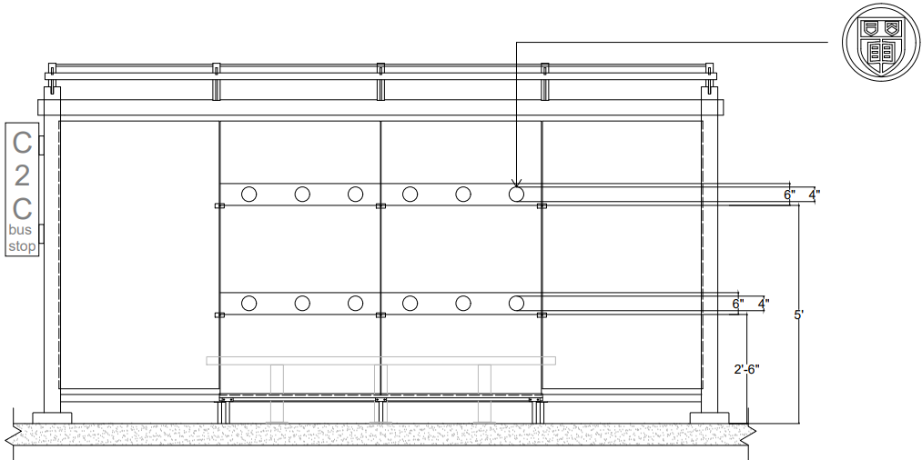
Base Model Features
Flat roof design with nominal 7’ by 16’ roof dripline
9/16” laminated safety glass roof panels secured by gasketed pressure ribs
Two dual port 110V powered USB charging outlets mounted to shelter corner posts
Rear and full end walls of 3/8” clear tempered safety glass
Double wide center front windscreen of 3/8” clear tempered safety glass providing two ADA compliant front entrances
Brackets for mounting digital signage to shelter rear windscreen (include electrical/IT conduits)
Front Elevation

Slide 10
Site Design
Provide minimum 1’-0” clearance setback from back edge of sidewalk to bus shelter overhang
Provide minimum additional concrete pad outside of shelter for campus amenities such as trash/recycling receptacles, exterior light posts and blue lights and potential exterior setting
Trash/recycling receptacle standard model: Victor Stanley, Inc.: Model A-36 from the Steelsites collection with an integral canopy dome; color: powder coat black.
Tolar Model 17947-121-96” Euro Model Bench Option

Slide 11
Questions

