Slide 1
Project Management – Professional Development Series
Facilities and Campus Services Engineering and Project Management February 13, 2020

Slide 2
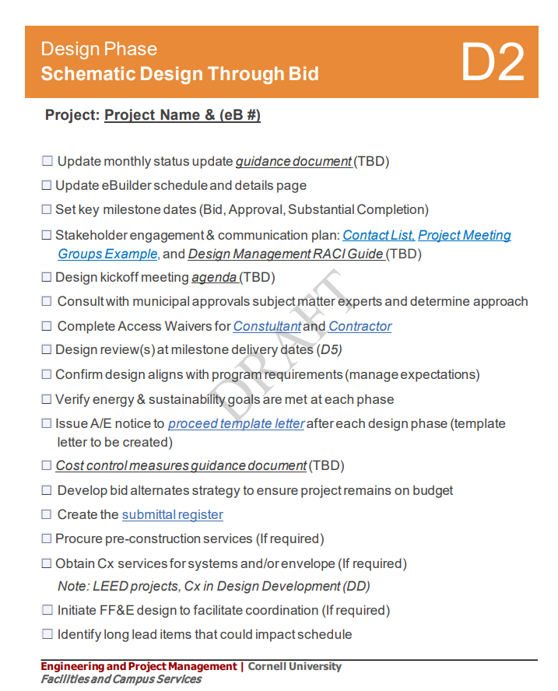
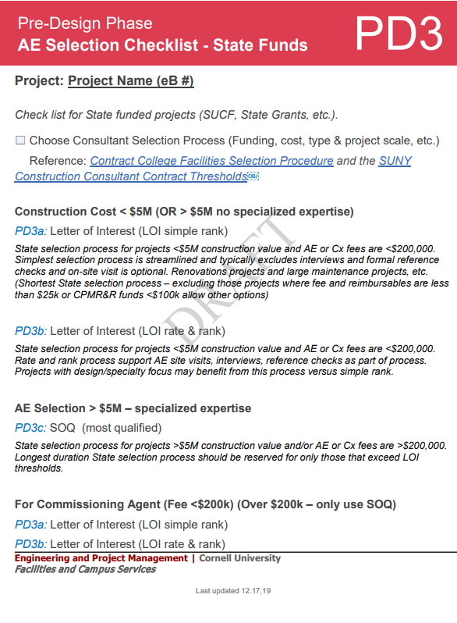
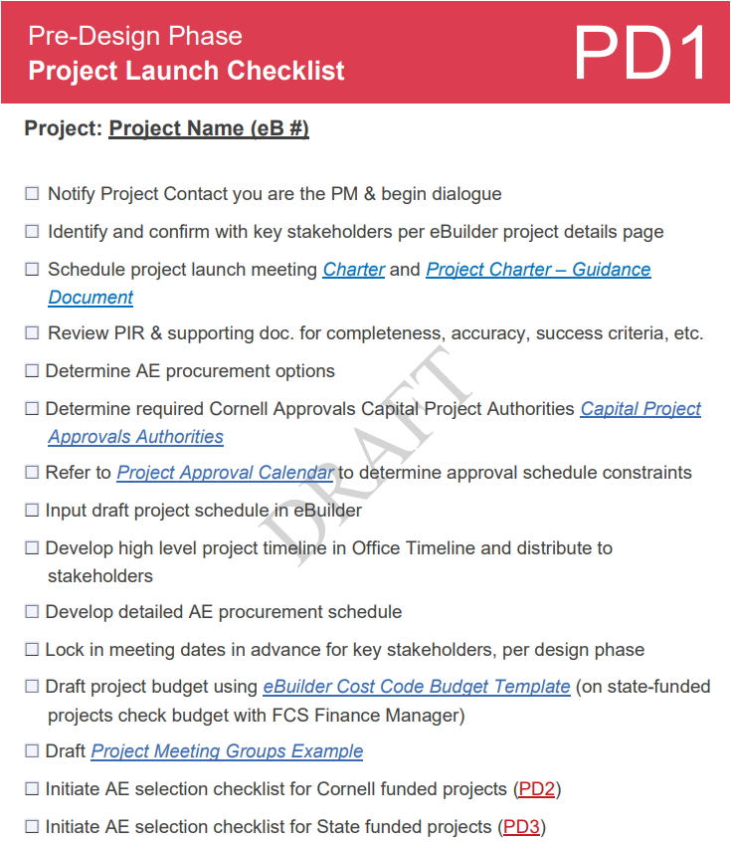
General Updates
FM related design reviews (D2)
State Contracts over $250k (PD3)
CPM R&R projects (PD1)
PM Checklists
PAR Prep and Approval process (PD1)
Notes:
All FM related design reviews will be funneled through Shelley using the email FMdesignreview@cornell.edu and it will follow same format as the Facilities engineering process
State Contracts over $250k (Design or Construction) will have to go to the Office of the State Comptroller (OSC) for a 30 day review period. (This can happen in parallel with PAR authorization for design or construction – but will often exceed the internal Cornell approval duration)
We will now waive the PM fee on CPM R&R projects
The PM Checklists will go live in March
During the PAR Prep and Approval process in eBuilder, the reminder notifications have changed when it has not moved forward. In the past, is used to be that all actors in each step were notified after 3 days and then every day thereafter until it moved to the next step; now only the PM is notified after 5 days and every day thereafter.

Slide 3
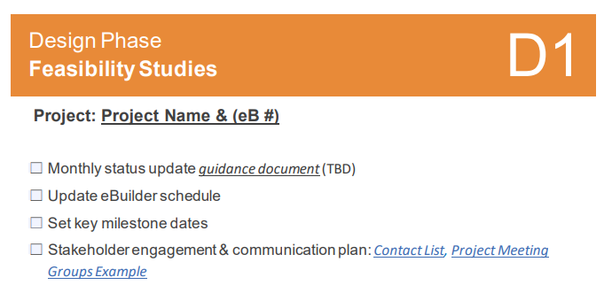
General Updates
Code updates (D5)
CU Standards new or revamped for this fiscal year:
013015 Entry Spaces
107343 Bus Shelters
329100 Soils and Planting Preparation (revamped)
329200 Turfs and Grasses (revamped)
330526 Utility identification: direct buried nonconductive (revamped)
PAR requirements for studies (today’s presentation) (D1)
Notes:
The Code updates to the New York State Uniform Fire Prevention and Building Code (the “Uniform Code”) and the State Energy Conservation Construction Code (the “Energy Code”) will be effective on May 12, 2020. The Notices of Adoption can be viewed by clicking the “February 12” link at http://www.dos.ny.gov/info/register/2020.html
New or revamped CU Standards for this fiscal year:
013015 Entry Spaces
107343 Bus Shelters
329100 Soils and Planting Preparation (revamped)
329200 Turfs and Grasses (revamped)
330526 Utility identification: direct buried nonconductive (revamped)
Please review Mary-Lynn’s presentation for the information on studies with the capital planning framework, the flexibility in the approvals process for studies ($10,000-$99,999), and the requirements specific to space studies

