Slide 1
Project Management – Professional Development Series
Facilities and Campus Services Engineering and Project Management February 13, 2020

Slide 2
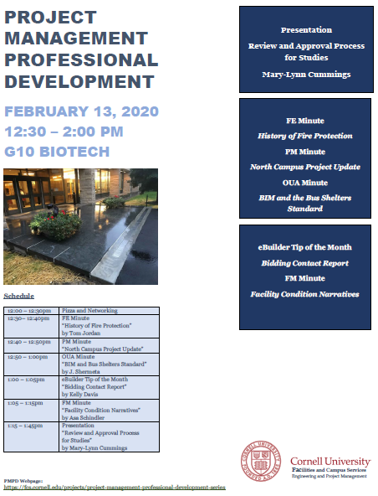
Today’s Agenda
Opening Remarks:
New General Updates slide
Project Management - Tool Kit:
FE Minute:
History of Fire Protection
OUA Minute:
BIM and Bus Shelter Standard
Project Management Minute:
North Campus Project Update
eBuilder Quick Tip:
Bidding Contact Report
FM Minute:
Facility Condition Narratives
Professional Development –
Review and Approval Process for Studies
Mary-Lynn Cummings
Sharing of Content: (Cornell Net ID Required)
– https://fcs.cornell.edu/projects/project-management-professional-development-series

Slide 3
Next Month’s Agenda: 3/12/2020
March
Budget 101: How to create your budget in eBuilder
Possible Future Topics
Leader as a coach
Access Control Systems
PO Options
AV Control Systems
EHS Safety Programs
EMCS Overview
PM Checklist
Pre-Construction Services

